Slide 1

cl-mongo : interfacing lisp and mongodb
Project to see how well lisp works as a development environment.
Needed an inter-operable persistence solution.

Slide 2
LISP in one slide
Functions are first-class objects
Functional Programming supported
Dynamic Programming Language
REPL : read-eval-print loop
Evaluator can be programmed using macros.
S-expression : (<function> arg1 arg2 …)
e.g. (list 1 2 3) => (1 2 3)
(reduce (lambda (x y) (+ x y))
(mapcar (lambda (x) (* 2 x) (list 1 2 3)))
=> 12

Slide 3
cl-mongo : design
Stay as close as possible to the javascript syntax
db.use ”test” → (db.use ”test”)
Key-value pairs :
{ ”field” : 2 } → (kv ”field” 2); ($ ”field” 2)
{ ”value” : { ”first” : 100 } } →
($ ”name” ($ ”first” 100))

Slide 4
cl-mongo : design
Enhance syntax only to increase readibility
db.test.find({ ”field” : { ”$gt” : 45}} →
(db.find ”test” (> ”field” 45))
db.test.find( { a : { $mod : [10 , 1] } }) →
(db.find ”test” ($mod ”a” (10 1) )

Slide 5
Connect, Insert and Find
(db.use ”test”)
(db.insert ”foo” (kv ”hello” ”world”) )
(pp (iter (db.find ”foo” :all)))
pp : pretty-printer
iter : iterator
(db.find ”foo” :all :selector ”k”)
(db.find ”foo” :all :selector (”k” ”l”))
(db.find ”foo” ($in ”k” (60 67)))

Slide 6
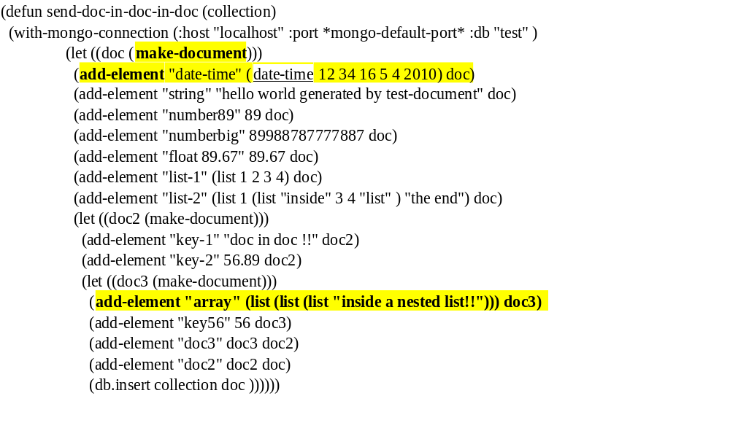
document

Slide 7
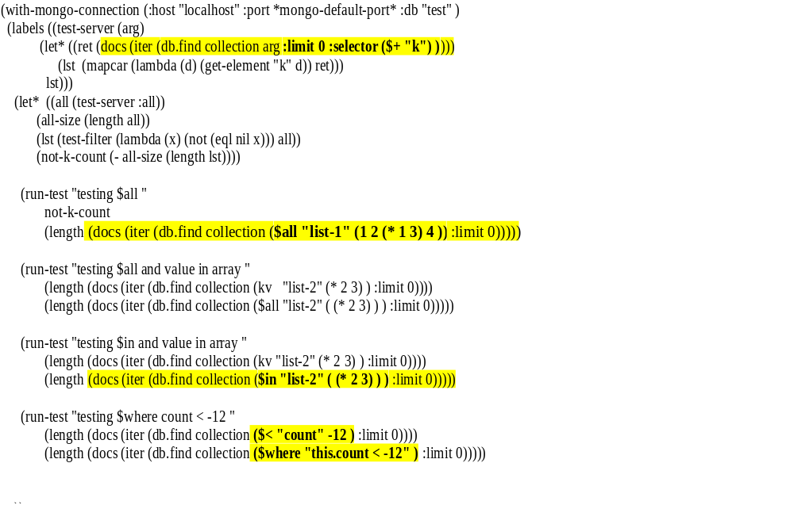
Advanced Queries

Slide 8
Javascript : client-side
(defjs …) macro : client side javascript
(defun echo (x) x ) → (echo 3) → 3
(echo x) is a regular lisp function.
(defjs echo (x) (return x) ) → (echo 3) → 3.0d0
(echo x) executes the parsed
S-expression on the server.
Uses parenscript to translate lisp to javascript

Slide 9
Javascript : server - side
(defsrvjs …) macro
(defsrvjs echo (x) (return x))
Create a lisp function referencing the javascript expression.
Store javascript on the server first time the function is called.
Calling (echo 4) will call out to the server using db.eval.

Slide 10
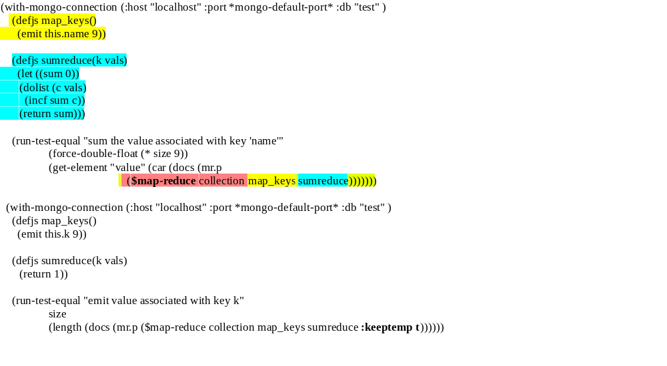
map-reduce

Slide 11
Conclusion
cl-mongo is fairly full featured :
Missing : - GridFS
- some bson serializers
- ....
http://github.com/fons/cl-mongo/

