Slide 1
OpenCV Features Detectors (detectors) and Descriptor Extractors (descriptors)
SIFT – became free since March 2020!
SURF – “this algorithm is patented and is excluded in this configuration”, even for the opencv-contrib-python library version 4.8.0.74
No Neural Network detector-descriptors and descriptors (R2D2, D2NET, SUPERPOINT, ORB-SLAM2, DELF, CONTEXTDESC, LFNET, KEYNET, DISK, TFEAT, HARDNET, GEODESC, SOSNET, L2NET, LOGPOLAR, etc.) are not considered.
Only OpenCV integrated detectors, descriptors and detector-descriptors.
Detector and descriptor list:
SIFT
RootSIFT
BRISK
AKAZE
KAZE
ORB
Features Detector list:
MSDDetector
HarrisLaplace
TBMR
StarDetector
BlobDetector
MSER
AGAST
FAST
GFTT
Shi-Tomasi
Harris
Descriptor Extractors list:
FREAK
TEBLID
BEBLID
VGG
BoostDesc
DAISY
BRIEF
LATCH
LUCID (does not work)

Slide 2
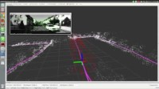
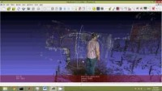
What can be done with the descriptor extractor
Link to video 1: https://youtu.be/j2ZNuBCr4SA
Link to video 2: https://youtu.be/KTk9Nzo3efc

Slide 3
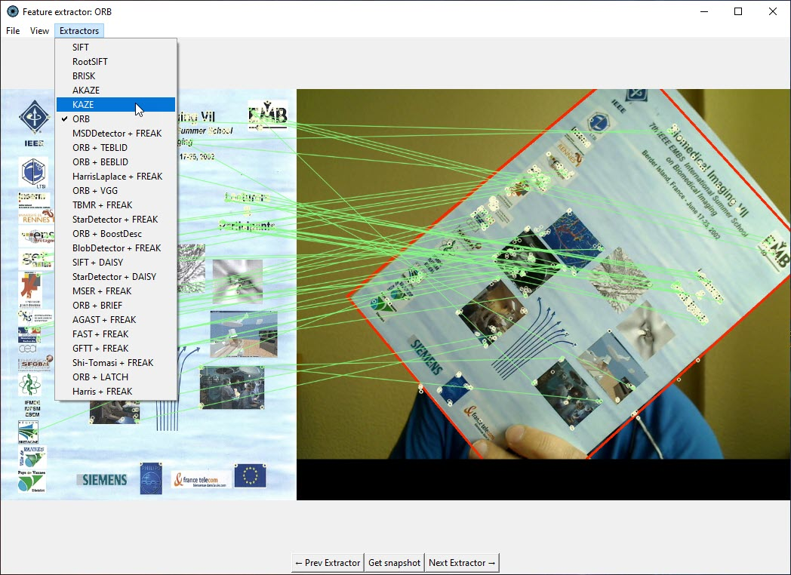
SIFT
RootSIFT
BRISK
AKAZE
KAZE
ORB
MSDDetector + FREAK
ORB + TEBLID
ORB + BEBLID
HarrisLaplace + FREAK
ORB + VGG
TBMR + FREAK
StarDetector + FREAK
ORB + BoostDesc
BlobDetector + FREAK
SIFT + DAISY
StarDetector + DAISY (no rotation)
MSER + FREAK
ORB + BRIEF
AGAST + FREAK
FAST + FREAK
GFTT + FREAK
Shi-Tomasi + FREAK
ORB + LATCH
Harris + FREAK
StarDetector + LUCID (does not work)
Decrease of efficiency
All object trackers are made rotation invariant and scalable except of “StarDetector + DAISY” (No. 17 in the list).

Slide 4
Application source code:
https://github.com/foobar167/junkyard/tree/master/feature_extractor
Minimal requirements:
numpy # ==2.2.6
opencv-contrib-python # ==4.12.0.88
Pillow # ==11.3.0
All feature detector-descriptor logic is in the "logic_extractor.py" file.

