Slide 1

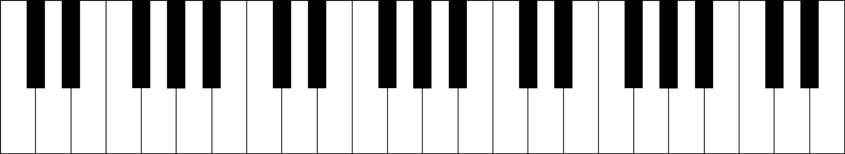






PIANETTE — KEYBOARD MAPPING
STREET FIGHTER ALPHA III
C3
C4
C5
Combos are available if you know how to play ... Piano ! — Depending on the selected character:
C_{major} [ C + E + G ] : Shoryuken (昇龍拳)
C_{minor} [ C + E♭+ G ] : R1
D_{minor} [ D + F + A ] : R2
F_{major} [ F + A + C ] : Inazuma Kakato Wari (稲妻かかと割り) or Senpuu Kyaku
G_{major} (1st inversion) [ D + G + B ] : Shoryuu-reppa (昇龍裂破) or Shakunetsu Hadouken (灼熱波動拳)
C₇ [ C + E + G + B♭]: Hadouken (波動拳)
D_{minor 7} [ D + F + A + C ] : Tatsumaki (竜巻)
E_{minor 7} (1st inversion) [ D + E + G + B ]: Shoryuken (昇龍拳) or Shinkuu Tatsumaki Senpu
www.foobarflies.io/pianette — github.com/tchapi/pianette

Slide 2
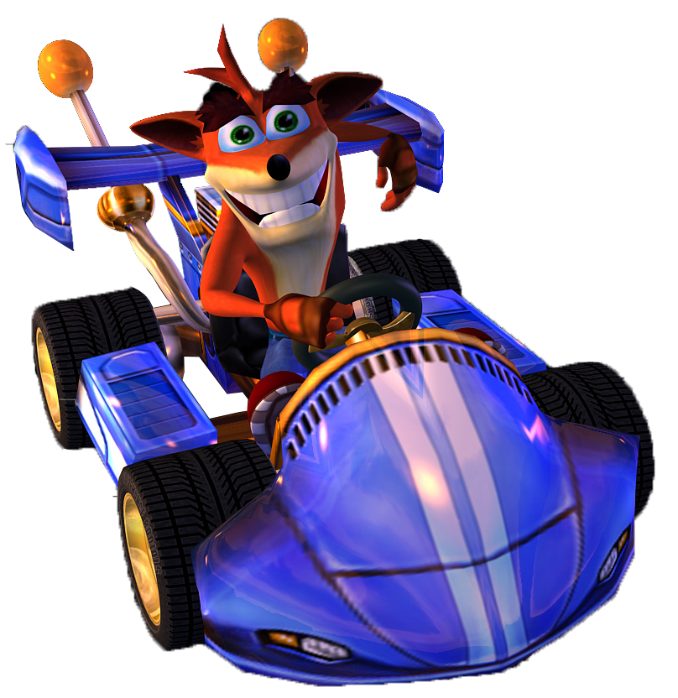

PIANETTE — KEYBOARD MAPPING
CRASH NITRO KART
C3
C4
C5
hop
×2
R1
×1
R1
brake
×5
×5
×3
×1
×2
×3
This game config is easier for soloists !
Play a song and use the following chords:
C_{major} [ C + E + G ] : Hop
F_{major} [ F + A + C ] : Boost !
G_{major} (1st inversion) [ D + G + B ] : Use a power-up !
Alternatives for Power Up:
F_{major 7} (1st inversion) [ D♯ + F + A + C ] or G_{major 7} (1st inversion) [ D + F + G + B ]
Keep it down for constant thrust !
www.foobarflies.io/pianette — github.com/tchapi/pianette

Slide 3
PIANETTE PLANNING
10 AM
11 AM
12 AM
1 PM
2 PM
3 PM
4 PM
5 PM
6 PM
Talk, Demo & Tech Q&A – 30’ with Cyril and Eric
Pianist session — 15’
Talk, Demo & Tech Q&A – 30’ with Cyril and Eric
Pianist session — 15’
Talk, Demo & Tech Q&A – 30’ with Cyril and Eric

Slide 4
PIANETTE PLANNING
10 AM
11 AM
12 AM
1 PM
2 PM
3 PM
4 PM
5 PM
6 PM
Free playing session – Street Fighter Alpha 3
Talk, Demo & Tech Q&A – 30’ with Cyril and Eric
Free playing session – Street Fighter Alpha 3
Pianist session — 15’
Free playing session – Street Fighter Alpha 3
Talk, Demo & Tech Q&A – 30’ with Cyril and Eric
Free playing session – Street Fighter Alpha 3
Free playing session – Crash Nitro Kart
Pianist session — 15’
Free playing session – Crash Nitro Kart
Talk, Demo & Tech Q&A – 30’ with Cyril and Eric
Free playing session – Crash Nitro Kart

Slide 5

HAPPENING NOW !
FREE PLAYING SESSION
Crash Nitro Kart
www.foobarflies.io/pianette — github.com/tchapi/pianette

Slide 6

HAPPENING NOW !
FREE PLAYING SESSION
Street Fighter Alpha 3
www.foobarflies.io/pianette — github.com/tchapi/pianette

Slide 7
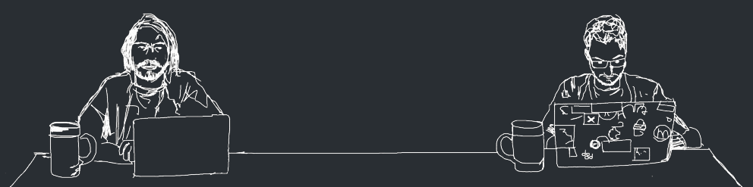
HAPPENING NOW !
TALK / DEMO
& TECH Q&A
with
Cyril and Eric
www.foobarflies.io/pianette — github.com/tchapi/pianette

