Slide 1
A Simple Min-Cut Algorithm
Joseph Vessella
Rutgers-Camden

Slide 2
The Problem
Input: Undirected graph G=(V,E)
Edges have non-negative weights
Output: A minimum cut of G

Slide 3
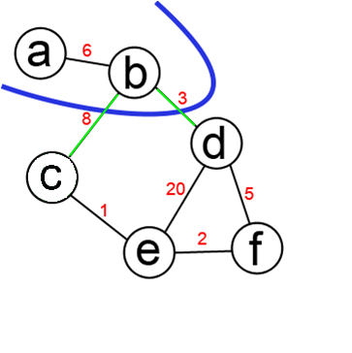
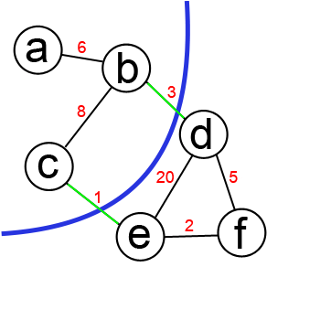
Cut Example
Cut: set of edges whose removal disconnects G
Min-Cut: a cut in G of minimum cost
Weight of this cut: 11 Weight of min cut: 4

Slide 4
s-t Cut Example
s-t cut: cut with s and t in different partitions
s = a and t = d
Weight of this a-d cut: 11 Weight of min a-d cut: 4

Slide 5
Naive Solution
Check every possible cut
Take the minimum
Running time: O(2^{n})

Slide 6
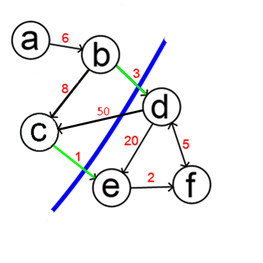
Previous Work
Ford-Fulkerson, 1956
Input: Directed Graph with weights on edges
and two vertices s and t
Output: Directed min cut between s and t

Slide 7
Possible Solution
Make edges bidirected
Fix an s, try all other vertices as t
Return the lowest cost solution
Running time: O(n x n³) = O(n⁴)

Slide 8
Previous Work
Hao & Orlin, 1992, O(nm log(n²/m))
Nagamochi & Ibaraki, 1992, O(nm + n²log(n))
Karger & Stein (Monte Carlo), 1993, O(n²log³(n))
Stoer & Wagner, JACM 1997, O(nm + n²log(n))

Slide 9
The Algorithm
MinCutPhase(G, w):
a ← arbitrary vertex of G
A ← (a)
While A ≠ V
v ← vertex most tightly connected to A
A ← A U (v)
s and t are the last two vertices (in order) added to A
Return cut(A-t,t)

Slide 10
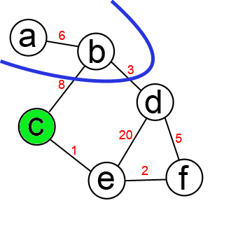
Most Tightly Connected Vertex
MTCV is the vertex whose sum of edge
weights into A is max.

Slide 11
The Algorithm
MinCutPhase(G, w):
a ← arbitrary vertex of G
A ← (a)
While A ≠ V
v ← vertex most tightly connected to A
A ← A U (v)
s and t are the last two vertices (in order) added to A
Return cut(A-t,t)

Slide 12
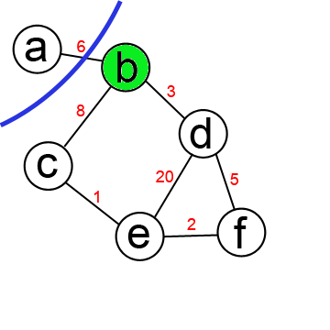
Example
A: (a)
A: (a,b)

Slide 13
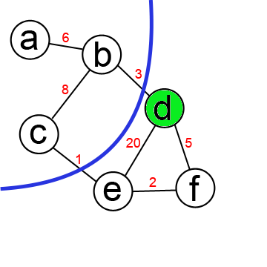
Example
A: (a,b)
A: (a,b,c)

Slide 14
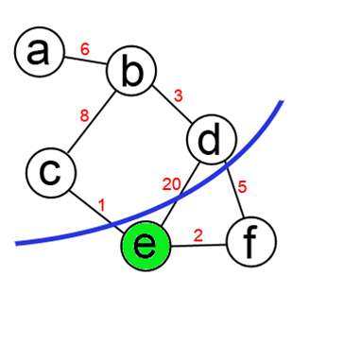
Example
A: (a,b,c)
A: (a,b,c,d)

Slide 15
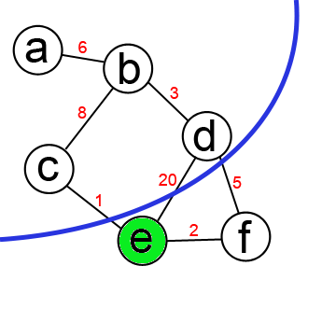
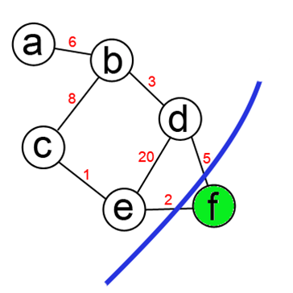
Example
A: (a,b,c,d)
A: (a,b,c,d,e)

Slide 16
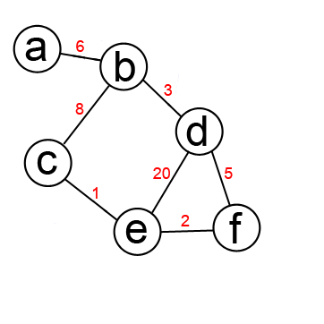
Example
A: (a,b,c,d,e)
A: (a,b,c,d,e,f)

Slide 17
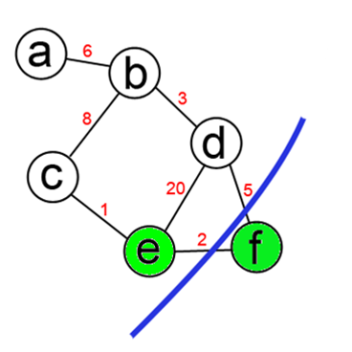
Example
s = e and t = f

Slide 18
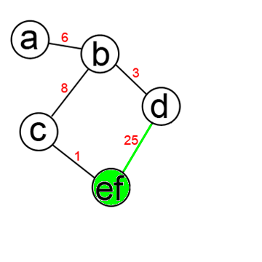
Example
Merge(G,e,f): G ← G\{e,f} U {ef}
For v ∈ V, v ≠ {ef}
w(ef, v) is sum of w(e,v) and w(f,v) in orig. graph

Slide 19
The Algorithm
MinCutPhase(G, w):
a ← arbitrary vertex of G
A ← (a)
While A ≠ V
v ← vertex most tightly connected to A
A ← A U (v)
s and t are the last two vertices (in order) added to A
Return cut(A-t,t)

Slide 20
Key Result
Theorem: MinCutPhase returns a min s-t cut

Slide 21
Implications
What if min cut of G separates s and t?

Slide 22
Implications
What if min cut of G separates s and t?
Then min s-t cut is also a min cut of G

Slide 23
Implications
What if min cut of G separates s and t?
Then min s-t cut is also a min cut of G
What if min cut of G does not separate s and t?

Slide 24
Implications
What if min cut of G separates s and t?
Then min s-t cut is also a min cut of G
What if min cut of G does not separate s and t?
Then s and t are in the same partition of min cut

Slide 25
The Algorithm
MinCut(G,w):
w(minCut) ← ∞
While |V| > 1
s-t-phaseCut ← MinCutPhase(G,w)
if w(s-t-phaseCut) < w(minCut)
minCut ← s-t-phaseCut
Merge(G,s,t)
Return minCut

Slide 26
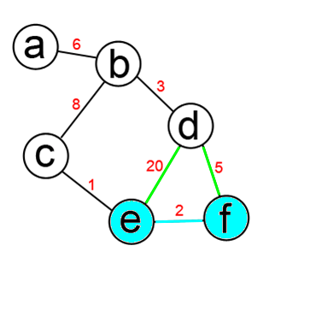
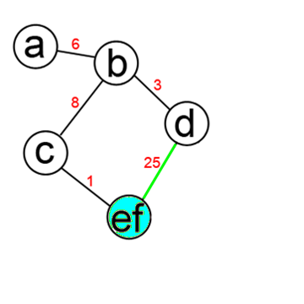
Merge(G,e,f)
Merge(G,e,f): G ← G\{e,f} U {ef}
For v ∈ V, v ≠ {ef}
w(ef, v) is sum of w(e,v) and w(f,v) in orig. graph

Slide 27
The Algorithm
MinCut(G,w):
w(minCut) ← ∞
While |V| > 1
s-t-phaseCut ← MinCutPhase(G,w)
if w(s-t-phaseCut) < w(minCut)
minCut ← s-t-phaseCut
Merge(G,s,t)
Return minCut

Slide 28
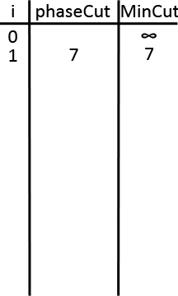
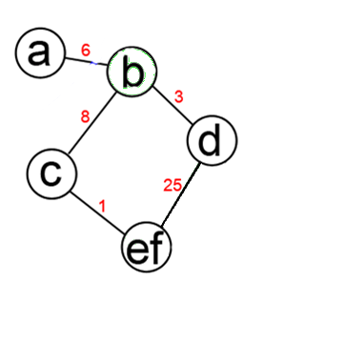
Example
We already did one MinCutPhase
s = e and t = f

Slide 29
The Algorithm
MinCut(G,w):
w(minCut) ← ∞
While |V| > 1
s-t-phaseCut ← MinCutPhase(G,w)
if w(s-t-phaseCut) < w(minCut)
minCut ← s-t-phaseCut
Merge(G,s,t)
Return minCut

Slide 30
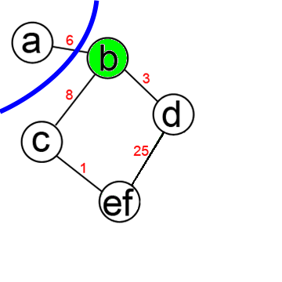
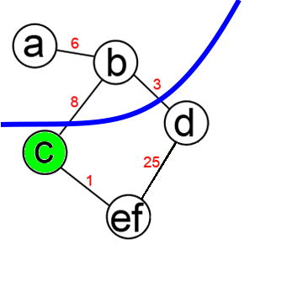
Example
A: (a)
A: (a,b)

Slide 31
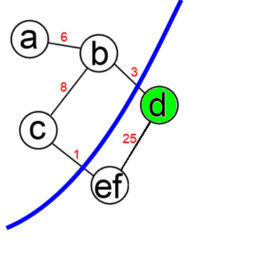
Example
A: (a,b)
A: (a,b,c)

Slide 32
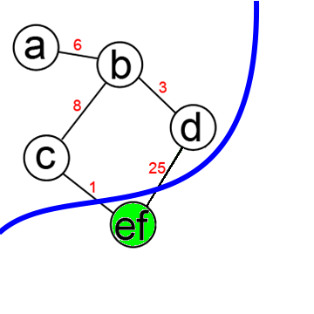
Example
A: (a,b,c)
A: (a,b,c,d)

Slide 33
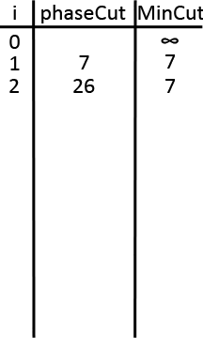
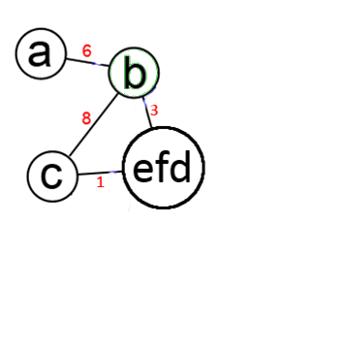
Example
A: (a,b,c,d)
s = d and t = ef

Slide 34
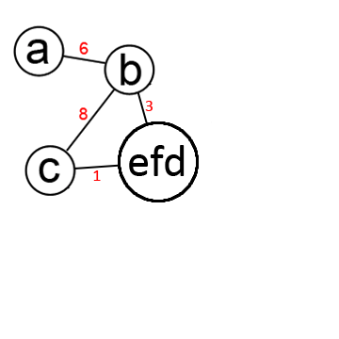
Example
A: (a,b,c,d)

Slide 35
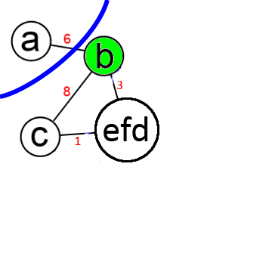
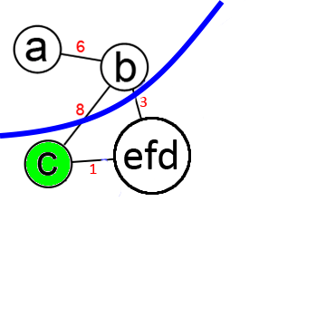
Example
A: (a)
A: (a,b)

Slide 36
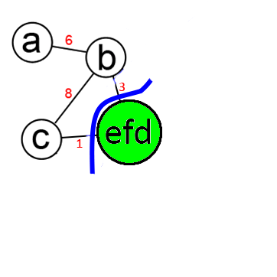
Example
A: (a,b)
A: (a,b,c)

Slide 37
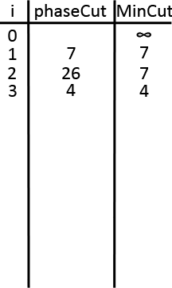
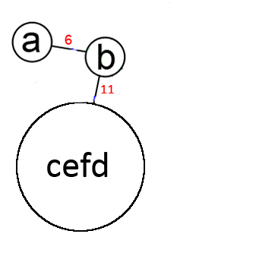
Example
A: (a,b,c)
s = c and t = efd

Slide 38
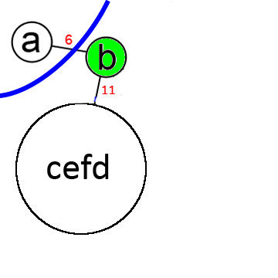
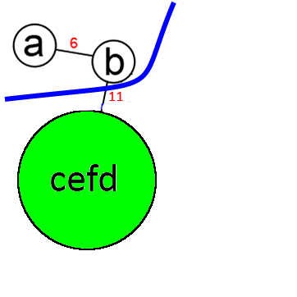
Example
A: (a)
A: (a,b)

Slide 39
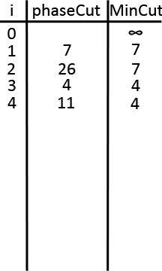
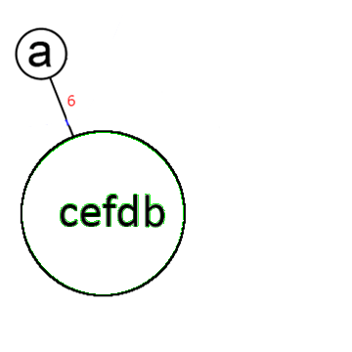
Example
A: (a,b)
s = b and t = cefd

Slide 40
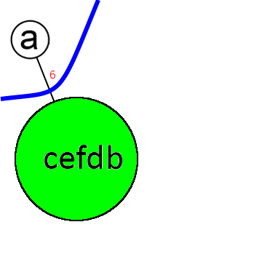
Example
A: (a)

Slide 41
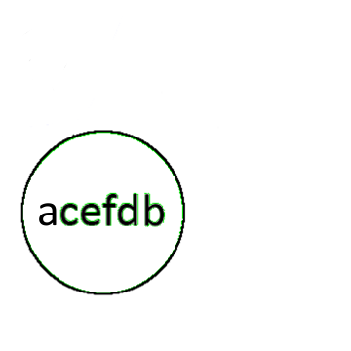
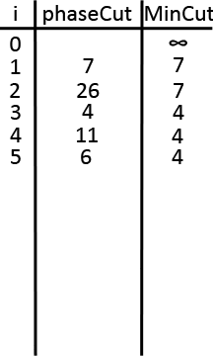
Example
A: (a)
s = a and t = cefdb

Slide 42
Example
We found the min cut of G as 4 when we were
in the following MinCutPhase

Slide 43
The Algorithm
MinCut(G,w):
w(minCut) ← ∞
While |V| > 1
s-t-phaseCut ← MinCutPhase(G,w)
if w(s-t-phaseCut) < w(minCut)
minCut ← s-t-phaseCut
Merge(G,s,t)
Return minCut

Slide 44
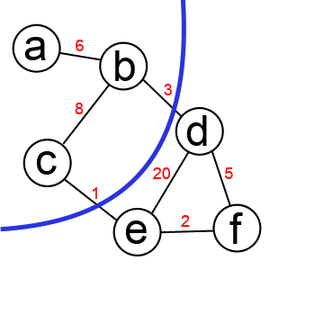
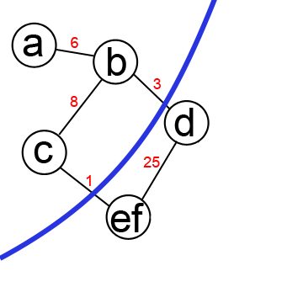
The Key
MinCut(G) = Minimum of all s-t cuts in graph

Slide 45
Correctness
Merge removes many redundant cuts
We only consider when merged vertices are on same side of cut
By end of MinCut(G), we consider min cuts between all pairs of vertices

Slide 46
Correctness
MinCutPhase(G, w):
a ← arbitrary vertex of G
A ← (a)
While A ≠ V
v ← vertex most tightly connected to A
A ← A U (v)
s and t are the last two vertices (in order) added to A
Return cut(A-t,t)

Slide 47
Correctness
Theorem: (A-t, t) is always a min s-t cut
Proof: We want to show that w(A-t, t) ≤ w(C)
for any arbitrary s-t cut C

Slide 48
Notation
C: arbitrary s-t cut
A_{v}: set of vertices added to A before v
C_{v}: cut of A_{v} U {v} induced by C
A ← (a, b, c, d, e, f)
A_{d} ← {a, b, c}

Slide 49
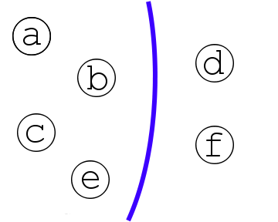
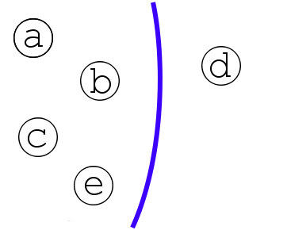
Notation
A: (a, b, c, d, e, f)
C
C_{e}

Slide 50
Active Vertex
vertex in A in the opposite partition of C from the one before it
C
A: (a,b,c,d,e,f)

Slide 51
Correctness
Lemma: For all active vertices v, w(A_{v},v) ≤ w(C_{v})

Slide 52
Correctness
Theorem: (A-t, t) is always a min s-t cut
Proof: By the lemma, for an active vertex v
w(A_{v},v) ≤ w(C_{v})
Since t is always active and C_{t} = C
w(A_{t}, t) ≤ w(C)
Thus MinCutPhase returns a min s-t cut

Slide 53
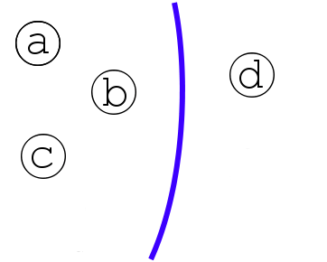
Correctness
Lemma: For all active vertices v, w(A_{v},v) ≤ w(C_{v})
Proof: Induction on the no. of active vertices, k
Base case: k = 1, claim is true
A: (a, b, c, d)
C_{d}
w(A_{d},d) = w(C_{d})

Slide 54
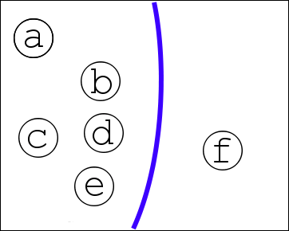
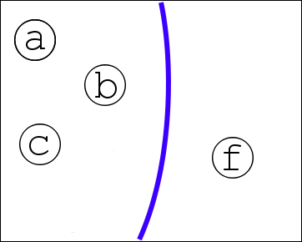
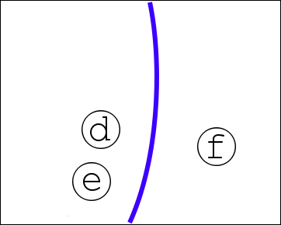
Correctness
IH: Assume inequality holds true up to u
v: first active vertex after u
w(A_{v}, v) = w(A_{u}, v) + w(A_{v} - A_{u}, v)
A: (a,b,c,d,e,f)
u = d and v = f
=
+

Slide 55
Correctness
w(A_{v}, v) = w(A_{u}, v) + w(A_{v} - A_{u}, v)
≤ w(A_{u}, u) + w(A_{v} - A_{u}, v) (u is MTCV)
≤ w(C_{u}) + w(A_{v} - A_{u}, v) (by IH)
≤ w(C_{v})

Slide 56
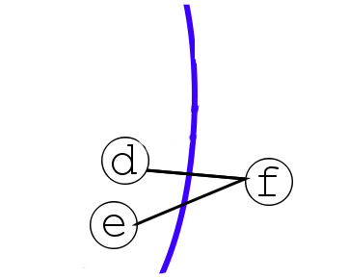
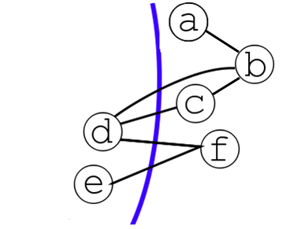
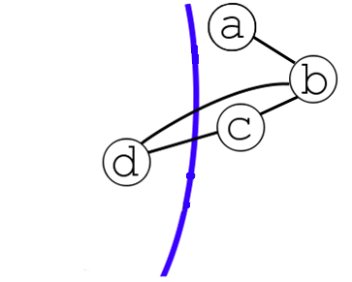
Correctness
Edges crossing (A_{v} - A_{u}, v) cross C
Contribute to C_{v} but not C_{u}
A: (a,b,c,d,e,f)
u = d and v = f
(A_{v} - A_{u}, v)
C = C_{f}
C_{d}

Slide 57
Summary
Lemma: For all active vertices v, w(A_{v},v) ≤ w(C_{v})
Theorem: (A-t, t) is always a min s-t cut

Slide 58
Running Time
MinCutPhase(G, a):
a ← arbitrary vertex of G
A ← (a)
While A ≠ V
v ← vertex most tightly connected to A
A ← A U (v)
s and t are the last two vertices (in order) added to A
Return cut(A-t,t)

Slide 59
Running Time
MinCutPhase(G, a):
a ← arbitrary vertex of G
A ← (a)
While A ≠ V
v ← vertex most tightly connected to A
A ← A U (v)
s and t are the last two vertices (in order) added to A
Return cut(A-t,t)

Slide 60
Running Time
Vertices not in A: priority queue with key
key(v) = w(A,v)
Can extract MTCV in log(n)
When v added to A, for each neighbor u of v
key(u) = key(u) + w(u, v)
So, we update the priority queue once per
edge and get O(m + nlog(n)) per MinCutPhase

Slide 61
The Algorithm
MinCut(G,w):
w(minCut) ← ∞
While |V| > 1
s-t-phaseCut ← MinCutPhase(G,w)
if w(s-t-phaseCut) < w(minCut)
minCut ← s-t-phaseCut
Merge(G,s,t)
Return minCut

Slide 62
Running Time
MinCut calls MinCutPhase n times
Get overall time of O(nm + n²log(n))

Slide 63
Reference
M. Stoer and F. Wagner. A Simple Min-Cut Algorithm, JACM, 1997

Slide 64
Thank You!

