Slide 1
Google Maps Project
jan.schulz@devugees.org

Slide 2
Task 1
1 – Pull the latest devugees8 repository
2 – Get an API Key from https://cloud.google.com
3 – Go to jquery/gmproject
4 – Analyze gm_1 – gm_3.html – Try to understand it based on the comments and my explanations. Insert your API Key to test it.
5 – Create the following layout in index.html (next slide)

Slide 3
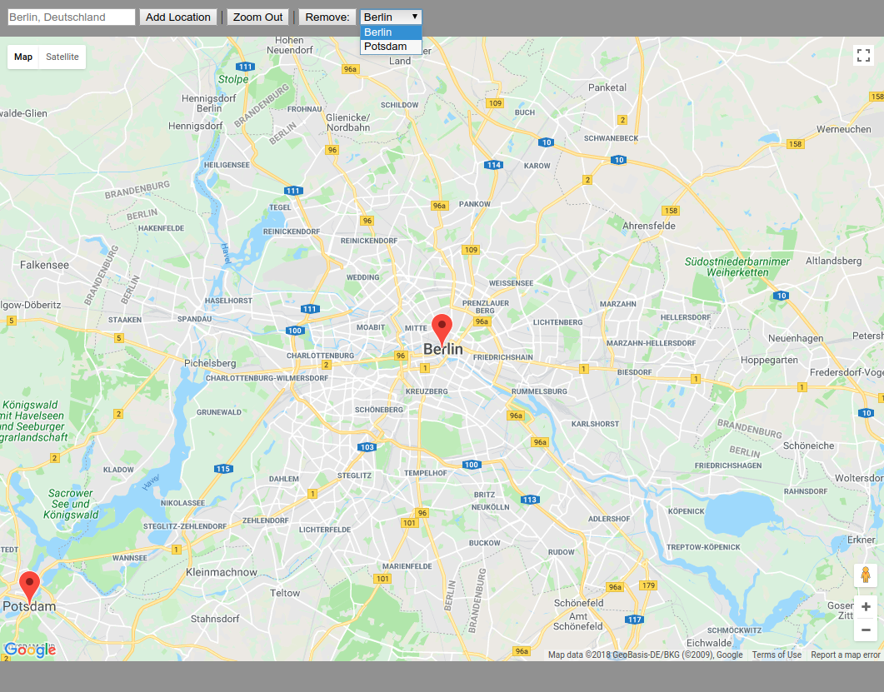

Slide 4
Task 2
6 – Add the following features using Jquery. Before you start, think how you can organize your marker points.

Slide 5
The user can enter a geo code here
Adds the geo code as new marker to the map
Zooms out to zoom level 3
Removes the selected location

