Slide 1



Slide 2
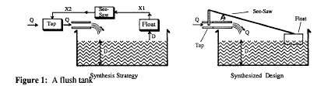
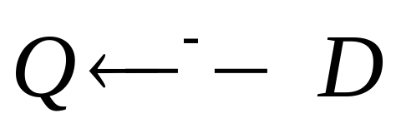
as the depth of water(D) in the tank increases,the rate of flow of water into the tank(Q) should decrease.

Slide 3
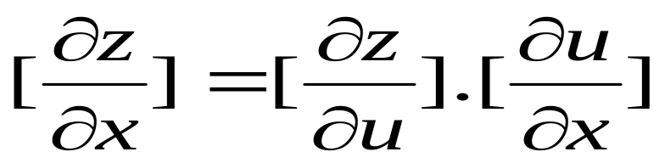
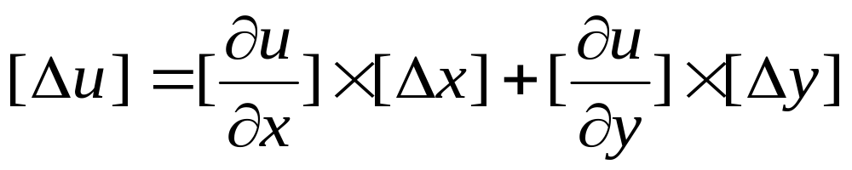
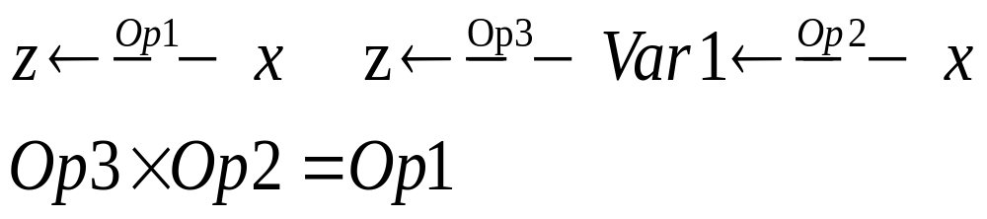
1. The function of function(chain)rule
Let u=f(x,y), z=g(u,v)
2. The total influence rule
Let u=f(x,y)
1. Inverse application of the function of function rule:

Slide 4
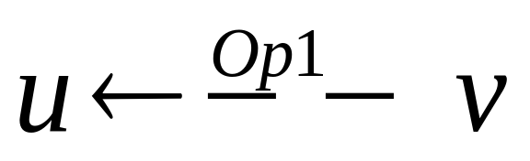
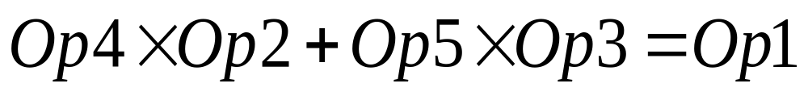
2. Inverse application of the total differential rule
Op4
Var1
Op2
u
v
Op5
Op3
Var2

Slide 5
