Slide 1
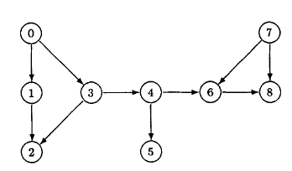

"two nodes are linked to each other."

Slide 2


Slide 3
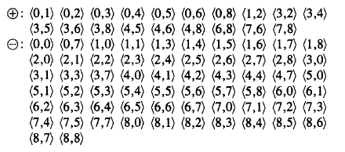


Slide 4
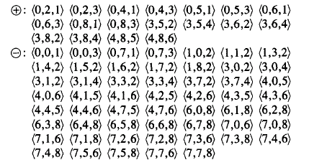

can-reach(X₃,X₂)

