Slide 1
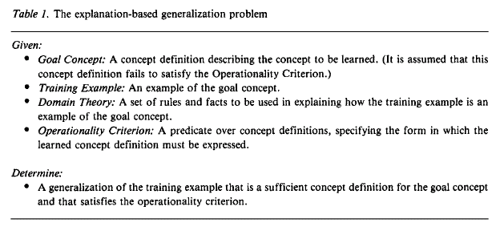

Slide 2
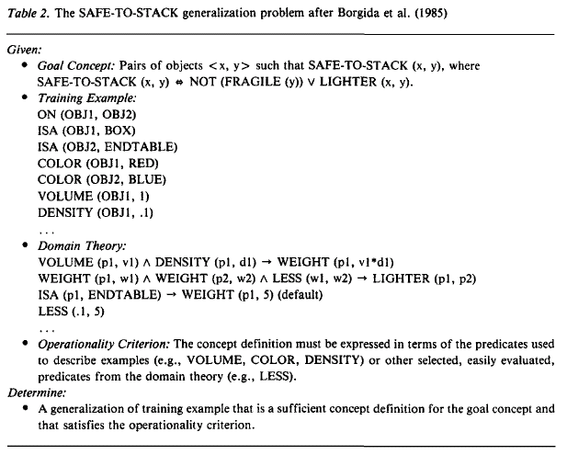

Slide 3
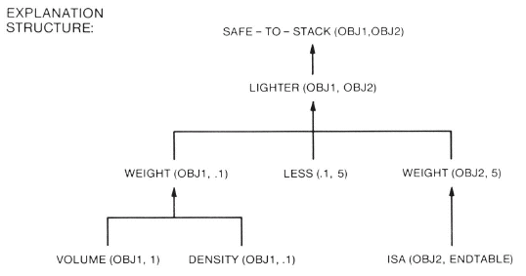

Slide 4
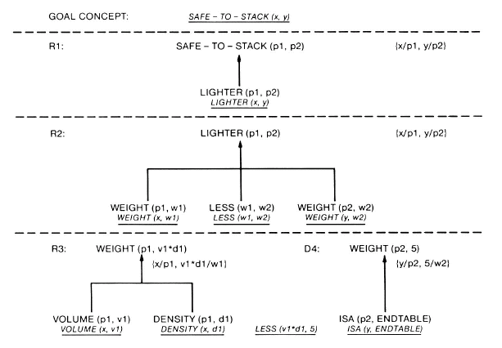

Slide 5
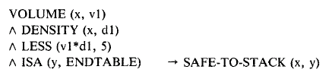

Slide 6
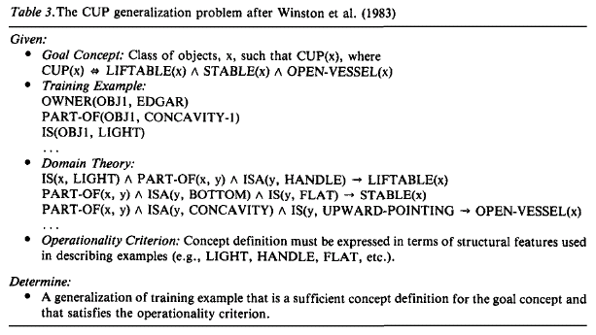

Slide 7
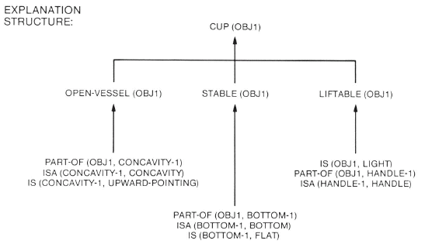

Slide 8


Slide 9
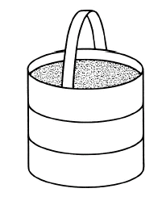
LIFTABLE, DRINKABLE-FROM,

Slide 10
Fred is the father of Mary and is a millionaire. John approached Mary. She was wearing blue jeans. John
pointed a gun at her and told her he wanted her to get into his car. He drove her to his hotel and locked
her in his room. John called Fred and told him John was holding Mary captive. John told Fred if Fred
gave him $250,000 at Trenos then John would release Mary. Fred gave him the money and John released
Mary.

Slide 11
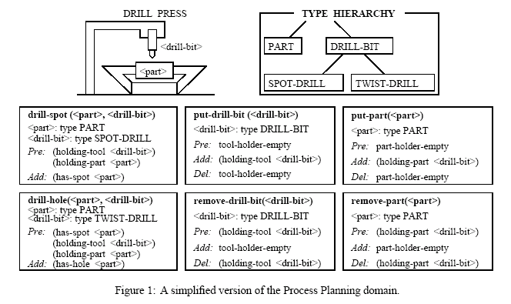

Slide 12
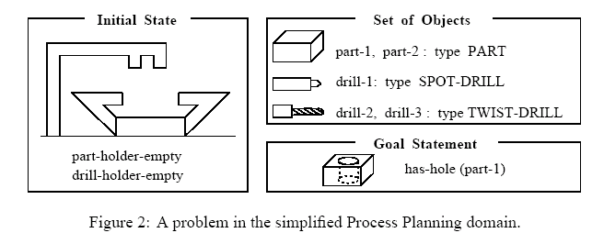

Slide 13
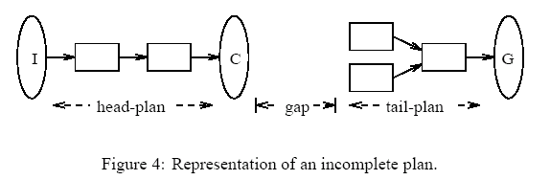
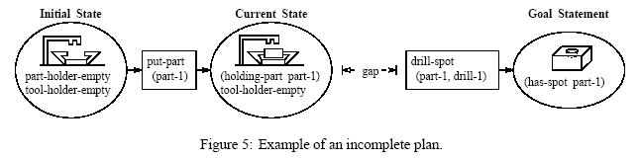

Slide 14
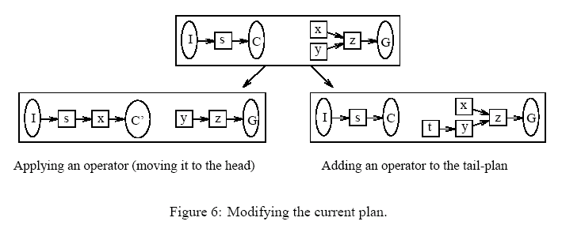

Slide 15
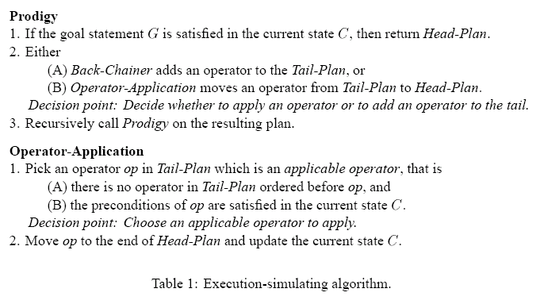

Slide 16
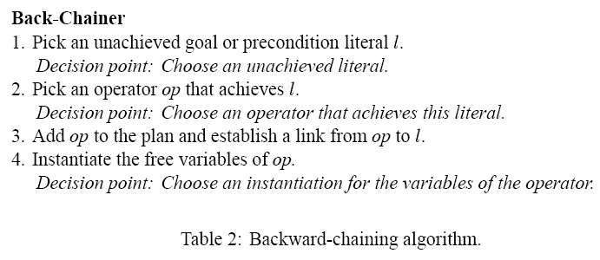

Slide 17
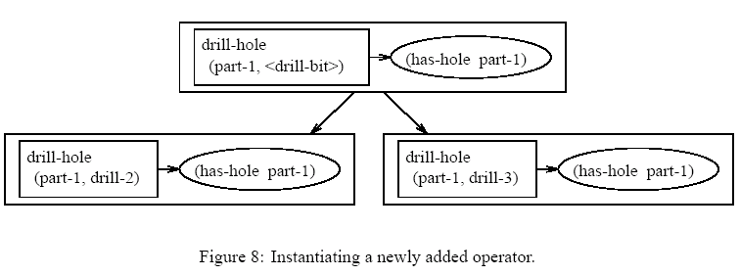

Slide 18
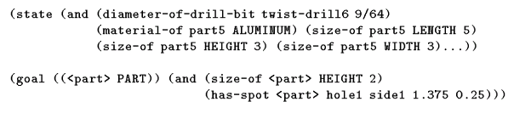

Slide 19
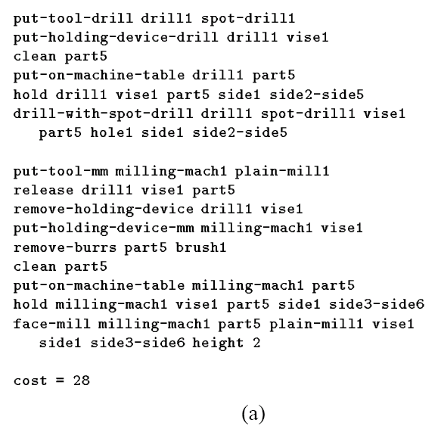

Slide 20
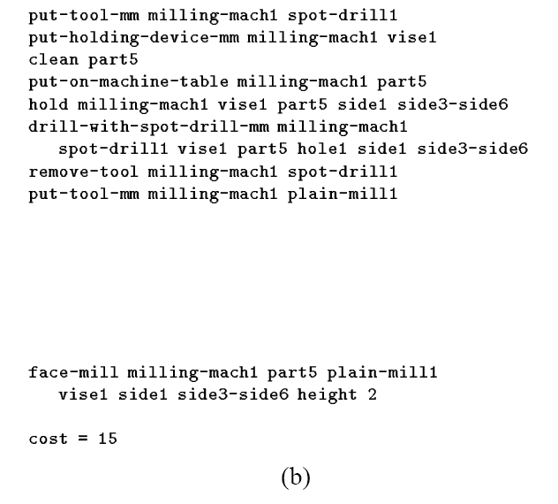

Slide 21
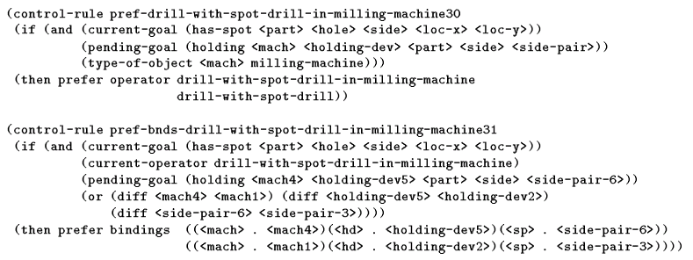

Slide 22
参考文献：（第1次课—第13次课）
Machine Learning:An Artificial Intelligence Approach, Michalski , (TP11/M149)
P83-134(Chapter 4 A Theory and Methogology of Inductive Learning)
P307-363 (Chapter 10 Rediscovering Chemistry with the BACON System; Chapter 11 Learning From Observation: Conceptual Clustering)
2.归纳学习—算法，理论，应用，洪家荣著，科学出版社。（TP18/H46）
P1-43 第一章：有导师学习算法
P43-58 第二章：学习理论（4，5）本章前半部分，不包括PAC学习
P81-103 第三章：无导师学习算法
3.机器学习：实现人工智能的途径，Michalski, 科学出版社。(TP18/M33)
第四章：归纳学习的理论和方法学，P49-81

Slide 23

第十章：BACON系统重新发现化学定律；第十一章：从观察中学习：概念聚类 P190-226
4. J.R, QUINLAN, Induction of Decision Trees, Machine Learning 1: 81-106, 1986
5.Jiarong Hong, AE1: An Extension Matrix Approximate Method for the General Covering Problem, International Journal of Computer and Information Sciences, Vol.14,No.6,1985.
6.

