Slide 1
Version Control with Git & Github
Jitender
(Informatics@CSB)

Slide 2
Learning outcomes
By the end of the course you should be able to: Understand what version control is and why its useful
Create repositories, add files and track changes
Share your repositories with others through hosting platforms such as GitHub
Understand the benefits of an open approach to code sharing
“get you started on the journey”

Slide 3
Agenda
Understand what version control is and why it’s worth using
Be able to set up git
Be able to use git to manage versions of files, seeing file history and changes
Understand what github is and how it allows collaborative working
Coffee Break 11’sh
Finish @ 12.30 or 1 pm if we over-run

Slide 4
Course Material
http://training.scicomp.jic.ac.uk/version_control_with_git_and_github.html
http://swcarpentry.github.io/git-novice
https://rogerdudler.github.io/git-guide/ (multilingual)
http://jlord.us/git-it/
https://guides.github.com/activities/hello-world/
https://kbroman.org/github_tutorial/

Slide 5
https://www.youtube.com/watch?v=nhNq2kIvi9s
[Learn Github in 20 Minutes]
https://www.youtube.com/watch?v=7dYHRI55wxo
LEARN GIT IN 15 MINUTES | Git Tutorial | Easy Overview

Slide 6
So let git started…

Slide 7
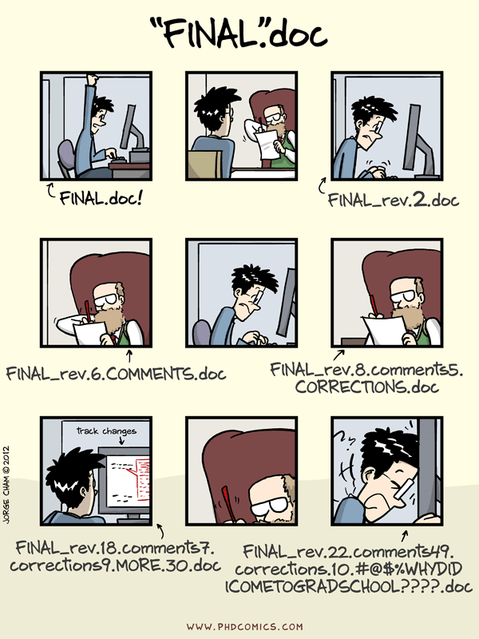
Motivation
“Piled Higher and Deeper” by Jorge Cham, http://www.phdcomics.com

Slide 8
Keeping Track of Changes:
So it seems ridiculous to have multiple nearly-identical versions of
the same document. There is some relief though when we use
Microsoft Word’s Track Changes
Google Docs’ version history
Dropbox
Unlimited UNDO and REDO

Slide 9
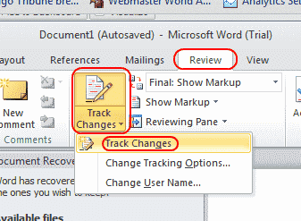
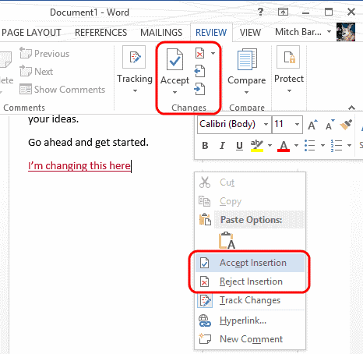
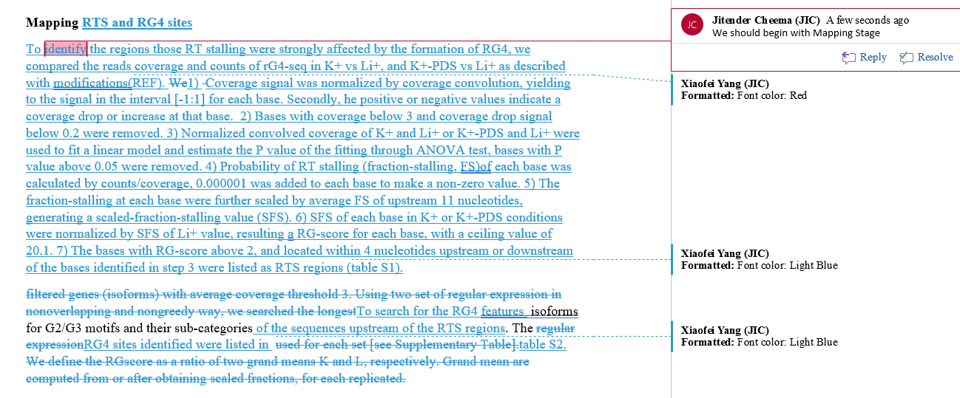
Git
Track changes
Similar to Words review

Slide 10
Git : "the stupid content tracker"
git means unpleasant person in British English slang
Git (/ɡɪt/^{[7]}) is a distributed version-control system for tracking changes in source code during software development.
It is designed for coordinating work among programmers, but it can be used to track changes in any set of files.
Goals include speed, data integrity, and support for distributed, non-linear workflows.
Created by Linus Torvalds in 2005 for development of the Linux kernel

Slide 11


GitHub
Microsoft paid $7.5 billion to takeover of code repository site Github
has more than ~ 85 million repositories hosted on GitHub, and
28 million developers contribute to them.
Gitlab and BitBucket

Slide 12

https://git.nbi.ac.uk
https://academind.com/

Slide 13
Why use git? Why use github?
Github is like facebook for programmers. (HUB)
- Everyone’s on there. You can look at what they’re working on and easily peruse their work(code) and make suggestions or changes.
- github, all of the code is easily inspected, as is its entire history.
-You don’t have to set up a git server.
* Version control is the only reasonable way
to keep track of changes in a code, manuscripts, presentations, and data analysis projects.
* Use git: you’ll have annotated each small change.
* Merging collaborators’ changes made easy.
- deal with a collaborator sending you modifications distributed across many files
- had to deal with two people having made changes to the same file at the same time? Painful.

Slide 14
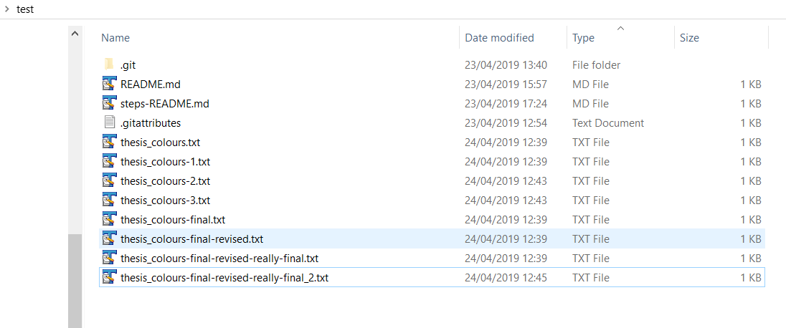
Why Git and GitHub exists ?
Working on something say a “thesis” or an “essay” – a project
Keep track of an entire history of things you working on
“save the previous one” Just in case
Dropbox/ googledocs
“not only for you” Collaborators

Slide 15
Git/GitHub in simple words
System to keep track of the entire history of the project as well as allow many people to collaborate on the project together
It does not have a problem two people working on the same document at the same time
GIT is the actual VERSION CONTROL software. It is invented by the guy who invented LINUX ( Linus Torvalds)﻿

Slide 16
Take home message
Git | Github
distributed version control system accessible through a command line | user interface for a Git repository hosting
software | Website; hosting service for projects that used git
Track changes to our files over time | I can share all of my coding projects with the world.
hard | easy

Slide 17
GitHub first…
With an aim:
Share
Collaborate
Post it online

Slide 18
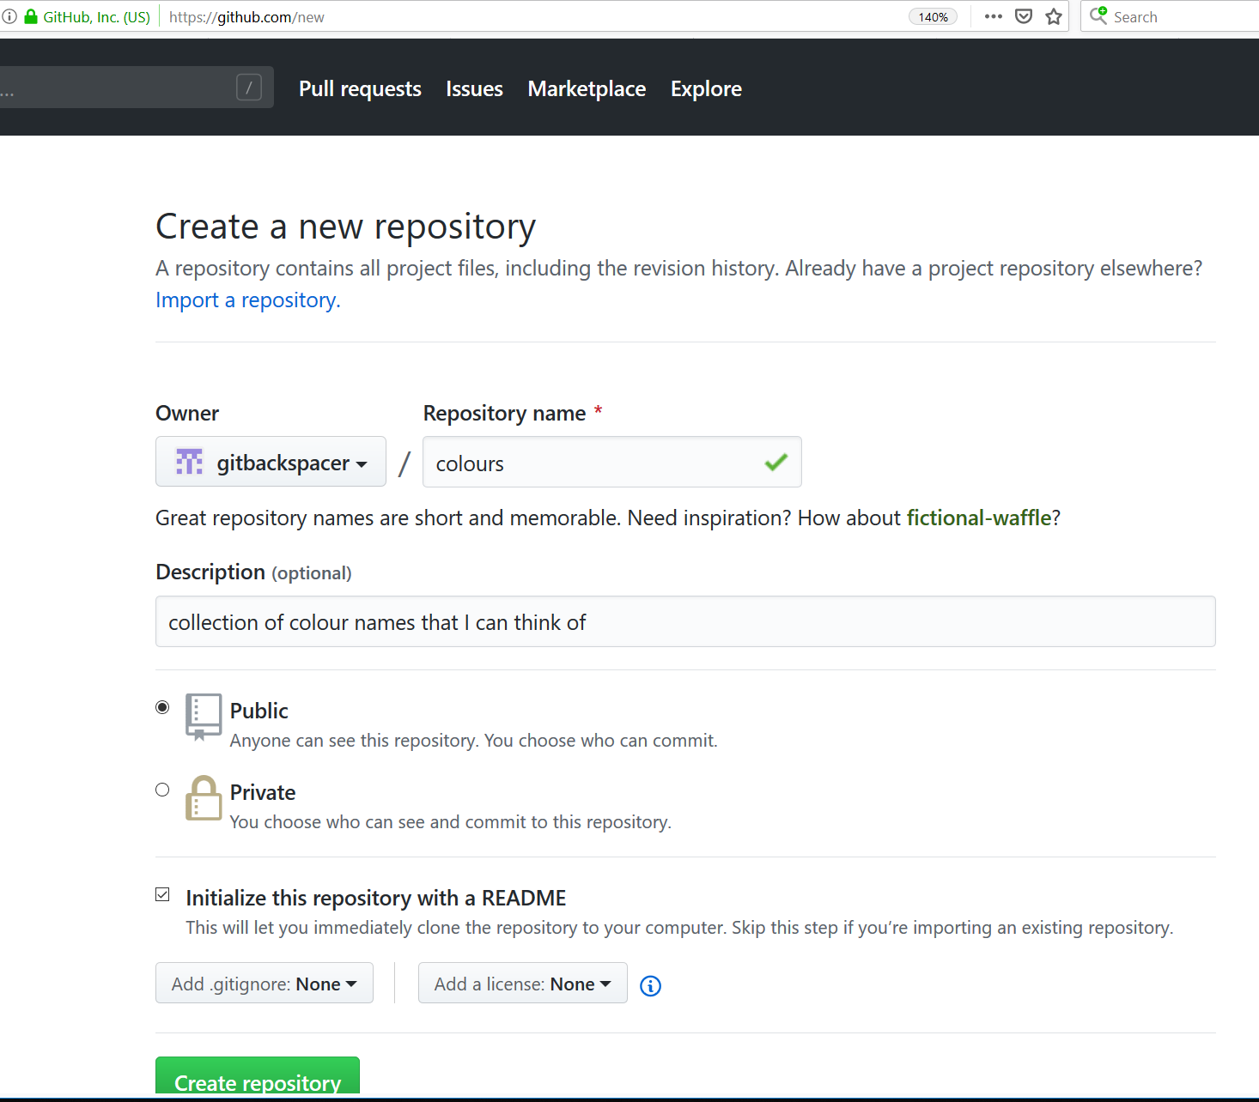
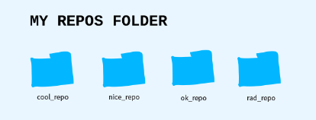
Github First https://github.com/gitbackspacer
Make an account
Create a repository (repo)
A repository is a collection of related items(it is a collection of files related to a software project).
You can imagine it as a project folder with all the relevant files inside of it. In fact, that's what it will look like on your computer anyways. Sometimes they're called "repos" for short

Slide 19
Repo
You tell Git what your project is and Git will start tracking all of the changes to that folder.
This makes it a Git repository: a folder of items being tracked by Git.
Git tracks when files are added, subtracted or even a single letter in a single file is changed.
All of this plus who did it and when, tracked by Git. In software, tracking changes like this is called version control.

Slide 20
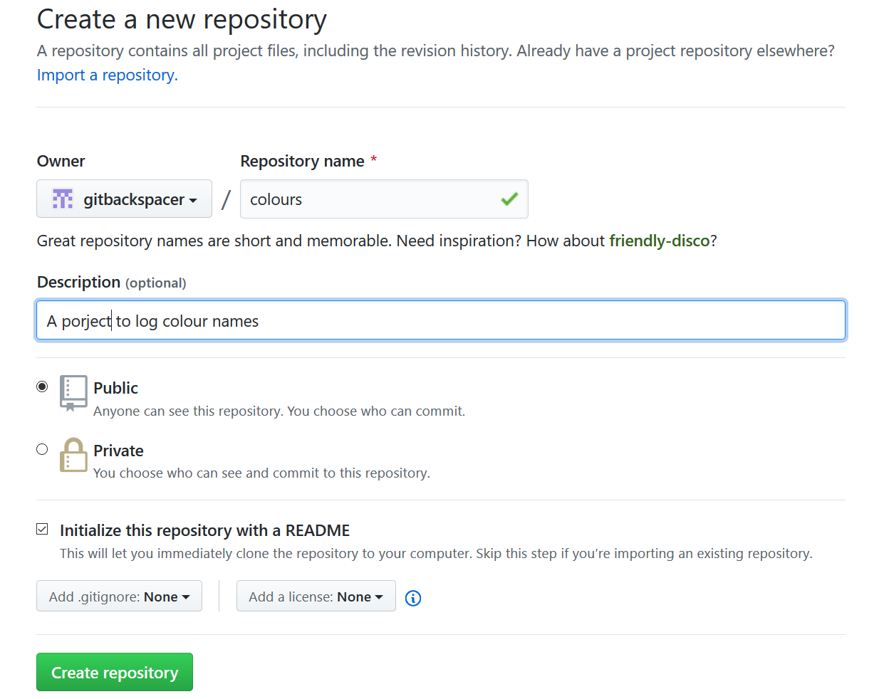
https://github.com/new

Slide 21
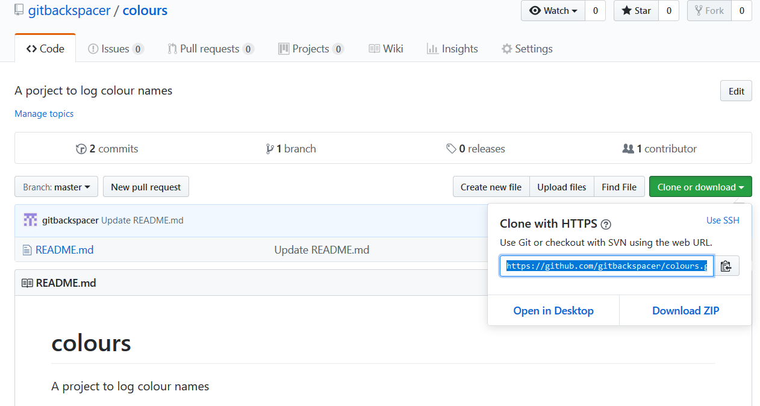

Slide 22
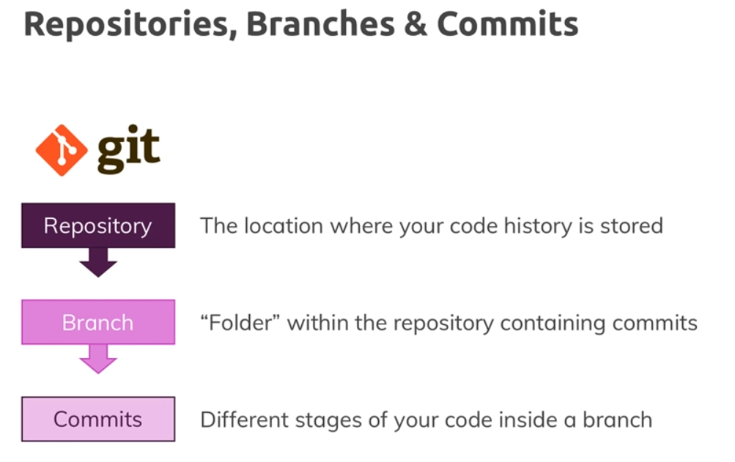
https://academind.com/

Slide 23
Lets Get started:
To turn an ordinary directory into a Git project,
* open up the command line
* cd into the project directory
and run
git init

Slide 24
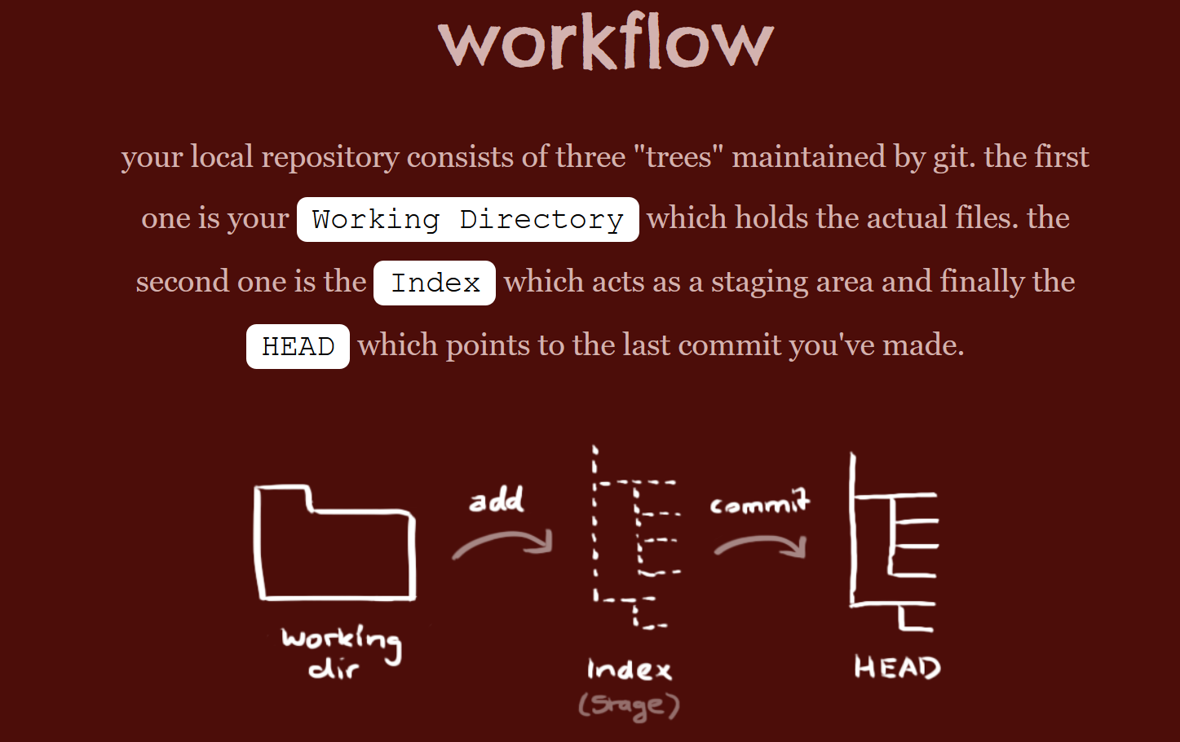
http://rogerdudler.github.io/git-guide/

Slide 25
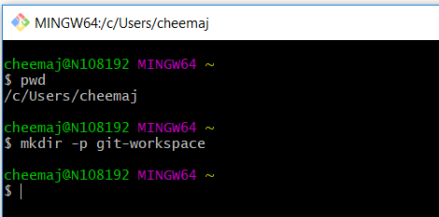
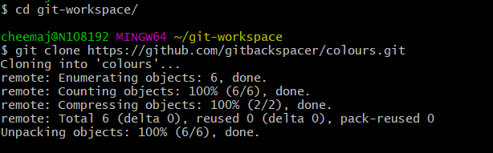
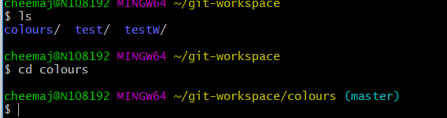
Copy back Locally

Slide 26
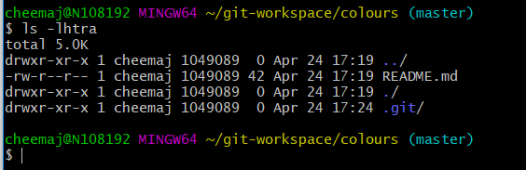
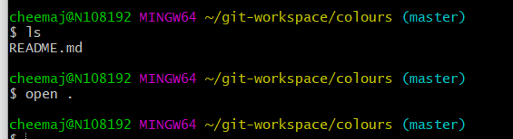
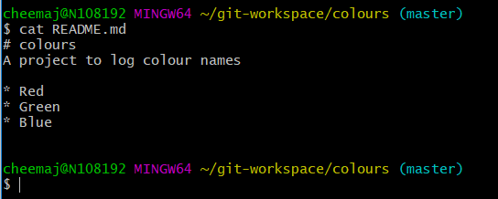
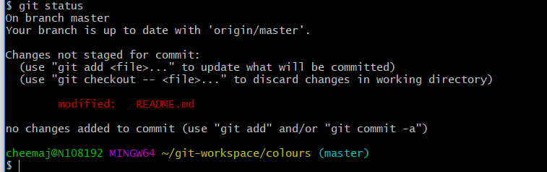

Slide 27
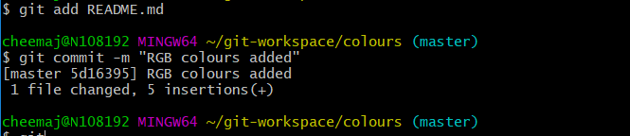
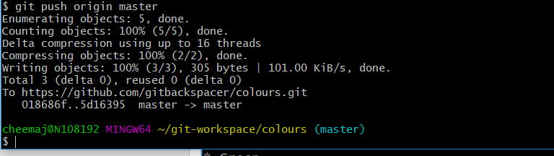
“add” and “push”

Slide 28
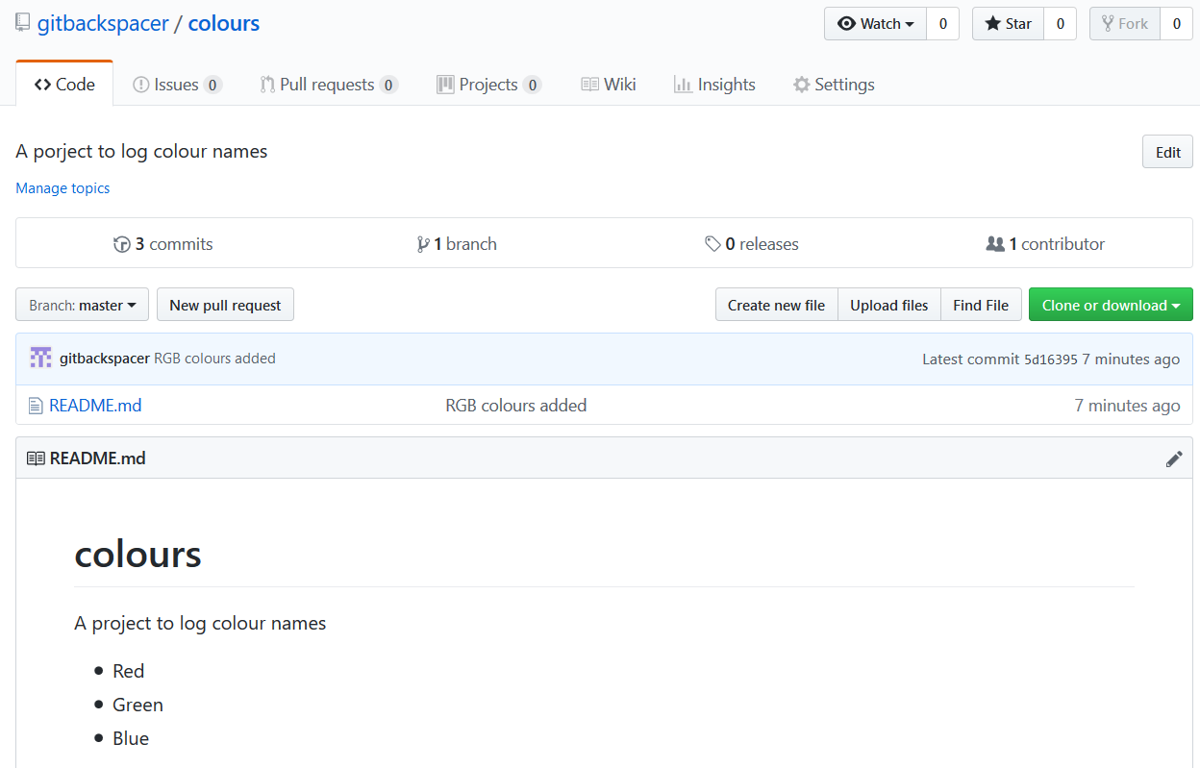
Has it updated on Github?

Slide 29
### repo remote url ###
https://github.com/gitbackspacer/colours.git
# prepare a local folder
mkdir -p git-workspace
# step into it
cd git-workspace/
# download the repo we made at github website
git clone https://github.com/gitbackspacer/colours.git
# see what is this directory or folder
ls
# step into colours folder
cd colours

Slide 31
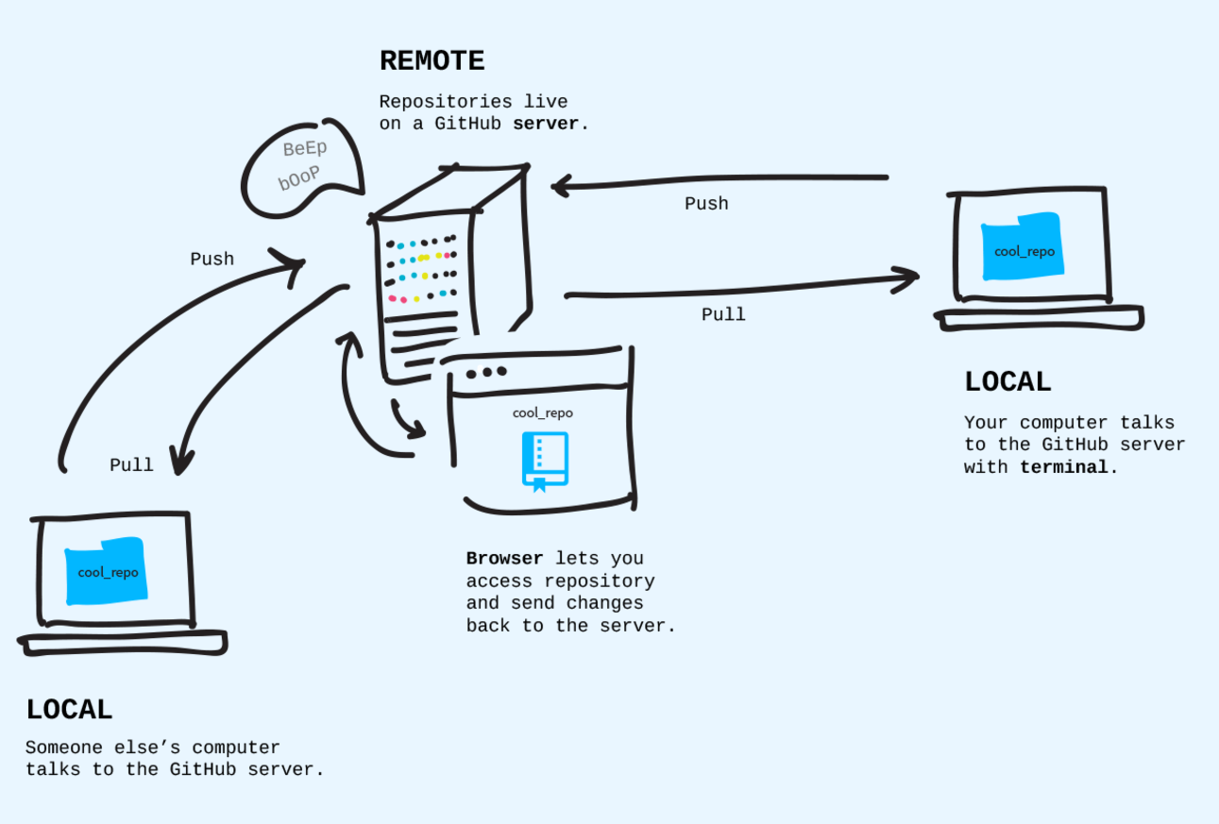
Where do repo lives?

Slide 32
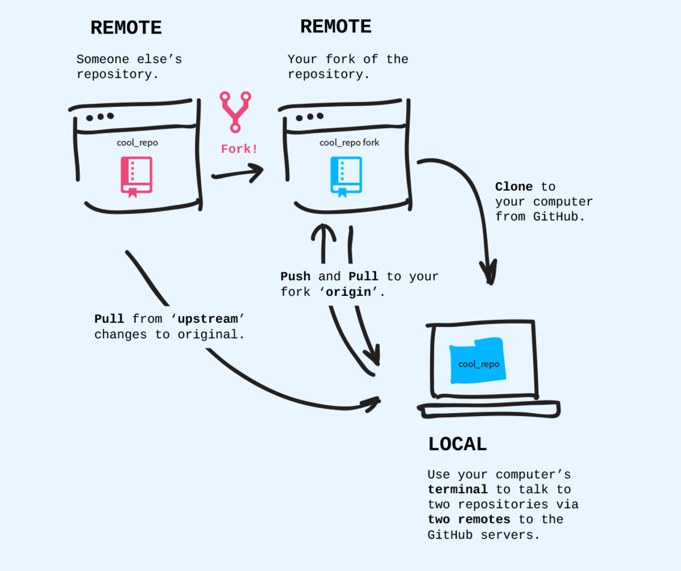
Fork and Clones

Slide 33
https://speakerd.s3.amazonaws.com/presentations/452113d0cb8c0131162302b4824706e4/20140601_github-kaigi-yunico.pdf

Slide 34


Staging area
http://rightrants.com/wp-content/uploads/2018/11/172b.jpg
Courtesy: http://elledecoration.co.za/wp-content/uploads/2009/05/manufactum.jpg

Slide 36
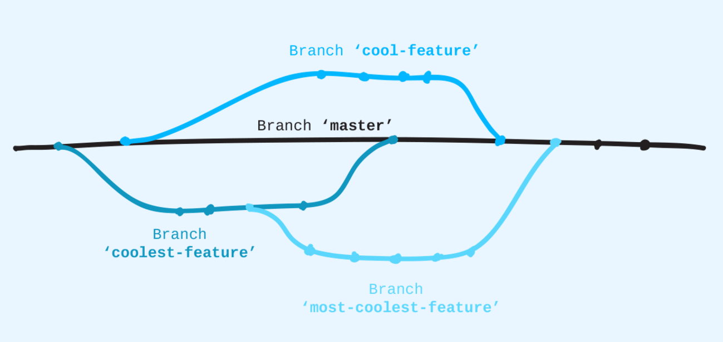
Branching off

Slide 37
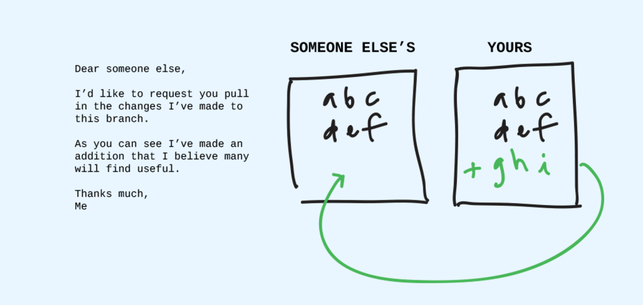
Pull Requests

Slide 38
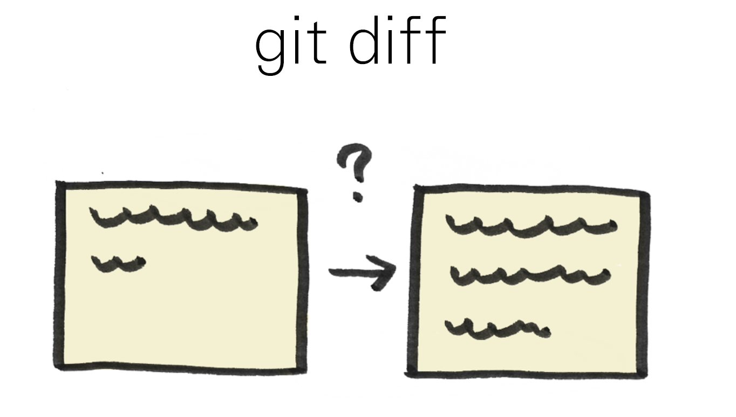
https://speakerd.s3.amazonaws.com/presentations/452113d0cb8c0131162302b4824706e4/20140601_github-kaigi-yunico.pdf

Slide 39
https://speakerd.s3.amazonaws.com/presentations/452113d0cb8c0131162302b4824706e4/20140601_github-kaigi-yunico.pdf

Slide 40
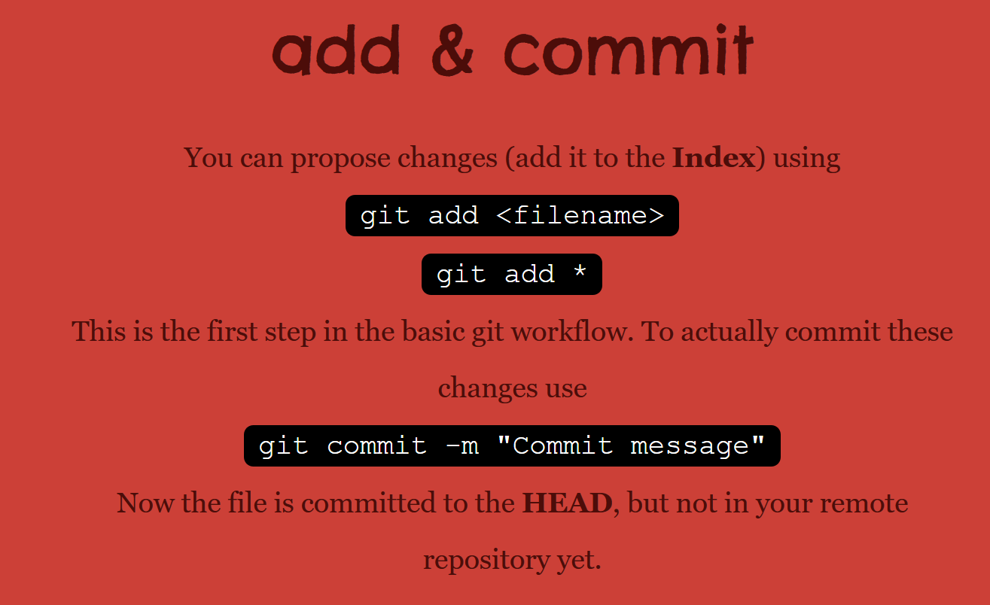

Slide 41
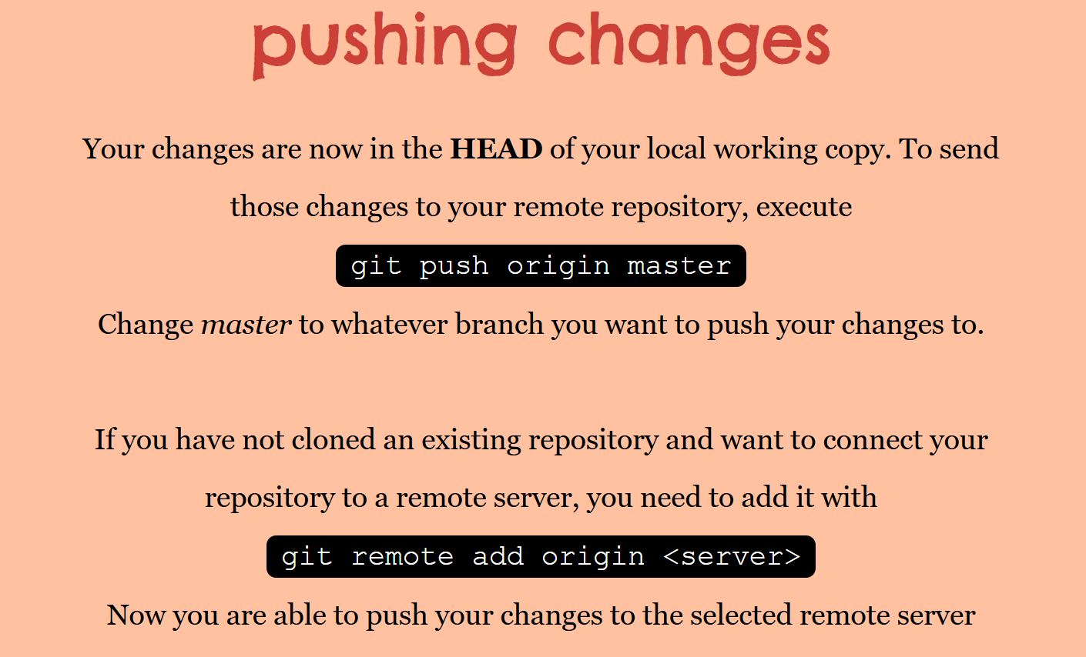
gpom

Slide 42
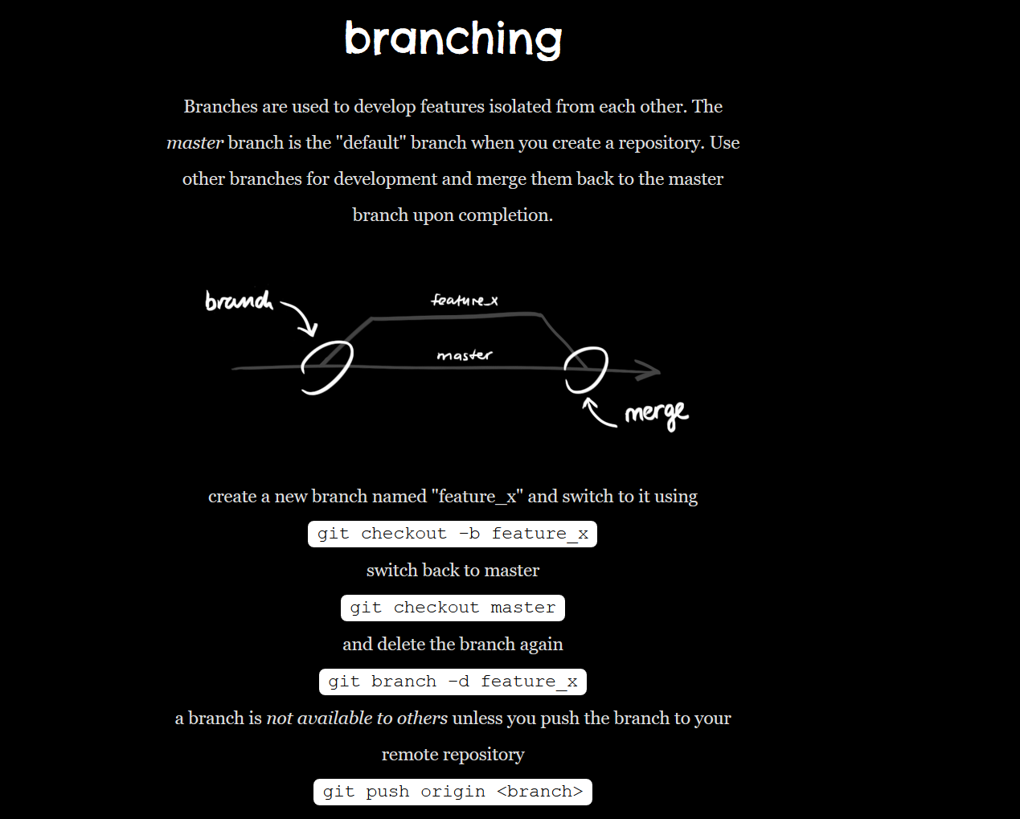

Slide 43
Questions
https://www.youtube.com/watch?v=7dYHRI55wxo

