Slide 1
Ignite the Chef Community!
Let’s Make the Chef Community Even Awesomer

Slide 2
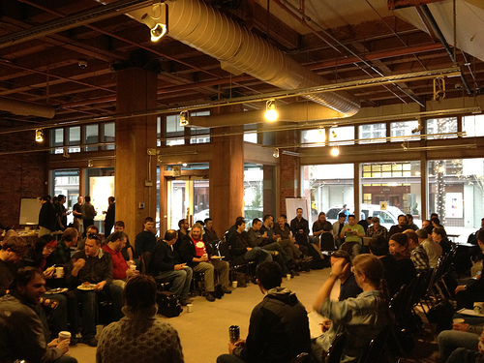
Infrastructure as code…
Community as Colleagues

Slide 3
Business Value of Community
More productive employees
Easier to recruit
Faster problem resolution
An excellent investment!

Slide 4
What’s Next?
CAMS
The “S” in CAMS is for Sharing
Share your story
Share your problems
Share your solutions

Slide 5

Don’t be afraid of Meatspace
Attend the big conferences
Join local Meetup groups
Traveling? Offer to speak at the local geek meetup

Slide 6
No local meetups?
Are you sure?
Start one
Convince your boss
Register a twitter handle
Sign-up on Meetup.com

Slide 7
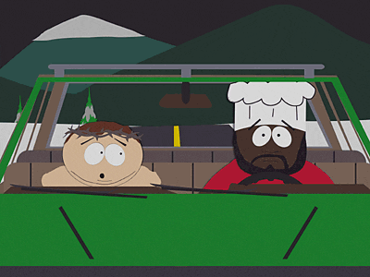
The Ugly Truth
It’s Easy to get LEFT BEHIND

Slide 8

No Assholes!

Slide 9

Poisonous People Kill Fun Dead

Slide 10

No Assholes but…
We need more than just

Slide 11
Welcome New Contributors!
3,000 lines of ruby?
Swallow the horror
Help make it awesome

Slide 12



Be Nice!
Jesse and Adam are nice
So We Are To
JASWAT! Or…

Slide 13
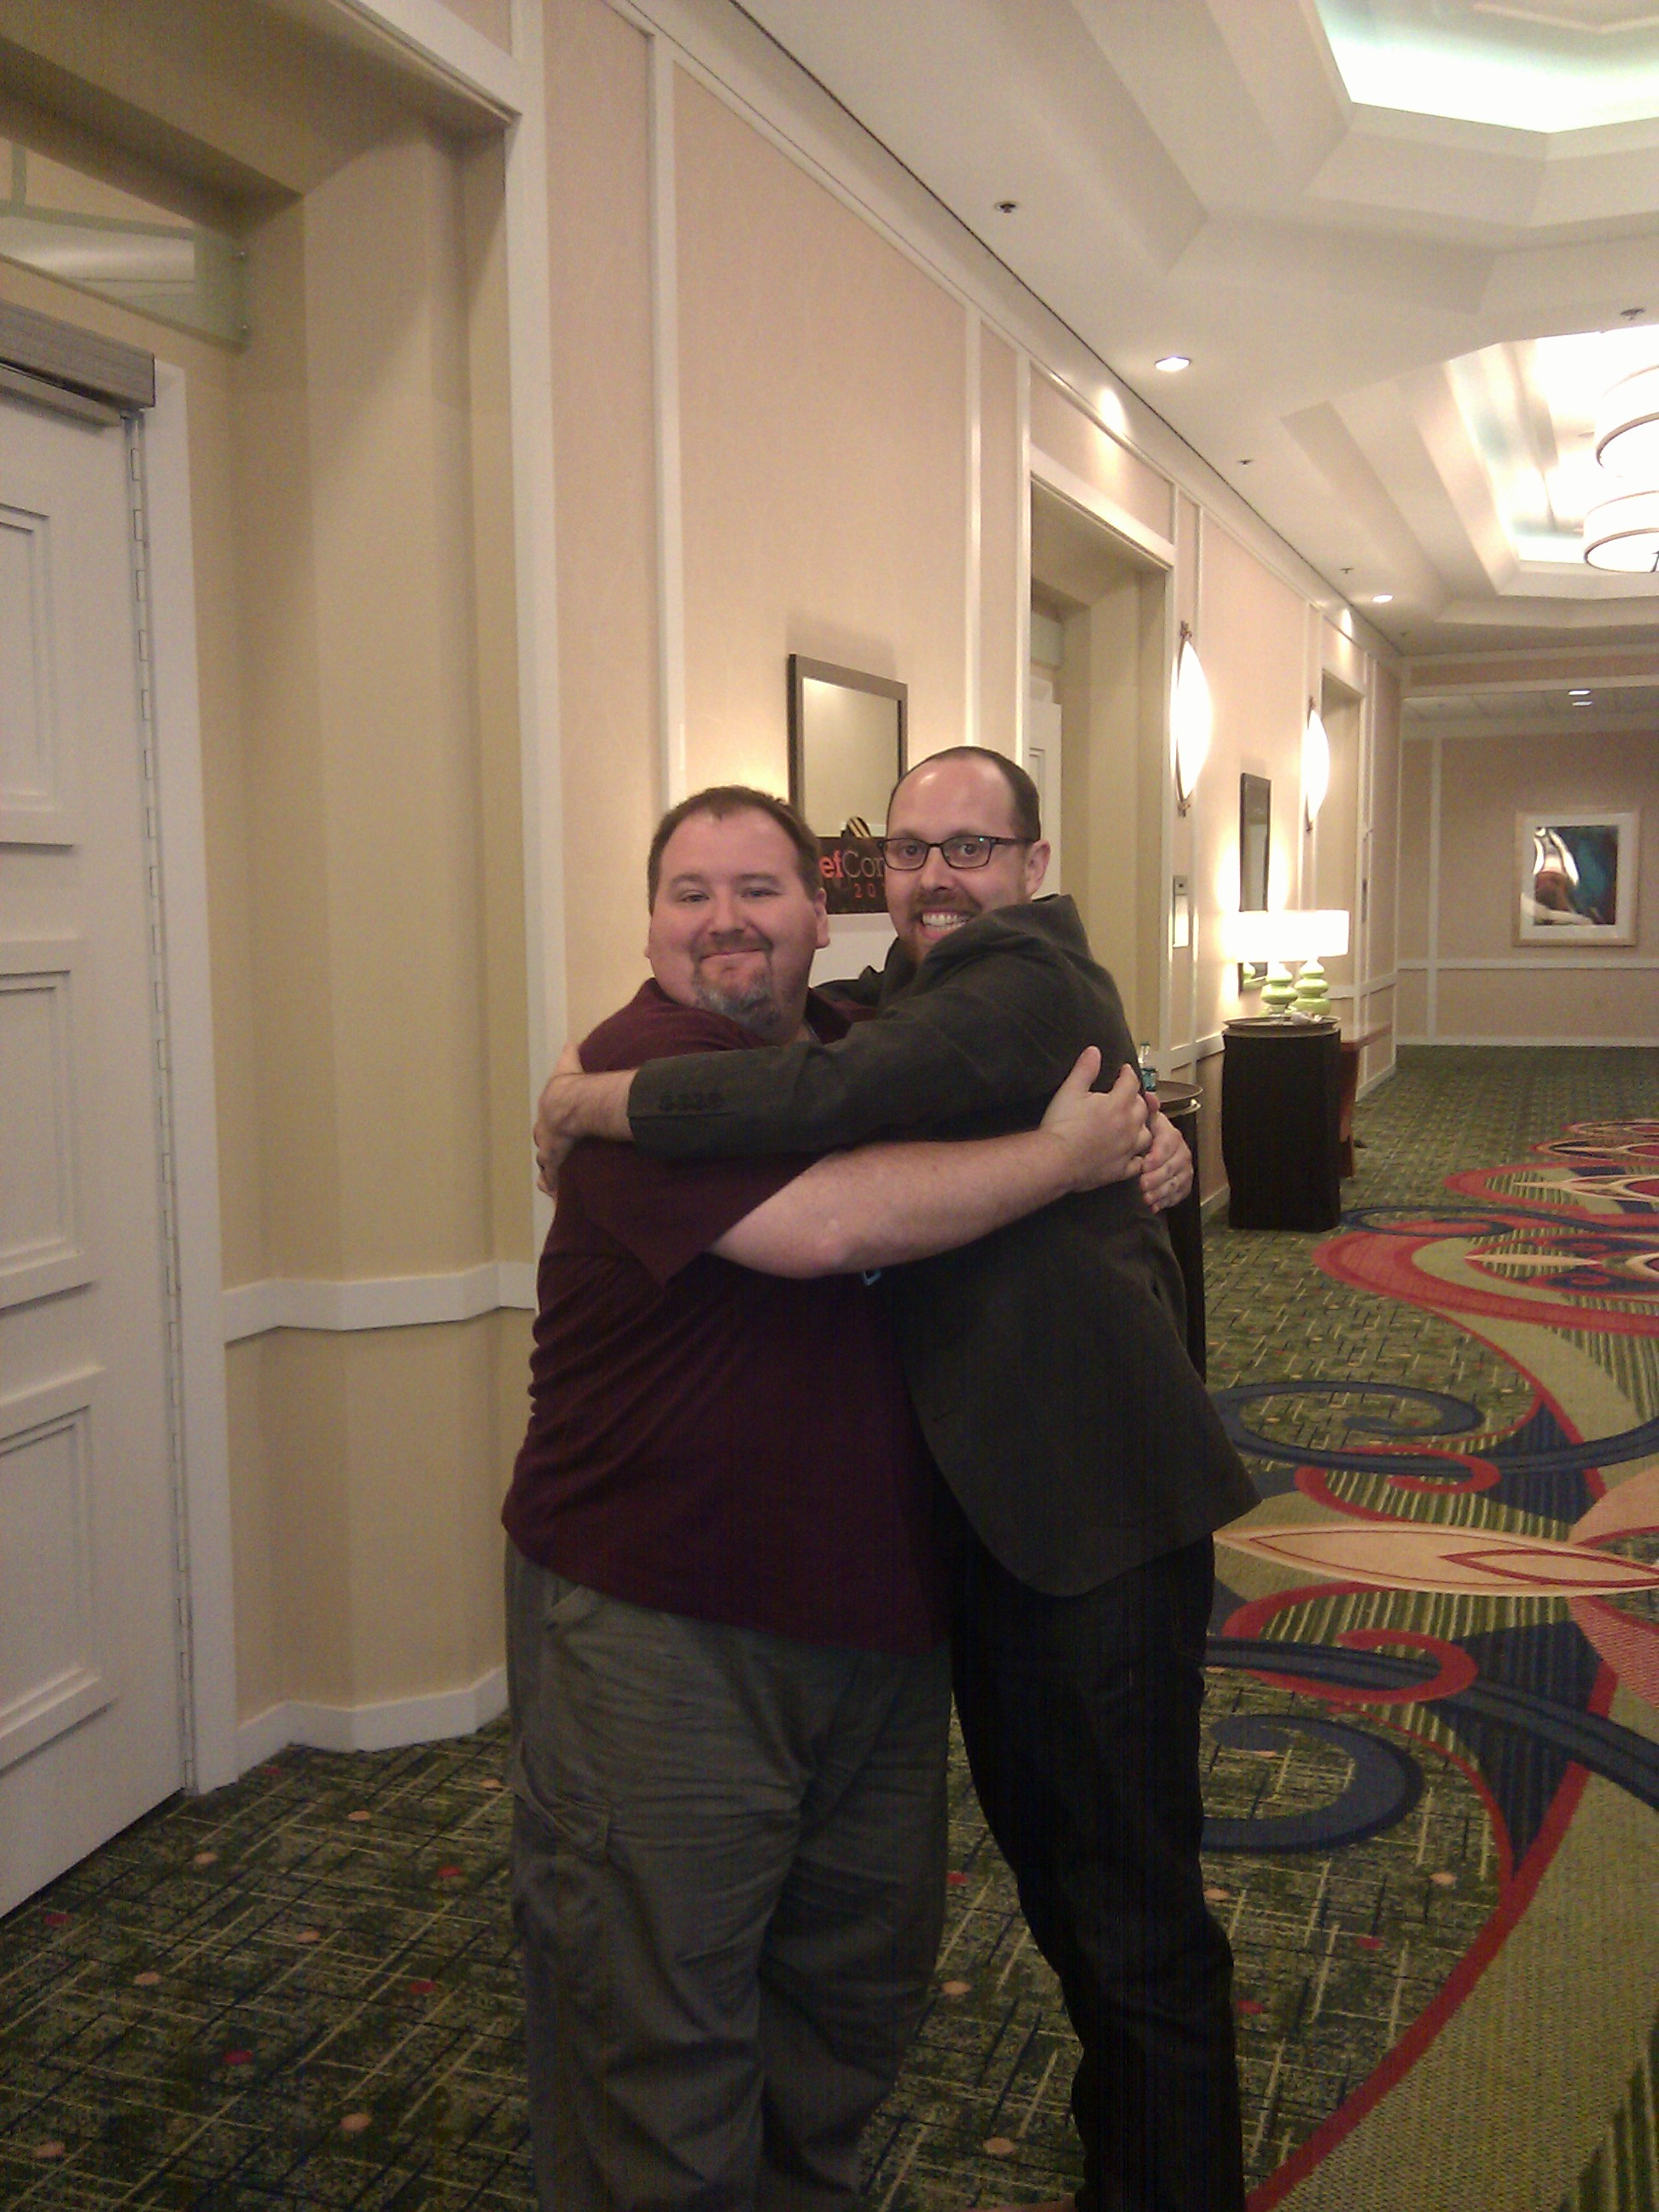
Hug Driven Development

Slide 14
Submit patches
Even little changes are appreciated!

Slide 15
Food Fight Show
"bi-weekly" podcast for the Chef and DevOps community
Tools, tips, process, and culture
What's Cookin' - All the latest in Cookbook News

Slide 16
Food Fight Show Episodes
Etsy Examined
TESTALLTHETHINGS
Back to the Kernel with Greg Kroah-Hartman
...and 14 more!

Slide 17
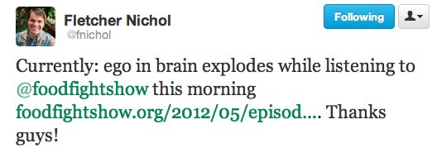
Food Fight Show
Featuring YOU!

Slide 18
Get featured on the show
Make your cookbooks more awesome
Link to github
Include a CHANGELOG.md
Add tests!

Slide 19
Contribute
http://github.com/foodfightshow
Patches welcome!

Slide 20

Listen
Be sure to listen to the Food Fight Show!
http://foodfightshow.org

