Slide 1
FoodMind – Product Features
Personalized food decision support
AD Project · Team 5 · Final Project Presentation
Chen Yaqi A0335050U
Lei Tianyou A0335067A
Wu Aomo A0335088X
Chen Chen A0335082J
Huang Qijun A0335061N
Deng Yunke A0335081L
Luo Yuxiang A0335071M

Slide 2
Agenda
01 End-User Demo
02 Machine Learning
03 Agent
FoodMind · Team 5
1

Slide 3
Problem & Inspiration
Inspired by a real Xiaohongshu post: friends kept a shared document to remember good meals, restaurants and drinks — so the group could decide what to eat quickly.
01
02
03
Time cost
Scattered evidence
Still manual
Every meal became a research task.
Reviews, hygiene cues, preferences and history lived in different places.
Users still had to search, compare and choose themselves.
The need: reusable, personalised decision support.
FoodMind · Team 5
2

Slide 4
Solution Overview
›
Generate
›
Filter & rank
›
›
Decide
›
Reuse
Record & share
Result
• Candidate meals come from the user's own history, authorised group records and a curated seed catalogue.
• Hard rules remove invalid items; a hybrid model ranks the rest.
• Users accept, reject, rate or mark "Would Eat Again" — feedback drives the next decision and offline retraining.
• Android and Web expose the same capabilities and business rules.
FoodMind · Team 5
3

Slide 5
Product Features Built
ID | Use case | Key technologies
UC-01 | Register, sign in, manage profile & preferences | Spring Security, JWT, Bean Validation, JPA
UC-02 | Food & drink posts and history | Spring Boot REST, ownership & visibility rules
UC-03 | Groups, feed & Want to Try | Group APIs, invite codes, permission filters
UC-04 | Explainable food recommendations | Recommendation Agent, hard filters, Logistic Regression
UC-05 | Accept / reject / rate / re-recommend | Feedback API, rejection constraints, offline retraining
UC-06 | Cooking plan from ingredients, budget, time | Cooking Planner Agent, recipe catalogue, Pydantic schema
UC-07 | Chatbot platform search | Chatbot Orchestrator + Platform Search Agent
UC-08 | Summarise / compare shared items | Content Summary Agent, reference resolver
UC-09 | Dashboard & weekly recap | Vico / Recharts, Spring Boot aggregation
Identical business scope on Android and Web; only the UI layout differs.
FoodMind · Team 5
4

Slide 6
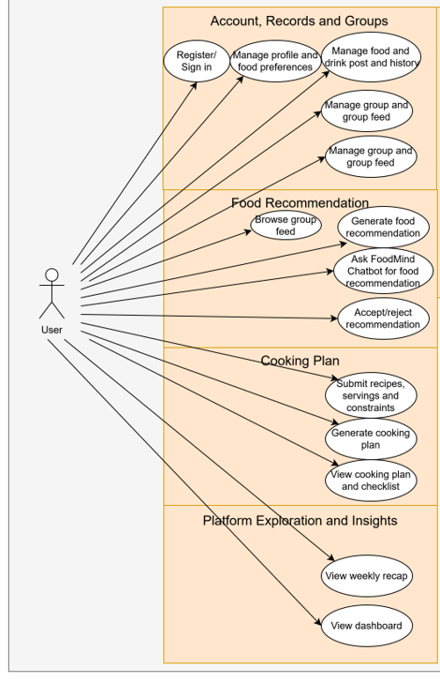
High-Level Use Case Diagram
待改进
FoodMind · Team 5
5

Slide 7
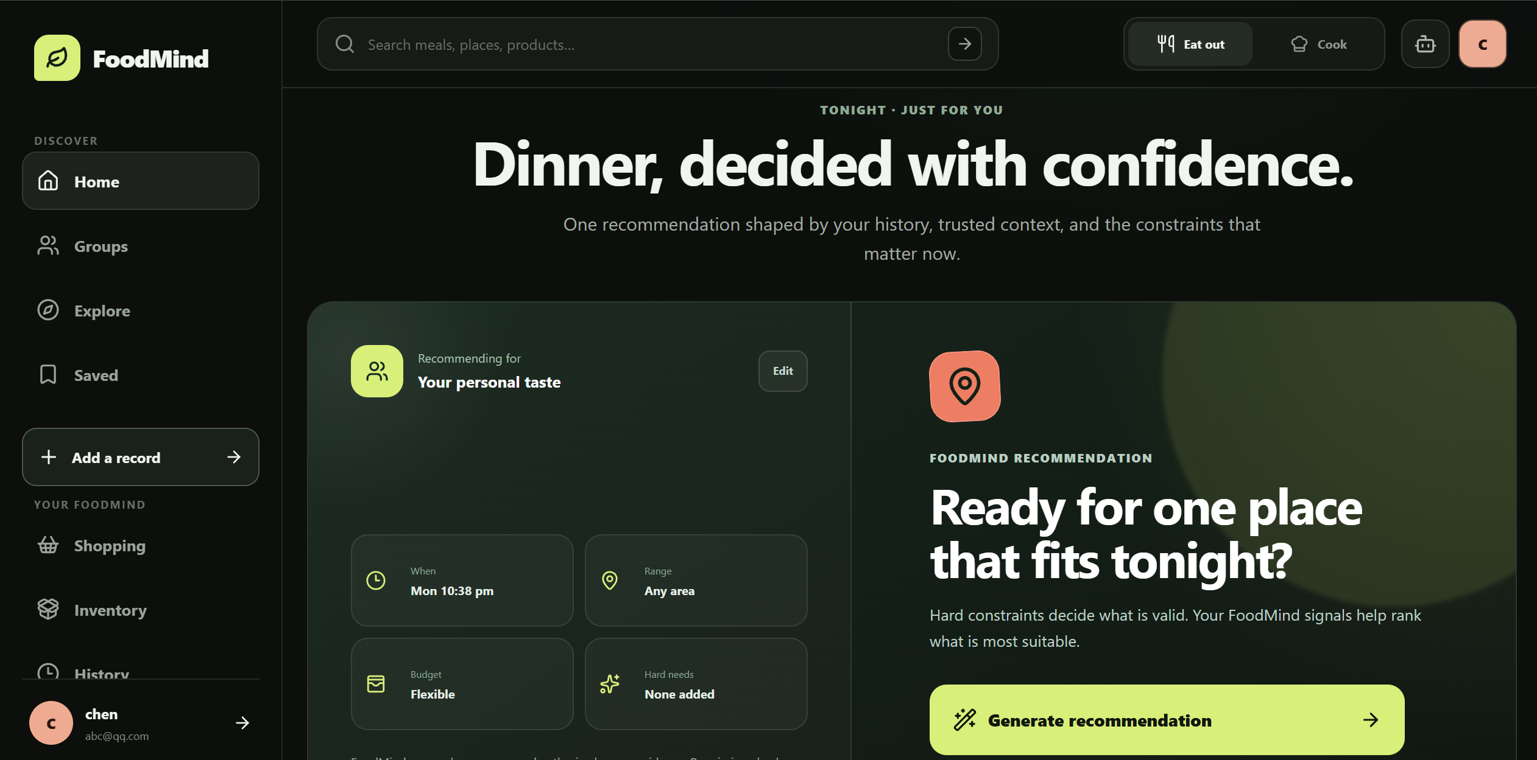

Slide 8
AI meal recommendation and feedback loop
Open “Eat Out & Delivery” → Enter Current Context → Select an Optional Trusted Group → Generate Recommendation → View Explainable Top Choice → Try Another Option / Accept / Reject → Submit Post-Meal Rating → Improve Future Recommendations

Slide 9
Data Visualisation & Weekly Recap
Live Dashboard
Weekly Recap
• Bar, pie and line charts (Vico on Android, Recharts on Web).
• Meal/drink frequency, cuisine mix, spending, ratings, repetition, recommendation outcomes.
• Computed from source records — not a competing system of record.
• A separate, concise periodic report — not a live dashboard.
• Summarises the week's eating and spending at a glance.
• Both clients consume identical backend metric definitions.
FoodMind · Team 5
12

Slide 10
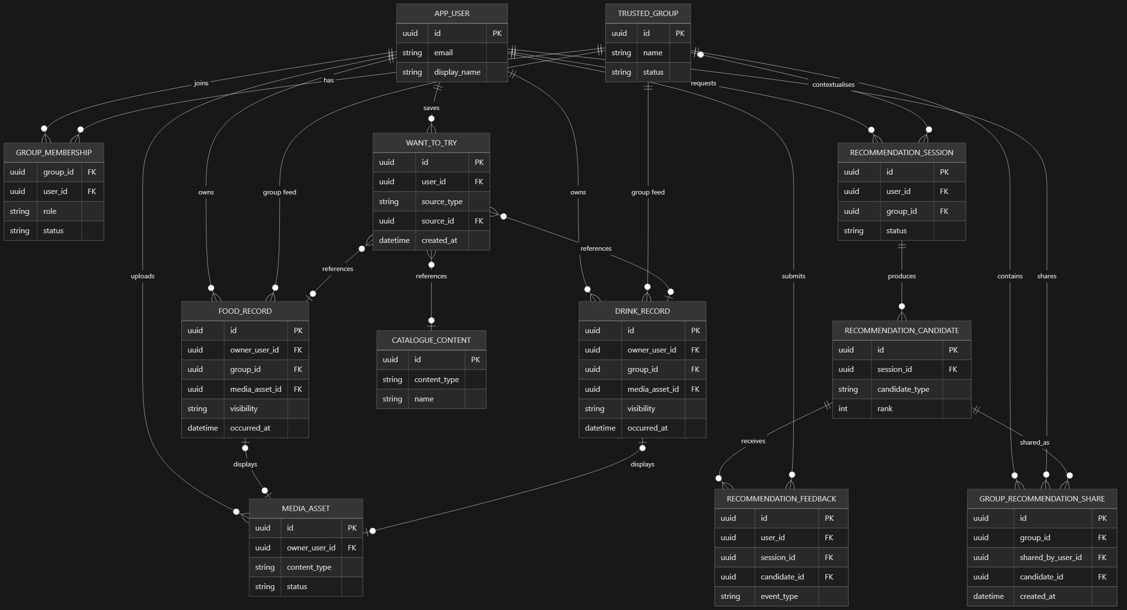
待改进
Data Model — High-Level ER Diagram
FoodMind · Team 5
7

Slide 11
Agent

Slide 12
Intelligence Services Design
01
02
03
RECOMMENDATION
COOKING
CHATBOT
Recommendation Agent
+
Inference Service
Cooking Planner Agent
Grounded Chatbot
Uses ingredients, recipes, time, budget and dietary constraints to build a feasible cooking plan.
Routes food-related requests to search, summary or comparison workflows using backend APIs and generate responses.
A bounded Recommendation Agent orchestrates a fixed LangGraph workflow, calls the private Inference Service once, validates model output, and returns explainable ranked recommendations.
LangGraph manages the Recommendation and Cooking workflows.Each Intelligence service applies bounded routing, timeouts, authorisation and traceable execution.
FOODMIND • TEAM 5
07
Notes:
FoodMind has three AI entry points: recommendation, cooking and platform exploration.
The Recommendation Agent calls retrieval, filtering and ranking tools, then explains the result. The Cooking Planner Agent uses ingredients, time, budget and dietary rules to retrieve a seed recipe and produce practical steps.
The independent Chatbot uses three Agents. Its Orchestrator delegates to the Platform Search Agent or Content Summary Agent. They search, summarise or compare authorised Meal Notes, Food Products and Places while keeping source references.
LangGraph manages state, routing, timeouts and traces. Agents use only allow-listed tools, cannot access PostgreSQL directly and cannot cross into another AI workflow. This keeps the system controlled and testable.

Slide 13
JWT Security
We did a special design. Use two different tokens
Short-lived Access JWT
Send to client
15 minutes
Used on every protected API request
Fast verification
Long-lived Refresh Token
Only in database
30 days
Used only at /auth/refresh
Hashed, rotated and revocable
Hacker
Client
Server
Long-lived Token
Short-lived Token 1
Short-lived Token 1
Short-lived Token 2
Short-lived Token 2

Slide 14
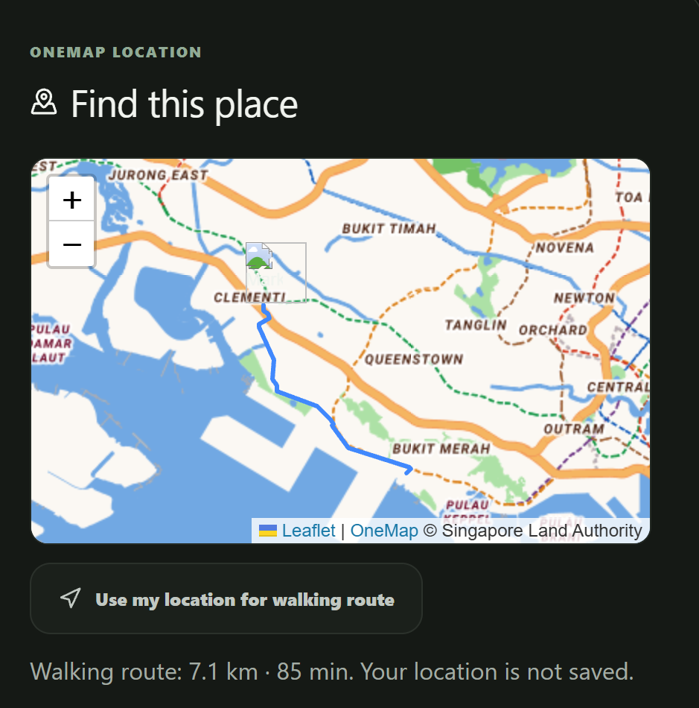
3rd API --- OneMap API (www.onemap.gov.sg)
We use this to implement Map Service

Slide 15
Summary
Layer | Implemented technologies
Clients | Android (Kotlin/Compose) and Web (React/TypeScript)
Common backend | Spring Boot, JWT, PostgreSQL, Flyway, OpenAPI
Agentic AI | Five LangGraph agents (recommendation, cooking, chatbot)
Machine learning | UserCF + ItemCF + Logistic Regression (hybrid)
Data & search | PostgreSQL full-text/trigram, permission-scoped
DevSecOps | GitHub Actions CI/CD, Trivy, secret/dependency scans
Thank you — questions welcome.
FoodMind · Team 5
17

