Slide 1
FoodMind
DevSecOps CI/CD
1
2
3
Commit
Analyze
Test
Secure. Observable. Reversible.
A running AWS pipeline that turns every release into verifiable evidence.
4
5
6
Package
Deploy
Monitor
19 AUGUST 2026
SA4106 • AD Project
Notes:
Opening (20 seconds): FoodMind uses a running DevSecOps pipeline on GitHub and AWS. The key message is not a list of tools; it is a verifiable chain from commit to security analysis, tested images, immutable deployment, post-deployment checks, and rollback. Today I will show the architecture, the current evidence chain, and a short live demonstration.

Slide 2
DESIGN PRINCIPLE
The course model becomes an operating loop
Commit
›
Analyze
›
Set up
›
Test
›
Deploy
›
Monitor
›
Repeat
Reviewable change
SAST • SCA • secrets
Compose • IaC
Unit • integration
Digest • OIDC • SSM
ZAP • JMeter • logs
Evidence → backlog
Fast feedback
Release assurance
PR checks finish early and close to the developer.
Integration, DAST and performance run at the correct later stage.
FOODMIND • DEVSECOPS
02
Notes:
Explain the course mapping (35 seconds): fast feedback stays close to the pull request, while integration, image scanning, DAST, performance, and monitoring run at the stage where they have enough context. The loop repeats because production and staging evidence becomes the next backlog input.
[Sources]
- /Users/huangqijun/Documents/新国立课件/敏捷开发课件/02 - DevSecOps Engg and Automation - Introduction.pdf
- /Users/huangqijun/Documents/新国立课件/敏捷开发课件/05 - Continuous Integration v1.0.pdf
- /Users/huangqijun/Documents/新国立课件/敏捷开发课件/06 - Continuous Delivery v 1.0.pdf
- /Users/huangqijun/Documents/新国立课件/敏捷开发课件/07 - Secure CI-CD Pipeline v 1.0.pdf

Slide 3
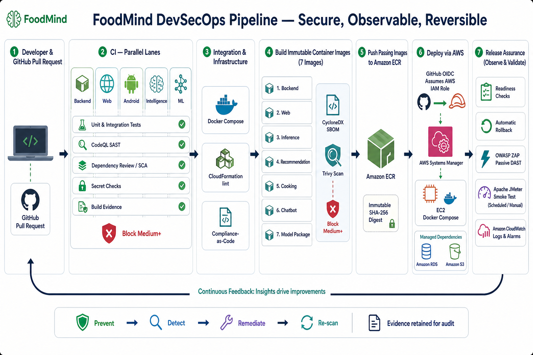
03
Notes:
Architecture (45 seconds): application repositories own fast service-level checks. The Infrastructure repository is the integration and release control plane. It validates pinned source revisions, builds and scans seven images, publishes immutable digests to ECR, deploys through OIDC and Systems Manager, then runs ZAP, JMeter, header checks, and operational feedback. The architecture image was generated with GPT Image and retained from the approved v2 deck.
[Sources]
- /Users/huangqijun/Documents/ADProject/output/devsecops/FoodMind-DevSecOps-Architecture.png
- /Users/huangqijun/Documents/ADProject/foodmind-infra/.github/workflows/compose.yml
- /Users/huangqijun/Documents/ADProject/foodmind-infra/.github/workflows/publish-staging.yml
- /Users/huangqijun/Documents/ADProject/foodmind-infra/.github/workflows/deploy-staging.yml

Slide 4
CONTINUOUS INTEGRATION
Pull requests stop defects before integration
Correctness
›
Lint • type • unit • contract
BLOCK
CodeQL SAST
›
security-extended queries
Medium+
Dependency Review
CVSS 4.0
›
Moderate+ blocks
Fail closed when evidence is missing or incomplete.
Evidence
›
SARIF • tests • artifacts
Android compiles for Kotlin CodeQL extraction; the other repositories use the supported analysis mode for their language.
FOODMIND • DEVSECOPS
04
Notes:
Pull-request CI (40 seconds): linting, type checks, unit and contract tests establish correctness. CodeQL provides SAST and Dependency Review provides SCA. Medium-or-higher security evidence blocks. A separate human reviewer is not required for the ML repository; the strict ML gate remains required, administrators are included, force-push is disabled, and conversations must be resolved.
[Sources]
- https://github.com/foodmind-team/foodmind-ml/pull/9
- /Users/huangqijun/Documents/ADProject/foodmind-ml/.github/workflows/ml-ci.yml
- https://docs.github.com/en/code-security/concepts/code-scanning/codeql/codeql-for-compiled-languages

Slide 5
SECURE SUPPLY CHAIN
The release is scanned before it reaches the registry
BUILD
SBOM
TRIVY
ECR
›
›
›
7 images
CycloneDX
Medium+ gate
SHA-256 digest
1
Backend
2
Web
3
Inference
4
Recommendation
5
Cooking
6
Chatbot
7
Model Package
Ordering guarantee
A failing candidate stops before docker push; SBOM and Trivy JSON remain available for audit.
FOODMIND • DEVSECOPS
05
Notes:
Secure supply chain (45 seconds): the publish workflow builds seven candidates. Each gets a CycloneDX SBOM and a pinned Trivy scan. A fixable Medium, High, or Critical finding stops the workflow before docker push. Passing candidates are stored and deployed using ECR SHA-256 digests, so the deployed bytes are the scanned bytes.
[Sources]
- /Users/huangqijun/Documents/ADProject/foodmind-infra/scripts/cd/publish-staging-images.sh
- /Users/huangqijun/Documents/ADProject/foodmind-infra/.github/workflows/publish-staging.yml
- /Users/huangqijun/Documents/ADProject/output/devsecops/evidence/release-manifest-staging-3496a39b3375.json

Slide 6
CONTINUOUS DELIVERY
AWS credentials are temporary and rollback is automatic
GitHub OIDC
AWS IAM
Systems Manager
EC2 Compose
›
›
›
Identity
Short-lived role
Controlled deploy
Digest-pinned
Readiness passes
Readiness fails
Release remains active
Restore previous release
RDS + S3 managed dependencies
CloudWatch logs + alarms → next backlog
FOODMIND • DEVSECOPS
06
Notes:
Continuous delivery (45 seconds): GitHub OIDC obtains short-lived AWS credentials. Systems Manager performs the controlled deployment to EC2 without opening an inbound administration port. Compose receives immutable image digests. Readiness decides success; if it fails, the deploy script restores the previous release automatically.
[Sources]
- /Users/huangqijun/Documents/ADProject/foodmind-infra/.github/workflows/deploy-staging.yml
- /Users/huangqijun/Documents/ADProject/foodmind-infra/scripts/cd/deploy-staging.sh
- https://docs.aws.amazon.com/IAM/latest/UserGuide/id_roles_providers_oidc.html

Slide 7
PIPELINE DEMONSTRATION
The live release has a complete evidence chain
1
Application PRs
Tests • CodeQL • SCA
CURRENT RELEASE
2
Compose gate
Run 31949676557
One chain
3
Secure publish
Run 31949803280
Open the Actions runs, then finish on the live staging endpoint.
4
AWS deployment
Run 31950088472
Never expose secrets or tokens.
5
Assurance
ZAP 31950196914 • JMeter 31964380538
FOODMIND • DEVSECOPS
07
Notes:
Evidence chain (50 seconds): start with passing application PR checks, then show the four current Infrastructure runs in sequence. Compose run 31949676557 validates the pinned revisions and integration. Publish run 31949803280 creates SBOMs, runs Trivy, pushes seven digest-addressed images, and creates release staging-3496a39b3375-31949803280-1. Deploy run 31950088472 performs OIDC, SSM, readiness, and rollback preparation. DAST run 31950196914 and JMeter run 31964380538 close the loop.
[Sources]
- https://github.com/foodmind-team/foodmind-infra/actions/runs/31949676557
- https://github.com/foodmind-team/foodmind-infra/actions/runs/31949803280
- https://github.com/foodmind-team/foodmind-infra/actions/runs/31950088472
- https://github.com/foodmind-team/foodmind-infra/actions/runs/31950196914
- https://github.com/foodmind-team/foodmind-infra/actions/runs/31964380538

Slide 8
SECURITY TESTING REPORT
Security evidence proves detect, fix, and re-scan
BEFORE
FIX
RE-SCAN
OS packages
142
Pinned dependencies
0
›
›
117 Medium
25 High
Lean runtime tooling
Fixable
Medium+
6 existing images
7 release images
Zero is the declared scanner result — not a claim of zero risk.
FOODMIND • DEVSECOPS
08
Notes:
Security report (50 seconds): the initial baseline across six existing images found 142 fixable Medium-or-higher findings: 117 Medium and 25 High. Remediation upgraded OS packages, pinned fixed dependencies, made Python builds deterministic, and removed unnecessary runtime tooling. The final scan covers seven release images and reports zero fixable Medium, High, or Critical findings. This is a scanner result at a declared threshold, not a claim of zero risk.
[Sources]
- /Users/huangqijun/Documents/ADProject/output/devsecops/evidence/README.md
- /Users/huangqijun/Documents/ADProject/output/devsecops/evidence/baseline-backend.json
- /Users/huangqijun/Documents/ADProject/output/devsecops/evidence/backend.json
- /Users/huangqijun/Documents/ADProject/output/devsecops/evidence/model-package.json

Slide 9
DAST • PERFORMANCE • MONITORING
Current staging passes post-deployment assurance
20
0%
781 ms
PASS
samples
error rate
p95 latency
p95 ≤ 2,000 ms
p95 budget used
781 ms
2,000 ms gate
OWASP ZAP passive DAST
Live security headers pass
CloudWatch feedback
FOODMIND • DEVSECOPS
09
Notes:
Current assurance (45 seconds): JMeter run 31964380538 tested the live staging endpoint with 20 samples. It recorded zero failures, a 0 percent error rate, 396.95 milliseconds average latency, and 781 milliseconds p95. The policy is zero errors and p95 no more than 2,000 milliseconds, so only 39.05 percent of the latency budget was used. Passive ZAP and the live security-header gate also passed.
[Sources]
- https://github.com/foodmind-team/foodmind-infra/actions/runs/31964380538
- https://github.com/foodmind-team/foodmind-infra/actions/runs/31950196914
- /Users/huangqijun/Documents/ADProject/output/devsecops/evidence/jmeter-live-summary-2026-08-17.json
- https://13.229.2.154.sslip.io/healthz

Slide 10
LIVE DEMONSTRATION
Open five screens in this order
1
PR checks
Application repository • Checks tab
5–7 MINUTES
2
Compose
Infra Actions • run 31949676557
One evidence chain
3
Publish
Infra Actions • run 31949803280
Pre-open every link in a separate browser tab.
4
Deploy
Infra Actions • run 31950088472
Use the guide if Wi-Fi is unstable.
5
Live assurance
/healthz • ZAP • JMeter
FOODMIND • DEVSECOPS
10
Notes:
Live demonstration (5 to 7 minutes): 1) open an application pull request and show the Checks tab; 2) open Compose run 31949676557 and identify pinned revision validation; 3) open Publish run 31949803280 and show SBOM, Trivy, and the release artifact; 4) open Deploy run 31950088472 and show OIDC, SSM, readiness, and rollback preparation; 5) open the live /healthz endpoint, then the DAST and JMeter runs. Keep every page open before presenting so the demonstration is a sequence of tabs rather than live searching.
[Sources]
- https://github.com/foodmind-team/foodmind-ml/pull/9
- https://github.com/foodmind-team/foodmind-infra/actions/runs/31949676557
- https://github.com/foodmind-team/foodmind-infra/actions/runs/31949803280
- https://github.com/foodmind-team/foodmind-infra/actions/runs/31950088472
- https://github.com/foodmind-team/foodmind-infra/actions/runs/31950196914
- https://github.com/foodmind-team/foodmind-infra/actions/runs/31964380538
- https://13.229.2.154.sslip.io/healthz

Slide 11
LOCAL DEMO BACKUP
Know where every demo artifact lives
1
Open foodmind-infra in VS Code
SAFE COMMANDS
2
releases/staging-source.json
gh auth status
3
.github/workflows/publish-staging.yml
gh run list
curl /healthz
4
scripts/cd/deploy-staging.sh
check headers
5
scripts/verify-aws-demo.sh
No secret output
Use live GitHub and AWS evidence first; use local files to explain implementation.
FOODMIND • DEVSECOPS
11
Notes:
Local backup (60 seconds): open /Users/huangqijun/Documents/ADProject/foodmind-infra in VS Code. Use releases/staging-source.json to explain exact source pins, .github/workflows/publish-staging.yml for SBOM and Trivy orchestration, scripts/cd/deploy-staging.sh for readiness and rollback, and scripts/verify-aws-demo.sh for the classroom verification path. Safe commands are documented in the separate live-demo guide. Do not print environment files, tokens, AWS credentials, repository secrets, or SSM parameter values.
[Sources]
- /Users/huangqijun/Documents/ADProject/foodmind-infra/releases/staging-source.json
- /Users/huangqijun/Documents/ADProject/foodmind-infra/.github/workflows/publish-staging.yml
- /Users/huangqijun/Documents/ADProject/foodmind-infra/scripts/cd/deploy-staging.sh
- /Users/huangqijun/Documents/ADProject/foodmind-infra/scripts/verify-aws-demo.sh

Slide 12
OPERATING RESULT
The pipeline is operating, evidenced, and reversible
1
All application security gates are merged
CURRENT RELEASE
2
Seven images are scanned before ECR
Infra 3496a39b
3
The release is deployed by immutable digest
7 ECR digests
p95 781 ms
4
Readiness and automatic rollback are active
DAST PASS
5
ZAP, headers and JMeter pass
Evidence retained
Live: staging-3496a39b3375-31949803280-1
FOODMIND • DEVSECOPS
12
Notes:
Close (30 seconds): the requested controls are operating now. Application security gates are merged, seven images are scanned before ECR, the release is deployed using immutable digests, readiness and automatic rollback are active, and ZAP, security headers, and JMeter pass. The current release is staging-3496a39b3375-31949803280-1, based on Infra revision 3496a39b. The evidence is retained in GitHub Actions artifacts and the release manifest.
[Sources]
- /Users/huangqijun/Documents/ADProject/output/devsecops/evidence/release-manifest-staging-3496a39b3375.json
- https://github.com/foodmind-team/foodmind-infra/actions/runs/31949803280
- https://github.com/foodmind-team/foodmind-infra/actions/runs/31950088472
- https://github.com/foodmind-team/foodmind-infra/actions/runs/31950196914
- https://github.com/foodmind-team/foodmind-infra/actions/runs/31964380538

