Slide 1
FoodMind
Decide dinner with confidence.
AD Project · Team 5 · Final Project Presentation
Chen Yaqi A0335050U
Lei Tianyou A0335067A
Wu Aomo A0335088X
Chen Chen A0335082J
Huang Qijun A0335061N
Deng Yunke A0335081L
Luo Yuxiang A0335071M
Notes:
[Sources]
Internal: foodmind-docs README — canonical scope and repository topology.

Slide 2
The FoodMind story
01 The user experience
02 Trust & ranking
03 Bounded agents
04 Backend & client parity
05 Delivery & security
FoodMind · Team 5
1
Notes:
[Sources]
Internal: presentation narrative derived from the current six repositories.

Slide 3
The user experience
Notes:
[Sources]
Internal: foodmind-docs README — recommendation-first UX clarification.

Slide 4
Dinner should not be a research project
A meal decision often starts with scattered memories, changing constraints and a group chat that never reaches an answer.
01
02
03
Decision fatigue
Context is fragmented
No accountable answer
Searching, comparing and coordinating consumes the moment meant for eating.
History, dietary needs, budget, distance and trusted group signals live apart.
Most discovery products still leave the final decision to the user.
FoodMind turns trusted context into a clear next step.
FoodMind · Team 5
2
Notes:
[Sources]
Internal: foodmind-docs README — product-experience clarification.

Slide 5
A decision loop, not another feed
›
Ask
›
Protect
›
Explain
›
Decide
›
Learn
›
Reflect
Remember
Authorised history and group evidence create the context. Hard constraints protect the choice; ranking orders the safe candidates; verified reasons explain the lead result; explicit feedback improves the next decision.
FoodMind · Team 5
3
Notes:
[Sources]
Internal: foodmind-web README — recommendation context, ordered candidates, feedback and re-recommendation.
Internal: foodmind-backend README — product-experience contract.

Slide 6
A complete decision experience
Moment | What FoodMind enables | Evidence
1 | Start with context | Preferences, history and constraints
2 | Choose together | Trusted groups, feeds and Want to Try
3 | Receive one lead answer | Ordered recommendations + Try another
4 | Know why | Verified reason codes and fallback disclosure
5 | Switch to cooking | Manual ingredients, plan and history
6 | Ask grounded questions | Chat references, comparison and summary
7 | See the pattern | Backend-owned dashboard and weekly recap
8 | Stay in control | Permission-safe Explore and search
UC-09 | Dashboard & weekly recap | Vico / Recharts, Spring Boot aggregation
The same public contract powers Web and Android; each client keeps the interaction native to its platform.
FoodMind · Team 5
4
Notes:
[Sources]
Internal: foodmind-web README — included capabilities.
Internal: foodmind-android README — responsibilities.

Slide 7
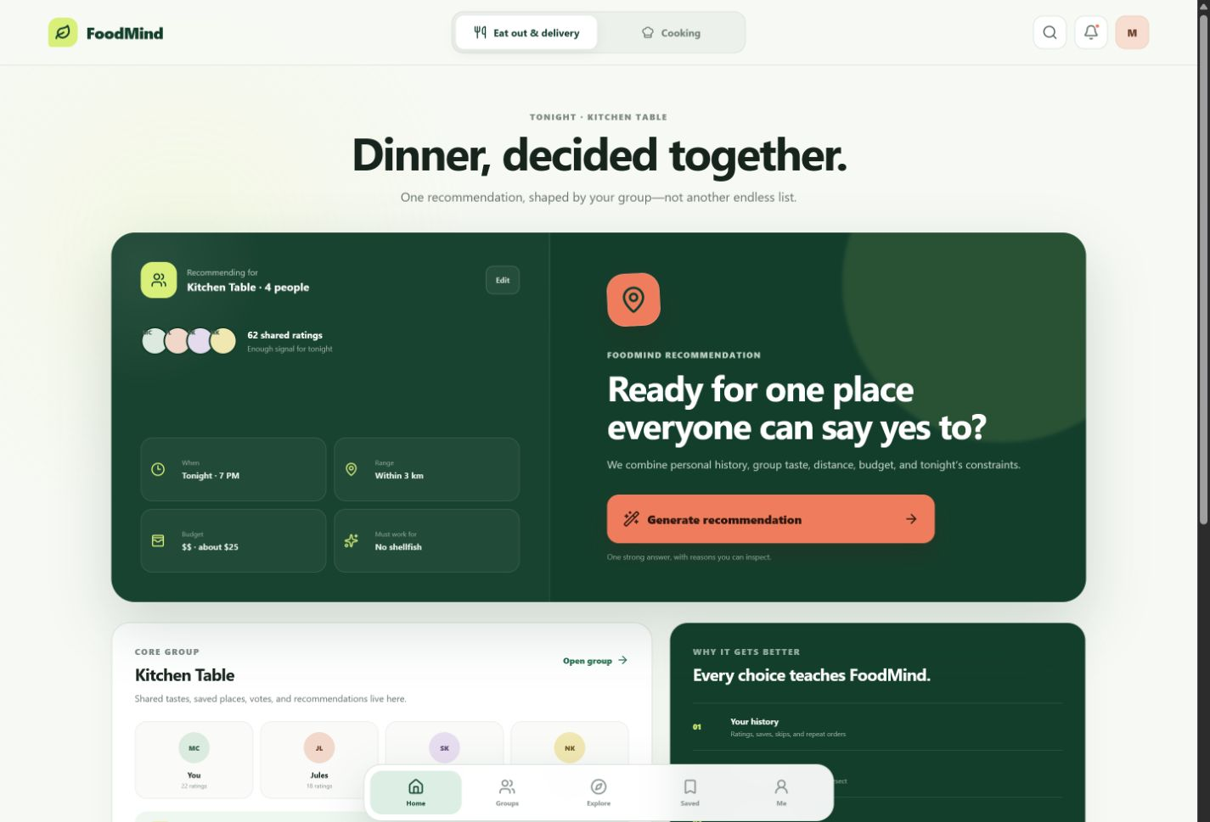
A decision in one calm minute
FoodMind · Team 5
5
Notes:
[Sources]
Internal screenshot: foodmind-web/docs/ux/today-dashboard-web.png.
Internal: foodmind-web README — responsive recommendation-first decision loop.

Slide 8
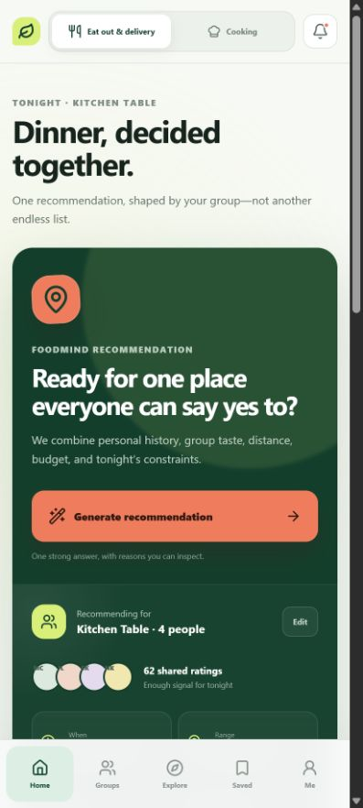
One experience across devices
Web and Android call the same /api/v1 contract. The backend owns authorisation and business rules; private Agent and inference services never become browser or mobile endpoints.
FoodMind · Team 5
6
Notes:
[Sources]
Internal screenshot: foodmind-web/docs/ux/today-dashboard-mobile-web.png.
Internal: foodmind-backend README — public and private system boundary.

Slide 9
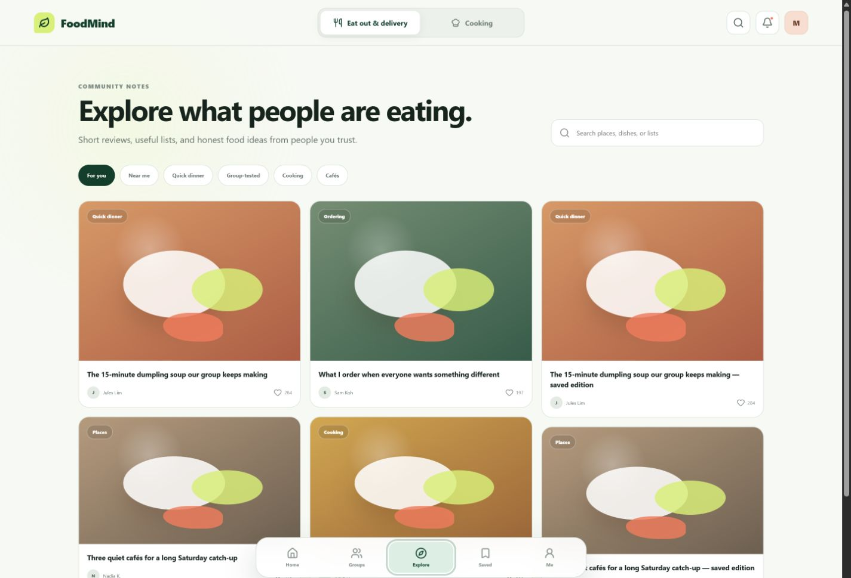
Trust belongs in the product
FoodMind · Team 5
7
Notes:
[Sources]
Internal screenshot: foodmind-web/docs/ux/explore-feed-web.png.
Internal: foodmind-web README — authorised Explore and Search.

Slide 10
Technology
Notes:
[Sources]
Internal: foodmind-ml README — hybrid model and project-stage limitation.

Slide 11
Safety comes before ranking
HARD FILTERS
allergy · diet · budget · spice · repetition · distance
SOURCE CODE
SAFE CANDIDATES
RANKED RESULTS
for (HardFilterPolicy policy
: policies) {
decision = policy.apply(...);
if (!decision.allowed())
return rejected;
}
HardFilterPipeline.java · lines 16–34
A prediction never overrides a hard constraint.
FOODMIND • TEAM 5
08
Notes:
[Sources]
Internal source: foodmind-backend/src/main/java/com/foodmind/foodmindbackend/recommendation/domain/filter/HardFilterPipeline.java:16-34.

Slide 12
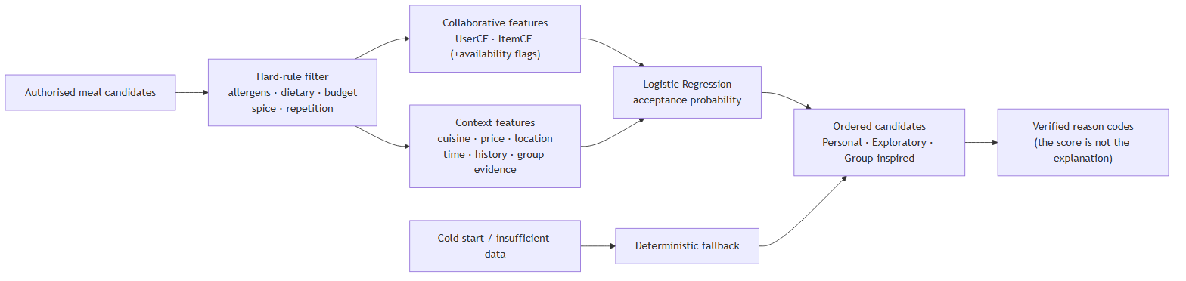
Ranking learns from evidence
model = NumpyLogisticRegression()
model.fit(x_train, y_train)
Features combine UserCF, ItemCF, preference, context, price, distance and history. Availability flags keep missing collaborative signals neutral.
The returned score ranks safe candidates; verified reason codes—not the score—explain the result.
FoodMind · Team 5
9
Notes:
[Sources]
Internal source: foodmind-ml/src/foodmind_ml/pipeline.py:449-495.
Internal: foodmind-ml README — feature contract and explanation boundary.

Slide 13
What the current evidence can—and cannot—say
Metric | Majority (val) | Hybrid LR (val) | Hybrid LR (test)
Accuracy | 0.9925 | 0.9925 | 0.9815
Precision | 0.9925 | 0.9925 | 0.9815
Recall | 1.0000 | 1.0000 | 1.0000
F1 | 0.9962 | 0.9962 | 0.9907
ROC-AUC | 0.5000 | 0.5568 | 0.8068
Offline experiment
Train: 48,379 rows
Validation: 266 rows
Test: 270 rows
19 engineered features
Food.com source summary
231,637 recipes · 538,139 interactions
Project-stage candidate, not production-validated.
The label distribution is strongly positive; validation has no true negatives. Report ROC-AUC beside accuracy, and retain deterministic preference/context fallback for cold start or unavailable collaborative signals.
FoodMind · Team 5
10
Notes:
[Sources]
Internal data: foodmind-ml/reports/metrics/hybrid_lr_metrics.json.
Internal data: foodmind-ml/data/processed/foodcom_summary.json.
Internal: foodmind-ml README — project-stage and evaluation limitations.

Slide 14
Bounded agents
Notes:
[Sources]
Internal: foodmind-intelligence/agent-service/app/agents/README.md.

Slide 15
One fixed graph. One scoring call.
01
02
03
RECOMMENDATION
COOKING
CHATBOT
Validate → score once → select
Controlled recipe planning
Grounded search and summary
A fixed acyclic graph produces up to three ordered results.
Allow-listed backend tools only
Manual/authorised inputs; time, budget and dietary rules are validated.
No direct database or public-web access.
graph.add_edge(START, "validate_envelope")
… validate → score_once → select_results → reasons → response
MAX_WORKFLOW_STEPS = 8
FOODMIND • TEAM 5
07
Notes:
[Sources]
Internal source: foodmind-intelligence/agent-service/app/agents/recommendation/src/recommendation_agent/workflow/graph.py:17-75.

Slide 16
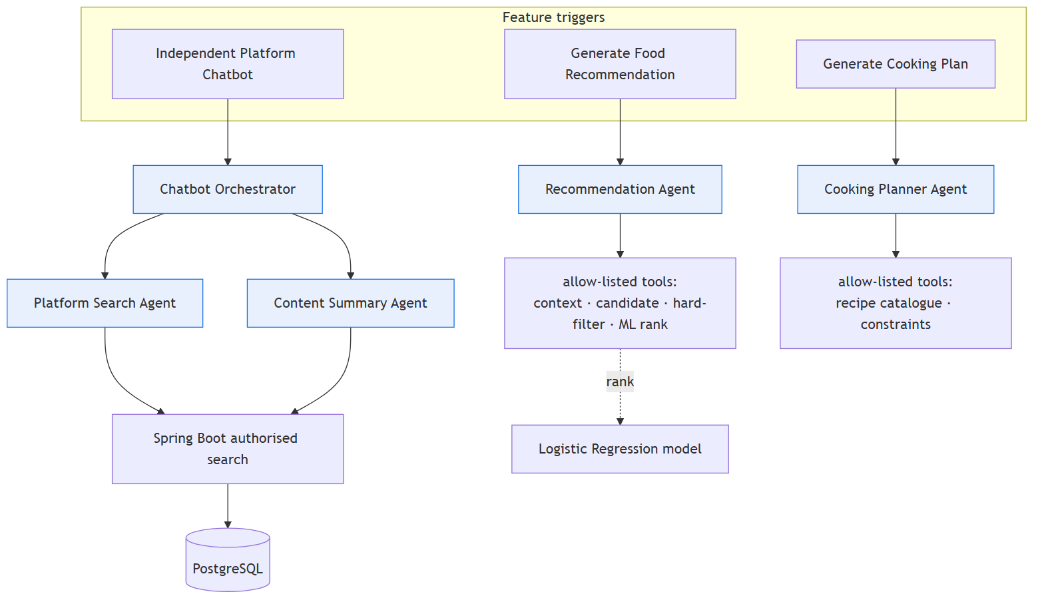
Every AI response remains accountable
The Agent receives only backend-authorised context, calls private inference once, derives verified reason codes, and returns a schema-validated response.
if outputs exceed the request candidates → reject
if the workflow exceeds its deadline → return a bounded failure
if an internal result is invalid → Backend applies deterministic fallback
FoodMind · Team 5
8
Notes:
[Sources]
Internal source: foodmind-intelligence/agent-service/app/agents/recommendation/src/recommendation_agent/application/service.py:21-49.
Internal source: foodmind-intelligence/agent-service/app/agents/recommendation/src/recommendation_agent/workflow/graph.py:93-160.

Slide 17
The system of record
Notes:
[Sources]
Internal: foodmind-backend README — public business API and system-of-record boundary.

Slide 18
Backend orchestration
Notes:
[Sources]
Internal: foodmind-backend README — Spring Boot authorisation, persistence and private integrations.

Slide 19
One contract. Two clients.
Private FastAPI
Recommendation Agent + inference runtime
Android · Kotlin + Compose
Spring Boot /api/v1
authorisation · business rules · validation
idempotencyService.begin(...)
… validate Agent output …
completeWithFallback(...)
Web · React + TypeScript
PostgreSQL
records · groups · sessions · feedback
Why the boundary matters
Traceable recovery
Only Spring Boot authenticates users, selects authorised context, validates private-service output and persists the safe result.
Schema rejection and agent failure resolve to a deterministic, auditable fallback.
GenerateRecommendation.java · lines 58–116
FOODMIND • TEAM 5
09
Notes:
[Sources]
Internal source: foodmind-backend/src/main/java/com/foodmind/foodmindbackend/recommendation/application/GenerateRecommendation.java:58-116.
Internal: foodmind-backend README — system boundary.

Slide 20
Parity is enforced, not assumed
val expected = operations(contractSnapshot)
val missing = expected - actual.toSet()
check(missing.isEmpty() && extra.isEmpty())
check(expected.size == 84)
The Android build gate verifies every public backend operation is declared exactly once; Web verifies its generated OpenAPI snapshot and usage coverage.
Both clients share permission outcomes and backend-owned metric definitions—not duplicated business logic.
FoodMind · Team 5
11
Notes:
[Sources]
Internal source: foodmind-android/build.gradle.kts:136-182.
Internal: foodmind-web README — API check and coverage gate.
Internal: foodmind-android/contracts/backend-openapi-v1.lock — 84 operations.

Slide 21
A decision creates evidence for the next one
Dashboard
Weekly recap
Backend-owned metrics make spending, cuisine mix, recommendation outcomes and history consistent on Web and Android.
A concise time-bounded reflection turns recent choices into a usable conversation—not another dense dashboard.
FoodMind · Team 5
12
Notes:
[Sources]
Internal: foodmind-web README — dashboard metrics and weekly recaps.
Internal source: foodmind-backend/src/main/java/com/foodmind/foodmindbackend/analytics/api/DashboardController.java.

Slide 22
Delivery & trust
Notes:
[Sources]
Internal: foodmind-docs README — required delivery evidence.

Slide 23
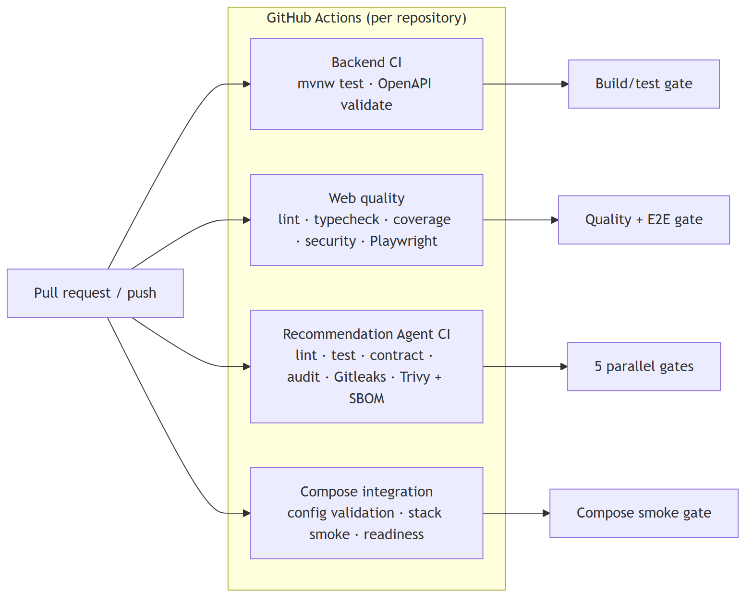
Quality gates travel with the contract
Backend validates OpenAPI and tests the Spring Boot boundary. Web verifies API coverage, lint, types, tests and production build. Intelligence validates contracts, security tests, dependency/secret/image scans and SBOM evidence.
The point is not a pipeline diagram—it is preventing cross-repository drift before it reaches a user.
FoodMind · Team 5
13
Notes:
[Sources]
Internal: foodmind-web README — validation commands.
Internal: foodmind-android README — API generation and coverage gates.
Internal: foodmind-intelligence agent README — private service topology.

Slide 24
Private models must be verifiable
Model package guard
digest = hashlib.sha256(artifact.read_bytes()).hexdigest()
if digest != manifest["artifactSha256"]:
raise ModelPackageError("model artifact checksum mismatch")
The runtime also rejects incompatible schemas, invalid tensor shapes and non-local packages. User authorisation remains in Spring Boot; private services receive only service-scoped requests.
Security evidence is presented as implemented controls and repository tests—not a claim of completed production certification.
FoodMind · Team 5
14
Notes:
[Sources]
Internal source: foodmind-intelligence/inference-service/app/model.py:31-74.
Internal: foodmind-backend README — security and private integration boundary.

Slide 25
Six code paths. One accountable product.
1
1 Safe candidates first
HardFilterPipeline evaluates each candidate against allergen, dietary, budget, spice, repeat, distance, time and cleanliness policy before ranking.
2
2 Ranking with a boundary
The ML pipeline fits a Logistic Regression over explicit feature availability; its current offline evidence stays labelled project-stage.
3
3 Contract parity by design
Android rejects any API drift from the committed 84-operation OpenAPI snapshot; Web applies its own snapshot and usage coverage checks.
FoodMind · Team 5
15
Notes:
[Sources]
Internal source: foodmind-backend/.../HardFilterPipeline.java:16-34.
Internal source: foodmind-ml/src/foodmind_ml/pipeline.py:449-495.
Internal source: foodmind-android/build.gradle.kts:136-182.

Slide 26
Six repositories. One delivery boundary.
Web
React · TypeScript
Backend + private services
Spring Boot · FastAPI
Data + model package
PostgreSQL · ML release
Android
Kotlin · Compose
The architecture separates public clients, the system-of-record backend, private agents/inference and offline model development. Deployment claims remain limited to repository-backed evidence.
FoodMind · Team 5
16
Notes:
[Sources]
Internal: foodmind-docs README — confirmed six-repository topology.
Internal: foodmind-backend README — public/private system boundary.

Slide 27
FoodMind makes the next meal an easier yes
Promise | How we keep it accountable
A better next meal | Personal context, trusted groups and clear choices
A safer recommendation | Hard filters before hybrid ranking
An explainable answer | Verified reason codes and deterministic fallback
A consistent product | One OpenAPI contract across Web and Android
A responsible AI boundary | Private services, validated packages and traceability
A repeatable delivery path | Six repositories with explicit ownership and quality gates
A trusted decision loop—designed for people, backed by accountable technology.
FoodMind · Team 5
17
Notes:
[Sources]
Internal: synthesis of current FoodMind repositories and source evidence cited throughout this deck.

