Slide 1
FoodMind
DevSecOps CI/CD
1
2
3
Commit
Analyze
Test
Secure. Observable. Reversible.
A running AWS pipeline that turns every release into verifiable evidence.
4
5
6
Package
Deploy
Monitor
Chen Yaqi A0335050U
Lei Tianyou A0335067A
Wu Aomo A0335088X
Chen Chen A0335082J
Huang Qijun A0335061N
Deng Yunke A0335081L
19 AUGUST 2026
SA4106 • AD Project
Luo Yuxiang A0335071M
Notes:
Good afternoon. This is Team5 and I am Chen Yaqi. Today I will present DevSecOps pipeline of our project.
Before we start, I will trigger our DevSecOps pipeline in the background. I am going to open a Pull Request to kick off the full GitHub Actions Workflows.
Our goal is to build a working AWS pipeline, which can turn every software release into verifiable audit evidence.
Three key attributes define our pipeline: Secure, Observable, and Reversible.
The high‑level workflow follows six major phases: Commit, Analyze, Test, Package, Deploy and Monitor.

Slide 2
DESIGN PRINCIPLE
The course model becomes an operating loop
Commit
›
Analyze
›
Set up
›
Test
›
Deploy
›
Monitor
›
Repeat
Reviewable change
SAST • SCA • repository-specific secret checks
Compose • IaC
Unit • integration
Digest • OIDC • SSM
ZAP • JMeter • logs
Evidence → backlog
Fast feedback
Release assurance
PR checks finish early and close to the developer.
Integration, DAST and performance run at the correct later stage.
FOODMIND • DEVSECOPS
02
Notes:
Next, let’s look at our design principle. We turned the theoretical DevSecOps model into a real‑world operating loop.
When developers raise a pull request, we kick off analysis including SAST, SCA and secret scanning.
Then we provision infrastructure via IaC and Docker Compose, run tests, deploy, and continuously monitor.
After monitoring, all evidence flows back to our backlog for improvements, closing the loop.
We follow two important ideas. First is fast feedback: PR checks run early, giving developers quick feedback close to their code change.
Second is release assurance: heavier tests like integration, DAST and performance testing run later in the pipeline, at the correct stage before release.

Slide 3
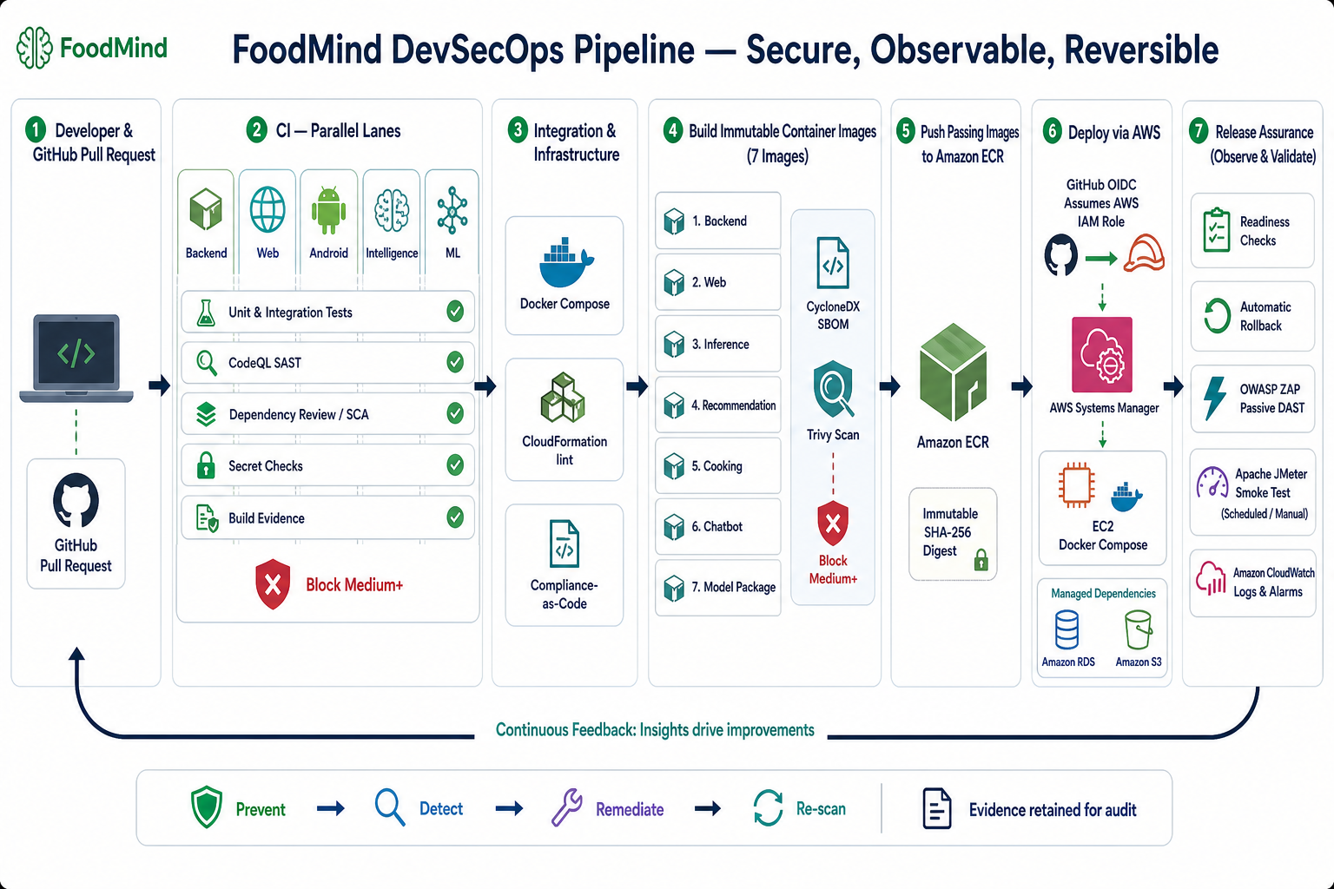
03
Notes:
This diagram shows our full end‑to‑end pipeline.
Everything starts when a developer opens a GitHub Pull Request.
In CI part, we run multiple checks: unit tests, CodeQL static analysis, dependency scanning and secret detection. Any medium‑or‑higher vulnerability will block the merge.
Next we handle infrastructure: Docker Compose and CloudFormation are validated as compliance‑as‑code.
Then we build seven immutable container images. We generate CycloneDX SBOM to list their libraries and run Trivy vulnerability scan. Again, fixable medium‑plus issues will block this step.
Safe images get pushed to Amazon ECR, tracked by SHA‑256 immutable digest.
For deployment, we use GitHub OIDC to get short‑lived AWS IAM credentials, no long‑lived secrets. We deploy via AWS Systems Manager onto EC2, pinning deployment strictly to image digest.
Finally we run release assurance: readiness checks, automatic rollback, ZAP dynamic security test, JMeter performance test, and CloudWatch logging and alarms.
All audit evidence is permanently retained. Our security model goes Prevent, Detect, Remediate and Re‑scan, feeding insights back to developers.

Slide 4
CONTINUOUS INTEGRATION
Pull requests stop defects before integration
Correctness
›
Lint • type • unit • contract
BLOCK
CodeQL SAST
›
security-extended queries
Medium+
Dependency Review
RELEVANT CHECKS
›
Medium+ policy
Relevant workflows fail at their policy threshold.
Evidence
›
SARIF • tests • artifacts
Controls vary by repository; Android has no workflow secret scan.
FOODMIND • DEVSECOPS
04
Notes:
Let’s zoom into Continuous Integration. Our CI runs on pull requests, stopping defects before code is merged into main branch.
We validate code correctness with linting, type checks, unit and contract tests.
For static security analysis we use CodeQL with its security‑extended query suite.
Dependency review blocks any medium or higher vulnerabilities from third‑party libraries

Slide 5
SECURE SUPPLY CHAIN
The release is scanned before it reaches the registry
BUILD
SBOM
TRIVY
ECR
›
›
›
7 images
CycloneDX
Fixable Medium+
SHA-256 digest
1
Backend
2
Web
3
Inference
4
Recommendation
5
Cooking
6
Chatbot
7
Model Package
Ordering guarantee
Scan before push: blocks fixable Medium+; SBOM + Trivy JSON retained.
FOODMIND • DEVSECOPS
05
Notes:
Next is secure software supply chain. After code passes CI, we build our seven container images.
We follow the rule: scan before push. Before sending images to ECR registry, we generate CycloneDX SBOM, which lists every component inside each container.
Then Trivy scans for vulnerabilities. Any medium‑plus vulnerability will block pushing to ECR.

Slide 6
CONTINUOUS DELIVERY
AWS credentials are temporary; a rollback path is automated.
GitHub OIDC
AWS IAM
Systems Manager
EC2 Compose
›
›
›
Identity
Short-lived role
Controlled deploy
Digest-pinned
Readiness passes
Readiness fails
Release remains active
Restore captured image set
FOODMIND • DEVSECOPS
06
Notes:
Moving to Continuous Delivery. A critical security point: we never store static AWS credentials.
GitHub Actions authenticates to AWS using OIDC federation, getting short‑lived temporary IAM roles.
Deployment is controlled via AWS Systems Manager onto our staging EC2 instance. Every deployment pins to immutable image digest.
After deployment, readiness health checks run. If checks pass, release stays live. If readiness fails, automatic rollback triggers and restores previous verified image set.
Note this staging environment uses single EC2, so it is not high‑availability.
CloudWatch captures logs and alarms; any issues feed back into our project backlog.

Slide 7
SECURITY TESTING REPORT
Security testing report, fix, and re-scan
HISTORICAL BASELINE
FIX
RE-SCAN
OS packages
142
Pinned dependencies
0
›
›
117 Medium
25 High
Lean runtime tooling
Fixable
Medium+
Six baseline images
Seven release images
Seven release images: 0 fixable Medium+ under declared policy — not zero risk.
FOODMIND • DEVSECOPS
08
Notes:
Now our security testing results. Our initial baseline scan found 142 vulnerabilities, including 117 medium and 25 high‑risk issues across our images.
We remediated these by pinning OS packages, locking dependency versions and slimming our container runtime tooling.
After remediation and re‑scan, our seven release images show zero fixable medium‑or‑higher vulnerabilities. Seperate the risks

Slide 8
DAST • PERFORMANCE • MONITORING
Latest staging smoke passes post-deployment assurance
20
0%
876 ms
PASS
request smoke
error rate
p95 latency
p95 ≤ 2,000 ms
p95 budget used
876 ms
2,000 ms gate
Passive unauthenticated ZAP
Headers; CSP/COEP exceptions documented
CloudWatch feedback
FOODMIND • DEVSECOPS
09
Notes:
After deployment to staging, we run post‑release assurance tests.
Our smoke test sends 20 sample requests, with zero error rate.
For performance, our p95 latency is 876 milliseconds. Our performance budget threshold is 2000 ms, so this release passes performance gate.
We run passive, unauthenticated ZAP DAST scan. We check HTTP security headers; any CSP or COEP policy exceptions are formally documented.
All metrics go to CloudWatch for ongoing monitoring.

Slide 9
OPERATING RESULT
The staging release path is implemented and evidenced.
1
Security workflows configured; universal merge enforcement next.
2
Seven images are scanned before ECR
3
The release is deployed by immutable digest
4
Rollback path implemented; drill evidence next.
5
ZAP, headers and JMeter pass
Latest: staging-b7ef36cdb57b-31977105758-1
FOODMIND • DEVSECOPS
12
Notes:
To wrap up, let’s summarize our operating results.
First, all security workflows are configured. Our next improvement is universal merge enforcement across repositories.
Second: all seven container images are scanned before being pushed to ECR registry.
Third: deployments are performed against immutable image digest rather than mutable tags.
Fourth: automated rollback path is implemented. Our future work is to perform full rollback drill and capture drill evidence.
Fifth: our passive ZAP security scan, security header checks and JMeter performance test all pass for staging.
Thank you for listening.

Slide 10
Thanks

