Slide 1
FoodMind
Personalized food decision support
AD Project · Team 5 · Final Project Presentation
Chen Yaqi A0335050U
Lei Tianyou A0335067A
Wu Aomo A0335088X
Chen Chen A0335082J
Huang Qijun A0335061N
Deng Yunke A0335081L
Luo Yuxiang A0335071M

Slide 2
Team Members Contribution Report
Chen Yaqi A0335050U
Backend, Web
Wu Aomo A0335088X
ML building and training
Huang Qijun A0335061N
Agent – Cooking Planner
Luo Yuxiang A0335071M
Android - Chatbot
Chen Chen A0335082J
Android - Manage Profile and Food Preference
Lei Tianyou A0335067A
Android - Create Food & Drink; Create Group
Deng Yunke A0335081L Android, Web - Dashboard

Slide 3
FoodMind Project Tree
Repository map & feature mapping
FoodMind/
├─ foodmind-backend/ public API · permissions · business rules · data
│ ├─ src/ … auth · user · catalog · record · group
│ │ search · chat · recommendation · cooking
│ │ analytics · wanttotry · media
│ ├─ resources/db/migration/ (Flyway V1–V12)
│ └─ docs/ (architecture · ERD · api)
├─ foodmind-web/ React client (Web)
│ ├─ src/routes/ Home · Chat · Cooking · Analytics
│ │ Record · Inventory · Group · Explore · Recipe
│ └─ src/lib/api/ (generated API client)
├─ foodmind-android/ Kotlin/Compose client (Android)
│ └─ app/src/… Main · Login · Profile · History · Groups
│ Dashboard · Chat · Cooking · Recommendation
├─ foodmind-intelligence/ private AI services (LangGraph)
│ └─ agent-service/app/agents/
│ ├─ recommendation/
│ ├─ cooking/
│ └─ chatbot/
├─ foodmind-ml/ offline training · model package
│ ├─ scripts/ (train_hybrid_model, …)
│ ├─ src/foodmind_ml/pipeline.py
│ └─ reports/metrics/hybrid_lr_metrics.json
├─ foodmind-infra/ Docker · CI/CD · cloud deployment
│ ├─ .github/workflows/ (per-repo CI)
│ ├─ scripts/cd/ (deployment scripts)
│ └─ cloudformation.*.yaml · compose.*.yaml
└─ foodmind-docs/ docs · evidence · presentation
└─ presentation/slides/ · planning/ · testing/ · evidence/
Functionality overview
Identity & access
backend/src/.../auth · user · permissions
web/src/routes/AuthRoutes.tsx · android/app/.../Login
Catalogue & search
backend/.../catalog · search · place maps
web/src/routes/ExploreRoutes.tsx · android/.../CatalogueDetailActivity.kt
Food records & groups
backend/.../record · group · inventory · wanttotry
web/src/routes/RecordRoutes.tsx · GroupRoutes.tsx · android/.../History
AI assistance
intelligence/agent-service/app/agents/chatbot
backend/.../chat · web/src/routes/ChatRoutes.tsx · android/.../Chat
Recommendations & cooking
intelligence/.../recommendation · cooking · ML model package
backend/.../recommendation · cooking · ml/scripts
Dashboard and Recap
Functionality → source modules · paths are repository-relative

Slide 4
Summary
Layer | Implemented technologies
Clients | Android (Kotlin/Compose) and Web (React/TypeScript)
Common backend | Spring Boot, JWT, PostgreSQL, Flyway, OpenAPI
Agentic AI | Five LangGraph agents (recommendation, cooking, chatbot)
Machine learning | UserCF + ItemCF + Logistic Regression (hybrid)
Data & search | PostgreSQL full-text/trigram, permission-scoped
FoodMind · Team 5
17

Slide 5
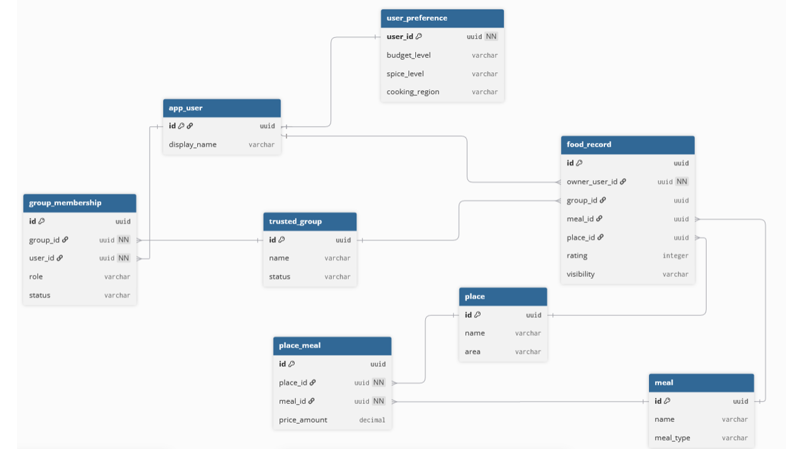
Data Model — High-Level ER Diagram - Data Foundation
FoodMind · Team 5
7

Slide 6
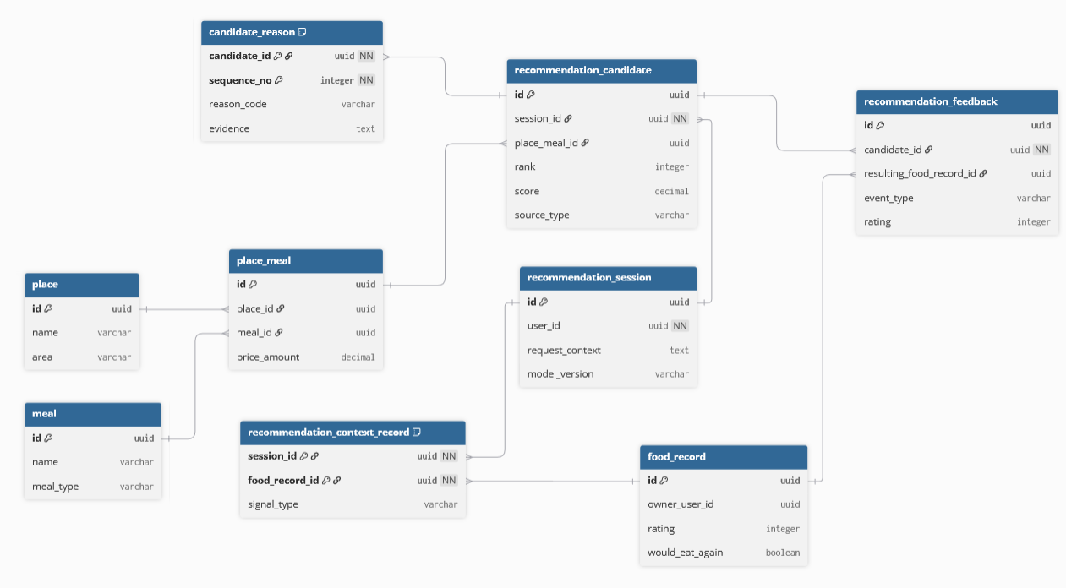
Data Model — High-Level ER Diagram - Personalized Recommendation
FoodMind · Team 5
7

Slide 7
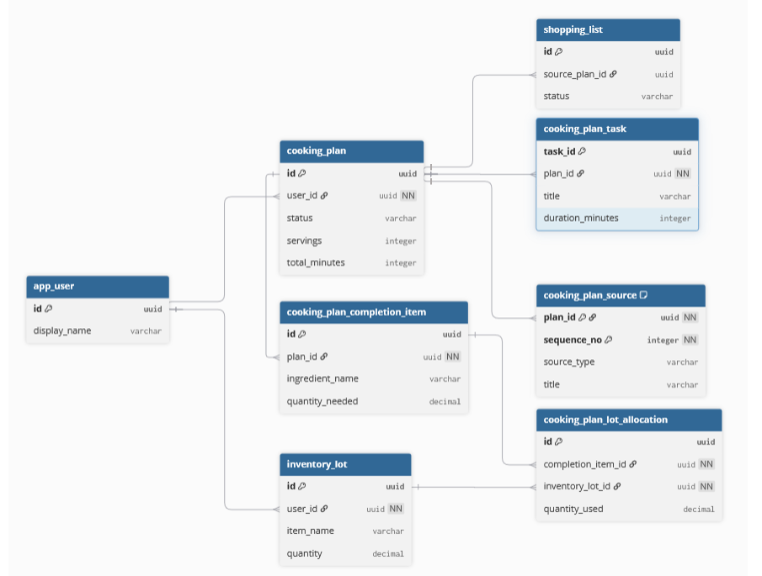
Data Model — High-Level ER Diagram - Agent Cooking Plan
FoodMind · Team 5
7

Slide 8
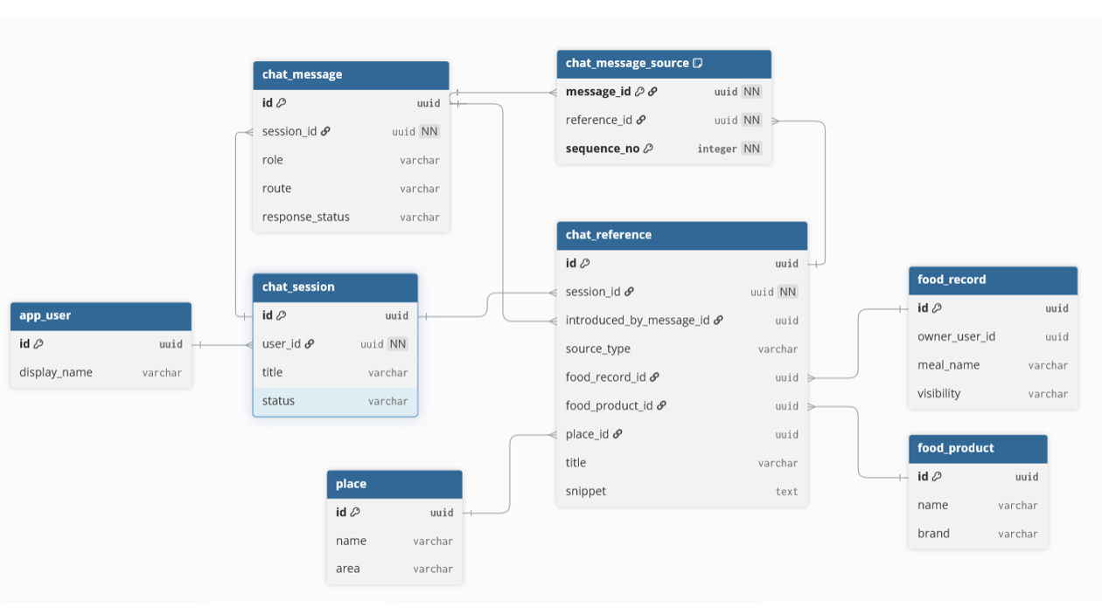
Data Model — High-Level ER Diagram - Grounded Chatbot
FoodMind · Team 5
7

Slide 9
Machine Learning

Slide 10
Hybrid Machine Learning Model
HARD RULES
Remove allergy / over-budget / repetition
MODEL FEATURES
LOGISTIC
REGRESSION
P(Accept)
Descending Ranking
UserCF
Similar users: "What do similar users like?"
ItemCF
Similar meals: "What meals are similar to meals I liked?"
Context
preference, want_to_try, group_preference, group_eligible_member_count, context_match, cleanliness_observed
Start dataset. Yelp Open Dataset
We also utilize LLM here.
It cannot invent evidence but only organize the result.
FOODMIND • TEAM 5
08
Notes:
Our Hybrid Model combines rules, Collaborative Filtering and Logistic Regression.
We first build a user-meal interaction matrix. User-based CF asks, “What do users with behaviour similar to mine enjoy?” Item-based CF asks, “Is this candidate behaviourally similar to meals I liked?”
Both CF scores become Logistic Regression features. Other features include cuisine match, spice compatibility, price, location, meal time, ratings and repetition.
Logistic Regression learns the importance of these features and estimates the probability that the user will accept each valid candidate. We therefore avoid guessing a fixed CF-to-LR ratio.
For a new user or meal, CF may be unavailable. Availability flags identify missing scores, so the model falls back to preferences, context, seed data and rules. Missing CF data is not treated as dislike.
Verified evidence and strong positive model contributions become reason codes. The Agent explains these codes but cannot invent evidence.
We will evaluate the classifier with a confusion matrix, precision, recall, F1 and ROC-AUC. Any simulated prototype data will be disclosed.

Slide 11
ML Evaluation
Metric | Majority (val) | Hybrid LR (val) | Hybrid LR (test)
Accuracy | 0.9925 | 0.9925 | 0.9815
Precision | 0.9925 | 0.9925 | 0.9815
Recall | 1.0000 | 1.0000 | 1.0000
F1 | 0.9962 | 0.9962 | 0.9907
ROC-AUC | 0.5000 | 0.5568 | 0.8068
Dataset
Train: 48,379
Validation: 266
Test: 270
19 engineered features
user_cf / item_cf scores + availability, preference, context, price, distance, history
Honest limitations
The dataset is heavily imbalanced (positive majority); the validation set contains no true negatives, so validation ROC-AUC is weak.
Cold start and insufficient collaborative data fall back to preference/context features and a deterministic ranking.
FoodMind · Team 5
10

Slide 12
Agent

Slide 13
Intelligence Services Design
01
02
03
RECOMMENDATION
COOKING
CHATBOT
Recommendation Agent
+
Inference Service
Cooking Planner Agent
Grounded Chatbot
Uses ingredients, recipes, time, budget and dietary constraints to build a feasible cooking plan.
Routes food-related requests to search, summary or comparison workflows using backend APIs and generate responses.
A bounded Recommendation Agent orchestrates a fixed LangGraph workflow, calls the private Inference Service once, validates model output, and returns explainable ranked recommendations.
LangGraph manages the Recommendation and Cooking workflows.Each Intelligence service applies bounded routing, timeouts, authorisation and traceable execution.
FOODMIND • TEAM 5
07
Notes:
FoodMind has three AI entry points: recommendation, cooking and platform exploration.
The Recommendation Agent calls retrieval, filtering and ranking tools, then explains the result. The Cooking Planner Agent uses ingredients, time, budget and dietary rules to retrieve a seed recipe and produce practical steps.
The independent Chatbot uses three Agents. Its Orchestrator delegates to the Platform Search Agent or Content Summary Agent. They search, summarise or compare authorised Meal Notes, Food Products and Places while keeping source references.
LangGraph manages state, routing, timeouts and traces. Agents use only allow-listed tools, cannot access PostgreSQL directly and cannot cross into another AI workflow. This keeps the system controlled and testable.

Slide 14
Backend

Slide 15
Review
- Authenticates users and services
- Enforces ownership, group visibility and business rules
- Coordinates persistence, recommendations, cooking, chat and media

Slide 16
JWT Security
We did a special design. Use two different tokens
Short-lived Access JWT
Send to client
15 minutes
Used on every protected API request
Fast verification
Long-lived Refresh Token
Only in database
30 days
Used only at /auth/refresh
Hashed, rotated and revocable
Hacker
Client
Server
Long-lived Token
Short-lived Token 1
Short-lived Token 1
Short-lived Token 2
Short-lived Token 2

Slide 17
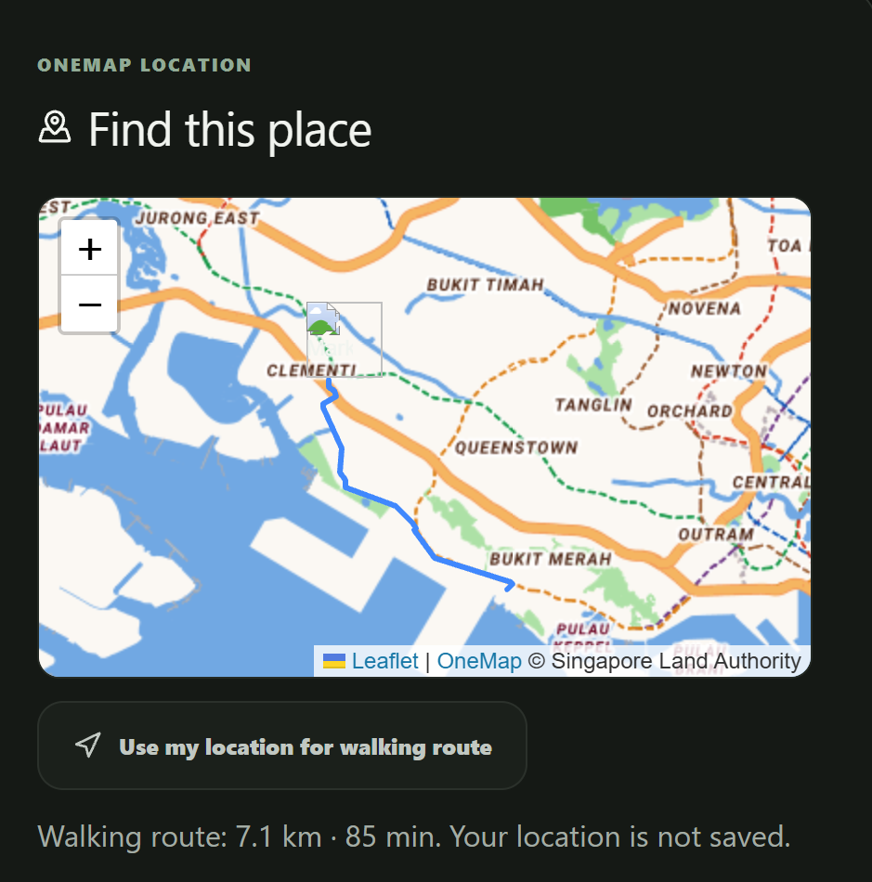
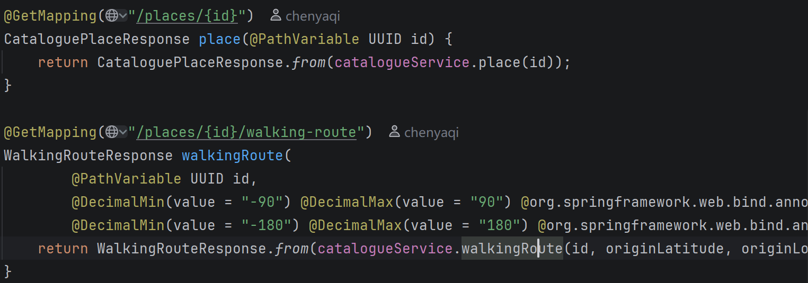
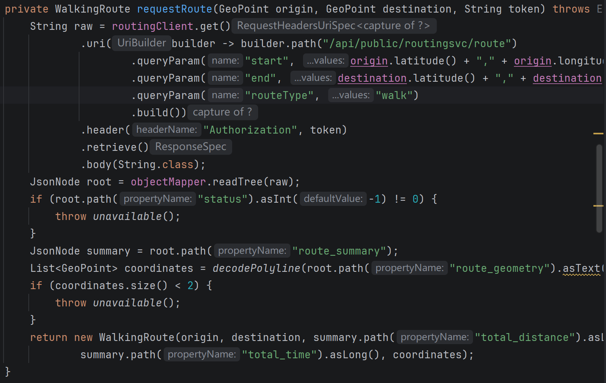
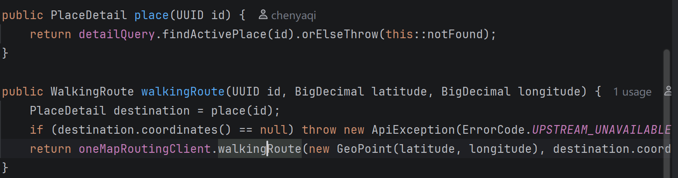
3rd API --- OneMap API (www.onemap.gov.sg)
We use this to implement Map Service

