Slide 1
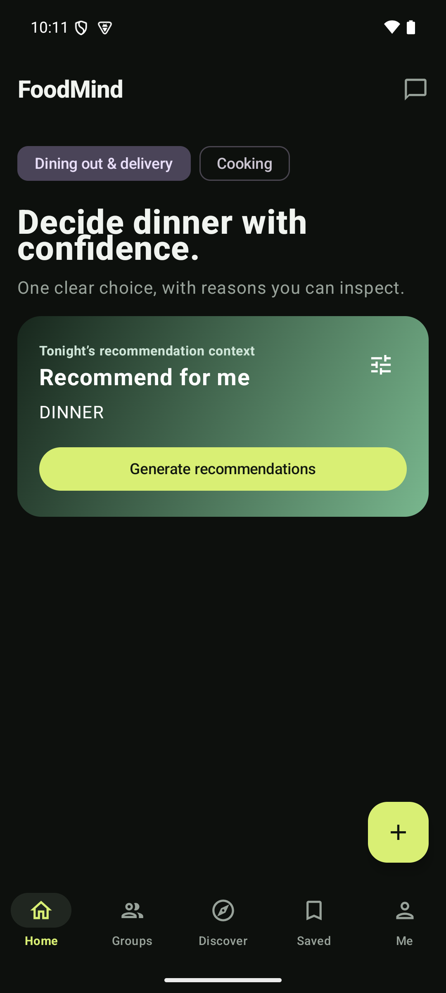
FOODMIND
What to eat.
How to cook it.
FoodMind connects personal taste, trusted groups, recommendations and guided cooking in one everyday experience.
PROJECT TEAM
Chen Yaqi A0335050U
Lei Tianyou A0335067A
Wu Aomo A0335088X
Chen Chen A0335082J
Huang Qijun A0335061N
Deng Yunke A0335081L
Luo Yuxiang A0335071M
FEATURE-LED LIVE DEMO
20 AUG 2026 · CURRENT PRODUCT
Notes:
FoodMind begins with a very ordinary question: what should I eat today? The problem is not a lack of options. It is the effort of turning personal taste, the current situation, and other people's suggestions into one confident choice. FoodMind brings that journey together. It helps users decide, share with people they trust, and, when they want to cook, move from a recipe to a plan they can actually follow. [Demo cue] Keep the live product on the Home screen while this opening is delivered. [Sources] - Android screenshot captured from the current local product on 2026-08-20: assets/android-home.png [/Sources]

Slide 2
WHY FOODMIND
A daily question becomes a repeatable habit
Food choices are frequent, personal and easy to postpone. FoodMind turns history, trusted group context and cooking intent into one clear next step.
LESS
FIT
LOOP
decision friction
personal relevance
repeat engagement
From “what should I eat?” to a clear starting point.
Records and feedback make future choices more useful.
Discover → decide → record → learn.
That adds up to a business worth building, not just a helpful feature — more on the next page.
Notes:
This is valuable because the decision happens repeatedly. A useful answer today can become a record, feedback, and better context for tomorrow. For users, that means less daily friction and more relevant choices. For the product, it creates a repeat habit across two common situations: eating out and cooking at home. [Sources] - Current FoodMind product UI and project documentation; qualitative synthesis only, with no external market claims. [/Sources]

Slide 3
BUSINESS VALUE
Turning food data into business value
FoodMind turns food and nutrition data into personalized, actionable intelligence — helping businesses operate more efficiently, improve user experience, and unlock new growth opportunities.
EFFICIENCY
PERSONALIZATION
REVENUE / GROWTH
Less manual work, faster decisions
Recommendations tuned to each user
Sharper recommendations, stronger returns
FoodMind cuts the time spent on manual analysis, menu planning, nutrition judgment and user matching — so teams decide faster.
Using preferences, health goals and dietary restrictions, FoodMind delivers more precise recommendations — improving user experience and retention.
More precise food recommendations, user insight and operational optimization help food, health, retail and platform businesses lift conversion, repeat use and service capacity.
Notes:
FoodMind turns food and nutrition data into personalized, actionable intelligence, which creates value in three ways. First, efficiency: it cuts the time spent on manual analysis, menu planning, nutrition judgment and user matching, so teams decide faster. Second, personalization: using preferences, health goals and dietary restrictions, it delivers more precise recommendations that improve experience and retention. Third, revenue and growth: sharper recommendations and operational insight help food, health, retail and platform businesses lift conversion, repeat use and service capacity. [Sources] - Current FoodMind product UI and project documentation; qualitative synthesis only. No market size, revenue or conversion figures are stated or implied — those numbers are intentionally left out of the demo. [/Sources]

Slide 4
OVERVIEW
FoodMind supports the whole food journey
DECIDE
01
02
03
04
Recommend
Discover
Save
Groups
Context + reasons
Explore shared ideas
Want to Try shortlist
Trusted sharing
COOK
01
02
03
04
Recipes
Cooking
Records
Insights
Import and review
Recover, plan, execute
Food & Drink history
Recap + Assistant
The next pages walk through Explore, Recommendation, Cooking, then everything else under Feature 4.
Notes:
Before we focus on the main features, this slide shows the complete product. Users can discover ideas, save a Want to Try shortlist, create Food and Drink records, share within trusted groups, request recommendations, manage recipes, generate cooking plans, and return to history, weekly insights and the Assistant. [Demo cue] Briefly show the bottom navigation and the More or profile feature list. [Sources] - Current FoodMind product UI and project documentation. [/Sources]

Slide 5
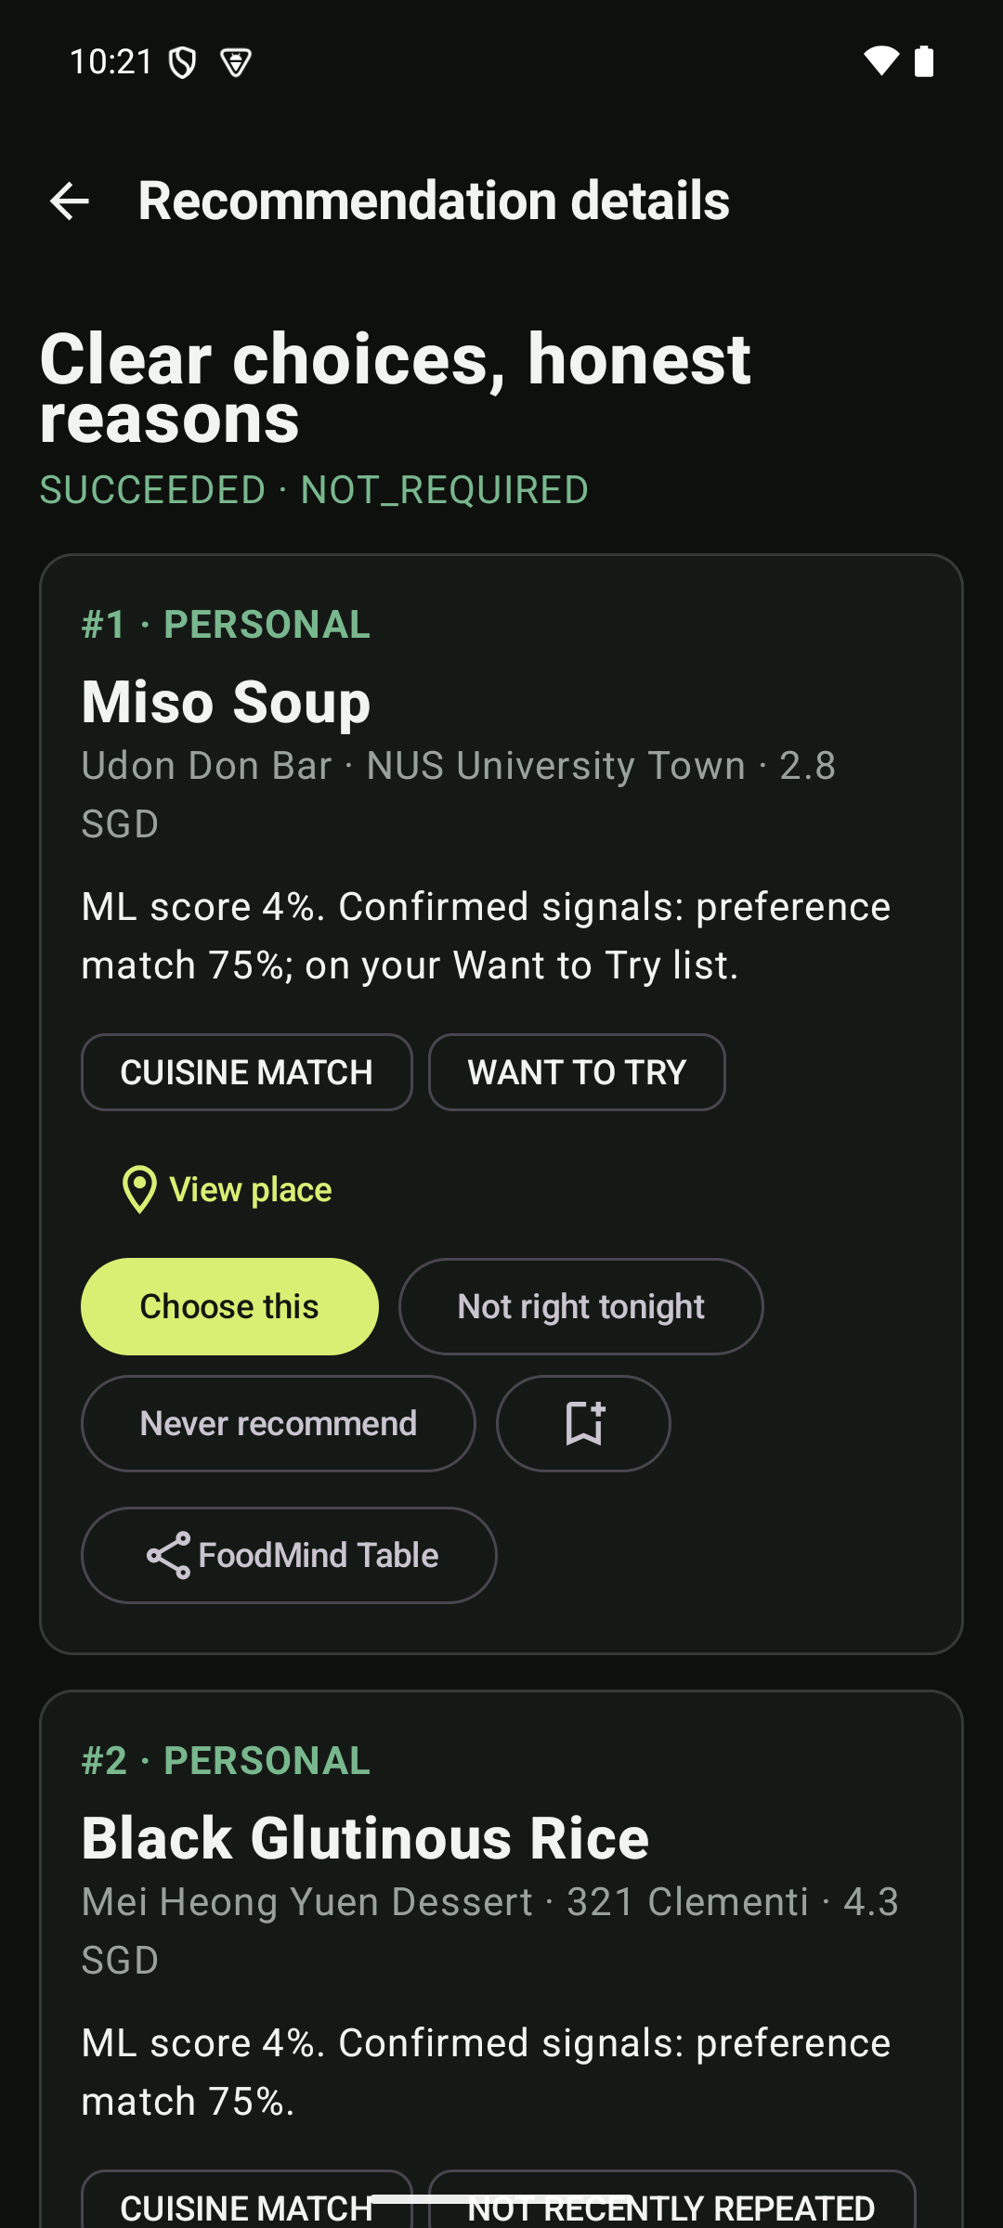
FEATURE 1 · RECOMMEND
DECIDE
Tonight’s context becomes one explained choice
WHEN
AREA
BUDGET
Tonight
Any area
Flexible
Miso Soup — at Udon Don Bar · $2.80
The leading pick, two alternatives, and named reasons — cuisine match, Want to Try, preference match. Choose it, say it’s not right tonight, or turn it into a saved record.
BUSINESS VALUE every accepted or rejected result sharpens data competitors don’t have.
Notes:
The second main feature is recommendation. The user starts with clear context: when they want to eat, the area, and how flexible the budget is. The result still leaves the user in control — a leading choice, alternatives, and reasons that explain why each option may fit. [Demo cue] Start a recommendation from Home, submit the context, then open Recommendation details and choose or share the result. [Sources] - Android screenshot captured from the current local product on 2026-08-20: assets/android-recommend-detail.png [/Sources]

Slide 6
FEATURE 1 · RECOMMEND
MODEL
Under the hood: a hybrid model, not a black box
TECHNICAL CHALLENGE
Hybrid recommendation model combining collaborative filtering with content features to enable personalized ranking
Sparse collaborative data during cold start, while maintaining recommendation quality
Feature version consistency between training and inference, to avoid discrepancies in production results
HARD RULES
Allergy Over-budget Repetition
COLLABORATIVE FILTERING
UserCF ItemCF Context
LOGISTIC REGRESSION
P(Accept)
Descending Ranking
Notes:
Here's how the ranking actually works. UserCF and ItemCF each contribute a similarity signal — what similar users liked, and what meals are similar to meals this user already liked. Those signals, plus context, feed a logistic-regression scorer that outputs P(accept), which is the ML score shown on screen, and results are ranked by that score. Hard rules for allergy, budget and repetition run before ranking, so the model only ever ranks options the user could actually accept. The honest technical difficulty: the training set is heavily imbalanced and thin for cold-start users, so validation ROC-AUC alone isn't a reliable signal on its own — for those cases the team falls back to a deterministic preference and context ranking rather than letting the model guess. [Demo cue] Point back to the “ML score” and named signals already visible on the Recommendation details screen. [Sources] - Android screenshot captured from the current local product on 2026-08-20: assets/android-recommend-detail.png ("ML score", "cuisine match", "preference match"). - Team-authored technical reference (uploaded by the user): Final_Presentation_CodeQuality.pptx — "Hybrid Machine Learning Model" (UserCF, ItemCF, logistic regression, hard rules) and "ML Evaluation" (Train 48,379 / Validation 266 / Test 270, 19 engineered features, class imbalance and cold-start limitations) slides. [/Sources]

Slide 7
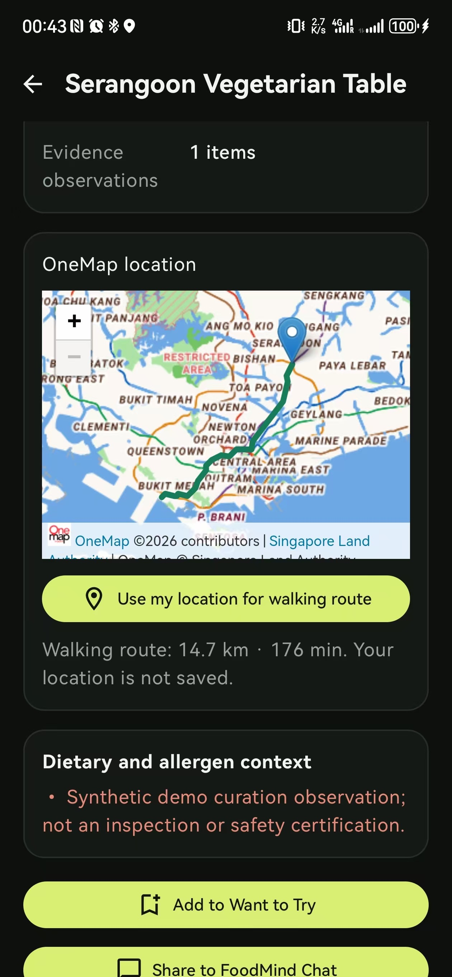
FEATURE 1 · RECOMMEND
MAP
Every result comes with a real route and a safety note
Each recommendation is grounded in a real OneMap location so users can see exactly where a suggestion sits, paired with an on-demand walking-route estimate
Consistence Map Experience
Deliver a unified map experience across Web and Android platforms, enabling seamless OneMap integration.
Coordinate Order Conversion
Convert the latitude/longitude order in GeoJSON data to ensure walking routes are rendered correctly.
Location Privacy Protection
Ensure user coordinates are never persisted, safeguarding privacy for the map location feature.
Notes:
Recommendation isn't just a name and a score. Each result resolves to a real OneMap location, so the user can see exactly where it is. A walking-route estimate — distance and time — is computed from the user's location on request and isn't saved without consent. Dietary and allergen context can be attached too, but it's clearly labeled as a curation observation, not an inspection or safety certification, so the app never overstates what it knows. [Demo cue] Open a recommendation result, show the OneMap location and walking-route estimate, then point out the dietary and allergen note and its disclaimer. [Sources] - Android screenshot captured from the current local product on 2026-08-20: assets/android-location-safety.jpg (screen: "Serangoon Vegetarian Table", OneMap location, walking route, Dietary and allergen context). [/Sources]

Slide 8
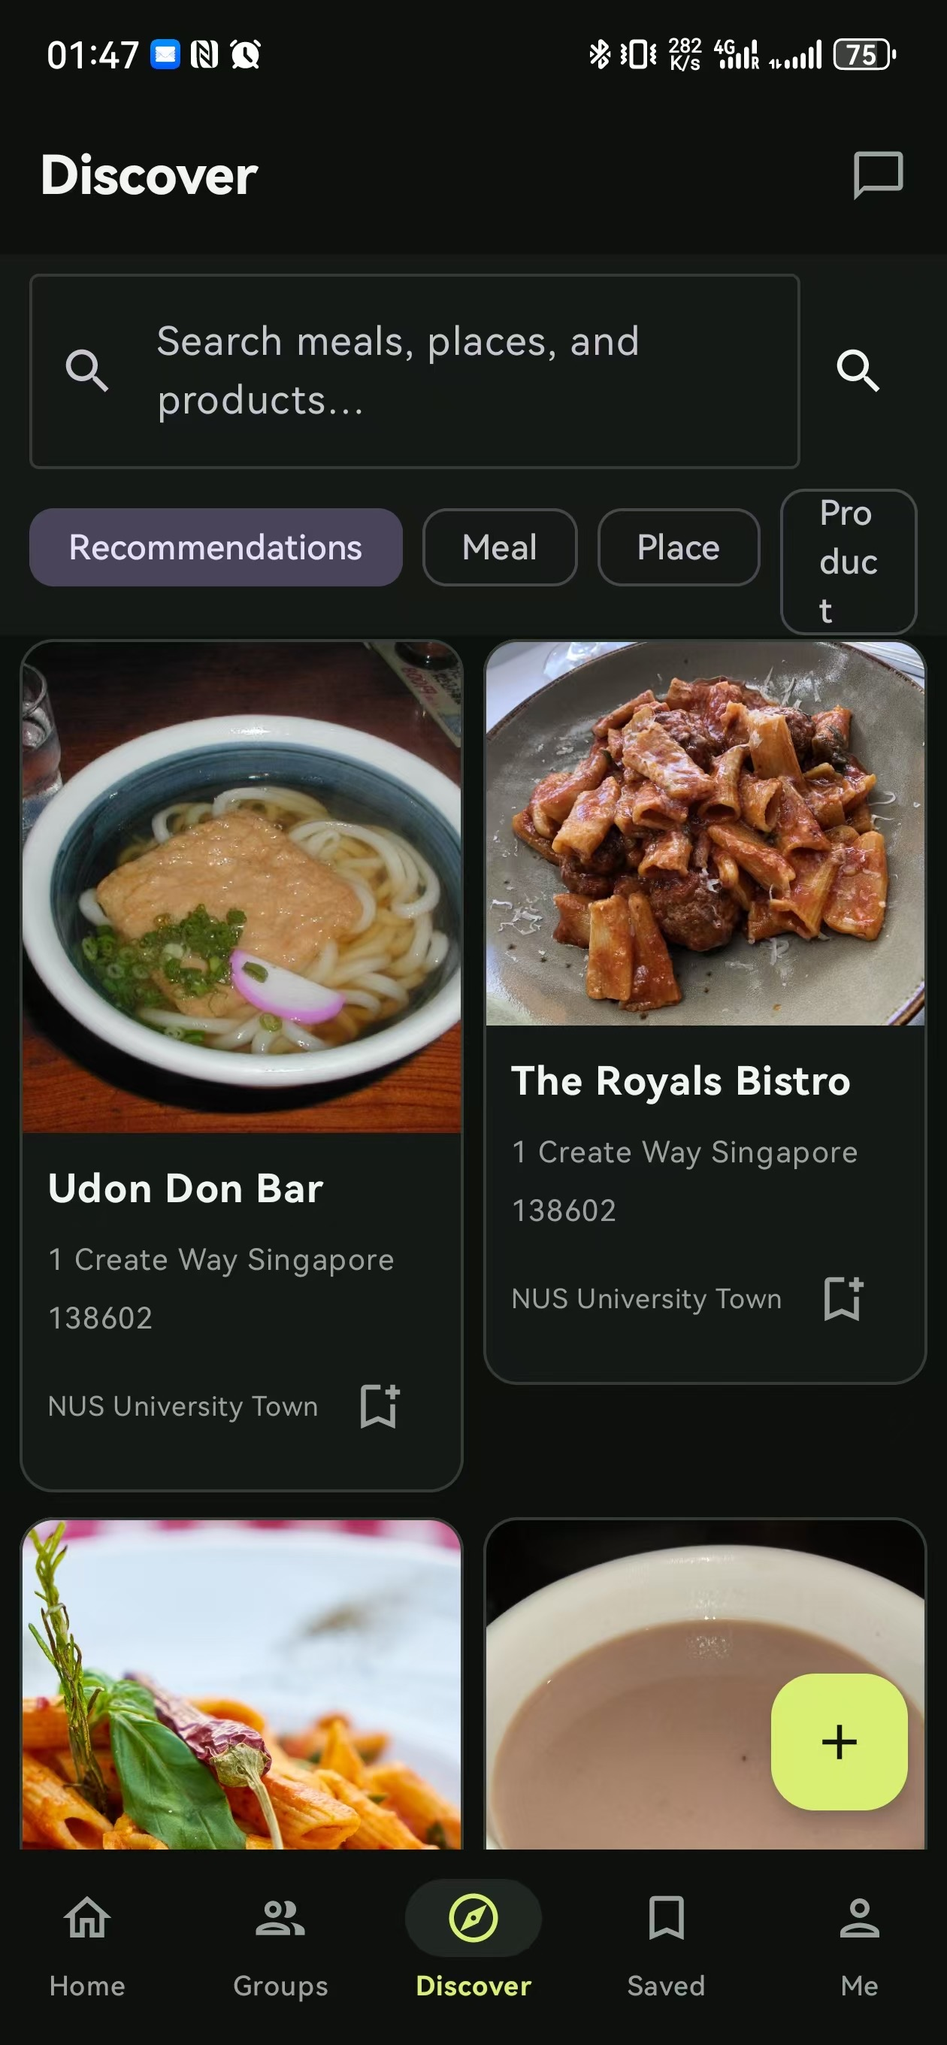
FEATURE 2 · EXPLORE
DISCOVER
Browsing turns into a shortlist, not just scrolling
Search and curated places, side by side
Explore lets a user search meals, places and products directly, or browse curated places like Udon Don Bar and The Royals Bistro without typing anything.
One tap to keep an idea
Anything interesting is saved straight to Want to Try, ready to resurface the next time a decision comes up.
BUSINESS VALUE every search and save is a preference signal that sharpens later recommendations.
Notes:
The first main feature is Explore. Users can search meals, places and products directly, or browse curated places without typing anything. Anything interesting is saved straight to a Want to Try shortlist, ready to resurface later. [Demo cue] Open Discover, search or browse a curated place, then save it to Want to Try. [Sources] - Android screenshot captured from the current local product on 2026-08-20: assets/android-discover.png [/Sources]

Slide 9
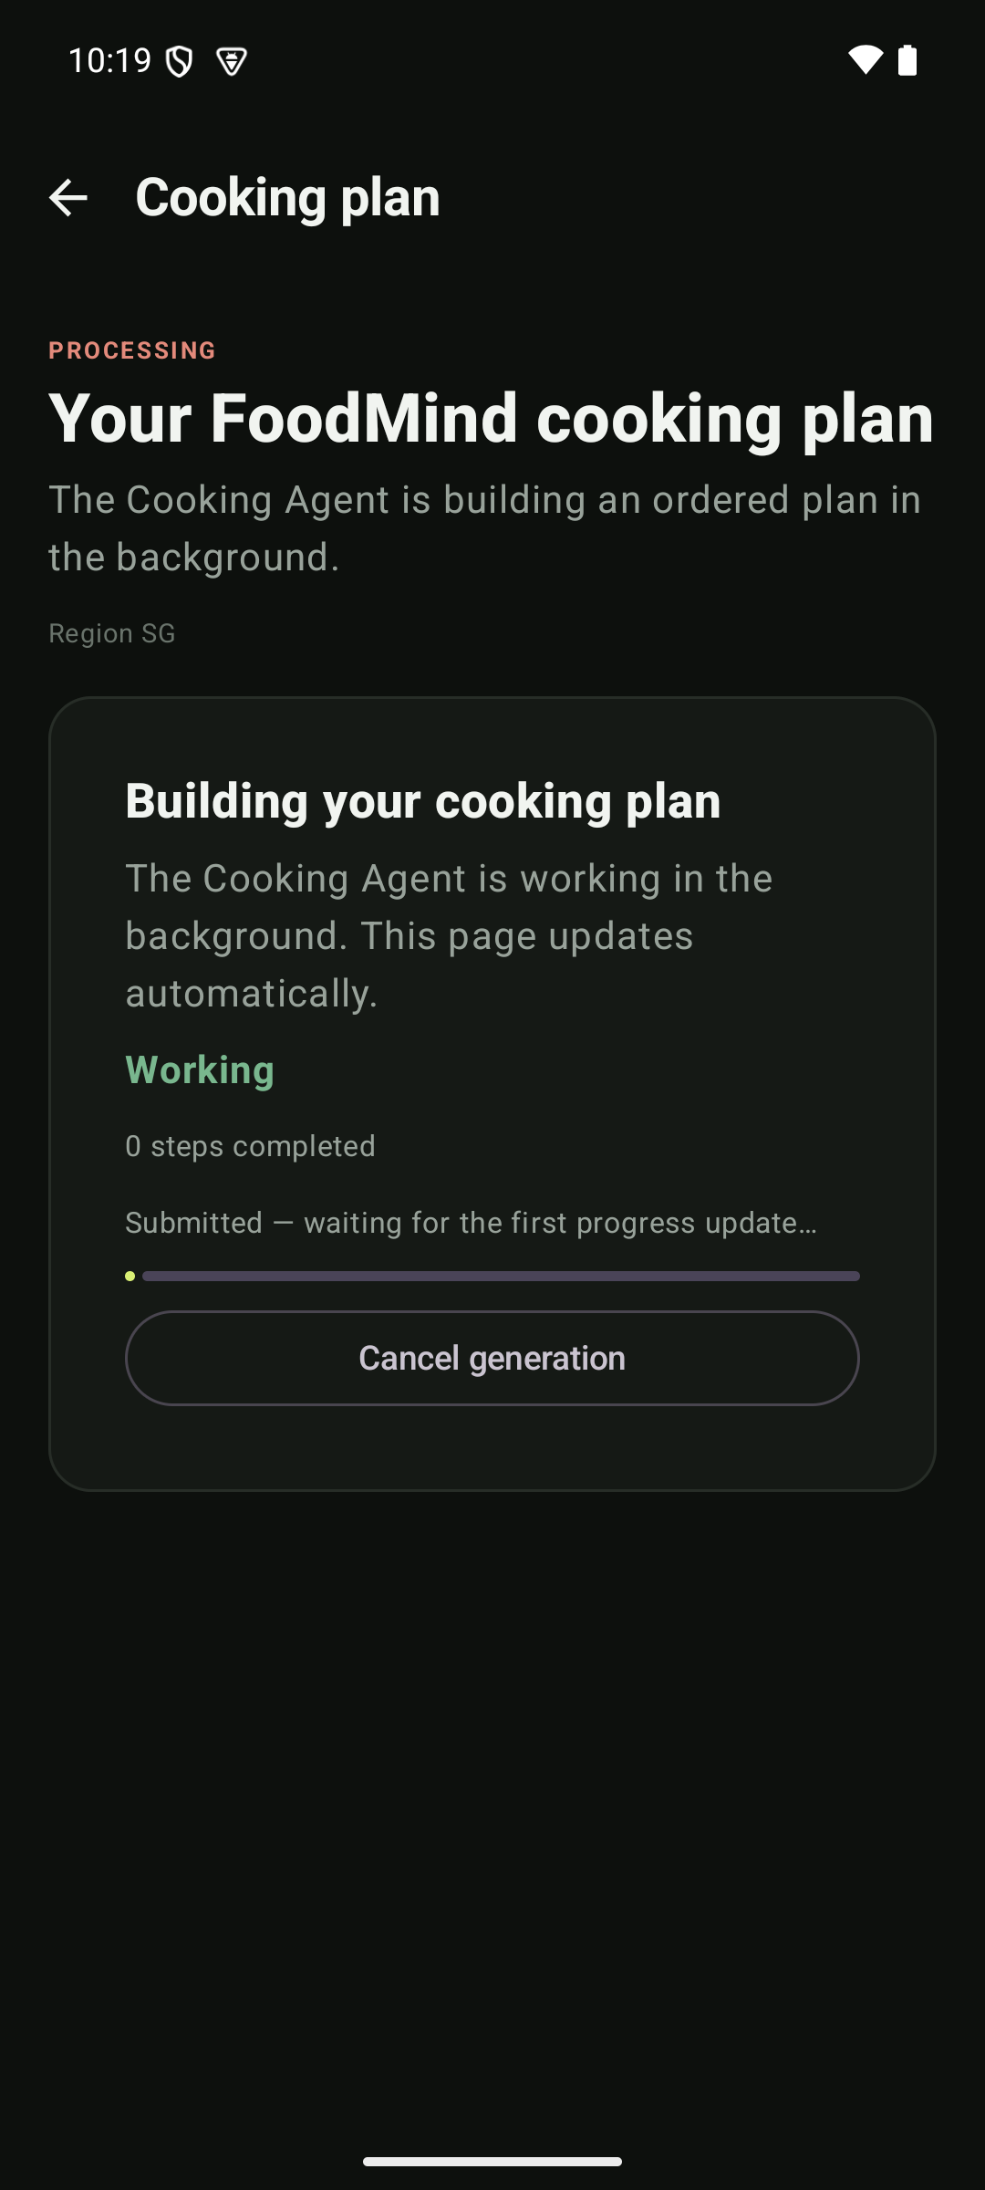
FEATURE 3 · COOKING
COOK
Cooking recovers from real constraints, then finishes with a plan
1
Paste a recipe
Any language, reviewed before saving.
2
Something’s missing
The Cooking Agent pauses and asks — reduce servings, or buy what’s missing.
3
Ready to cook
A solver-optimal task order with a live makespan comes out the other end.
BUSINESS VALUE a finished plan turns one recommendation into a repeatable, higher-effort habit.
Notes:
The third main feature is Cooking. It begins with a recipe the user already understands, entered in their own words. Cooking rarely goes exactly as planned — if ingredients are missing, the Cooking Agent pauses and asks rather than silently guessing. Once resolved, FoodMind produces an ordered, ready-to-cook plan. [Demo cue] Show Add recipe, generate a plan, resolve Needs confirmation by buying missing ingredients, then open the Ready plan. [Sources] - Android screenshot captured from the current local product on 2026-08-20: assets/android-final-plan.png. Supporting screens shown live: recipe entry/review, shopping list, and the Ready plan. [/Sources]

Slide 10
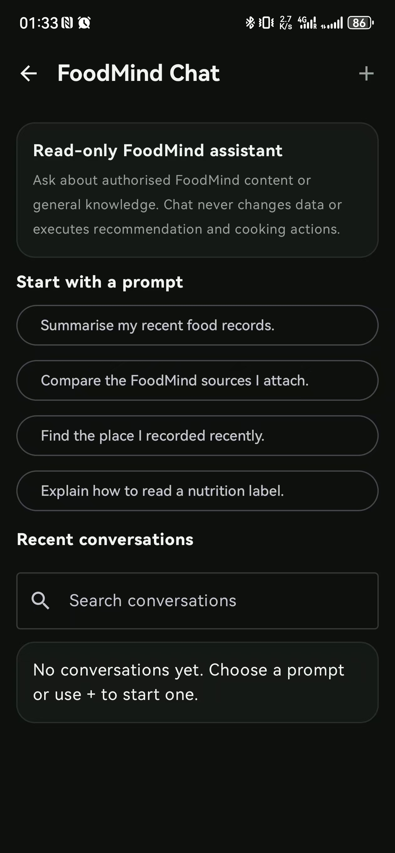
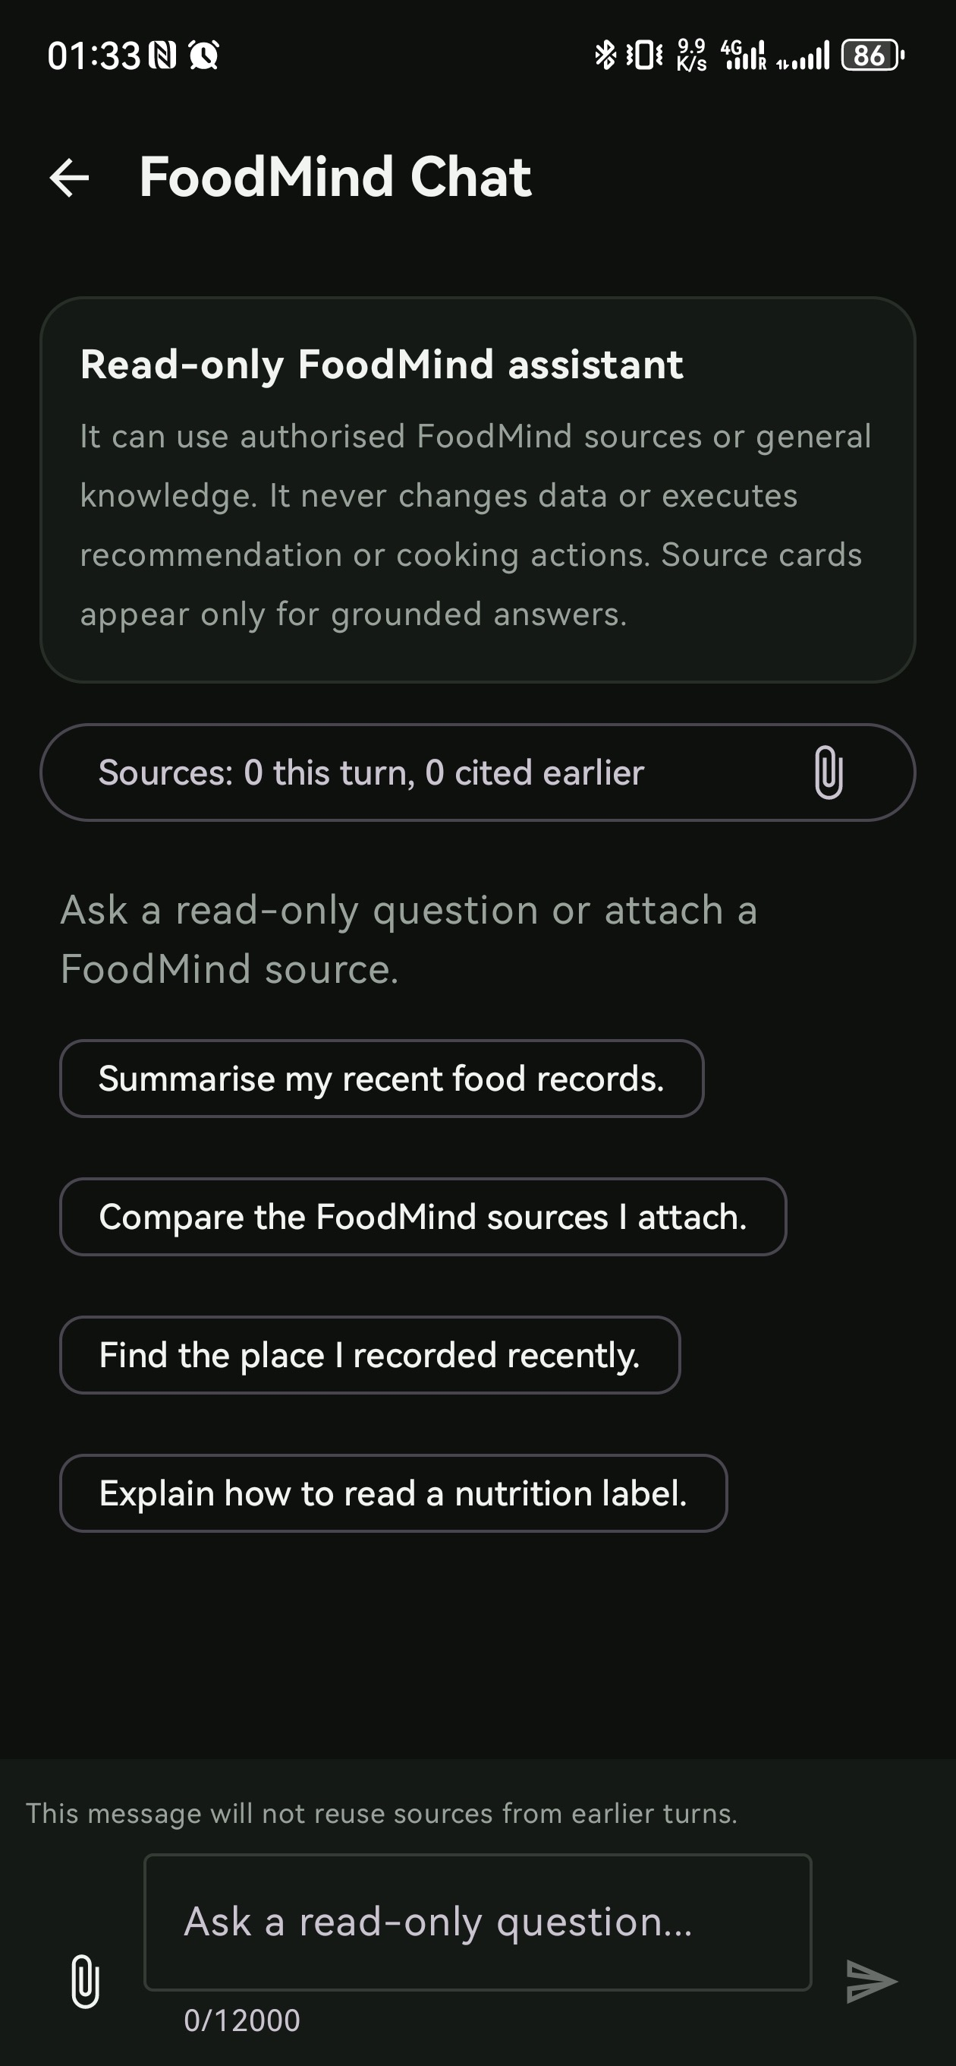
FEATURE 4 · CHATBOT
CHAT
A read-only assistant, grounded in your own data
Prompts open the door
Four suggested prompts — summarise records, compare attached sources, find a recent place, or ask a general nutrition question — show what’s in scope without the user guessing.
Read-only, and it says so
It can use authorised FoodMind sources or general knowledge, but never changes data or executes a recommendation or cooking action; source cards appear only for grounded answers, and don’t carry over between turns.
BUSINESS VALUE an assistant that only reads and cites its sources is safer to trust with real user data — and easier to explain to a reviewer.
Notes:
The Assistant is deliberately narrow. It opens with four suggested prompts — summarise records, compare attached sources, find a recent place, or ask a general nutrition question — so the scope is obvious before the user types anything. Every screen restates the same boundary: it can use authorised FoodMind sources or general knowledge, but it never changes data or executes a recommendation or cooking action. Source cards only appear for grounded answers, and each message states it will not reuse sources from earlier turns. [Demo cue] Open the Assistant, tap a suggested prompt, then point out the “Read-only FoodMind assistant” banner and the sources counter. [Sources] - Android screenshots captured from the current local product on 2026-08-21: assets/android-chatbot-prompts.jpg (FoodMind Chat: "Read-only FoodMind assistant", "Start with a prompt", "Recent conversations"), assets/android-chatbot-compose.jpg ("Sources: 0 this turn, 0 cited earlier", "This message will not reuse sources from earlier turns."). [/Sources]

Slide 11
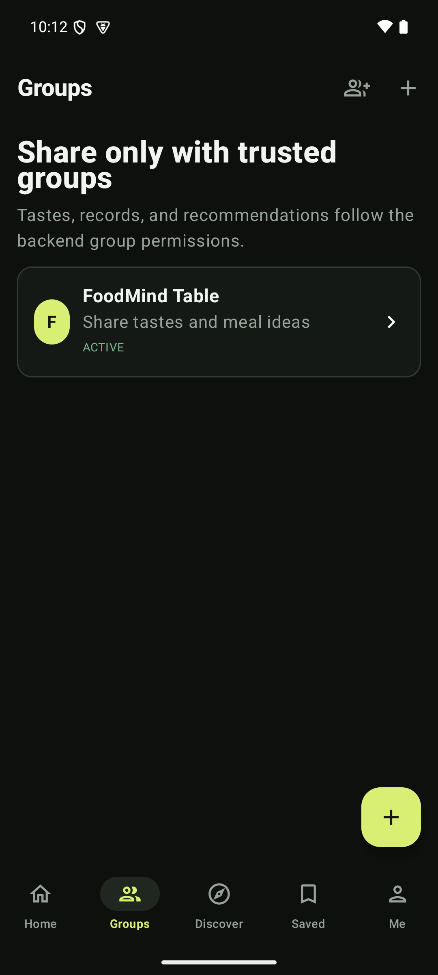
FEATURE 4 · EVERYTHING ELSE
LEARN
The rest of the loop
Trusted group sharing
Members share tastes, records and meal ideas inside a circle they chose — private by default, shared only when the user opts in.
Records management
Food and Drink records can be created, edited or deleted directly — Cooking, Insights and Recommendation all read from the same accurate history.
BUSINESS VALUE a controllable social graph and a clean records base are the quiet infrastructure the rest of the product's data moat depends on.
Notes:
Everything outside the three main features still matters. Trusted group sharing lets a user create or join a circle and choose, record by record, whether it stays private or is shared. The Assistant is a grounded chatbot that routes to search, summary or comparison over the user's own data rather than answering as an open-ended model. Records management lets a user create, edit or delete Food and Drink records directly, and Cooking, Insights and Recommendation all read from that same accurate history. [Demo cue] Open Groups, enter FoodMind Table, then open the Assistant and Record management under Me. [Sources] - Android screenshot captured from the current local product on 2026-08-20: assets/android-groups-created.png. - Referenced but not re-displayed: assets/android-more-features.png (labels: "Assistant · Continue your FoodMind conversation", "Record management · Create, view, edit, or delete meal and drink records"). [/Sources]

Slide 12
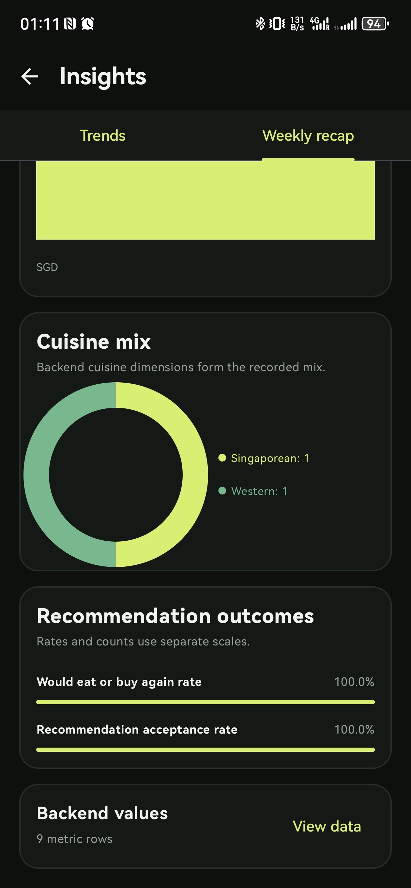
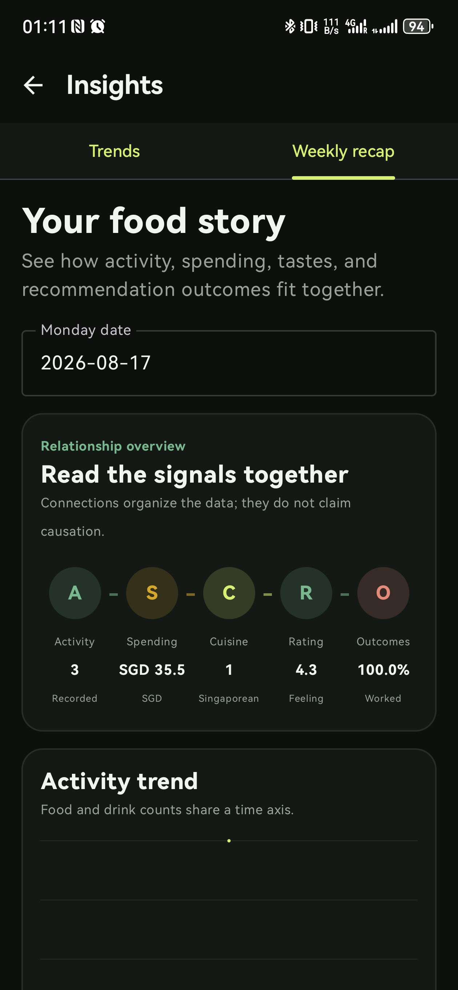
FEATURE 4 · EVERYTHING ELSE
INSIGHTS
The same history, read two ways
Weekly Recap is the report
Both screens are the Weekly Recap tab: a snapshot anchored to one Monday date, walking through cuisine mix, recommendation outcomes and a “food story” that connects activity, spending, cuisine, rating and outcomes.
Trends is the live dashboard
The Trends tab sits right next to it — the always-on view a user can open any time, reading the same underlying history without waiting for the week to end.
BUSINESS VALUE a live dashboard and a periodic report from one history keep users checking in for different reasons.
Notes:
Explore also covers Insights, and Insights makes the dashboard/report distinction directly: pictured here is the Weekly Recap tab, a snapshot anchored to one Monday date that walks through cuisine mix, recommendation outcomes and a “food story” connecting activity, spending, cuisine, rating and outcomes for the week. Right next to it is the Trends tab — the always-on dashboard view a user can open any time, reading the same underlying history without waiting for the week to end. [Demo cue] Open Insights, show the Trends tab, then switch to Weekly recap and scroll to the relationship overview. [Sources] - Android screenshots captured from the current local product on 2026-08-20: assets/android-discover-2.JPG (Insights → Weekly recap tab: Cuisine mix, Recommendation outcomes), assets/android-discover-3.JPG (Insights → Weekly recap tab: “Your food story” relationship overview, Activity trend). The Trends tab is visible as a UI label on both screenshots; its own content was not separately captured. [/Sources]

Slide 13
FOR TECHNICAL REVIEWERS
Three product decisions worth a closer look
The narrative above is for users. This page is for reviewers who want to know what is actually running underneath.
01
02
03
Hybrid ranking, not a black box
Agent-orchestrated, constraint-based planning
Grounded, not open-ended
Recommendations blend UserCF, ItemCF and a logistic-regression scorer under hard rule filters (allergy, budget, repetition) — each result carries named signals a user can inspect.
A bounded Cooking Planner Agent, orchestrated with LangGraph, treats planning as a scheduling problem over recipes, servings and inventory and returns a solver-optimal task order.
The Chatbot and Recommendation Agent are routed workflows over authorised backend tools, not a free-form LLM — responses stay traceable to the user’s own data.
Notes:
This page is for technical reviewers. First, ranking is a hybrid of UserCF, ItemCF and a logistic-regression scorer, filtered by hard rules, so a result can point to the reason it was shown. Second, cooking plans come from a bounded Cooking Planner Agent orchestrated with LangGraph, solving a scheduling problem over recipes, servings and inventory. Third, the Chatbot and Recommendation Agent are routed, tool-using workflows rather than open-ended generation, so responses stay grounded in the user's own data. The team can go deeper live if reviewers want to trace any of the three. [Sources] - Android screenshots captured from the current local product on 2026-08-20 and 2026-08-21: assets/android-recommend-detail.png, assets/android-final-plan-ready.png, assets/android-recipe-review.png, assets/android-chatbot-compose.jpg. - Team-authored architecture reference (uploaded by the user): Final_Presentation_CodeQuality.pptx — Hybrid Machine Learning Model, Intelligence Services Design and Recommendation/Cooking Agent Workflow slides. Descriptions here are intentionally kept high-level; implementation depth is covered verbally by the team. [/Sources]

Slide 14
SUMMARY
What FoodMind is, and what makes it work
MAIN FEATURES
IMPLEMENTED TECHNOLOGY
Explore & Save
Hybrid ranking
Search or browse curated places, keep a Want to Try shortlist.
UserCF + ItemCF + logistic regression, hard rules.
Insights & Recap
Agentic, constraint-based planning
A live Trends dashboard and a periodic Weekly Recap report.
LangGraph Cooking Agent, solver-optimal order.
Recommendation
Grounded chatbot & recommendation agent
Context in, a ranked, explained choice out.
Routed workflows, not open-ended generation.
Cooking
Permission-aware sharing
Free-text recipes become an executable plan.
Group visibility enforced by the backend.
Groups, Records & Chat
One product, two surfaces
Trusted-circle sharing, records, and a read-only assistant.
One consistent experience, Android and web.
Notes:
As a summary: on the left, the main features that make up the everyday loop. On the right, the technology decisions that make those features work — hybrid ranking, agentic constraint-based planning, a grounded chatbot and recommendation agent, permission-aware sharing, and one consistent product across mobile and web. [Sources] - Current FoodMind product UI and project documentation; feature list matches Slide 4, technology list matches Slides 8, 12 and 13 and the team-authored Final_Presentation_CodeQuality.pptx. [/Sources]

