Slide 1
AD PROJECT • TEAM 5
FoodMind
Personalized food decision support
Turning personal experience and trusted group knowledge into faster everyday choices.
Team Member | Matric Number
Chen Yaqi | A0335050U
Wu Aomo | A0335088X
Huang Qijun | A0335061N
Luo Yuxiang | A0335071M
Lei Tianyou | A0335067A
Chen Chen | A0335082J
Deng Yunke | A0335081L
Notes:
Good afternoon, everyone. We are Team 5, and our proposed project is called FoodMind, a meal-decision and food-insight platform.
Before explaining the system, I would like to show where our idea came from.

Slide 2
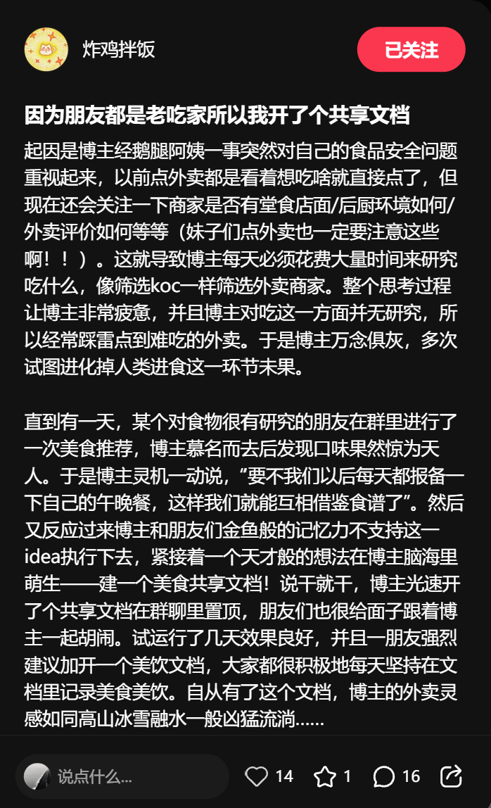
A shared document solved a real daily problem
This project was inspired by this Xiaohongshu (Chinese social media) post.
The post roughly means:
After the food quality incident, I became much more conscious of food safety. In the past, I simply ordered whatever looked good. Now, I also check whether a restaurant has a physical dine-in location, what its kitchen is like, and what delivery customers say about it.
As a result, I spent a huge amount of time every day researching what to eat and carefully vetting delivery restaurants. The whole process was exhausting. Since I was no food expert, I still often ended up ordering disappointing meals. I became so frustrated that I wished humans could evolve beyond the need to eat food—but, unfortunately, that never happened.
Then one day, a foodie friend recommended a restaurant in our group chat. I tried it, and the food was incredible. That gave me an idea: why not share what we eat for lunch and dinner every day, so we can give one another meal ideas?
However, our goldfish-like memories made this difficult, so I created a shared food document and put it in our group chat. My friends enthusiastically joined in, recording good meals, restaurants, and later drinks as well. It worked so well that, ever since, I have never run out of inspiration for what to order.
“We often don’t know what to eat, so I created a shared document in WeChat group."
They use this document to preserve good meals, restaurants and drinks.
Then they can learn from each other and decide what to eat quickly.
FOODMIND • TEAM 5
02
Notes:
This is a real post from Xiaohongshu, a Chinese social media platform. Its title roughly means, “My friends are serious foodies, so I created a shared document.”
The blogger used to order whatever looked appealing. After seeing a widely discussed story about a food vendor, however, they became more conscious of food safety. They began checking whether a restaurant had a good hygienic environment, what its kitchen looked like, and what delivery customers said.
Every meal decision became a research task. It took a lot of time and mental energy, but the blogger still sometimes ordered disappointing food. They even joked that they should evolve beyond the need to eat food.
One day, a friend who knew a lot about food recommended a restaurant in their group chat. The blogger tried it and found the food excellent. The group then created a shared food document to preserve good meals, restaurants and drinks.
This is one real-life example.
[Sources]
- User-provided Xiaohongshu post and shared-document screenshots from the FoodMind proposal source materials.

Slide 3
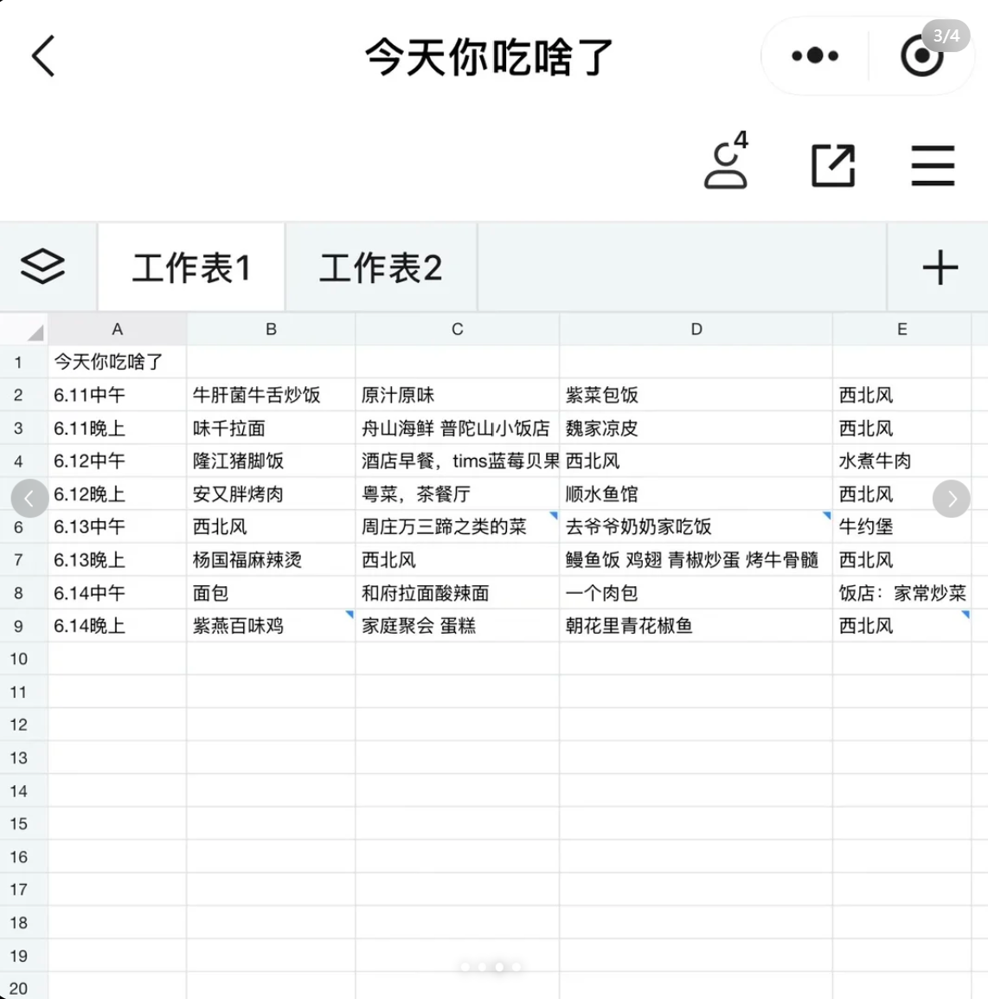
The shared document was still manual
01
Time cost
Every meal became a research task.
02
Scattered evidence
Reviews, hygiene cues, preferences and history lived in different places.
03
Still manual
Users had to search, compare and choose by themselves.
The need: reusable, personalised decision support.
FOODMIND • TEAM 5
03
Notes:
Ok, let look at this table. This is their shared document. The first row is June Eleven Lunch. Group Member B ate this one. Group Member C ate this one. Member D ate this one. And so on…
This document looks very useful so far. But it still need people to manually maintain it. This will cost a lot of time. And once the number of records become large, it becomes difficult for them to retrieve.
Our goal is to reuse this trusted datasource and support faster and more personalised decisions.
[Sources]
- User-provided shared food-record screenshot from the FoodMind proposal source materials.

Slide 4
We creates a continuous decision loop
RECORD
UNDERSTAND
ACT
Record
& share
Retrieve trusted
datasource
Filter
Explain
& Decide
Feedback
Learning loop
Same capabilities on Android and Web; one common backend keeps the experience and business rules consistent.
FOODMIND • TEAM 5
04
Notes:
This is our general workflow: record and share, retrieve, filter and rank, explain, choose or reject, rate and analyse.
Users can record food and drinks, keep posts private or share them with a trusted group. They can request recommendations, explore authorised content through a chatbot, and view personal insights.
The loop preserves useful experience and turns every explicit decision into feedback for later analysis and offline model updates.

Slide 5
How does this work?
1
CONTEXT
2
CANDIDATES
3
DECISION ENGINE
4
RESULT
Meal type • budget
area • mood • time
User history
authorised groups
seed catalogue
Rules remove invalid items
Hybrid Model ranks the rest
Options
ACCEPT / REJECT / RATE / WOULD EAT AGAIN
FOODMIND • TEAM 5
05
Notes:
Okay, how does this work?
First, the user select some conditions(Meal type, budget, area, so on…)
Then the system will use these things to filter out some candidates.
The machine learning model will choose the best result.
At last, The agent explains the result.

Slide 6
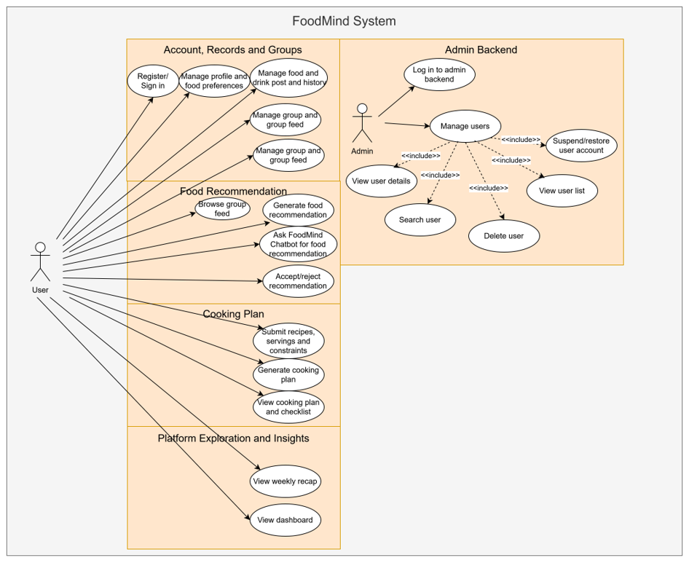
Use Cases Diagram
FOODMIND • TEAM 5
06
Notes:
This use-case diagram translates our proposed solution into a clear functional scope.
For normal users, the flow begins with registration, preferences and personal food records. Users can then manage trusted groups, browse authorised group content, generate recommendations, accept or reject them, request cooking plans, use the FoodMind chatbot, and review weekly recaps and dashboards.
The Admin path is separate and limited to account administration. This separation keeps normal user data and administrative functions under different permission rules.
The diagram also makes the three AI entry points visible: food recommendation, cooking planning and platform exploration. These use cases define the integrated MVP that the remaining slides explain.
[Sources]
- User-provided FoodMind use-case diagram, image(1).png.

Slide 7
Agents Design
01
02
03
RECOMMENDATION
COOKING
CHATBOT
Recommendation Agent
Cooking Planner Agent
Chatbot Orchestrator
Retrieves, filters, ranks
and explains meal options.
Platform Search Agent
Content Summary Agent
Uses ingredients, time, budget
and dietary rules to build a plan.
Authorised platform content only.
LangGraph manages state, routing, timeouts and traces. Agents use allow-listed tools and cannot cross into another AI workflow.
FOODMIND • TEAM 5
07
Notes:
FoodMind has three AI entry points: recommendation, cooking and platform exploration.
The Recommendation Agent calls retrieval, filtering and ranking tools, then explains the result. The Cooking Planner Agent uses ingredients, time, budget and dietary rules to retrieve a seed recipe and produce practical steps.
The independent Chatbot uses three Agents. Its Orchestrator delegates to the Platform Search Agent or Content Summary Agent. They search, summarise or compare authorised Meal Notes, Food Products and Places while keeping source references.
LangGraph manages state, routing, timeouts and traces. Agents use only allow-listed tools, cannot access PostgreSQL directly and cannot cross into another AI workflow. This keeps the system controlled and testable.

Slide 8
Hybrid Machine Learning Model
HARD RULES
Allergies • dietary restrictions • budget • spice • repetition
MODEL FEATURES
LOGISTIC
REGRESSION
ACCEPTANCE
PROBABILITY
UserCF
Similar users
ItemCF
Similar meals
Context
Cuisine • price • location • time
Start dataset. Yelp Open Dataset
Explanation: verified reason codes only.
The Agent cannot invent evidence.
FOODMIND • TEAM 5
08
Notes:
Our Hybrid Model combines rules, Collaborative Filtering and Logistic Regression.
We first build a user-meal interaction matrix. User-based CF asks, “What do users with behaviour similar to mine enjoy?” Item-based CF asks, “Is this candidate behaviourally similar to meals I liked?”
Both CF scores become Logistic Regression features. Other features include cuisine match, spice compatibility, price, location, meal time, ratings and repetition.
Logistic Regression learns the importance of these features and estimates the probability that the user will accept each valid candidate. We therefore avoid guessing a fixed CF-to-LR ratio.
For a new user or meal, CF may be unavailable. Availability flags identify missing scores, so the model falls back to preferences, context, seed data and rules. Missing CF data is not treated as dislike.
Verified evidence and strong positive model contributions become reason codes. The Agent explains these codes but cannot invent evidence.
We will evaluate the classifier with a confusion matrix, precision, recall, F1 and ROC-AUC. Any simulated prototype data will be disclosed.

Slide 9
Android and Web
Private FastAPI
Five Agents + Hybrid ML
Android
Kotlin + Compose
SpringBoot REST API
Authentication • permissions
business rules • validation • writes
Web
React + TypeScript
PostgreSQL
Guardrails
Deployment
• Spring Boot authorises every context
• Agents use allow-listed tools
• No direct Agent-to-database access
Vercel • ECS Fargate • RDS
FastAPI remains private.
FOODMIND • TEAM 5
09
Notes:
Android uses Kotlin and Jetpack Compose, while Web uses React and TypeScript. Both provide the same capabilities through one Spring Boot REST API.
Spring Boot is the only public business API. It owns authentication, authorisation, rules, search, analytics and database writes. PostgreSQL is the system of record. S3 stores optional photos, while PostgreSQL stores their keys and metadata.
FastAPI is private and runs LangGraph and scikit-learn. Spring Boot sends only authorised context. Pydantic validates structured AI outputs, and Spring Boot separately validates permissions, business rules and persistence.
Users therefore cannot call Agents directly, and Agents cannot retrieve arbitrary private data or write to the database.
Web runs on Vercel. Spring Boot runs on AWS ECS Fargate, FastAPI remains private, PostgreSQL uses RDS and S3 stores photos.

Slide 10
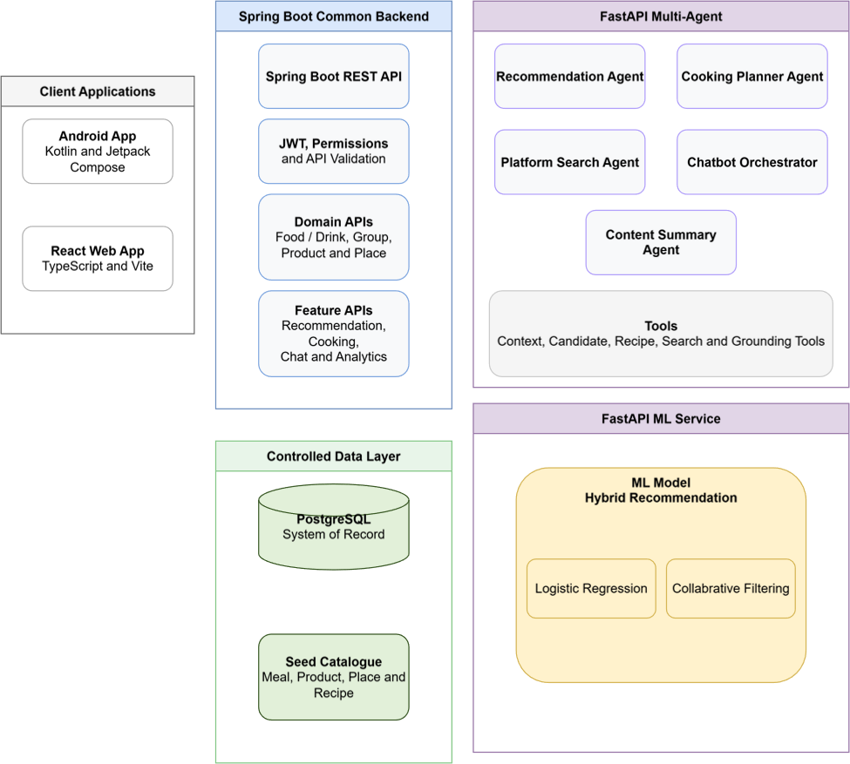
Architecture
FOODMIND • TEAM 5
11
Notes:
This architecture maps the use cases to controlled service boundaries.
The Android application and React Web application use the same Spring Boot backend. Spring Boot owns JWT authentication, permissions, API validation, domain APIs and feature APIs, so both clients follow the same business rules.
PostgreSQL is the system of record, while the seed catalogue supplies controlled Meal, Product, Place and Recipe data for the MVP.
The FastAPI multi-Agent service is private. It contains the Recommendation Agent, Cooking Planner Agent, Platform Search Agent, Chatbot Orchestrator and Content Summary Agent. They work through allow-listed tools rather than accessing the database directly.
The separate FastAPI ML service hosts the Hybrid Recommendation Model. Collaborative Filtering and Logistic Regression provide ranking signals, while Spring Boot remains responsible for authorisation and persistence.
This design supports the Proposal's technology mapping: each use case reaches only the services and tools it requires.
[Sources]
- User-provided FoodMind architecture diagram, image(2).png.

Slide 11
MVP 4-week plan
WEEK 1
WEEK 2
WEEK 3
WEEK 4
Design & contracts
Baseline vertical slice
Hybrid ML + five Agents
Cloud, UAT & demo
›
›
›
Data model
API contracts
UX flows
Record • share
retrieve • recommend
feedback
UserCF • ItemCF • LR
Agent tools
structured outputs
Deployment
integration tests
final demonstration
FUTURE WORK
Public search • maps • ordering • payment • advanced recommendation methods
FOODMIND • TEAM 5
12
Notes:
Our four-week plan moves from design and contracts, to a complete baseline flow, then Hybrid ML and all five Agents, and finally cloud deployment, UAT and demonstration.
We control limited data, Agent unpredictability, privacy and scope risks with disclosed seed data, deterministic fallbacks, structured outputs, permission checks, timeouts, traces and a strict MVP boundary.
Public search, maps, ordering, payment and advanced recommendation methods remain future work.

Slide 12
Thank you
13
Notes:
FoodMind begins with a real manual solution: friends preserving reliable food experiences in one document.
We make that idea structured, searchable, personalised, explainable and connected to feedback and analytics. FoodMind helps users turn personal experience and trusted group knowledge into better everyday decisions.
Thank you. We are happy to answer your questions.

