Slide 1
Data Analytics Bootcamp Project 1 Explanatory data analysis of life-expectancy based on health and development indicators per region
Group 1:
Gwendoline Grenu
Peter Lehel
Temitope Ajose-Adeogun
Farheen Oomatia

Slide 2
Table of Content
Aim of the project
Relationship between GDP and Life Expectancy across the entire dataset – Temi
Overview of GDP data for Asia, Europe and Africa – Peter
Data on diseases analysed for Asia & Africa– Gwen
Life expectancy in the American regions – Farheen
Limitations and Conclusion

Slide 3
Aim of the project
Dataset overview – which indicators are we looking at
Overview of life expectancy change over a decade
Correlation of GDP, life expectancy and health factors for selected regions
Life expectancy comparisons within each continent

Slide 4
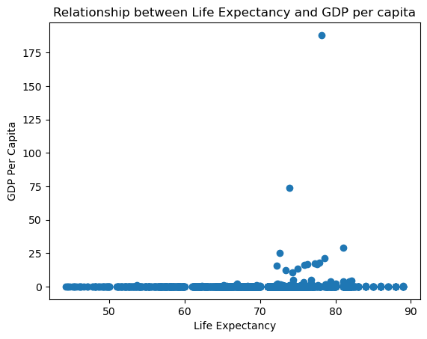
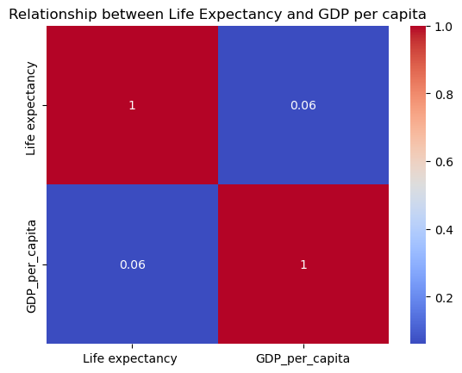
Relationship between Life Expectancy & GDP per capita across the entire dataset.
Life expectancy is mostly between 70-80 years.
There is a weak positive correlation between life expectancy & GDP per capita in the dataset. This means that although both life expectancy and GDP per capita tend to go up in response to one another, the relationship is not very strong.
This suggests that as income per household rises in these countries, there is a rise, albeit slight, in the life expectancy of the country’s inhabitants.
GDP per capita increases the life expectancy through increasing economic growth and development in a country and thus leads to the prolongation of longevity.

Slide 5
Peter's part

Slide 6
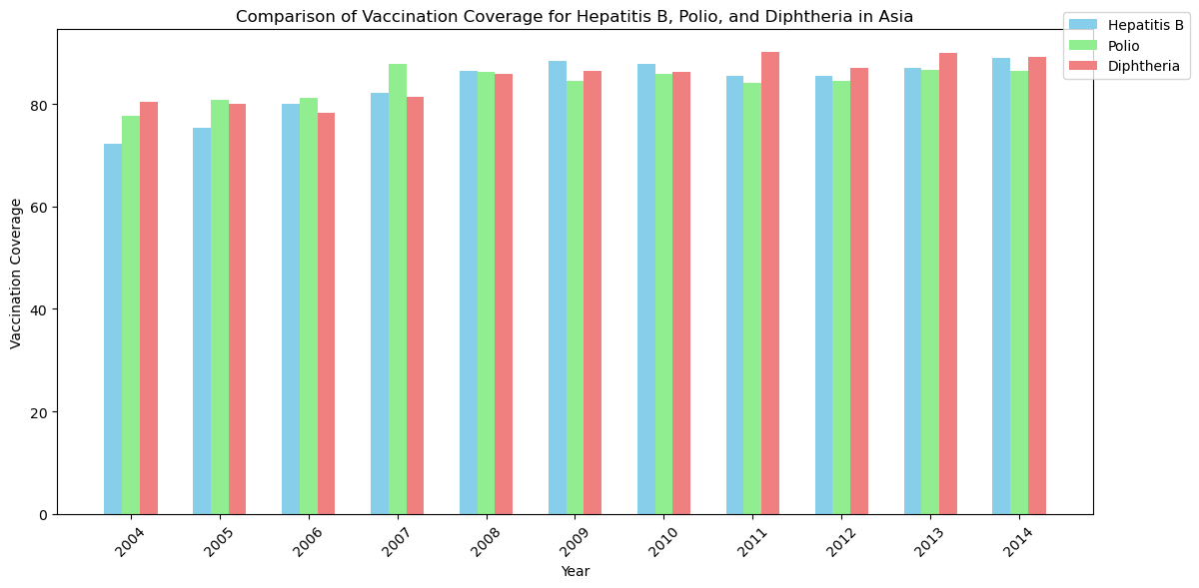
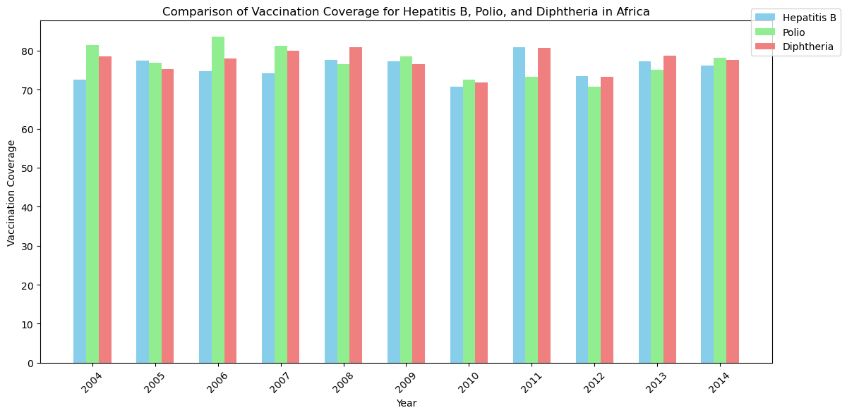
Comparison of vaccination coverage for Hepatitis B, Polio and Diphtheria for Asia and Africa

Slide 7
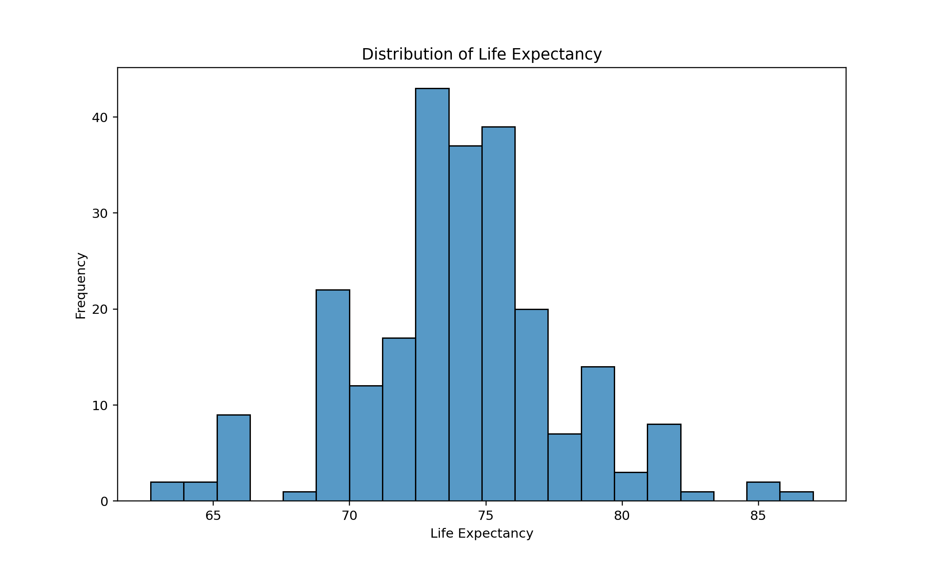
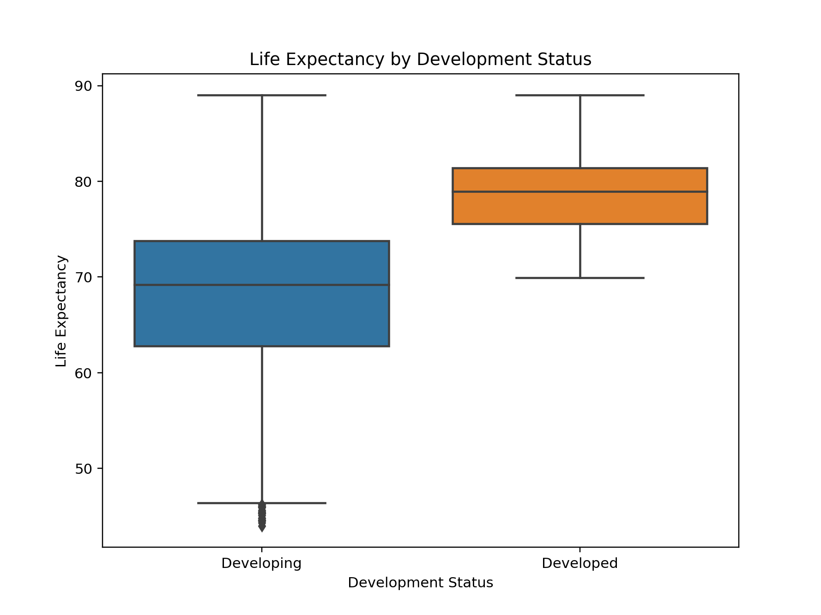
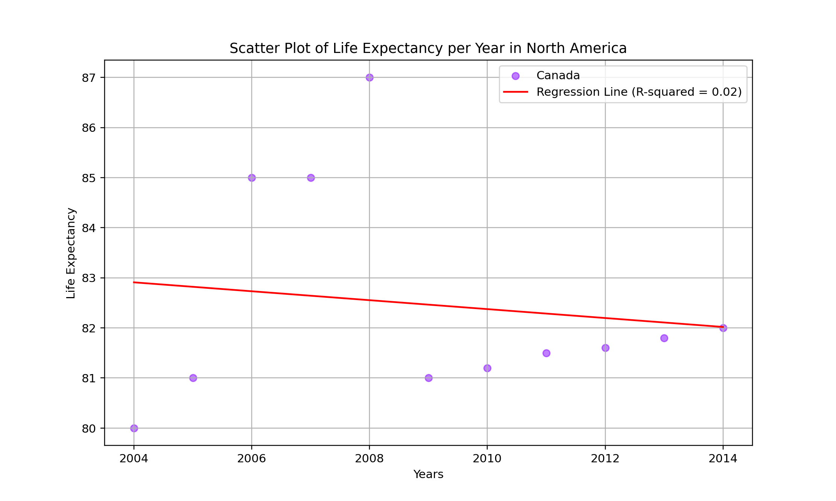
Life expectancy overview across the Caribbean, North, Central and South America 1. Life expectancy is around mostly at around 71-76 years 2. As a general trend, across all countries in the Caribbean, Central and South America, the life expectancy rose between 2004 and 2014. Only North America's regressions line shows a decline. - only Canada - unexplained spikes in LE skewed the graph
3. Life expectancy overview across developing and developed countries -> developing countries show a wider distribution of LE compared with developed countries
4. More outliers probably due to infant death

Slide 8
Limitations and Conclusion
Missing data from some countries
Missing USA from North America
Some indicators were not analysed due to loss of resource
Dataset accuracy - eg. Country status not as expected
Reliability of source
Political and envrionmental factors missing which might explain unspected spikes or drops in data
Resources:
https://www.kaggle.com/datasets/arunjangir245/life-expectancy-data

Slide 9


