Slide 1
Sample provided as-is.
Not intended for production use.

Slide 2
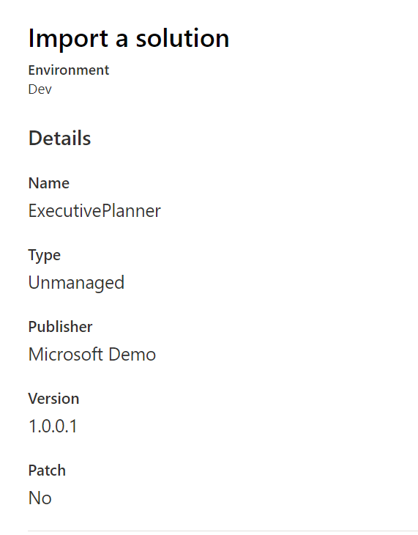
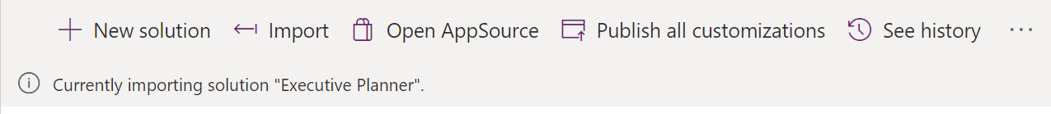
In your target environment, go to Solutions and import the solution package.
Wait for completion of import.

Slide 3
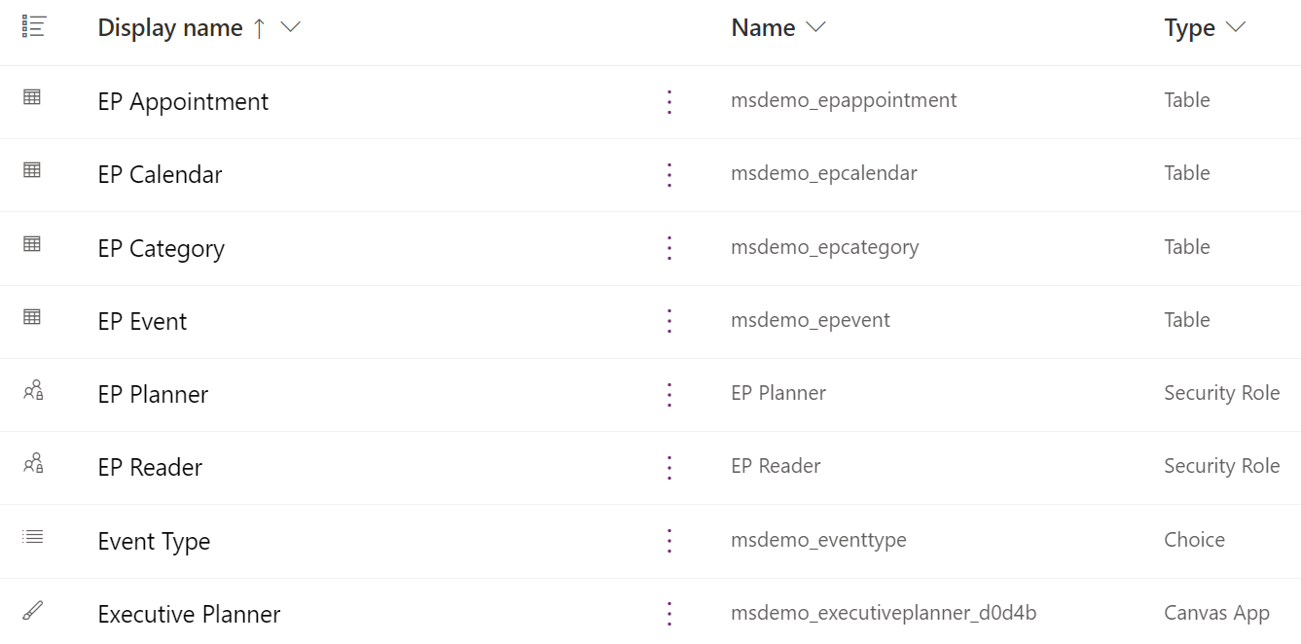
The solution package includes the following:

Slide 4
Tables in Executive Planner (EP) Solution
EP Appointment – Stores appointments selected from Exchange Online into the planner.
EP Calendar – Stores Calendars used in the planner – this is to allow selection of Calendars (User mailbox) for the planner view without requiring view permissions for the related Exchange Calendar.
EP Category – stores configuration of categories and its colour code
EP Event – stores list of events – out of office, holidays, etc.
Security Roles
The solution uses two roles
EP Planner – users in this role can add appointments to the planner, add/modify category and events.
EP Reader – users in this role can only access the “Review” screen, in a read-only access.

Slide 5
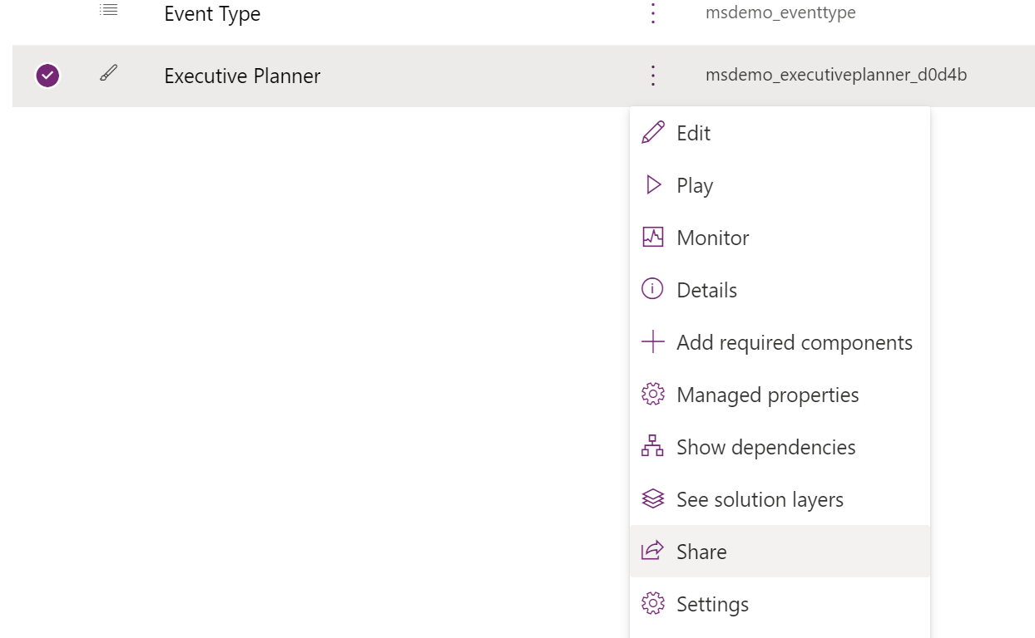
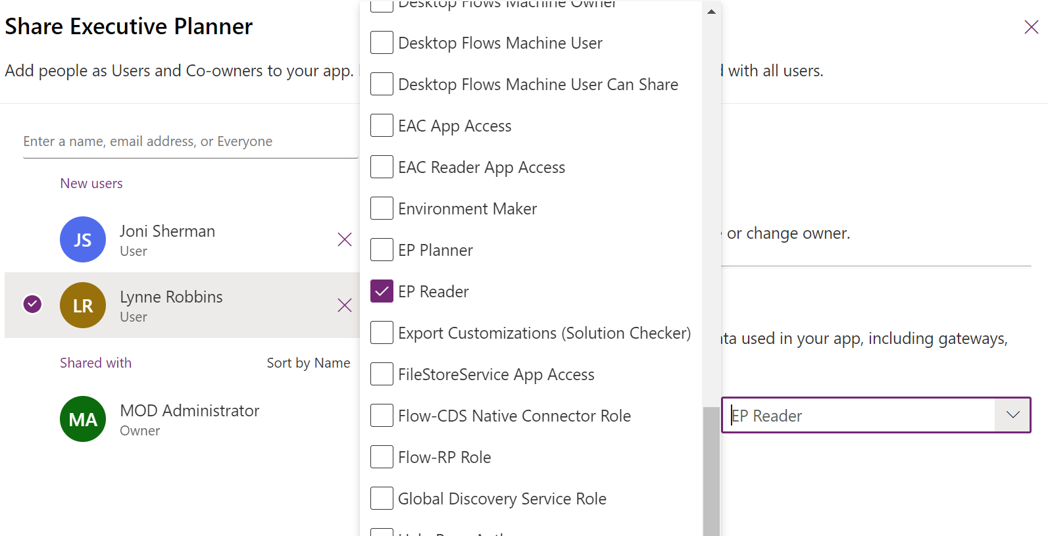
Admins/Owners must share the app to users and select the appropriate roles.

Slide 6
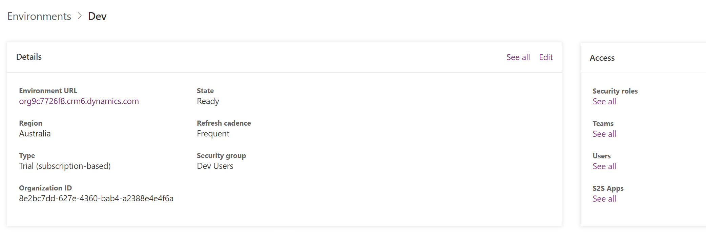
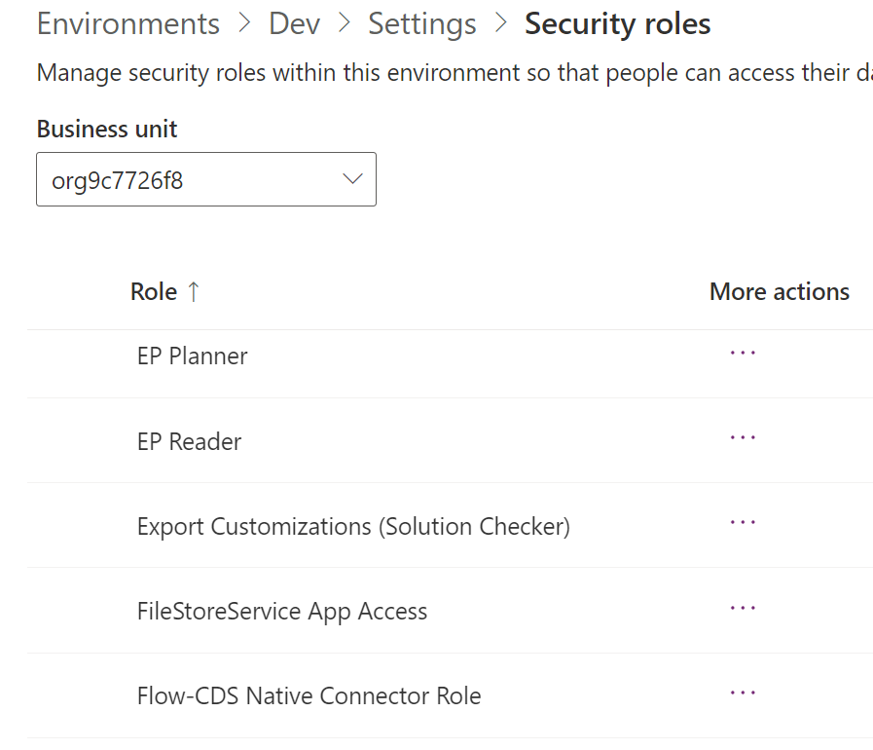
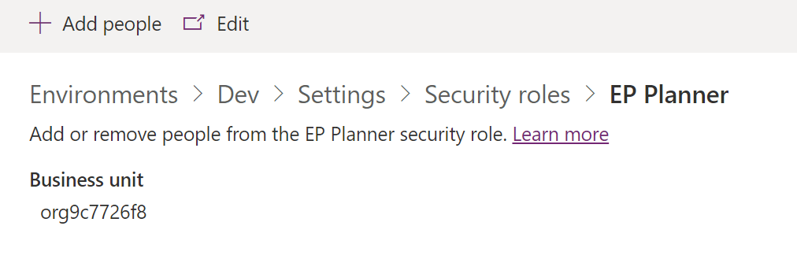
Roles can be assigned individually to users. App will still need to be shared to the users.
In the Environment Admin Center, click on Security roles “See all”
Two roles installed from the solution will be available: EP Planner and EP Reader. Click into either one and select “Add People” to assign users into the role.
You can also go to users list and assign role from there or click on “Teams” to assign groups.

Slide 7
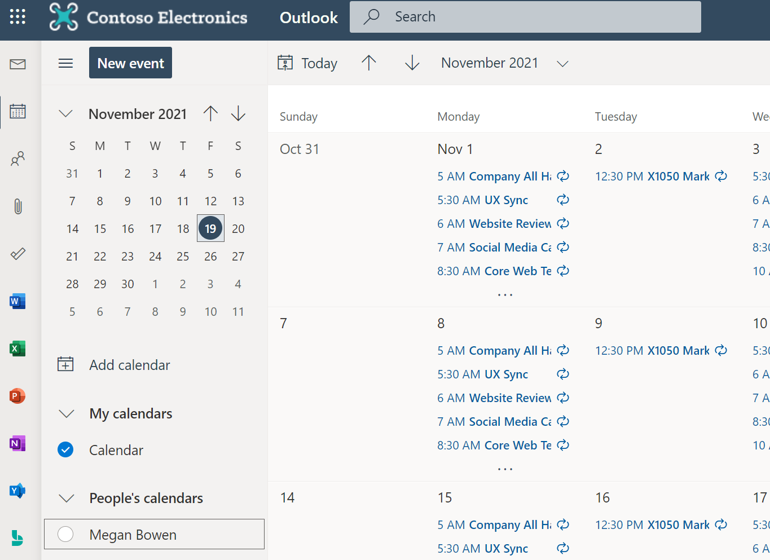
For EP Planner role: App will list Calendars from Outlook. The EP Planner user must:
Already have read access to the calendar
Added the calendar in Outlook.

Slide 8
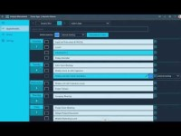
Demo 1 – EP Planner

Slide 9
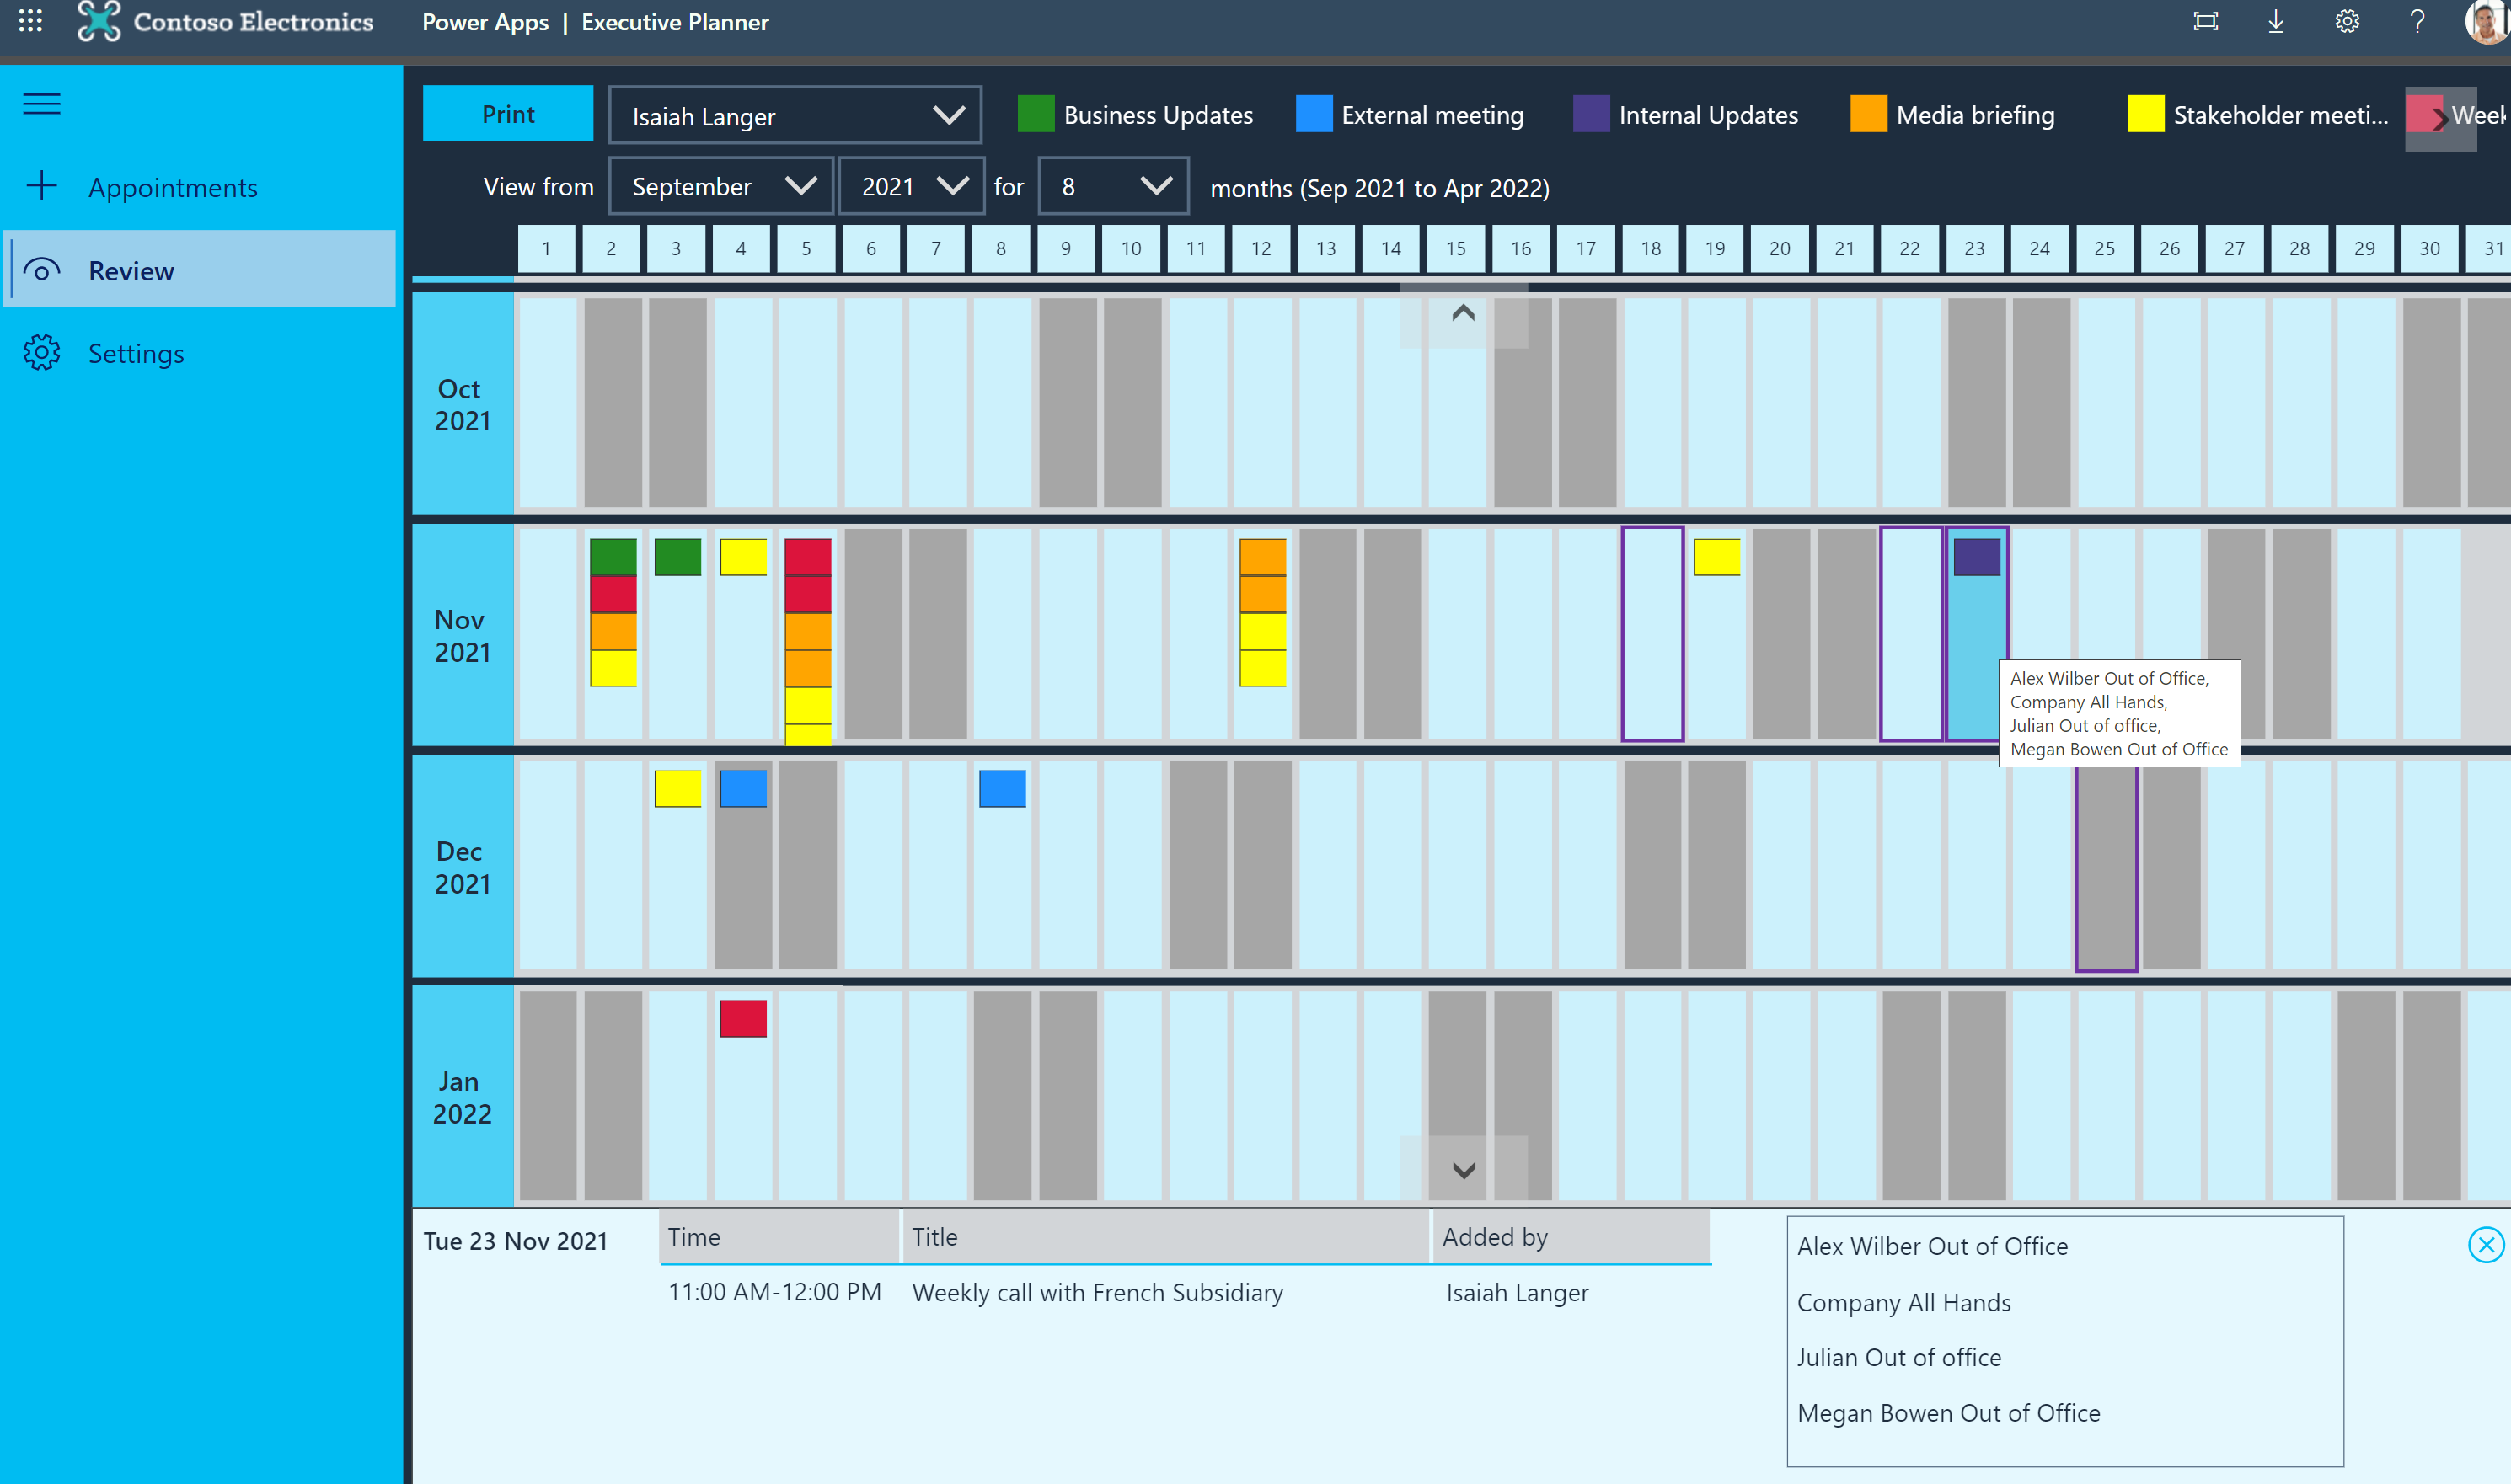
Note: New feature – click on any date tile will reveal details as a slider out from the bottom screen with details. Shows events with time and name of the planner who added it. Also lists all events on the date (any public holidays, Out of office, etc). Slide out can be closed by clicking on the (x) icon.

Slide 10
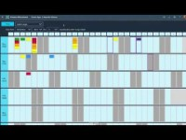
Demo 2 – EP Reader

