Slide 1
Easy (practical) Domain Driven Design
Notes:
We’re going to break DDD down into it’s most core components and show simple, easy to understand examples to reenforce the concepts
Most difficult parts
Knowing how to implement
Distilling information

Slide 2





Ryan Foote Cloud Team Architect, Lighthouse Dayton Freight Lines
rfoote@daytonfreight.com
@TheRealDenster

Slide 3
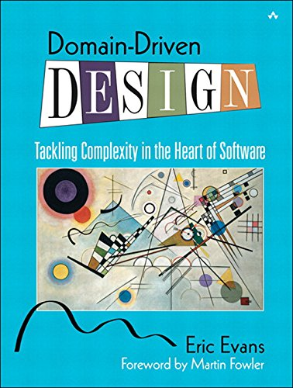
What’s the Point?
Enterprise software is complicated
Software development is hard
Traditional documentation is unhelpful
Often implementation and conceptual model do not match
Notes:
Big ball of mud
Easy to make mistakes
Big balls of mud make it hard to fix mistakes
Docs will say one thing, big ball of mud another

Slide 4
Which leads to…
Applications that…
Are large
Are monolithic
Are difficult to maintain
Are difficult to refactor
Possibly aren’t even useful
Business logic packed away in interesting places, duplicated, and/or inconsistent
Codebase doesn’t reflect what’s in documentation
Notes:
Giant, nebulous, difficult to maintain software that possibly doesn’t even solve the real world problem
Last bullet -> Conceptual model says shipments are in control of adding detail lines to themselves, but in implementation, it’s the “ShipmentDetailsService”.

Slide 5
Need a way to create maintainable software that solves business problems, while communicating effectively to domain experts and developers alike, using familiar language.
Thus…
Domain Driven Design

Slide 6
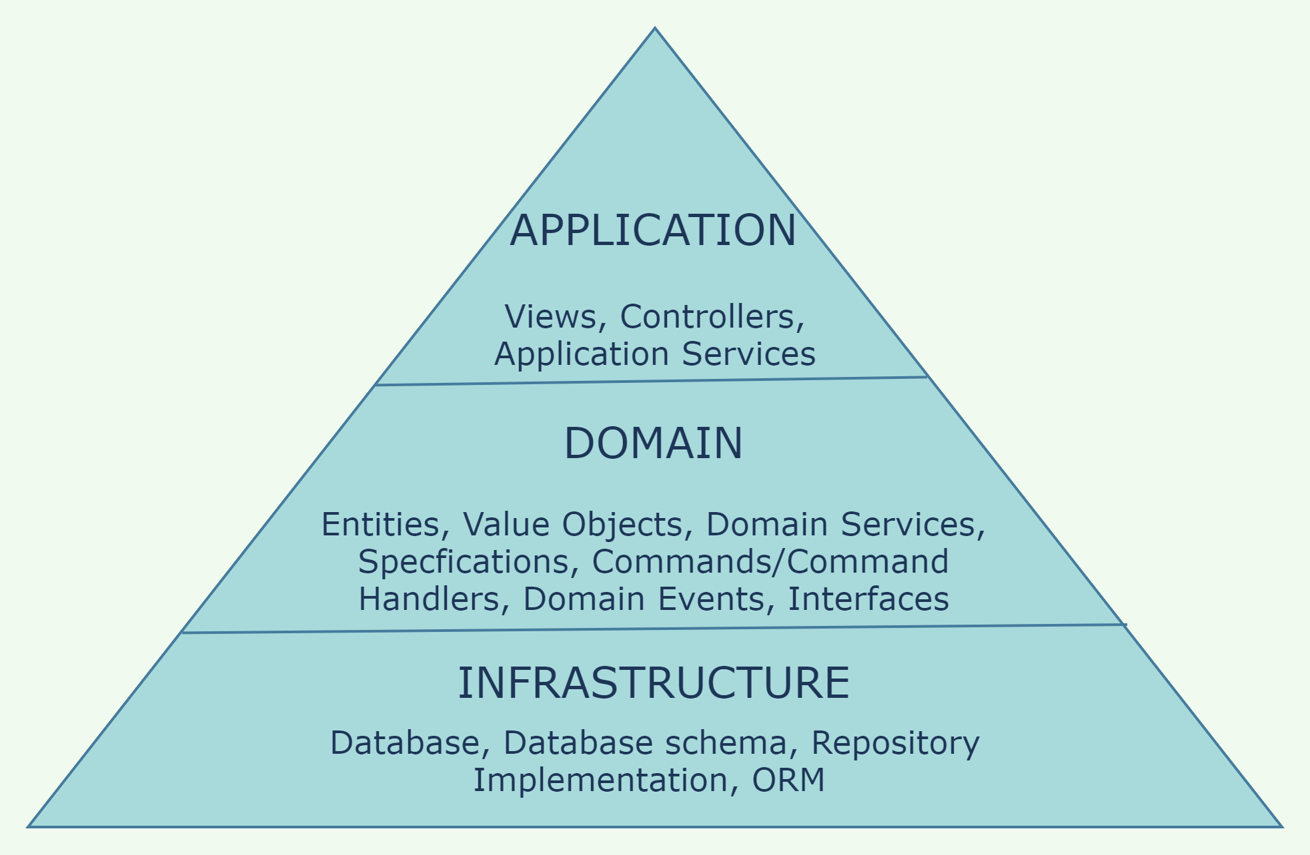
What is Domain Driven Design?
Focus is on the DOMAIN (business problem area)
Leverage domain experts – Developers should understand the domain
Complex domain should be based on a model (documentation)
Conceptual model that business folks can understand
Implementation should match
Notes:
MAIN IDEA: Bring developers and domain experts together to develop a conceptual model. Stick to things related to the domain itself, not infrastructure or application type services.
As you work to distill information within your domain, conversations w/ domain experts & developers should revolve around concepts that both can understand.
Domain experts don’t know about “databases”

Slide 7
What is Domain Driven Design?
Code Perspective
Object-Oriented
Classes reflect the behavior represented in the model
Not anemic
Not like DTOs
Described as “Old school”

Slide 8
Concepts
Domain
Bounded Context
Ubiquitous Language
Entity
Value Object
Aggregate / Aggregate Root
Repository
Service
Specification
Event

Slide 9
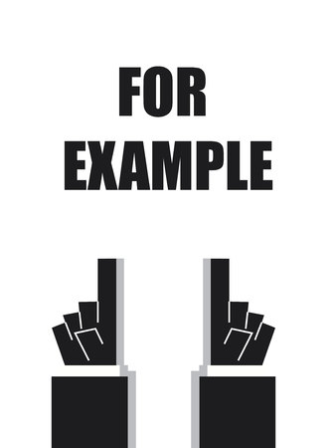
Domain
Business Problem Area

Slide 10
Transportation Management System
“Dayton Freight would like to sell software as a service that will allow customers to manage their shipping including capturing shipment data, retrieving rate quotes from carriers, dispatching to carriers, tracking, and paying carriers”

Slide 11

Ubiquitous Language
Language within context with a consistent definition
Used by entire team
All communications, documentation, and code
Developers & domain experts should agree on meaning
Tool for deep understanding of complex domain
Resolves lack of understanding of technical jargon, or jargon specific to a job/task/etc.
Keeps the domain experts, stakeholders, developers all on the same page

Slide 12
Ubiquitous Language
Quick Rate vs. Rate Shop vs. Re-Rate
Domain expert might just refer to “rating”
Be mindful when communicating across contexts/teams
Language is “contextual” to bounded contexts

Slide 13
Bounded Context
Break down domain into smaller “bounded contexts” by identifying boundaries
Give ubiquitous language context
“Bulkheads” of the system
Prevents unnecessary complexity from leaking outside of the context
Each should own its own data
Separate database or schema
Ex. Tracking context shipment vs. ShipmentManagement context shipment
Tracking -> Status, some date/times, perhaps a location?
ShipMgt -> All the shipment things
Reduce or eliminate context-to-context communication*
Clear & intention revealing interfaces
Notes:
#1 – Teams decide this. Things that change together.
#1 – who is responsible for what? Which entity “owns” which data and process
#2 – within a context, language means something. “contextual”.
Dispatching in shipmgt might mean something different than dispatching through a dispatching service
- Not referring to API gateways, SPAs, or any other aggregator type “service” or context
Just mean, for example, shipment management shouldn’t call dispatching to dispatch one if it’s shipments
Microservice “discovery”

Slide 14
Lighthouse TMS Domain Example
Shipment Management
Rating
Dispatching
Tracking
Shipment Audit
Billing
Customers/Users
Notes:
Spend some time talking about Lighthouse domain
Will reference more throughout

Slide 15

Entity
Has identity
Lifespan is tracked
Changing a property value doesn’t change identity
Requires way to track
Some sort of id
Account#, email, auto number?
Enforces domain logic directly involving the entity
Controls how objects it is responsible for change
Responsible for keeping itself in valid state

Slide 16
Entity
Reference Object
Notes:
- Show the Shipment entity in the Core project

Slide 17
Value Object
Does NOT have identity
Value-based equality
It’s what’s INSIDE that counts (not identity)
Immutable
Can define helper methods & extensions for enforcing “rules”
Address value object vs. Address entity
What about shipment details?
Notes:
Show ShipmentId and Address value objects
SimpleValueObject for things that have ONE “code” or “value” that identifies it
i.e. PackagingType
ValueObject can be interchangeable with record type (just provides equality)

Slide 18
Value Object
Immutable Descriptor
Notes:
- Show ShipmentId and Address value objects

Slide 19

Aggregate Root
“Transactional unit” for changes
Consistency boundary
Boundary
Defines what’s inside
Isolates related concerns from one another
Brings structure to the design
Root
Single entity
Only object in aggregate that outside objects can hold references to
Entities in aggregate (other than root) can hold refs to each other, but have no outside identity
No outside objects can see these outside of the context of root
Notes:
-

Slide 20


Aggregate Root
Shipment
Dispatch
Details
Rate
TrackingEvents

Slide 21
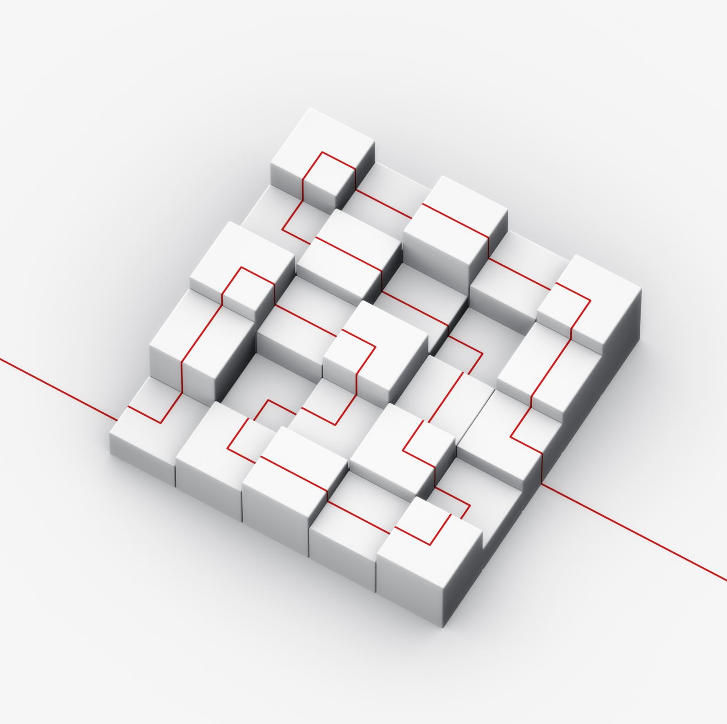
Repository
Per aggregate root
Provides way to obtain object refs to domain objects
Helps preserve model driven design
Abstracting away underlying storage and infrastructure
Forces developers to respect the model (by not writing SQL)
Provides add, remove, edit, querying for objects
via straight-forward, intention revealing interface
Database isn't part of the "conceptual model"
i.e. In Lighthouse domain, there is no such thing as a database
Repos hide the persistence mechanism, could be database, files, memory, etc.
Notes:
Gets references to objects
Objects are the “starting point” for “traversal”
Can then ask objects for objects they control
Need a place to start… thus repos

Slide 22
Repository
Reference Getter
Notes:
- Show Kernel.DbContextRepository

Slide 23
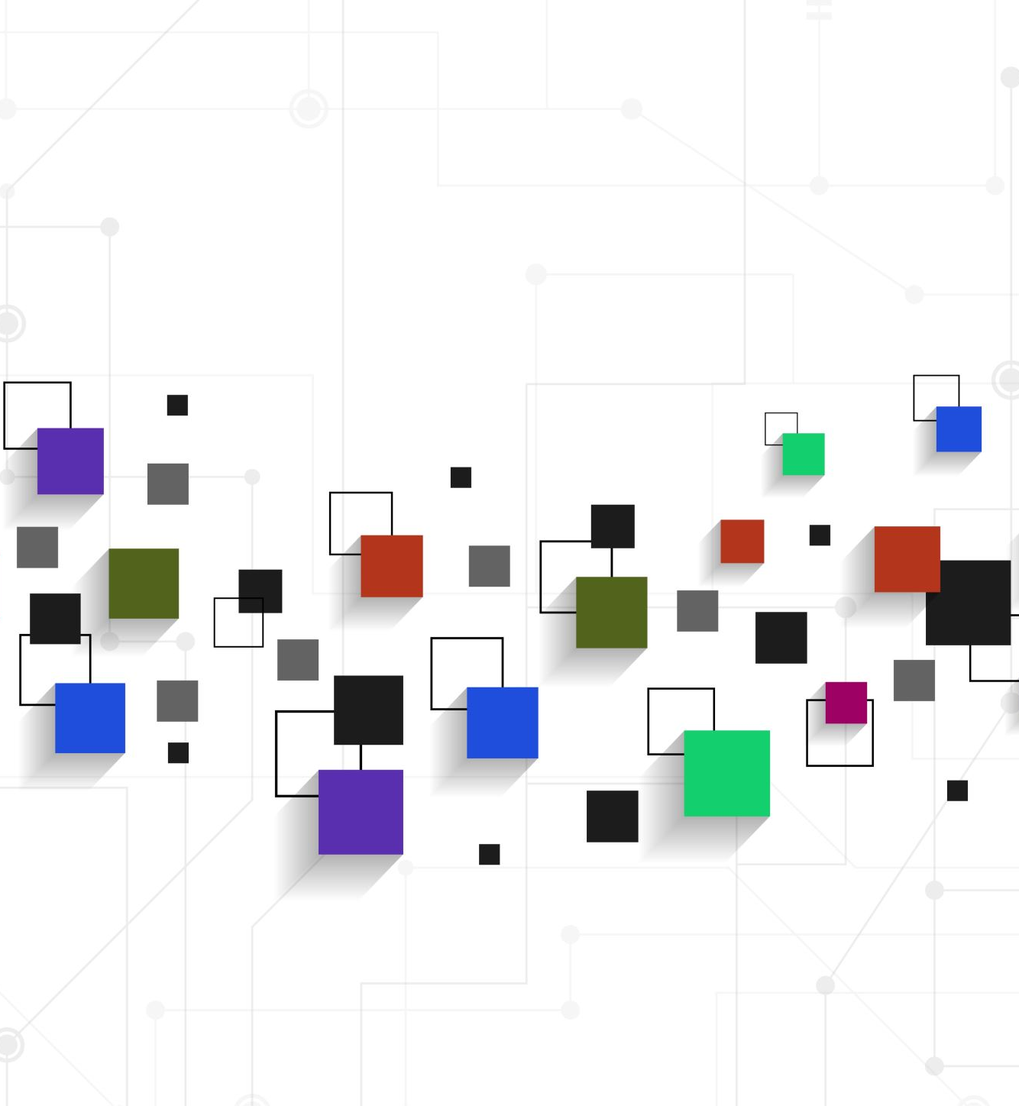
Service
Operations that do not belong to any object
Not responsibility of any existing entity or value object
3 Characteristics
Operation does not belong w/ any entities or value objects
Stateless
Interface consists of other concepts in the domain
Service doesn’t introduce its own concepts
Operation names should come from ubiquitous language
Service & interface should be part of the domain model
Notes:
- Outside of DDD, will have names like SomethingManager

Slide 24
Service
“Sometimes, it just isn’t a thing.”
- Eric Evans, Domain Driven Design
Notes:
Show ShipmentIdService, DispatchNumberService
Interface in “domain” layer, implementation is in “infrastructure” layer

Slide 25
Specification
Sometimes business rules don’t fit nicely in any existing entities or value objects
A value object that exists to evaluate another object against a predicate (rule)
Does the thing satisfy the rule, basically.
Ex. Delinquent invoices
Useful for domain queries
Ex. Want to provide a view showing all delinquent invoices

Slide 26
Specification
Queries & rules
Notes:
- Show ActiveShipmentsSpecification

Slide 27
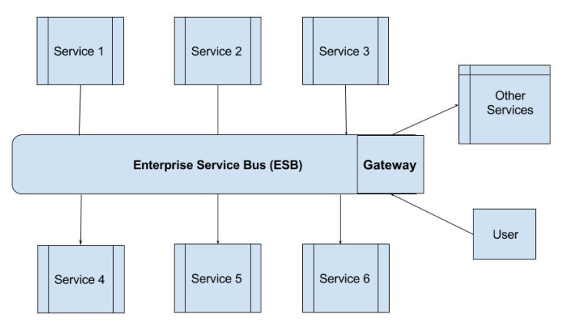
Event
Happened in the past
Expresses domain state changes
Support separation of concerns
Makes it possible to integrate w/ other bounded contexts
Integration vs. Domain events
MediatR (mediator, pub/sub)
EventGrid, Service Bus, etc.
https://www.tutorialspoint.com/soa/soa_enterprise_service_bus.htm

Slide 28
Event
Hey, what just happened?
Notes:
- Show Shipment.cs and the repo base for publishing

Slide 29
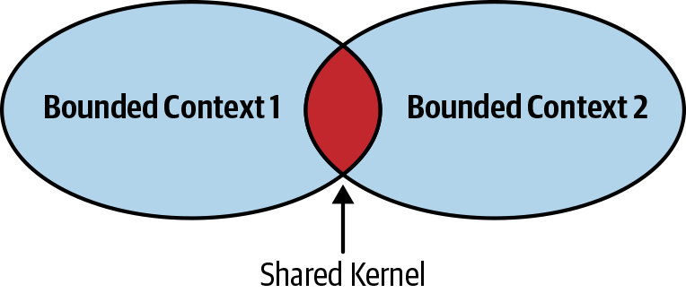
Shared Kernel
Library(ies) for code shared between different bounded contexts
Cross-cutting
Nothing subdomain-specific
Ex. Security, logging & monitoring, IRepository, base repo implementation, exceptions, DDD-related base classes (Entity, ValueObject, Specification
Generic (but important) enough to share across bounded contexts
Shouldn’t change much
When changing, every team should agree
Could implement as Nuget package(s) in dotnet
https://bit.ly/3Eqw6vT

Slide 30
Main Idea
Developers & domain experts work to identify key concepts & behaviors
Create a conceptual model that represents these
Develop shared language based on the model
Match your implementation to the conceptual model
If a domain expert can’t understand a concept, it doesn’t belong in the model – Ex. “controller”, “endpoint”, “client”, “database”
Iterate, refine, refactor
If a concept no longer makes sense, remove it or put it where it does make sense
Audit vs. Billing
Pragmatic vs. Dogmatic

Slide 31
Implementation Tips & Tidbits
Use GUIDs for entity ids
Doesn’t rely on round trip to the database to create
Avoid service-to-service direct communication
Communicate with commands and events
Use API gateway and service discovery
“Front end” applications communicate through API gateway
Practice Event Storming to flesh out commands, events, aggregates and to develop ubiquitous language
Microservice scoping technique
Use read models for queries
CQRS & Event Sourcing

Slide 32
Tips
Use MediatR w/ handlers in the domain layer
Use ORM if possible
EF Core fluent API to hide database complexity & keep model clean
Migrations help simplify the DevOps story
Don’t publish separate “integration events”
Use “internal” MediatR notification handlers for handling “in-process” events,
Have an internal handler for sending out over whichever event bus you choose
Avoid putting business logic in stored procs
Keep SQL out of domain layer

Slide 33
Tips
Configure ASP.NET to not get in your way w/ your domain classes
JSON converters
Use value objects as part of JSON requests/responses
Type converters
Use value objects in routes
Ex. ShipmentIdentifier / DispatchIdentifier
Put some validation logic in the create methods of value objects

Slide 34
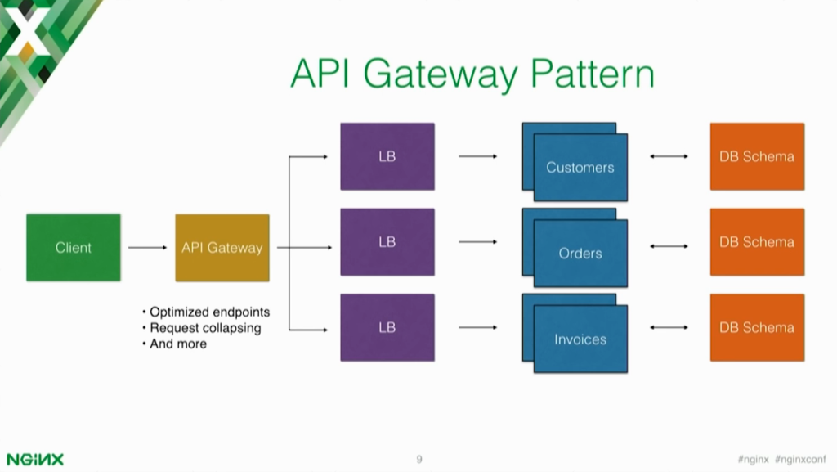
Notes:
- Customers, orders, invoices do not know about each other

Slide 35
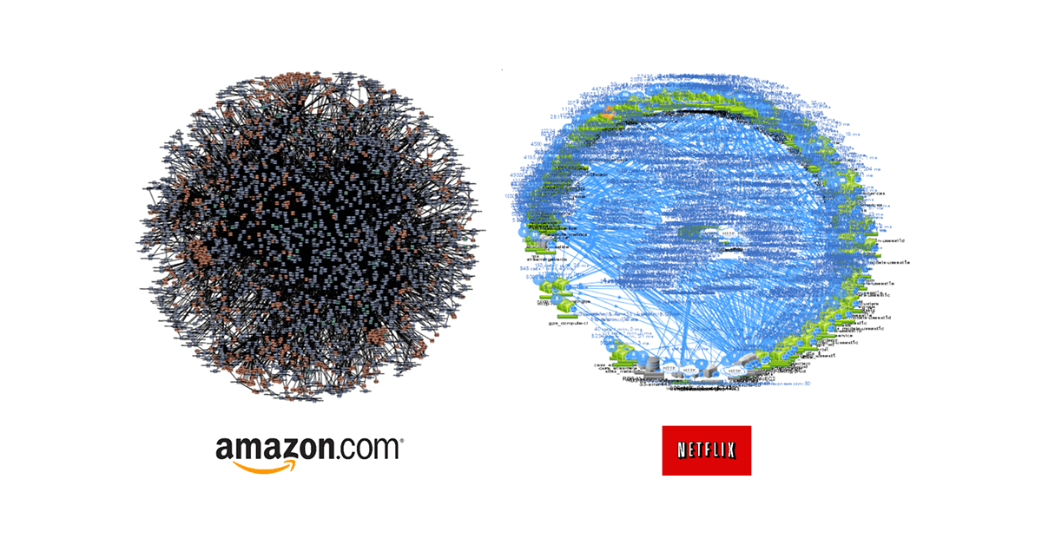

Slide 36
Example Repo
https://github.com/footedr/easyddd
rfoote@daytonfreight.com
@TheRealDenster

Slide 37
Other Links
https://www.eventstorming.com/
https://app.pluralsight.com/library/courses/dotnet-microservices-scoping-organizing/table-of-contents
Event Storming Course (Pluralsight)
https://amzn.to/32oAE95
DDD Book
https://github.com/jbogard/MediatR
https://github.com/ardalis/ApiEndpoints

