Slide 1
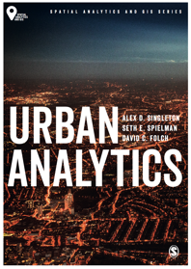
Computing 101
Alex D. Singleton, Seth E. Spielman, David C. Folch (2017) Urban Analytics. London: Sage.

Slide 2
Learning Objectives
The essential components of a computer, and those locations where computation can occur.
The environmental consequences of computing.

Slide 3
Computer Hardware
A computer is made up of three components
Input devices, such as a mouse and keyboard
Output devices, such as a monitor and printer
A system unit
A system unit is composed of
The central processing unit (CPU)
Memory
Storage

Slide 4
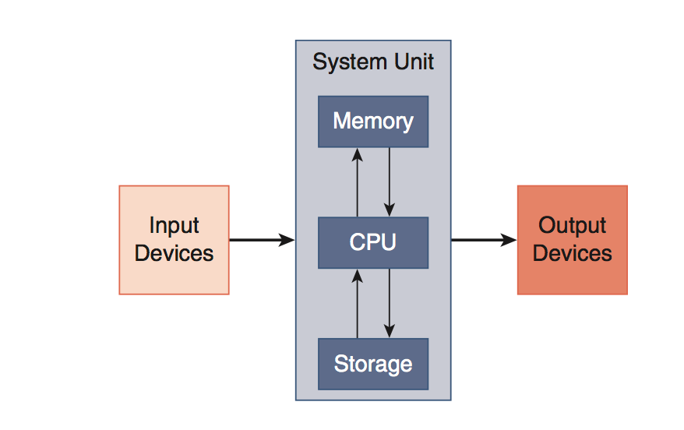
Computer Hardware

Slide 5
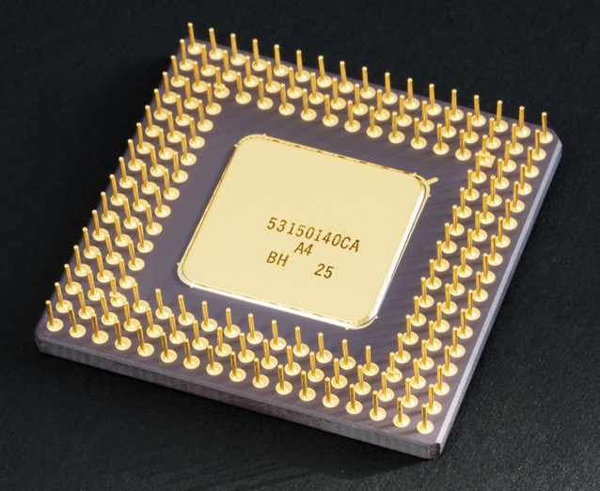
CPU
Measured by the number of clock cycles per second
2.3 GHz (gigahertz) can perform 2.3 billion clock cycles / second
Important characteristics CPUs are the number of cores and multithreading capability
Bottom of a CPU
Source: https://en.wikipedia.org/wiki/Central_processing_unit#/media/File:Intel_80486DX2_bottom.jpg. Photography © Andrew Dunn, 2005 CC BY-SA 2.0

Slide 6
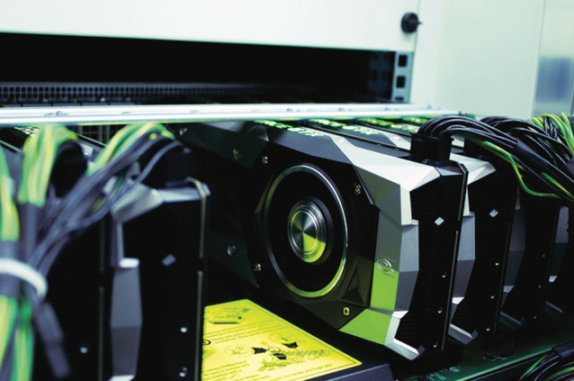
Graphics Processing Unit
Evolved mainly to serve demands of video games
Very high number of cores V CPU
Useful to solve “embarrassingly parallel problems”
Late 2000s, the unique architecture of GPU began being leveraged to process large amounts of arbitrary data
Graphics cards can be installed in workstations or be rack mounted together enabling linkage between multiple cards
Source: Photograph by Benedikt S. Vogler CC BY-SA 2.0 (Flickr)

Slide 7
Memory
Data in active use by the CPU is held in memory
Memory is volatile (requires power)
Type
Cache memory – faster /more expensive; CPU intensive operations
Primary storage (RAM)
Measured in Gigabytes
Different types of computer memory
Source: https://en.wikipedia.org/wiki/Computer_memory#/media/File:Kinds-of-RAM.JPG

Slide 8
Storage
The hardware used for long-term archiving of software and data
Typically measure in Terabytes
Types
Hard disk drives (HDDs
Solid state drives (SSDs)
Also hybrid solutions
A Solid State Drive
Source: https://en.wikipedia.org/wiki/Computer_memory#/media/File:Intel_X25-M_Solid-State_Drive.jpg CC BY 2.0

Slide 9
Platforms
The combination of an operating system and hardware upon which software solutions are built
Vary in size
Urban analytics is mainly concerned with:
Personal computer
Cluster (or supercomputer)
“Cloud” computer
Utility for distributed workload

Slide 10
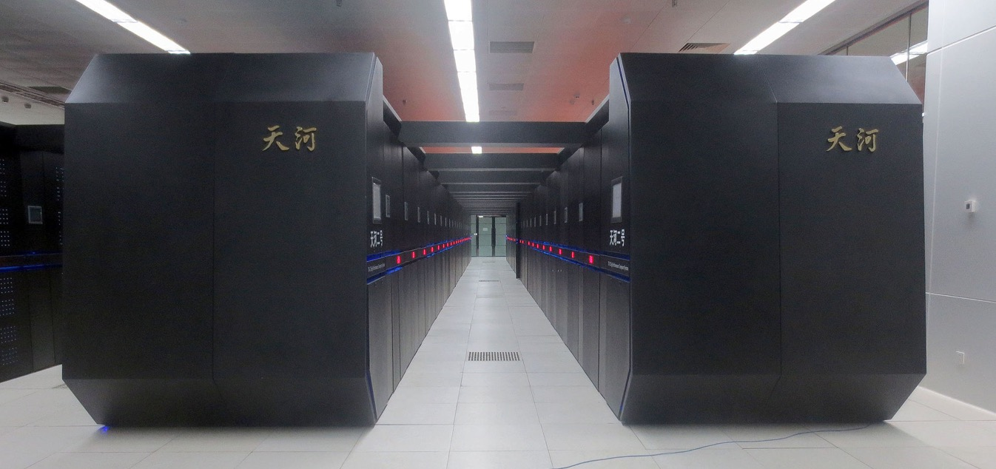
Tianhe-2 in National Supercomputer Center in Guangzhou
Source: https://en.wikipedia.org/wiki/Tianhe-2#/media/File:Tianhe-2.jpg. CC BY-SA 4.0

Slide 11
Distributed Workload
Types of distributed computing
Embarrassingly parallel problem
Executing the same (or similar) independent tasks many times
Other problems that require the distributed processes to be aware of one another
e.g. agent-based modeling
“Rent” a compute platform from a remote provider
Cloud computer

Slide 12
Computers and the Environment
Computers contain
Harmful substances
Arsenic, lead, and mercury along with
Reusable substances
Aluminum, copper, and plastic
Much e-waste is deposited in landfills but where e-waste routed for recycling, it is often transported to the developing world
US Environmental Protection Agency recognized certified recyclers
Responsible Recycling (R2) (sustainableelectronics.org) or e-Stewards
(e-stewards.org) standards
Upgrading hardware less frequently or extending the life by upgrading individual components is the ideal way to reduce the harmful effects of e-waste

Slide 13
Computers and the Environment
Distributed computing has energy considerations
For operating and cooling
Balance between computing time and energy use
A measure of supercomputer efficiency is the number of Floating Point Operations Per Second divided by the energy consumed to do the operations
Green500 list (www. green500.org)

Slide 14
Conclusions
The definition of a computer varies widely
Made up of a series of components
Distributed computing takes various forms
Aims to improve computational speed
Balance between
Performance
Cost
Environmental impact

