Slide 1
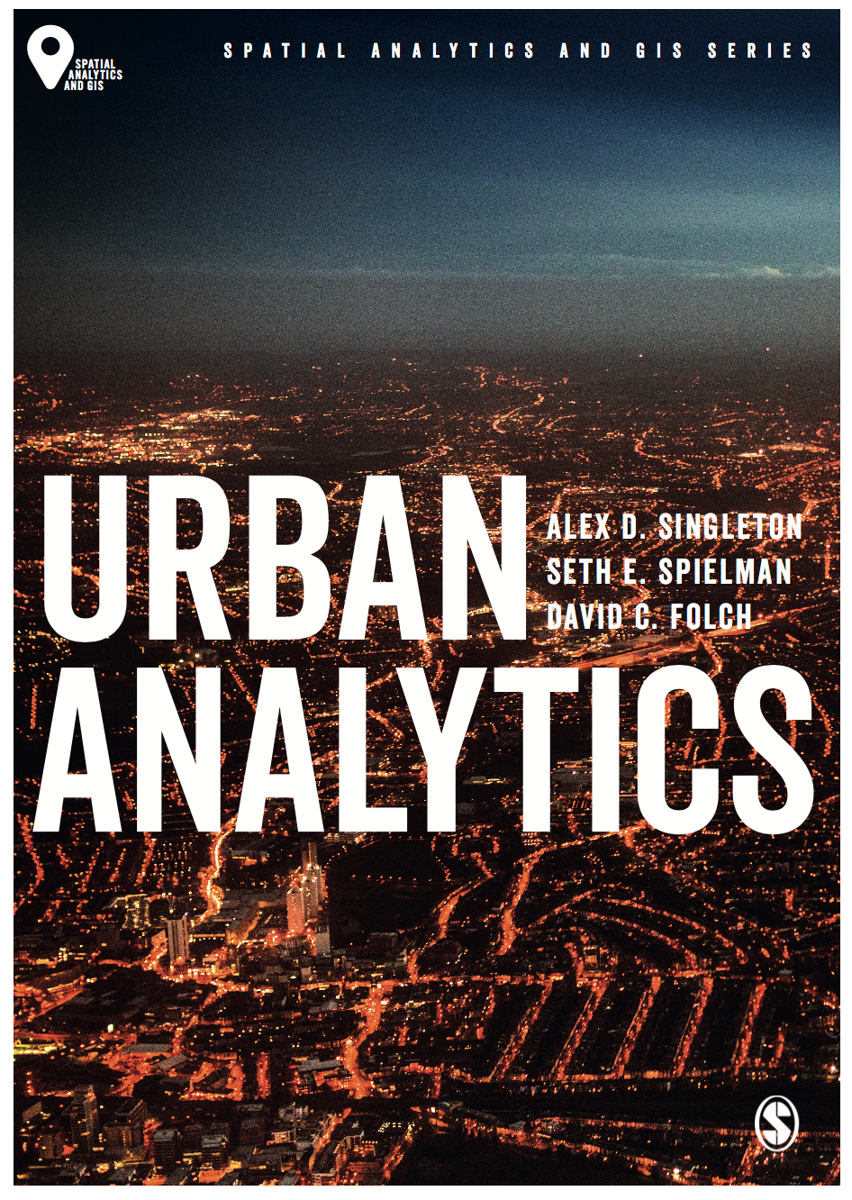
Traditional Data
Alex D. Singleton, Seth E. Spielman, David C. Folch (2017) Urban Analytics. London: Sage.

Slide 2
Learning Objectives
There are many different types of data collected within urban contexts.
Data are generated organically, as a byproduct of our daily lives, or through purposeful data collection processes.
Data can record activity, attributes, and dynamics over a range of spatio-temporal scales.
The different types of traditional data collected about cities.

Slide 3
Urban Data
Urban analytics usually focuses on dynamics within cities, not between them
Cities are atomic in nature
Composed of physical and natural objects
Each with different degrees of interaction
Data collection within cities will typically aim to capture different aspects of these relationships

Slide 4
Macroscope…
The combination of urban data with analytic technologies has been described as a macroscope
a microscope might allow us to see things that are too small
macroscope lets us focus on things that are too big to be observed directly

Slide 5
Types of data
Organic
byproduct of some process like communicating with friends, buying something online or in a store, riding the bus or train
See Lecture 4 for examples…
Purposeful/Designed
collected through a carefully designed, statistically robust collection program
e.g. national demographic/economic surveys; census
might be the only way to produce an accurate estimate
Designed to be representative
Often overseen by statisticians with a specialization in the design of surveys that are representative of a population

Slide 6
Types of Data
Purposeful
Lower frequency – slow dynamics
Very expensive
US 2010 Census – $42 per person counted
Reported with a margin of error
Organic
Often high frequency – fast dynamics
Byproduct of some transactional process
Relatively cheap…
Relative little metadata or measures of uncertainty

Slide 7
Margins of Error
Many large surveys are reported with a margin of error
Reflects that when a poll is conducted not everyone within a country is contacted, and some of the people who are contacted do not respond
Uncertainty in how close each poll’s findings are to the “truth”
Systematic problems
Are there particular segments who are more likely to not respond?
e.g. political poll – trust of the media?

Slide 8
National Statistics Data
Most countries have a body responsible for national statistics
e.g. US Census Bureau or Office for National Statistics (UK)
Types of data… (not in every context)
Surveys
Census
Population registers

Slide 9
Census
Effort to collect details on every person in a country
Survey by mail, telephone, web, face-to-face etc.
Often legally obliged to complete the survey
Usually every 5 or 10 years
Vary in size/detail
Setting those questions asked is complex
Long questionnaires and certain questions get lower response
Greater uncertainty
Extensive testing of census surveys is common

Slide 10
Large Surveys
In some countries a Census is supplemented or replaced by large surveys
Ask questions to a representative sample of the population
Small area estimation is often used to estimate the values from the survey at a local (small area level)
The smaller the unit, the greater the margins of error
Example
American Community Survey

Slide 11
Conclusions
Fast v Slow dynamics lend themselves to capture through different types of data
Macroscope
Organic v purposeful data
National Statistics Agencies
Large Surveys
Census

