Slide 1

Data and Computing Software
Alex D. Singleton, Seth E. Spielman, David C. Folch (2017) Urban Analytics. London: Sage.

Slide 2
Learning Objectives
Some differentiating characteristics of software languages and their appropriate use.
How data are stored within a computing environment.

Slide 3
Types of Software
Consists of…
Programs that control what the computer does
Tools for particular analysis or storage tasks
Custom code written in an array of programming languages
Programming language
A formal structure for communicating with a computer
Compiled programming language
Interpreted languages
General purpose v domain specific

Slide 4
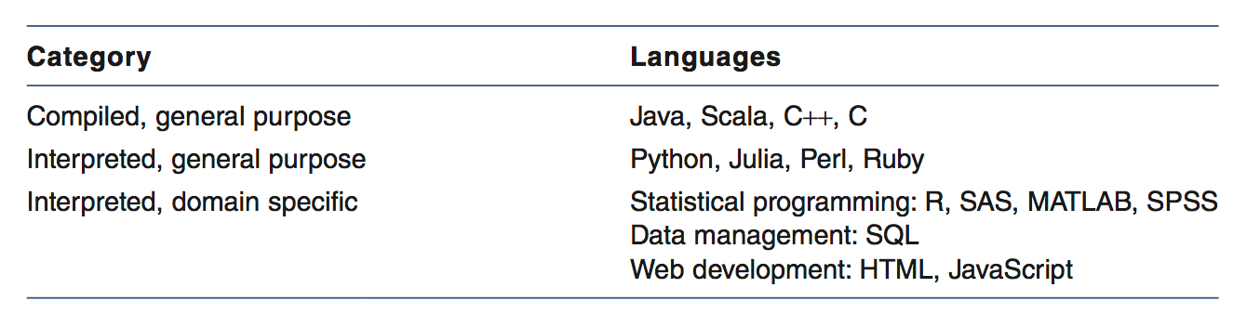
Types of Software
Examples of programming languages used for urban analytics

Slide 5
Which language is “best” for urban analytics?
Compiled languages typically run faster than interpreted languages
However, they require more lines of code to be written to accomplish the same task
Steeper learning curve
Interpreted languages are iterative and mean that they are better at quickly prototyping ideas
Balance between the speed of writing the code relative to the speed of running the code
No consensus on a single “best” language

Slide 6
What are data?
Data are the raw facts; e.g.
Details about a person, place, event, etc.;
Information is derived by transforming and combining data
Maps and visualization
Statistics and models
Data management can be the most time consuming step in an urban analytics work flow

Slide 7
What are data?
Data are often stored in computers as integers, floats, and strings
Floats
Numbers with decimal places
Integers
Whole numbers, either positive or negative, and include zero
Strings
A sequence of one or more characters
Computers use a base 2 numbering system, so no matter what we enter it is eventually stored as a series of zeros and ones

Slide 8
What are data?
Each zero or one is a bit, and 8 bits make a byte
The number of bits used to define a number gives its range, for example, an 8-bit number can take values from 0 to 255
e.g.
11111111 and computed as 128 + 64 + 32 + 16 + 8 + 4 + 2 + 1 = 255
11110111 is 128 + 64 + 32 + 16 + 0 + 4 + 2 + 1 = 247
Each bit stored takes up space in memory or long-term storage
Once the number of bits has been set, all numbers take up the same amount of space
Knowledge of the range of data values can be used to pick the appropriate number of bits for storing the data.

Slide 9
Data Storage: ASCII
ASCII (American Standard Code for Information Interchange)
8-bit system
Assigns the binary equivalent of numbers 0 to 127 to 95 printable characters
upper and lower case letters
numerals
punctuation
space
33 control codes
Several extended ASCII systems – inc. UTF-8
Convert binary values into human-readable characters

Slide 10
Data Storage: ASCII
CSV (Comma-Separated Values) format is one of the most common ASCII file structures
Data table paradigm
Values are stored as ASCII characters with some delimiter separating them
Delimiter is typically a comma, but could in principle be any character including a tab, pipe (|), or colon (:)
Each line of a CSV has an end of line ASCII character(s)
e.g.
Column1,Column2,Column3
1,4,5
5,6.7,8

Slide 11
Data Storage: JSON / XML
JSON (JavaScript Object Notation)
XML (Extensible Markup Language)
attribute:value paradigm – e.g.
Age:25
Gender:M
Hierarchies can also be formed – e.g.
(“name”: “Station 8,” “calls”:(“2012”:4872, “2013”:4581, “2014”:4263)), (“name”:“Station 9,” “calls”:(“2013”:2441,“2014”:3994))

Slide 12
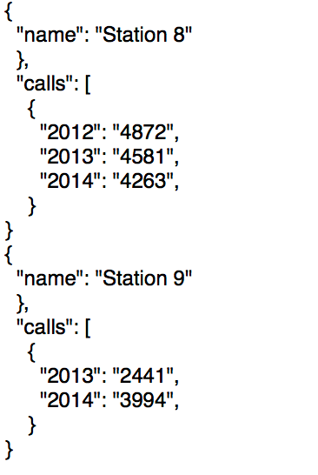
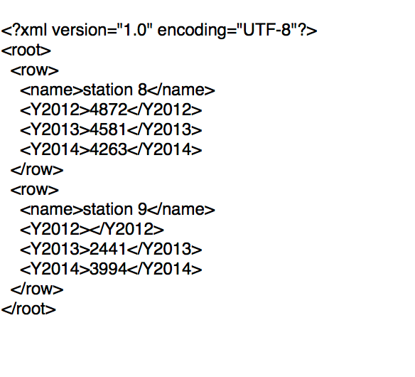
Data Storage: JSON / XML
JSON
XML

Slide 13
Data Storage: Databases
Relational database management system (RDBMS)
Data stored in data tables with relational keys
Tables can be joined dynamically using relational keys and/or queried
Language used – Structured Query Language (SQL)
Spatial Databases
Extend the concept by storing geometry within a table alongside attributes
Enable spatial queries

Slide 14
Data Storage: Metadata
Data about data – documentation
Types
Descriptive – records in each dataset
Structural – attributes of the dataset as a whole
Clear metadata make analysis simpler!

Slide 15
Conclusions
Software take multiple forms
Programming languages have different levels of abstraction
Impact performance/speed of coding
No best language
Data are stored in multiple types
Ultimately bits and bytes / 1 / 0
Data storage formats are multiple
All made more useful through metadata

