Slide 1

Representation
Alex D. Singleton, Seth E. Spielman, David C. Folch (2017) Urban Analytics. London: Sage.

Slide 2
Learning Objectives
What are GIS?
What is the need for generalization?
How are geographic features represented in a GIS?

Slide 3
Geographic Information Systems
Commercialized in the 1980s as an integrated software solution that combined spatial data management, analysis, and visualization
Graphic user interfaces that evolved as GISs developed reduced barriers to entry
Represent the real world as a series of layers, enabling query and analysis over both space and between layers
Success of GISs has resulted in a distillation of their core functionality within other classes of software
Coupling of toolsets is common

Slide 4
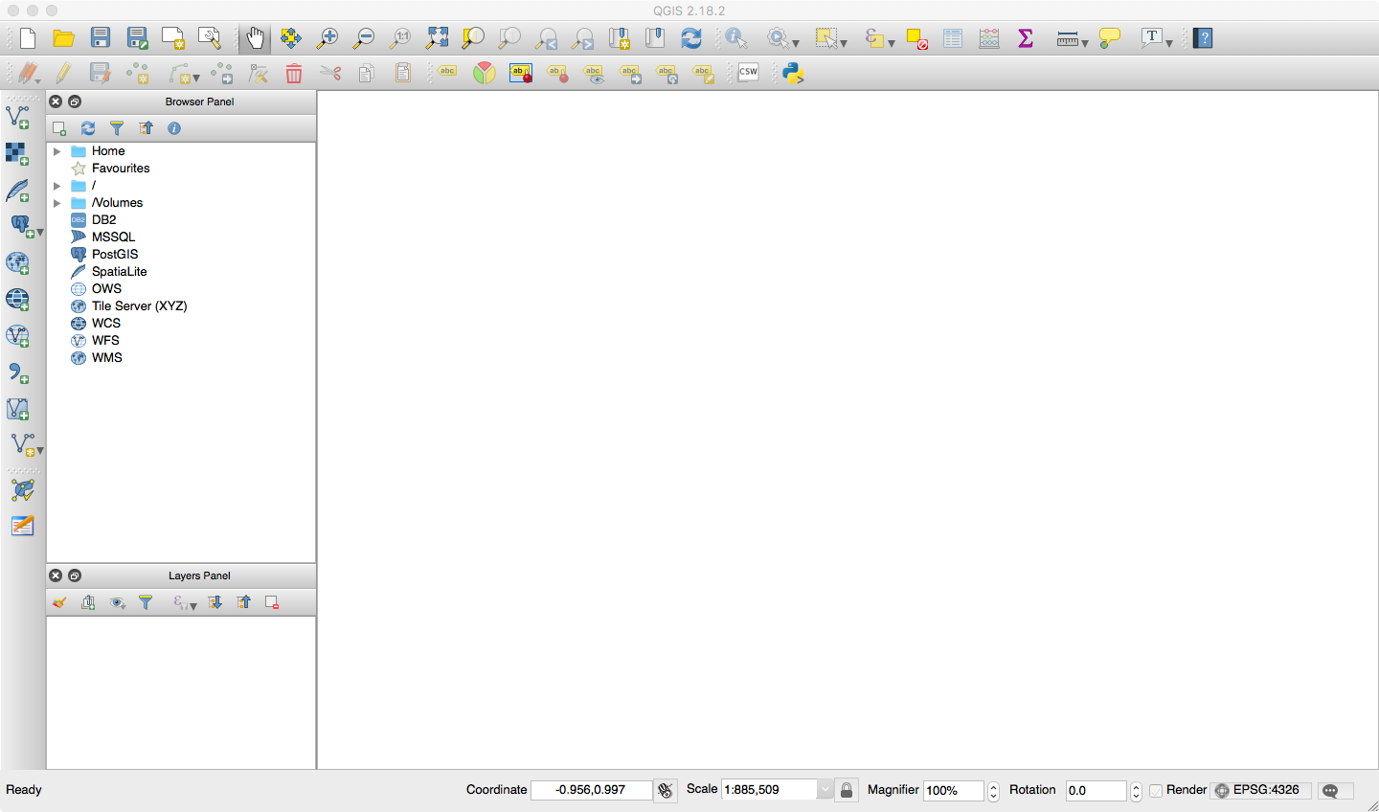
Geographic Information Systems
QGIS – A modern GIS GUI
All content licensed under CC BY-SA 3.0

Slide 5
Generalization
The real world is immensely complicated and representing it within a computer requires some deliberate simplification
Generalization is the practice of selecting the breadth or depth of features captured and/or displayed
Precision and detail of location or temporal measurements
Choice is led by the application requirements (how
the resulting maps will be used) and the practicality
or feasibility of data capture

Slide 6
Data Models
The two main data models used to store geographic features within a GIS include vector and raster.
A vector model presents a discrete view of space, with real-world objects represented through a series of defined structures that include points, lines, and polygons
A raster data model presents an alternate representation called a field view, which comprises an overlay grid across the entirety of a geographic extent

Slide 7
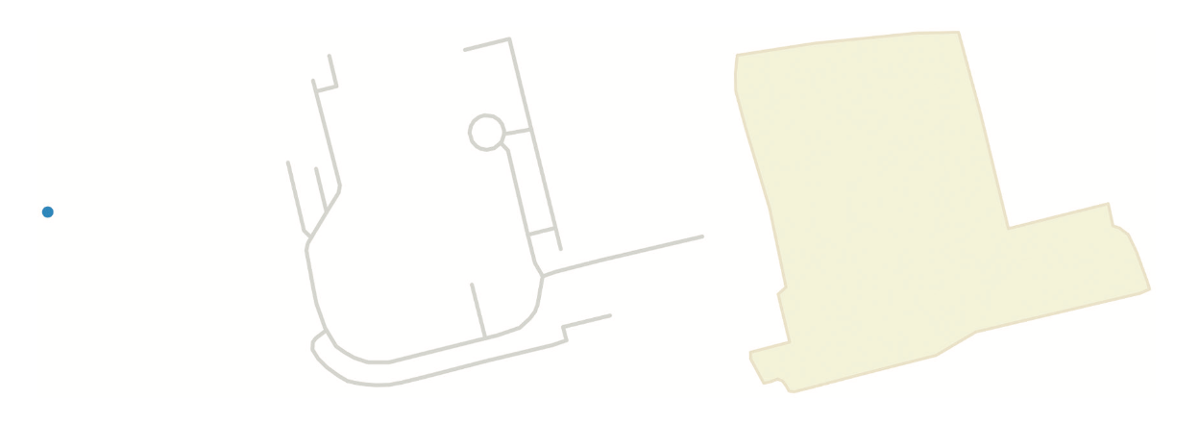
Data Models: Vector
The vector data model includes points, lines, and polygons Source: authors’ own; data – www.openstreetmap.org, © copyright OpenStreetMap

Slide 8

Data Models: Vector
A more complex polygon with a series of holes Source: Authors’ own; data – www.openstreetmap.org, © copyright OpenStreetMap

Slide 9
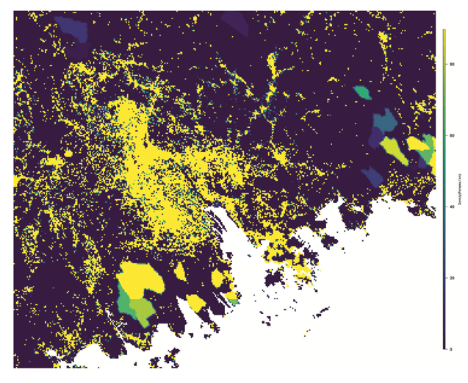
Data Models: Raster
Population in 1975
Population in 2015
Source: Authors own; Data: European Commission Global Human Settlement Layer http://ghsl.jrc.ec.europa.eu/
A raster data model used to illustrate population density in Guangzhou, Shenzhen, and Hong Kong, China

Slide 10
Geographic Information Systems
Early GIS often differentiated between software that managed features through raster or vector data models
Today there is increased fluidity between the use and visual representation of data stored in vector and raster models
Especially online

Slide 11
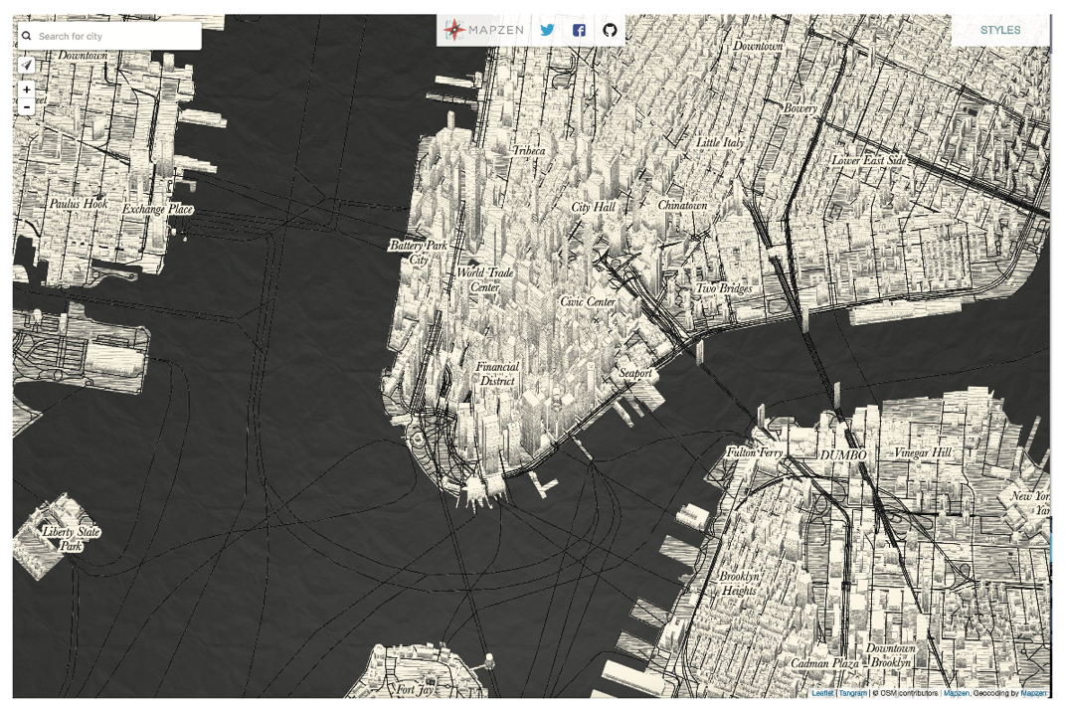
Geographic Information Systems
NYC rendered in a 3D drawn style as vector data within the Tangram platform from Mapzen
Source: Mapzen

Slide 12
Web Mapping Tiles
Most contemporary web mapping services present spatial data using a “slippy map”
Enables a user to pan a map seamlessly in the client browser at various levels of zoom
In raster applications this is achieved by taking an appropriately styled rendered map and splitting it up into regularly sized tiles
Styling of these tile layers may be altered depending on the intended scale (zoom)

Slide 13
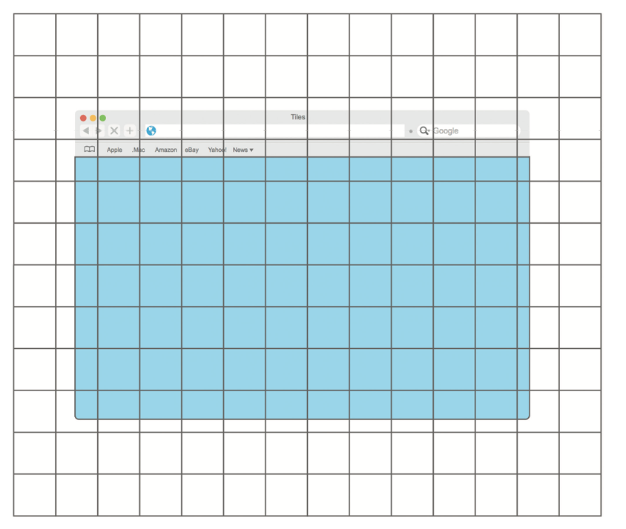
Web Mapping Tiles
The tiles that overlap the blue highlighted area would be visible to a user, while the other tiles are downloaded and hidden from view until the map is panned

Slide 14
Conclusions
GIS provide a tool for the encoding, management, analysis and representation of spatial features
Multiple data models
Vector v Raster
They require generalization

