Slide 1

Urban Visualization
Alex D. Singleton, Seth E. Spielman, David C. Folch (2017) Urban Analytics. London: Sage.

Slide 2
Learning Objectives
Data visualization is the art of presenting data graphically.
Urban governance can be assisted through visualization, and can also be used by citizens to lobby for change.
Effective visualization requires planning and consideration of visual hierarchy.

Slide 3
Visualization and Urban Governance
Graphics or maps might for example be implemented within operational tools
Increase transparency
the monitoring of progress toward strategic objectives
Integral to information platforms used to make strategic decisions

Slide 4
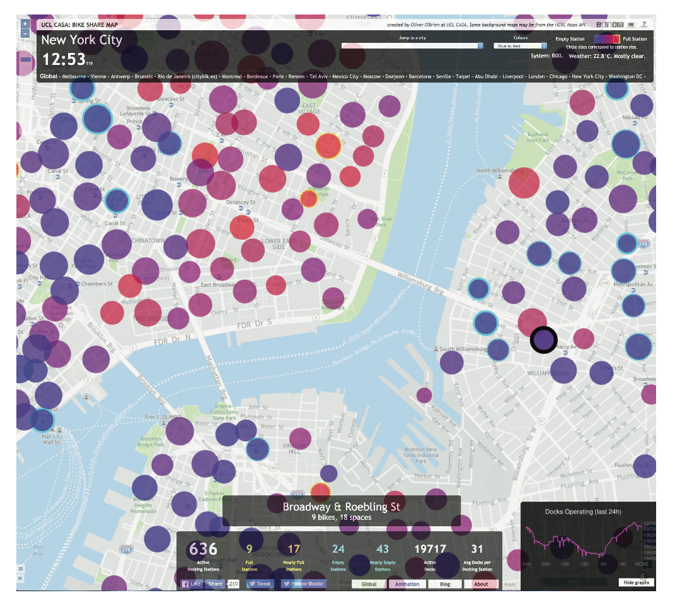
Data Dashboards
NYC bike share dashboard map showing live operating statistics for the Lower East Side of Manhattan and part of Brooklyn
Source: Oliver O’Brien, University College London (http://bikes.oobrien.com/newyork/). Reprinted with permission.

Slide 5
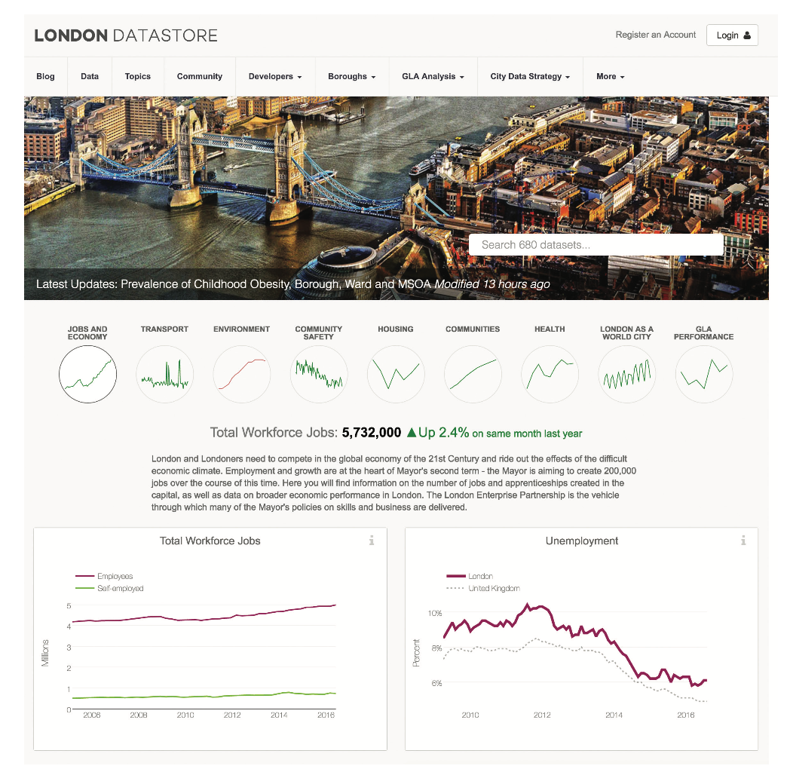
Data Dashboards
The London Data Dashboard uses graphs to display key longitudinal trends and also provides a link to the London Open Data Store
Source: https:// data.london.gov.uk/. Reprinted with permission.

Slide 6
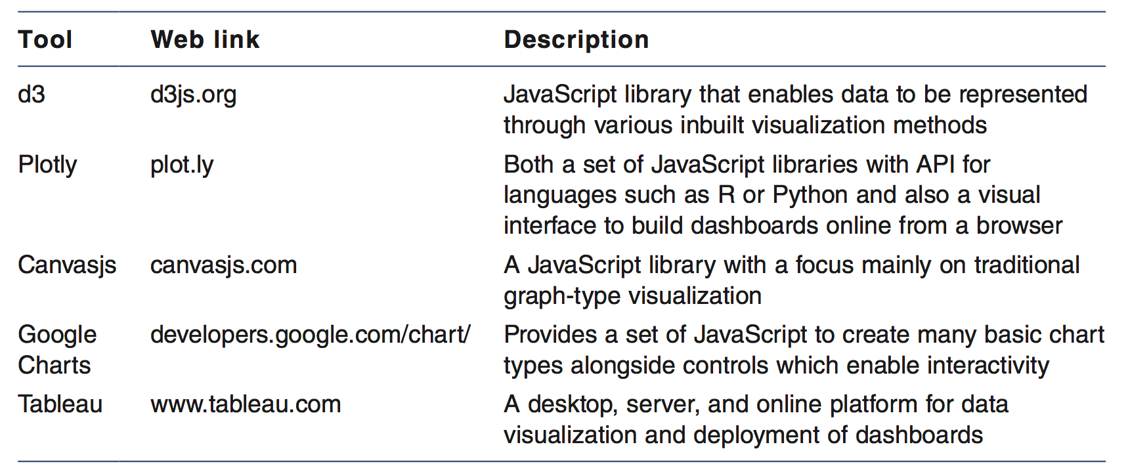
Data Dashboards
Common software and tools used to build data-driven dashboards

Slide 7
Community Empowerment
Early 2016 the Metropolitan Transit Authority (MTA) within NYC announced that the L subway line in New York may need to be closed for a significant period to enable repair work.
Arterial route that connects Brooklyn and Manhattan
Spatial data and mapping company Carto looked at the problem
American Community Survey (ACS)
Longitudinal Origin–Destination Employment Statistics (LODES)

Slide 8
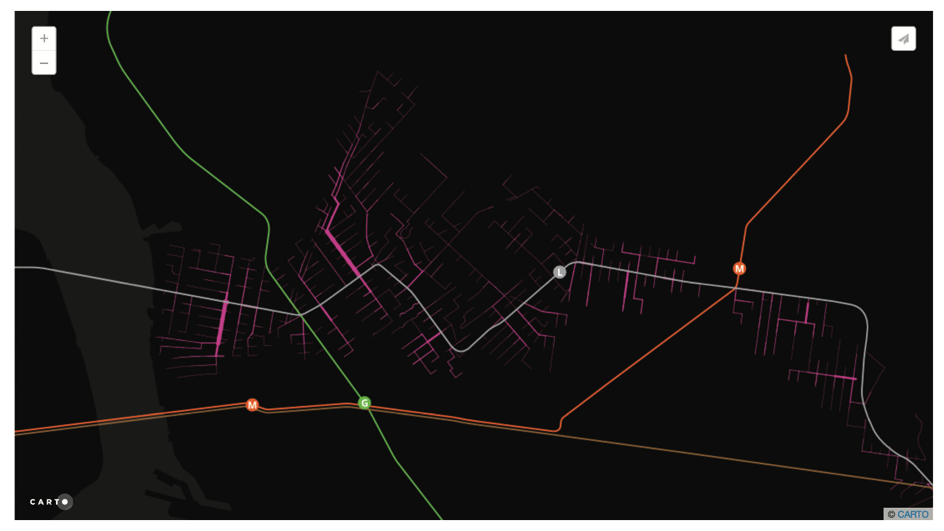
Community Empowerment
The most likely paths taken by the 114,000 people walking to the L train for their commute to work
Source: Map created by Mamata Akella, Carto. Reprinted with permission

Slide 9
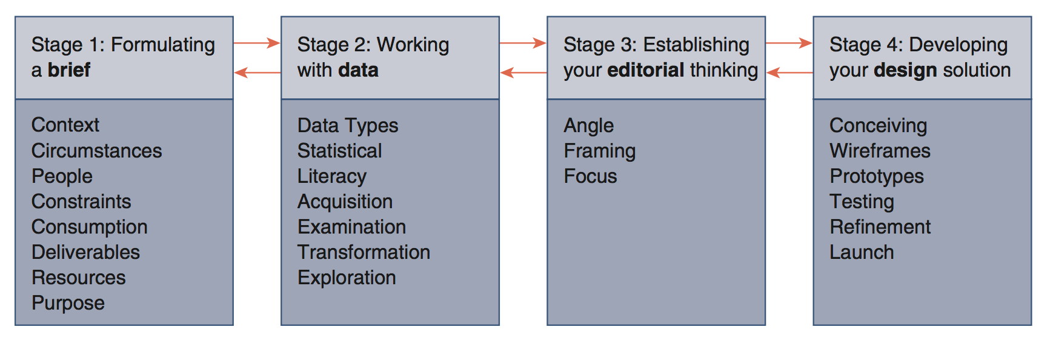
Making an effective visualization
Four stages of a visualization work flow
Source: adapted from Kirk (2016)

Slide 10



Making an effective visualization
Visualization must provide structure
Provided through a visual hierarchy
Color
Symbol
Size
Texture
Placement

Slide 11
Conclusions
Visualization can be a power tool for communication
Has great utility for
Community empowerment
Strategic decision making
Increasing transparency
Effective visualization require careful consideration of the visual hierarchy

