Slide 1

Urban Mapping
Alex D. Singleton, Seth E. Spielman, David C. Folch (2017) Urban Analytics. London: Sage.

Slide 2
Learning Objectives
There are numerous visualization methods applicable to spatial data.
Care is required when selecting an appropriate technique.
An understanding of those main types of geographic visualization.

Slide 3
Geographic Visualization
There are many different types of geographic visualization
Selecting an appropriate technique depends upon
the data being displayed
the message that the graphic aims to convey

Slide 4
Choropleth
To make a choropleth map you need
A variable – e.g. average rent
And a set of places – e.g. neighborhoods
Assign each neighborhood a color according to its rent
Shaded zones represent variables using color
Categorical values (uptown, midtown, downtown)
Continuous values (average rent by neighborhood that ranges from $500–$3000)
Diverging (above average or below average rent)
Aim: show geographic patterns in the distribution of the variable being mapped

Slide 5
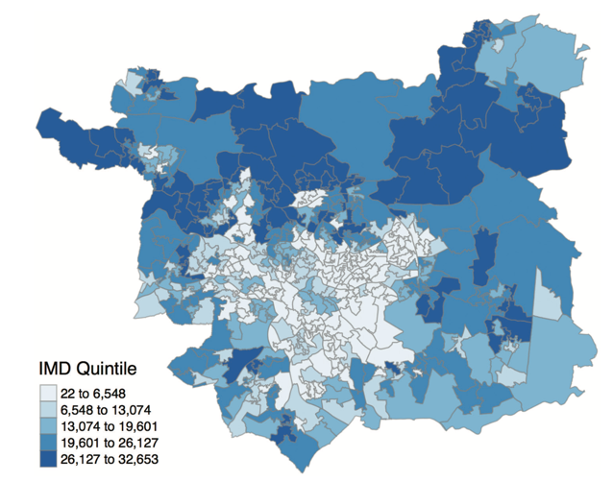
Choropleth
When attributes being mapped are continuous or diverging
Choose breaks in these distributions that create categories which are then assigned a color
What are the limitations of a choropleth map?
An example choropleth map showing the Index of Multiple Deprivation (IMD) in Leeds, UK. Breaks in the rank distribution were created using quintiles.
Source: Authors’ own; data – Department for Communities and Local Government (2015)

Slide 6
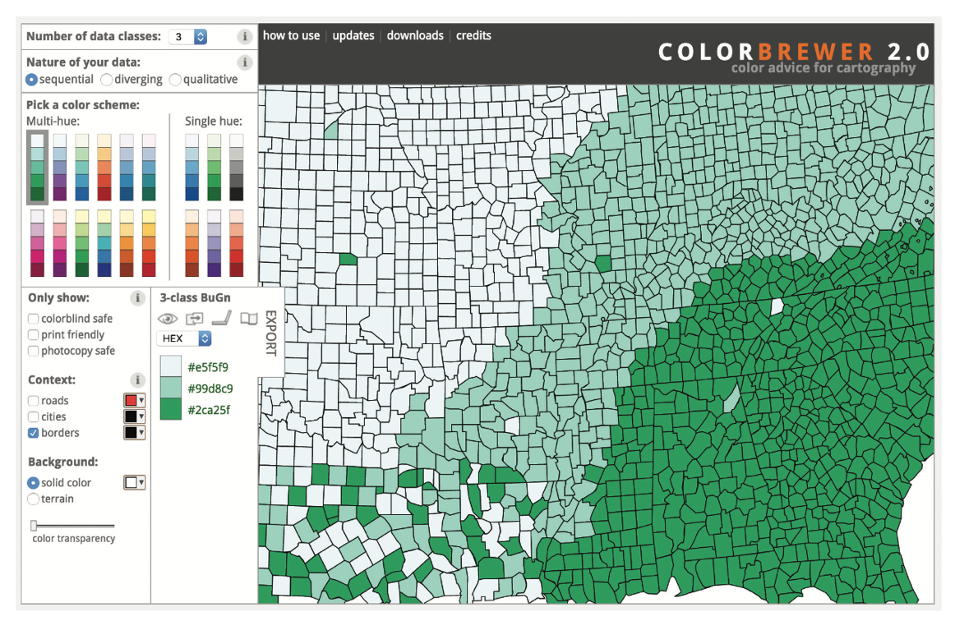
Colorbrewer

Slide 7
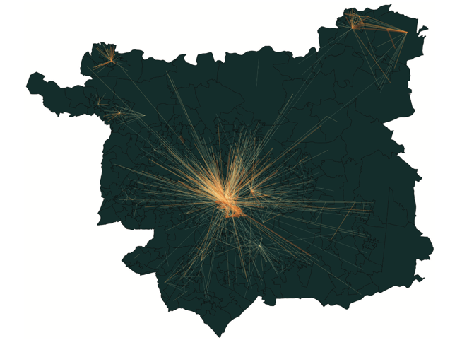
Flow
When relationships between features being mapped are known, it is sometimes useful to illustrate these by connecting them with lines
Shaded or scaled to indicate a volume of flow
Linear or real-world topology
The aggregate flow of commuters in Leeds, with lighter and thinner lines indicating smaller flows
Source: Authors’ own; data – Office for National Statistics (2011)

Slide 8
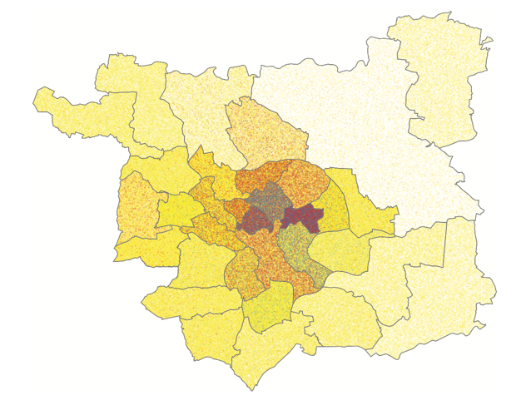
Dot Maps
Best used to show the location of events
But sometimes used to display zone based data
Can be used to represent the mix of different groups within zones
However, placement of points communicates a spurious level of precision
A dot density map for Leeds showing the mixing and density of people declaring themselves as being of White (yellow), Asian (red), or Black (blue) ethnic groups
Source: Data – Office for National Statistics (2011)

Slide 9
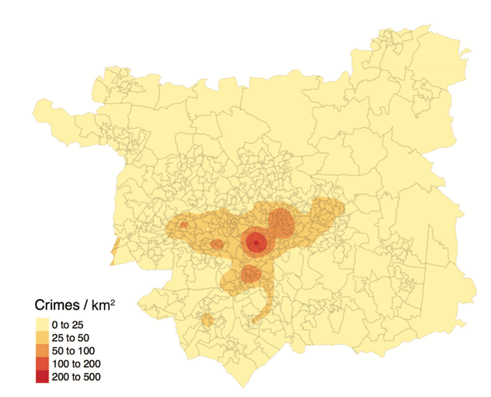
Heat Maps
Aims to resolve the issue of plots with high density of dots
Overplotting; makes patterns difficult to see
Uses kernel statistics
e.g. KDE
Creates color contours for intensity of points
A heat map representation of the location of crimes within Leeds Source: Authors’ own; data – Police.uk

Slide 10
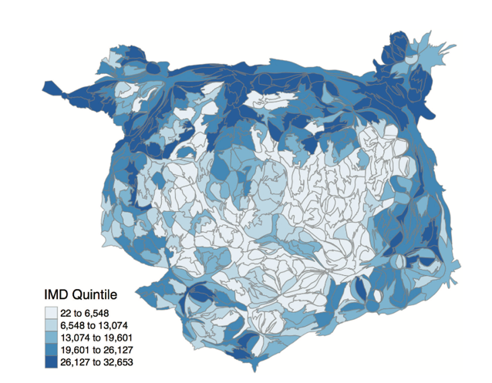
Cartograms
Variety of forms
Share a commonality that each zone is re-proportioned to be relative to some measure
Commonly total population
Distortion reduces the size of zones with lower population
May also be colored
An area cartogram representation of the IMD for Leeds, with the areas scaled in proportion to their total population
Source: Authors’ own; data – Department for Communities and Local Government (2015); Office for National Statistics (2011)

Slide 11
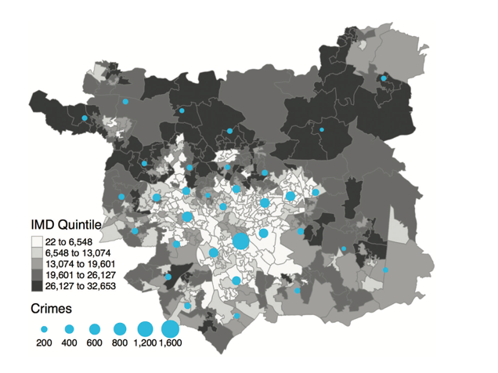
Proportional Symbol
Scales a set of symbols based upon some value
Often combined with choropleths
Can be quite cluttered
Scaled symbols used to indicate the relationship between the total numbers of recorded crimes in August 2016 and the IMD. Larger circles equate to more crimes.
Source: Authors’ own; data – Police.uk (2016 data); Department for Communities and Local Government (2015)

Slide 12
Conclusions
Numerous geographic data representation techniques
All have advantages/disadvantages
Choice depends greatly on the type of data and the message that one wishes to convey/intended audience

