Slide 1
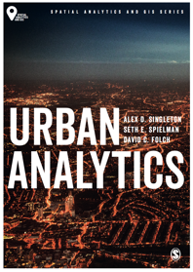
Explanatory Urban Models
Alex D. Singleton, Seth E. Spielman, David C. Folch (2017) Urban Analytics. London: Sage.

Slide 2
Learning Objectives
Correlation provides a useful method to examine relationships within data.
Regression is a flexible tool for helping to understand complex relationships within cities.
Urban data are spatial data and these can be statistically problematic when used in a model, but there are techniques to explicitly account for spatial patterns.

Slide 3
Correlation
Correlation measures the extent to which attributes are related
There are three steps:
Measure the average deviation from the mean (standard deviation)
x_{i} - x̅
Measure on average, how far away a data point is from the mean – Standard Deviation
Compute the z-score, which tells how far away a given observation is from the mean
Z_{i}=(x_{i}- x̅)/s.d.
Correlation statistic r is just the average of the product of the z-scores
r = (z1 ∗ z2 ) /n

Slide 4
Spatial Proximity
A key assumption in most statistics is that the observations are independent from one another
Proximity that drives many of the most important relationships within cities can be problematic for statistical models
The magnitude of a variable at one location should not be correlated with the magnitude at nearby locations, a phenomenon called spatial autocorrelation
Common in an urban context

Slide 5
Spatial Autocorrelation
Two types – substantive and nuisance
Substantive relationships are those deriving from the interdependence of actors and activities in nearby locations.
Nuisance spatial autocorrelation is grounded in data problems stemming from a mismatch between the actual spatial footprint of the phenomenon being studied and the available data.
Testing for spatial autocorrelation and incorporating it into a model requires a formal specification of the spatial structure

Slide 6
Spatial Autocorrelation
Done through a spatial weights matrix and spatial lag
Spatial weights matrix is an n*n square matrix, designated as W, where each element, w_{ij} describes the strength of the spatial relationship between each of the n spatial observations.
Three types of weights matrices: contiguity, distance, and nearest neighbors.
The key goal is that the weights provide a reasonable approximation of the spatial structure relative to the study area and the research question

Slide 7
Spatial Autocorrelation
Contiguity matrix
Binary: a one is entered in the weights matrix if two polygons are neighbors, and a zero otherwise.
Rook
Queen
Distance weights matrix considers the distance between observations.
The nearest neighbors approach defines the k closest points to an observation as its neighbors, where k is an integer defined by the analyst.
The nearest neighbor matrix is also binary.

Slide 8
Explanation
Regression is a statistical framework that allows us to predict how the mean of a dependent variable changes as an independent variable changes.
Regression models are useful when you have reason to believe that the mean of one variable is dependent on some other variable or variables.
Many different specific models based on the characteristics of the data and the goals of the analysis.

Slide 9
Ordinary least squares (OLS)
Regression models require the use of some mathematical notation
The thing we want to explain as y;
X is the data that we will use to help us understand y;
β describes the strength of the relationship between y and X.
We have many observations so we use the subscript i to refer to a single observation
We may have more than one potential explanatory variable x, so we use a numeric subscript to indicate a specific independent or explanatory variable, e.g. x_{i1} .

Slide 10
Ordinary least squares (OLS)
We start with some independent variables – e.g. x₁ and x₂ that we have reason to believe have meaningful relationships to the dependent variable, y.
Multiple observations (i 1,2,3,...,n) are needed for each of these variables, where n is the total number of observations in the dataset.
e.g. dependent variable might be the percentage of workers who commute by bike, with the independent variables being the total miles of bike lanes and number of days with measurable precipitation, and the n observations being all cities in the United States with more than 100,000 residents.
These data are used to estimate the parameters in the model, β0, β1, and β2.

Slide 11
Ordinary least squares (OLS)
The magnitude of a parameter describes the strength of the relationship between the independent and dependent variables, and the sign, either positive or negative the direction of the relationship.
e.g. one might expect that more bike lines will correspond to more bike commuters (positive relationship), while more inclement days will correspond to fewer bike commuters (negative relationship).

Slide 12
Ordinary least squares (OLS)
ε_{i}, represents the variation in the dependent variable that is not explained by the independent variables.
y_{i} =β₀ +β₁x_{i1} +β₂x_{i2} +ε_{i}

Slide 13
Example…
OLS regression results for Census Tracts in Phoenix, Arizona
Percent insured (dependent variable)
Independent variables
percent unemployed (pct_unemp)
percent 65 and older (pct_65over)
percent married (pct_mar)
percent white (pct_white)
percent Hispanic (pct_hisp)

Slide 14
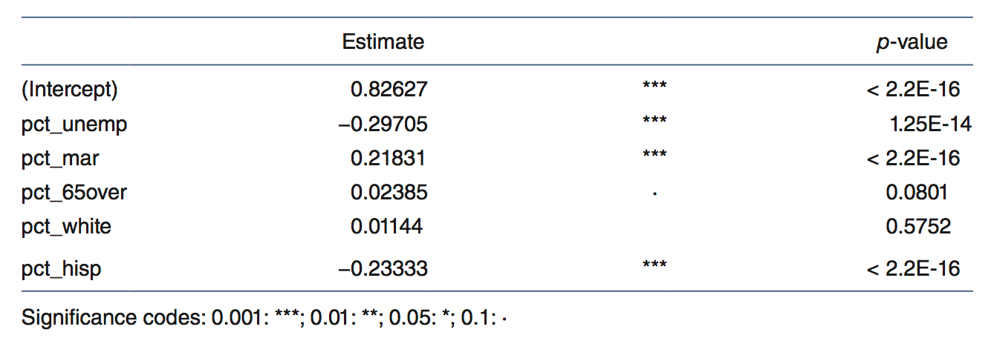
Example…
Ordinary least squares (OLS) results for health insurance coverage rate in Phoenix
Source: Authors’ own. Data from Minnesota Population Center: National Historical Geographic Information System (http://www.nhgis.org)

Slide 15
Example…
Places with higher unemployment have lower rates of insured residents (indicated by the negative sign on the parameter) and places with more married people have more insured people.
statistically significant (indicated by the stars on the coefficients), meaning that the reported relationship holds in most cases.
In contrast, having more people 65 and older is only marginally significant (p-value 0.08)
The relationship often holds, but not enough to consider it a strong relationship between the dependent and independent variables.
The R² statistic in the table indicates that the variables selected explain 72.82 percent of the variation in the insured rate across Phoenix neighborhoods.
What might the problem be with this model?

Slide 16
Conclusions
Correlation can be used to assess relationships within data for urban areas
Regression models have utility in explaining the magnitude and significance of relationships
There are issues with basic OLS when considering geographic problems that relate to spatial auto-correlation

