Slide 1
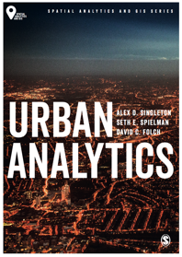
Future Urban Analytics
Alex D Singleton, Seth E Spielman, David C Folch (2017) Urban Analytics. London: Sage.

Slide 2
Learning Objectives
Some key themes running through this course.
Where urban analytics is likely to develop in the future.

Slide 3
How Do We Ask Questions of Urban Systems?
Managing cities has been and always will be an intensely political business as com- munities and groups advocate for (and against) change.
Future of city management and planning is going to be increasingly data driven
New kinds of urban computational infrastructure that enable the process of turning spatial data into actionable insight are becoming more important

Slide 4
How Do We Ask Questions of Urban Systems?
Data infrastructure is far from complete
the trade-off between the breadth and geographic scale of attributes being measured by many new forms of urban data versus their incompleteness or uncertainty
cost to collect, store, and disseminate the data
Ethics and privacy
Increasing role for artificial intelligence in simple data collection and processing tasks
More automation or algorithmic management of aspects of cities

Slide 5
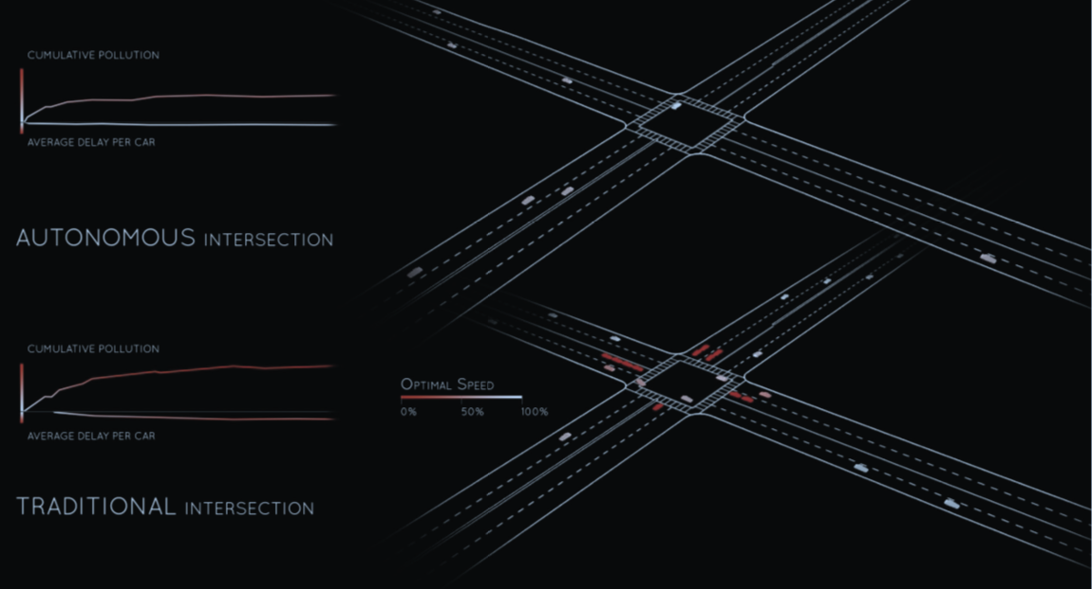
How Do We Ask Questions of Urban Systems?
MIT researchers work on intelligent intersections that simulate the coupling of traffic control (lights) with autonomous vehicles to enhance efficiency and reduce emissions
Source: senseable.mit.edu/wave/, a project by MIT Senseable City Lab

Slide 6
Urban Analytics Tools
Urban analytics therefore currently moves quite substantially away from a single integrated software platform
Requires a toolbox (not a single tool)
Fragmentation is understandable given that urban analytics brings together multiple disciplines
Prevalent for an analyst to couple multiple tools (and their constituent methods) together, running these programmatically and often utilizing distributed data

Slide 7
Urban Analytics Tools
It is likely we may see some convergence built around both key mechanisms of communicating information, such as maps and dashboards, and also tighter coupling to data

Slide 8
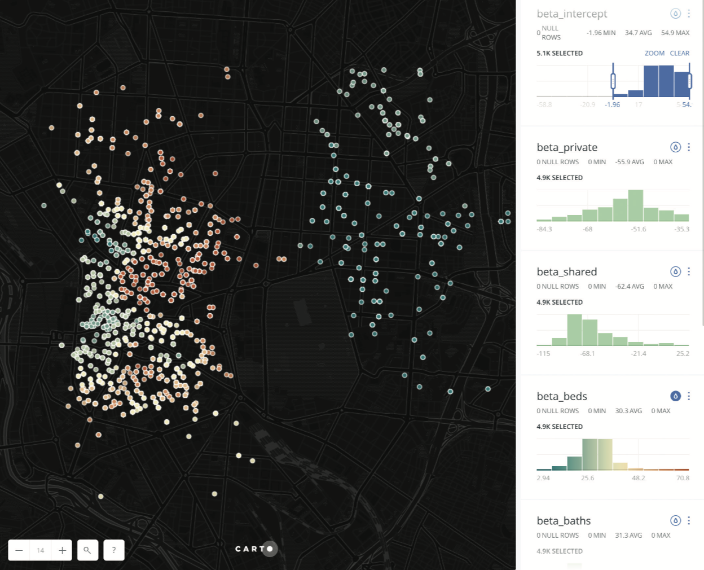
Urban Analytics Tools
Emerging interfaces may move future urban analytics back toward platforms; such as this Carto interface to a geographically weighted regression model
Source: Carto/Transparent Intelligence, Inc.

Slide 9
Cities Are Not Always Best Represented as Layers
Layering geographic data remains very helpful within many applications
Such a worldview might also be presented as a constraint for some urban applications
Thematic mapping may not always be appropriate
Given the deluge of real-time data within urban environments or wider consideration of dynamics or emergence, static mapping may hide these processes

Slide 10
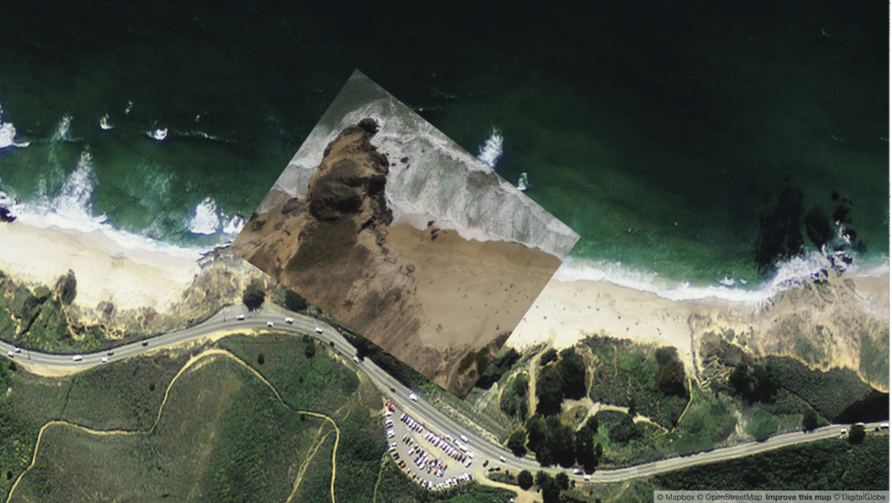
Cities Are Not Always Best Represented as Layers
The company Mapbox layers a dynamic video captured by a drone over high-resolution satellite imagery using the Mapbox GL JS framework
Source: https://www.mapbox.com/drone/video/ Mapbox, OpenStreetMap

Slide 11
Increasing Prominence of Visual Analytics and Data Synthesis
Volume of data in the world is growing much faster than the volume of data scientists
Generates a demand and a role for visual analytics and data synthesis through dimensionality reducing frameworks
Provide a more accessible interface to complex datasets and can complement more explanatory frameworks
Closer coupling of both new explanatory and exploratory techniques
increasingly prominent role in how deci- sions are made within urban environments, or how stakeholders can be effectively engaged in the decision-making process.

Slide 12
To the Future….?
Linked role of artificial intelligence (AI) and machine learning will continue to grow in popularity as a tool for exploring urban systems
Automation of urban systems, for example, the development of infrastructure that run autonomous vehicles, or in the “smartening” of cities
Integral to numerous emerging analytic techniques associated with the processing of Big Data
Analysis of imagery
Coverage and quality of the data improve, alongside emerging methods enabling the extraction of new information

