Slide 1
ThreadPilot
Morning summary
Generated 07:00
Yesterday
The General Manager's Co-Pilot
2,567 pieces across four stages; Washing below normal.
Top issue
DSS5105 Capstone · Track 1
Sprint 1 live presentation · Friday 16 October 2026
Still open: All 6 active TrendCart orders have stopped moving.
Decide
Matthew · LIU JING · Kevin Royce Thomson · Anqi Lin · Wendy
6 overdue, 9 due this week.
ADD: sixth team member's name and the group number
Real output of our briefing demo (simulated, 9 April 2026)
Notes:
~10 seconds. Whole talk about 4:40, leaving about 20 seconds of slack.
ThreadPilot is a co-pilot for the general manager of a knitwear factory. The card on the right is what the manager sees first: three lines, from our briefing demo on a simulated morning, 9 April 2026.
[Add before presenting: group number and the sixth team member's name.]

Slide 2
A GM's questions don't stop at 7 a.m.
“Did anything go wrong yesterday?”
Morning briefing in three lines: what happened, what is at risk, what needs a decision
7:00
“How is the TrendCart order doing?”
Asks which one. TrendCart has six orders; it does not guess
9:40
“Can we take 800 hoodies by the 25th?”
A date range with its assumptions, never a plain yes
11:15
“That order hasn't moved in a week.
Chase it up.”
Drafts the chase-up; sends only after you confirm, then logs it
14:30
“Remind me tomorrow if
packing is still behind.”
A standing watch that checks the data and alerts on its own
17:00
Notes:
~40 seconds.
These five questions come straight from the Track 1 brief. Today each one costs a phone call to a planner and a wait. The right-hand column is how ThreadPilot answers: a three-line briefing, ask rather than guess, estimates with assumptions, confirm before acting, and watches that fire on their own.

Slide 3





A designed tool set, not a chat window
TOOL KIND
WHAT OURS DOES
DELIBERATELY DOES NOT
Retrieval
Typed order look-ups, plus a read-only SQL agent (SELECT only) for everything else
Pick the first match when several fit
Judgement
“Normal” = mean of the previous 8 same weekdays ± the larger of 1.5 SD or 5%; Sundays closed
Treat one low day as proof of a fault
Tracing
Every number links to the source file and row behind it
Explain causes the data does not hold
Discovery
Ranks stalled customers, quiet orders and stages below normal; the top five make the page
List every finding
Action
Preview, then a 15-minute confirmation key; every executed action is logged
Send without a matching, unexpired key
33 tools specified in one table: input, output, purpose, non-goals, failure mode. The language model never does the arithmetic.
Notes:
~55 seconds.
The brief says the centre of the track is the tool set, so we specified every tool before building it: 33 in one table, each with its limits. Five kinds are the minimum.
Judgement is the one to remember: 'normal' is an explicit rule, the previous 8 same weekdays with Sundays closed, and the briefing, the chat and the dashboard share it. A test holds them to identical numbers. Action tools never send on their own: preview, confirmation key, audit log.
(Reference, if asked) Stack: FastAPI, MySQL 8, a SQLite store for sessions and confirmations, the OpenAI API for understanding and wording only, and a LangChain read-only SQL agent. docs/tool_spec.md lists 15 tools for the live backend and 18 for the dashboard chat.

Slide 4
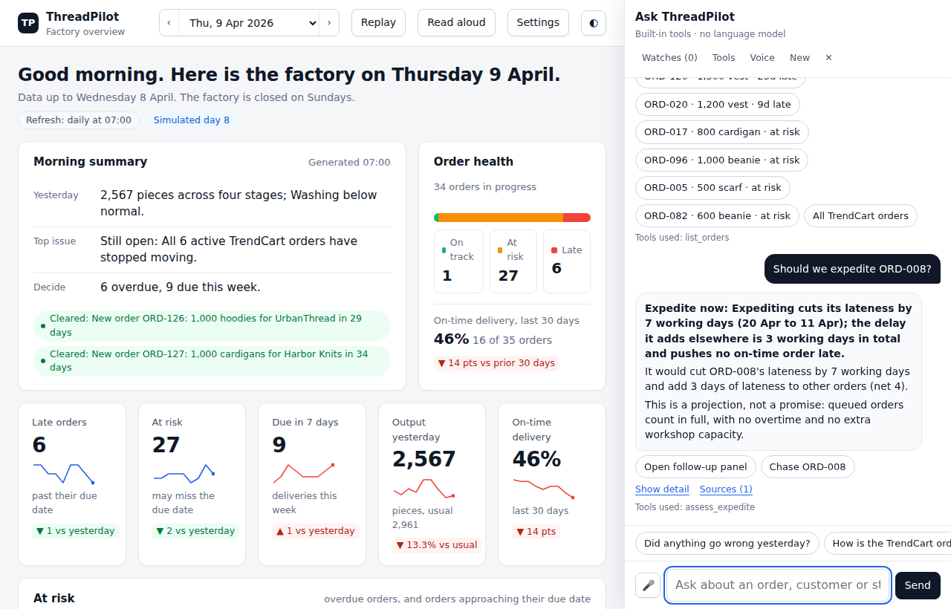
Concise first, evidence one click away
1
Three lines first
Yesterday, top issue, decision: readable at a glance.
2
Plain-words answers
“Should we expedite ORD-008?” Expedite now: saves 7 working days, adds 3 elsewhere. A projection, not a promise.
3
One click to the rows
Show detail, Sources and the tool used sit under every answer.
Briefing demo, simulated morning of 9 April 2026 (day 8). The demo chat uses built-in tools, no language model.
Notes:
~75 seconds. Live demo or screenshot walk-through.
Run these on 9 April (date picker, 'Simulated day 8'), in this order:
1. 'Did anything go wrong yesterday?' The three-line briefing, then Show detail.
2. 'Which orders are high risk?'
3. 'Should we expedite ORD-120?' The answer is 'find the blocker first': it is part of the stalled TrendCart group.
4. 'How is the TrendCart order doing?' It asks which of the six orders you mean.
5. 'Can we take 800 hoodies by the 25th?' A range with stated assumptions.
6. 'What's our revenue this month?' A refusal: the data holds no prices.
7. 'Chase ORD-120', then confirm.
Say clearly: this demo chat is built-in tools, not a language model. The live backend (OpenAI model + MySQL) is the full system.

Slide 5
What we measured, and what we haven't
25 / 36
first pass, nothing fixed yet (69%): the honest figure
18 / 21
held-out questions with new wording (86%)
5 / 5
planted events found by discovery, 1 to 5 days after each began
14 / 14
feasibility ranges that contained the real finish
Dashboard chat. The last two come from our own simulator: internal consistency, not real-world accuracy.
Not measured yet: accuracy of the live backend (OpenAI model + MySQL) on these questions. We will run it once and report that as first-pass.
Notes:
~60 seconds.
36 questions, with expected answers computed from the CSV files by code that does not use the briefing. First pass, nothing fixed: 25 of 36, 69%. That is the number we stand behind. After the first fixes, 21 new held-out questions with different wording gave 18 of 21.
Weakest first-pass areas were multi-turn, ambiguous questions and actions; unanswerable and feasibility questions passed 6 of 6. The set has 11 ambiguous-or-unanswerable and 11 feasibility-or-action questions, against the brief's minimum of 5 and 5.
Discovery and feasibility results come from our own simulator, so they show consistency, not real-world accuracy. Not yet measured: the live OpenAI-backed system. We wrote these questions ourselves, so teammates will add their own.

Slide 6
Where we are, and what comes next
What we have not proven
Next, from our own documents
Predictions were checked against our own simulator, which follows the same scheduling rule
The two-week order forecast is no better than repeating the last period
The data holds about 29 working days of work in progress against 12 to 30 days allowed, so almost every order is late and risk levels barely separate
1
Run the live-model evaluation once and report it as first-pass
2
Teammates add at least 10 questions each, written without reading the code
3
Move the briefing's findings onto the live MySQL data
4
Bring Morning Briefing into the team's cloud site (merge prepared)
Sprint 1
Sprint 2
Sprint 3
Final zip
Fri 16 Oct · this talk
Fri 30 Oct
Fri 13 Nov
Sun 15 Nov · GroupNN.zip
ADD: what Sprint 2 and Sprint 3 will deliver, and who owns each part
Notes:
~40 seconds.
Limits first. Predictions were validated against our own simulator, so they show consistency, not real-world accuracy. The order forecast is no better than repeating the last period, and the dashboard says so. The data holds about 29 working days of work in progress against 12 to 30 allowed, so nearly every order is late.
Next: run the live-model evaluation once, add teammates' questions, move the briefing onto the live MySQL data, and bring Morning Briefing into the team's cloud site. Sprint 2 is Friday 30 October, Sprint 3 Friday 13 November, final zip Sunday 15 November.
[Add before presenting: what Sprint 2 and Sprint 3 will deliver, and who owns each part.]

