Slide 1
Data Mining
(WQD7005)
Predicting Stock Price Movements
Using Bursa Announcements
Foo Wai Lun (WQD170073)
December 12, 2019

Slide 2
Project Milestones
Acquisition of Data ✓
Management of Data ✓
Processing of Data ✓
Interpretation of Data ✓
Communication of Insights ✓
⇓
Recommendations

Slide 3
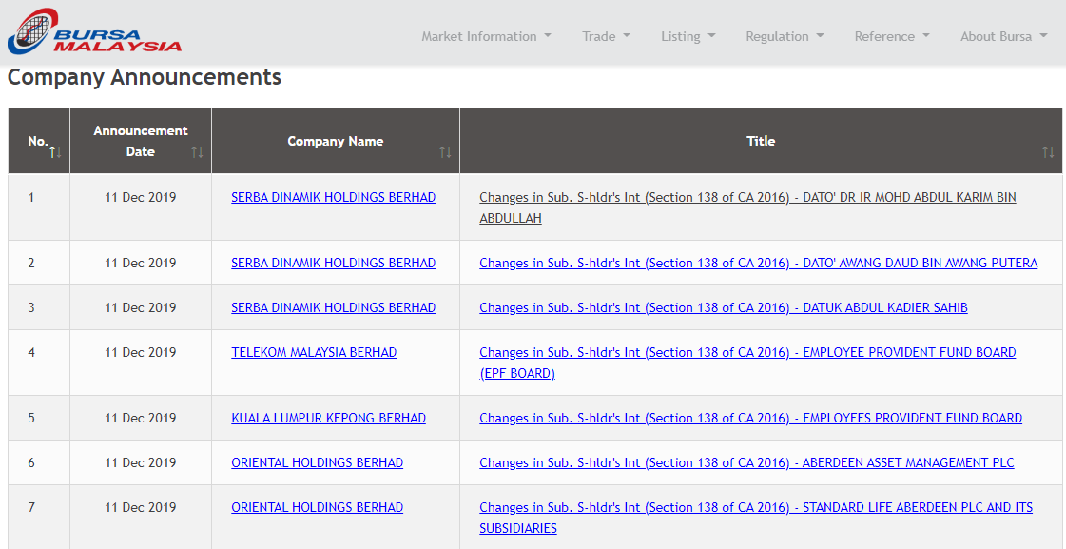
Understanding the problem
What action should you take when a major shareholder acquire/dispose shares?
Material announcements may impact share prices!
Investor must decide whether to buy, sell, or hold quickly.

Slide 4
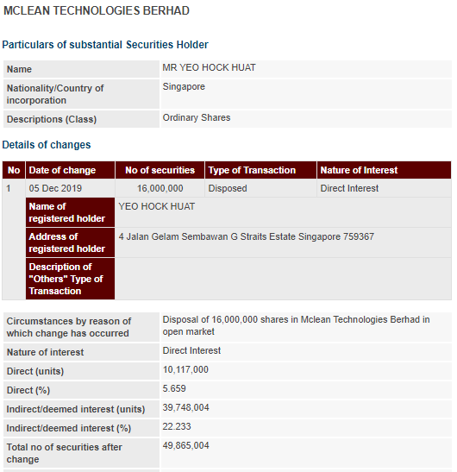
Understanding the problem
All announcements are inherently different.
Item 3
Market may react differently depending on the:
Transaction (% of shares transacted, acquisition/disposal)
Shareholder (reputation, % held in the company, etc.)
Company (sector, shariah or non shariah, availability for short-selling etc.)
Excepteur sint occaecat cupidatat non proident, sunt in culpa qui officia deserunt mollit anim id est laborum.

Slide 5
Data
Extracted information from more than 1,000 announcements in Bursa Malaysia, from Jan 2018 to Nov 2019. The focus is on the ACE Market in this project.
Analysed for patterns against the the average share prices of the companies of the next 5 trading dates after the announcements.

Slide 6
Features
These are the shortlisted variables to make prediction.
The Announcement
Types of transaction (i.e. acquisition or disposal of shares)
Size of the transaction (i.e. how many % of the company total shares)
The Shareholder
Size of ownership (i.e. how many % of the company total shares)
The Company
Sector
Shariah or Non-Shariah Compliant
Short Selling Available

Slide 7
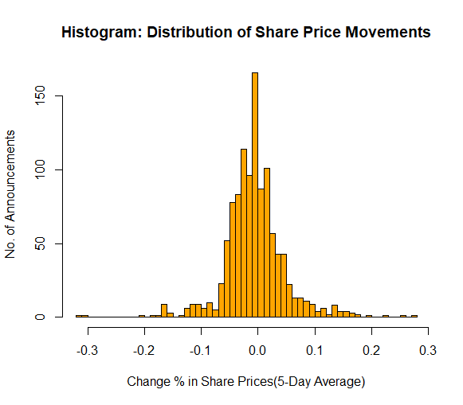
Insights #1
What can you expect to see in share prices after the announcements?
The possible outcomes are quite balanced based on historical data.
DOWN (4% or worse) | DOWN (1%- 4%) | STAGNANT | UP (1% to 4%) | UP (4% or better)
216 | 293 | 166 | 245 | 191
DOWN (1% or worse) |  | STAGNANT | UP (1% or better)
509 |  | 166 | 436

Slide 8
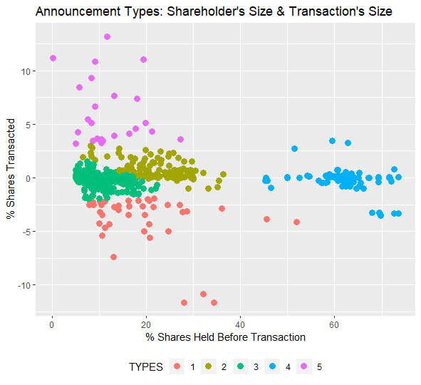
Insights #2
How many types of announcement were there?
Small shareholders’ small transaction (Type 3)
Large shareholders’ small transaction (Type 4)
Medium shareholders’ small transaction (Type 2)
Large acquisition announcement (Type 5)
Large disposal announcement (Type 1)
Type 1 | Type 2 | Type 3 | Type 4 | Type 5
74 | 220 | 524 | 255 | 38

Slide 9
Insights #3
Is it normal to have high % of shares transacted?
No. Most transactions were below 2.5% (see Type 3, Type 2, Type 4)
For the past 2 years, there were only few instances of acquisition or disposal exceeding 10.0% of company total shares (see Type 1, Type 5)
Type 1 | Type 2 | Type 3 | Type 4 | Type 5
74 | 220 | 524 | 255 | 38
Recommendation
Exercise care in these rare situations; the outcome may vary from case to case and may be unpredictable.

Slide 10
Recommended
Actions

Slide 11
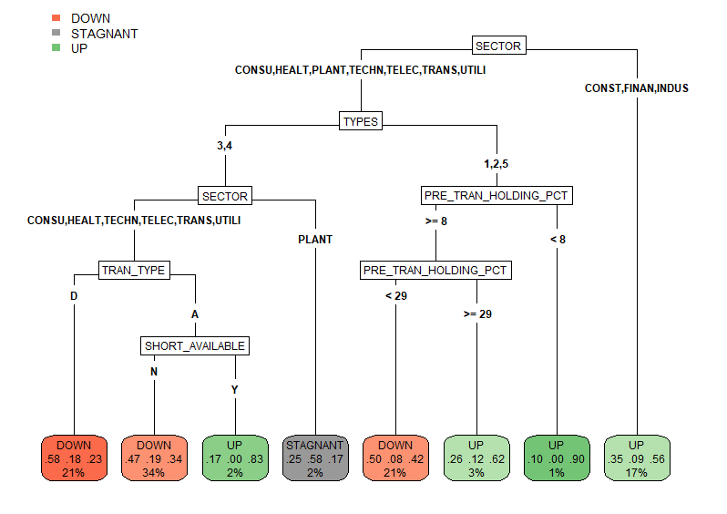
Hold
1. If the announcement is related to Plantation, and the announcement type is either Type 3 (Small S/holder Small Transaction), or Type 4 (Large S/holder Small Transaction), you can expect the share price to remain stagnant after the announcement - HOLD.
Recommendation
HOLD based on Sectors, and Announcement Types
1

Slide 12
Immediate Sell
1. If the announcement is a Disposal related to Consumer Products & Services, Health Care, Technology, Telecommunications and Media, Transportation & Logistics, or Utilities, and the announcement type is either Type 3 (Small S/holder Small Transaction), or Type 4 (Large S/holder Small Transaction), you can expect the share price to drop in most cases - SELL
1
Recommendation
SELL based on Sectors, Announcement Types, and Transaction Types

Slide 13
Immediate Buy
1. If it is related to Construction, Financial Services, or Industrial Products & Services - BUY
2. If it is related to other sectors, announcement Type 1 (Large Disposal), Type 5 (Large Acquisition) or Type 2 (Medium S/holder Small Transaction) , and s/holder holds < 8% or ≥ 29% - BUY
3. If short-sell is Yes, it is an Acquisition related to Consumer Products & Services, Health Care, Technology, Telecom. and Media, Trans. & Logistics, or Utilities, announcement Type 3 (Small S/holder Small Transaction), or Type 4 (Large S/holder Small Transaction) - BUY
Recommendation
BUY based on Sectors, Ann. Types, S/holding %, Trans. Types, Short-Selling
3
2
1

Slide 14
Conclusions:
Recommendation 1
Exercise care in rare situation, especially when the acquisition or disposal exceeds 10%.
Recommendation 2
NO ACTION when criteria are fulfilled
(please refer Slide 11)
Recommendation 2
Recommendation 3
IMMEDIATE SELL when criteria are fulfilled
(please refer Slide 12)
Recommendation 4
IMMEDIATE BUY when criteria are fulfilled
(please refer Slide 13)
BUY based on Sectors, Ann. Types, S/holding %, Trans. Types, Short-Selling
Recommendation 5
Shariah compliant has no material effect on investment action

Slide 15
THANK
YOU

