Slide 1
C Lang
By: Lt Felipe Pineda

Slide 2
Overview
¿Quien Soy Yo?
What is C Language?
C vs Python
How does it fit in the Malware world? 👾🌎

Slide 3

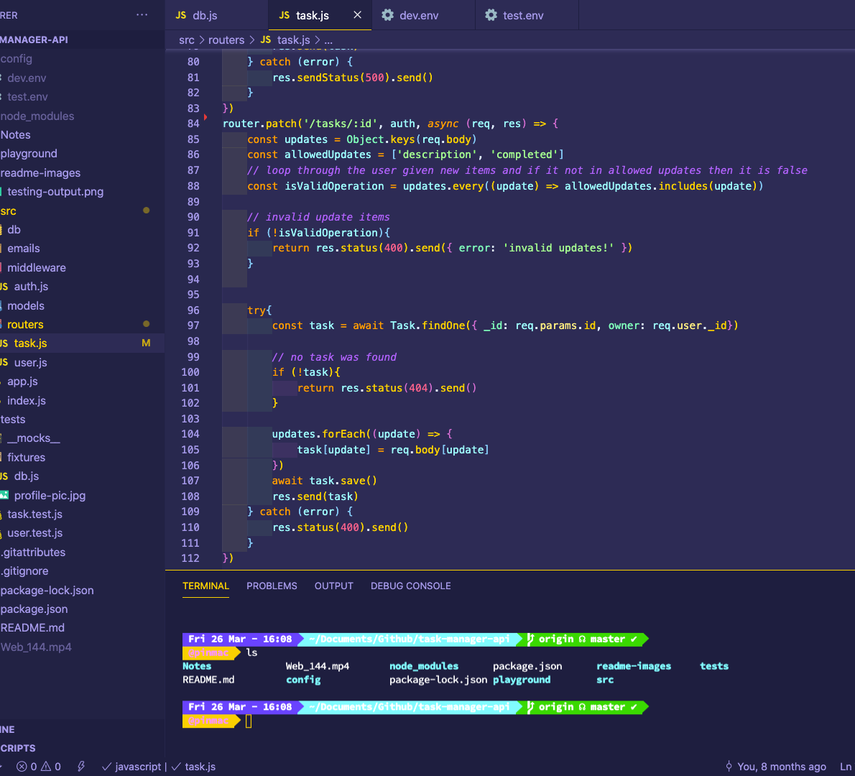
¿Quien Soy Yo?
Education
A.A.S in Computer Information Technology (Early College)
B.S in Computer Science
Work
Student Web Developer at UNC
IBM x 2 Internships (Software Engineer)
Cengage (Software Engineer)
Got to final round at Google :/
AF
1 out of 6 Sierra Alphas from my UCT class
17SA, although I was given the Z prefix but Idk if that’s still a thing
Languages
Python, Java, C, JavaScript, SQL, C#
Backend
NodeJS/Express, ASP.NET Core (C#)
Model/Business
MongoDB, SQL (PosgreSQL)
Frontend
React, Angular (ehh), pug/mustache, HTML5, CSS3

Slide 4
What is the C Language?
Procedural language
Think “sequence” and ”step by step”
Code is written as a sequence of instructions
Instructions are executed in the sequential order
I mean… what else could it be?
Object Oriented Programming
Think “Objects”
Everything is converted into an object in order interact with the real world
These objects contain data in the form of attributes (think ”variables”) and code in the form of methods (think “functions”)

Slide 5
C vs Python
C vs Python
There are a lot of difference but let’s hit on the big ones
C has Pointers while Python does not (natively)
C is compiled while Python is interpreted
C has to declare variable types while Python does not (natively)

Slide 6
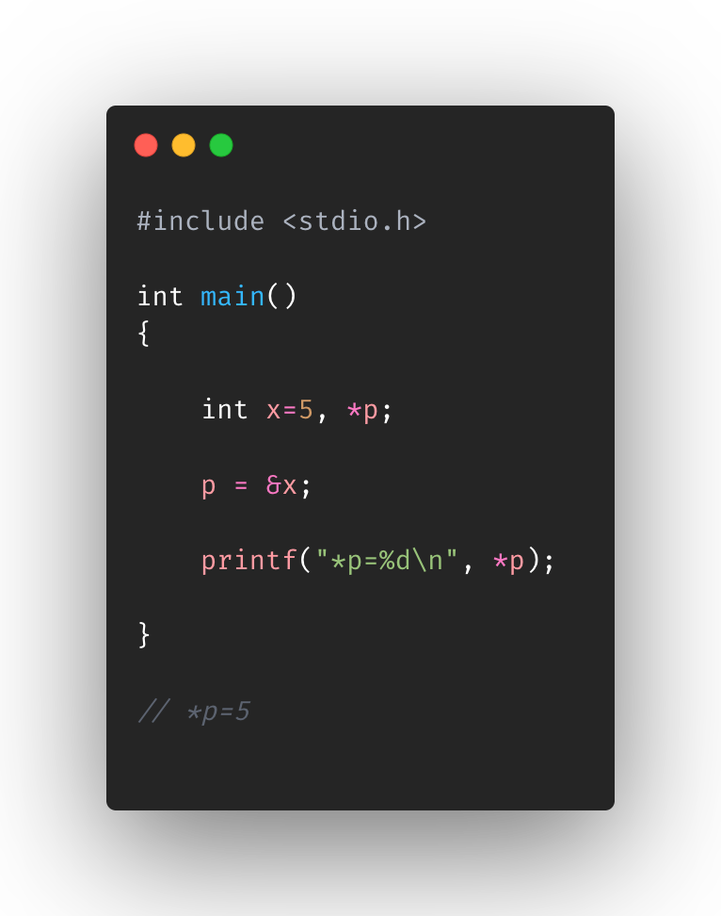
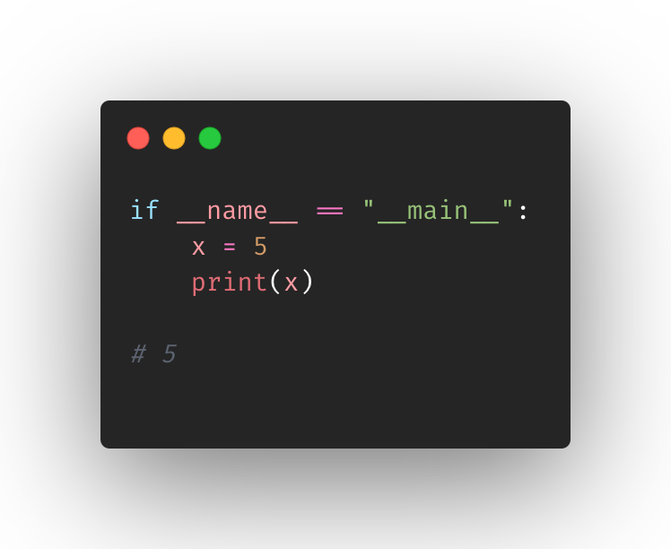
C vs Python
C | Python
Pointers | No Pointers (natively)

Slide 7
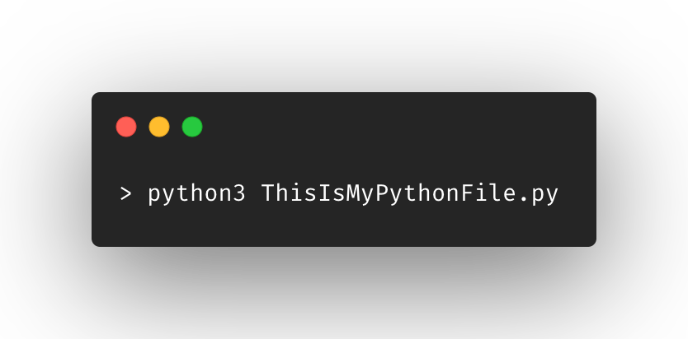
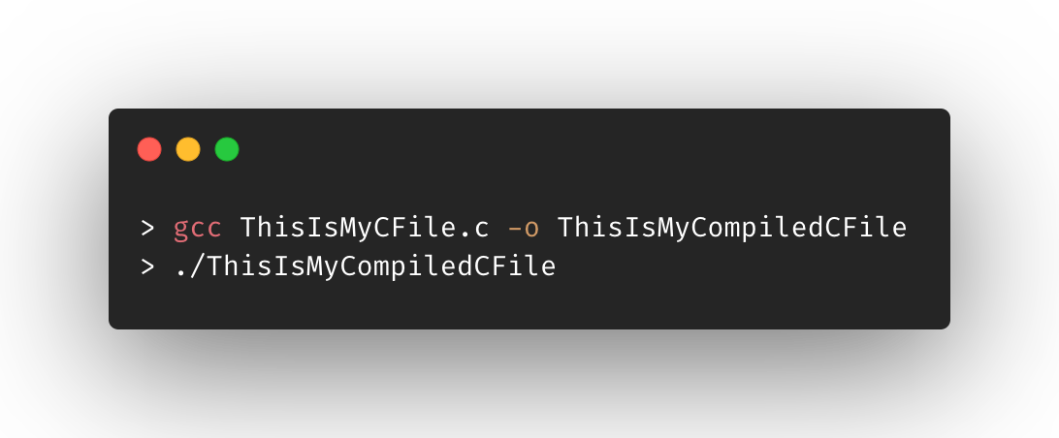
C vs Python
C | Python
Compiled | Interpreted

Slide 8
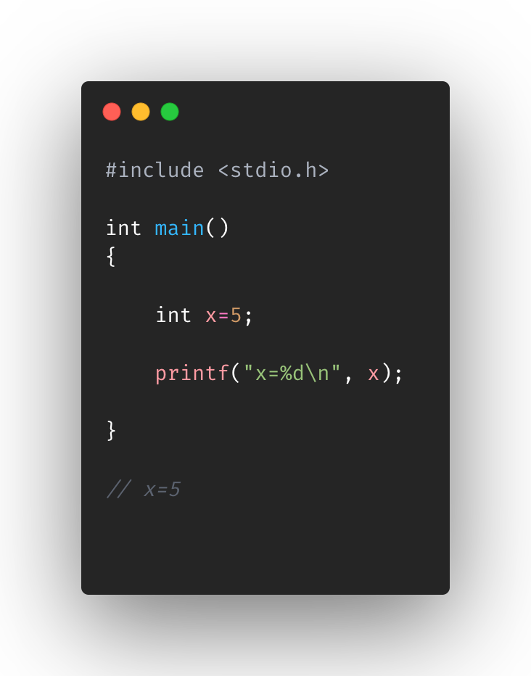
C vs Python
C | Python
Declares variable types | Does not need to declare variable types

Slide 9
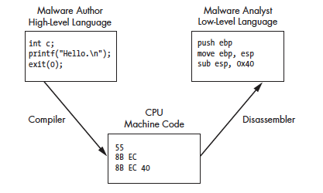
How does it fit in the Malware world? 🧐
Malware authors create their programs with high-level languages (C, C++, etc.)
Malware analysts operate at the low-level language (assembly)
If you can gain an understanding of high-level languages, then you’ll see things clearer

Slide 10
Overview
What is C Language?
C vs Python
How does it fit in the Malware world? 👾🌎

