Slide 1
Running a C File
By: LT Felipe Pineda

Slide 2
Overview
Structure of a C File
Process of a C File
Running a C File

Slide 3
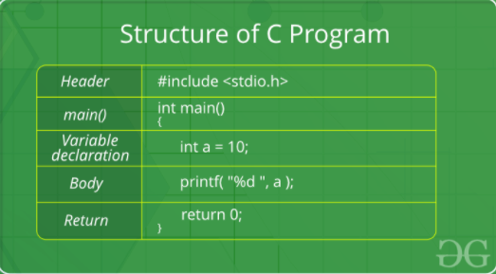
Structure of a C file
Notes:
Class: Do not worry if do not fully understand the syntax at the moment. This section is meant to get you familiar with the eagle’s eye view of the structure. It’s like learning the how to structure a paper.
Header
Includes header files
Header files are files with a “.h” extension which contains C function declarations and macro definitions
Examples
stdio.h
string.h
Main Method Declaration
The most important part of a program
The main method is the entry point for the program. It’s where it all begings
Normally a program will have multiple functions and then have the main function call all those (either directly or indirectly)
Pay attention to the “int” as that’ll come into play in the return section
Variable Declaration
It’s pretty standard to declare a variable before getting into the body.
You can’t use a variable until you declare it
Body
Operations or logic you wish to do
Return
It is what is returned to the caller
It can also be seen as the last statement to run
In the main section I asked you to remember the “int”. That is because whatever type you put there, it’s a promise that you’ll return that value type (it’s okay if you don’t get this yet but we will cover it in functions)
https://www.geeksforgeeks.org/c-language-set-1-introduction/

Slide 4

Header
Includes header files
Header files are files with a “.h” extension which contains C function declarations and macro definitions
Examples
stdio.h
string.h
Notes:
Two types of header files
Header files that the programmer writes
Header files that come with compiler
As you can see in the green image, you request the .h file to be “included” by using the #include directive
Including header files is the same thing as copying the content of the header file requested. However, we use the #include directive as it’s easier, less error-prone, and overall is not a good idea to copy content of a header file into source code.
https://www.tutorialspoint.com/cprogramming/c_header_files.htm

Slide 5
main()
Main is the function where execution begins
It is the entry point for any program
Pay attention to the “int” as that’ll come into pay when we get to the return section
Notes:
Developers will often put their logic flow into the main method as it’s the first thing to be called. Why does that matter?
As malware analysts, the main method is the perfect spot to start on
Normally, most functions being used by the program will be called by the main method, directly or by other functions indirectly.
The main method it parent of all when running your program

Slide 6
Variable Declaration
Area where variables are being declared that’ll eventually be used in the function
Notes:
It’s pretty standard to declare a variable before getting into the body.
You can’t use a variable until you declare it

Slide 7
Body
Operations or logic that you wish to do
In this case, it’s printing the value inside a

Slide 8
return
Ends execution of that function
Returns control to the calling function
In the main section, I asked you to remember the “int” being used. That is because whatever type you put there, it’s a promise that you’ll return that value type whenever that function ends execution.
Notes:
Return
It is what is returned to the caller
It can also be seen as the last statement to run
In the main section I asked you to remember the “int”. That is because whatever type you put there, it’s a promise that you’ll return that value type (it’s okay if you don’t get this yet but we will cover it in functions)
Class: it’s okay if you don’t get this yet but we will cover it in functions

Slide 9
Process of a C file
Editing
Compilation
Preprocessing
Compiling
Linking
Executing
Notes:
Instead of telling you the process and then running the file we are going to the both at the same time.
Don’t worry, it’s a simple script.

Slide 10
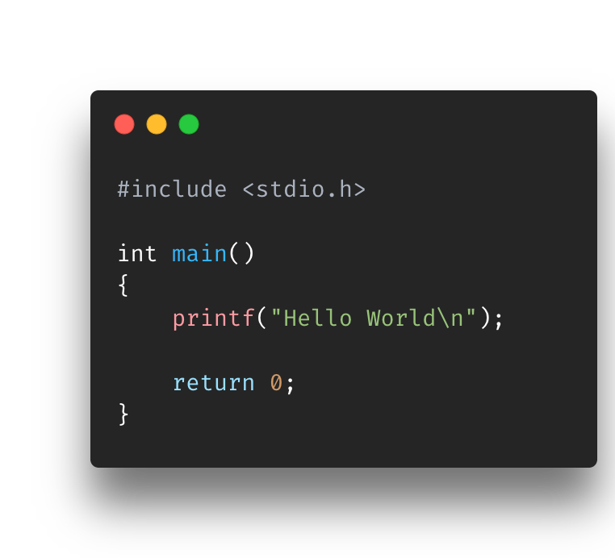
1. Editing
Create your source code
Multiple editors or IDEs
Your code is located within the Slides-Scripts folder
Notes:
The editing process is pretty straight-forward. It is the step where you create your source code that will eventually be compiled and executed.
Typically, developers have their own editor or IDE they prefer to use when creating their programs. However, you can go a basic as notepad++ when creating your C files
The only thing that matters is that it successfully compiles when your run it through the compiler
Each editor or IDE has it’s pros and cons, some help write code faster while others have more interactive feature. In the end, the same result is given

Slide 11
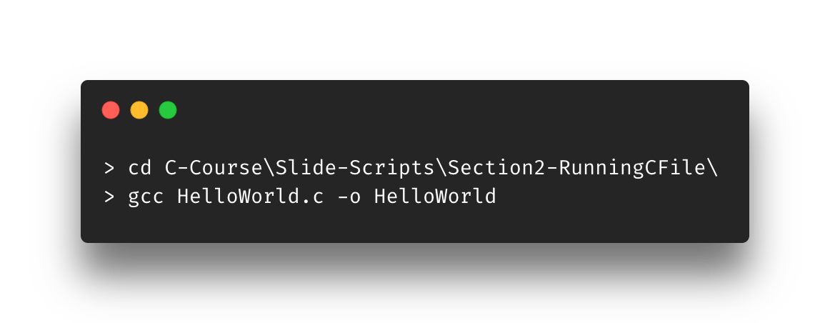
2. Compilation
cd into the path above
Run the gcc command
That was quick huh? Let’s find out what happened
Notes:
This means that we have written our source code file and now we gave it as input to the compiler.
You ran the compile command, and you are waiting for the next command line to show up
Normally these next four steps will be done in nanoseconds but let’s slow it down, next slide…

Slide 12

2a. Preprocessing
Removing comments
Expanding macros
Expanding included header files
Notes:
First step in compilation is a preparing step. It is called the preprocessing step and It runs through any line of code that is prefixed with “#”. For each line it looks at it and does the appropriate action. That includes macros and inclusion lines.
For now, just focus on the removing comments and expanding included header files. Notice that they both are prefixed with ”#”
Removes the comments as they do nothing with compilation
Looks for the stdio.h file and copy the header file into the source code file
More info
Preprocess also generates macro code and replaces symbolic constants defined using #define with their values

Slide 13
2B. Compiling
Generates Assembly->Machine/Object code (ex: 101010…)
Poof.. Now you have an .o/.obj file! We’ll get to the .exe file in a bit
Pay attention to what the compiler is doing here
It checks for compile-time errors
Any syntax or semantic errors will cause compile to error
It DOES NOT check for logic errors (AKA run-time errors)
Compile-time vs Run-time?
Notes:
Apparently during this step, it does the conversion of Assembly->Machine code in two different phases, but I combined them to save time/mental effort.
The key point here is not the conversion, but the what is happening during this step. In this step, the compiler is running through all the lines of code and checking for any compile-time errors
Compile-time errors are when you messed up on a syntax (ex: forgot a semicolon) or semantic error (variable is not defined)
Run-time error is when the code compiled correctly, but there is an issue with your logic that can only be determined when ran. An example would be an index out of array error.

Slide 14
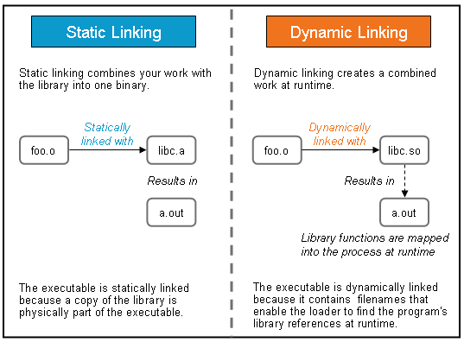
2c. Linking
Final step before execution ☺
It pretty much mashes everything together to build your final executable
Gets all dependencies/libraries and pushes it to a linker which links those items and your .o/.obj file creating your executable!
Static vs Dynamic linking?
Notes:
So, linking a weird step where it’s considered a part of the compilation process, but it’s actually done after the program is compiled. For now, let’s just say it’s the step before the running the script.
After this step you will have your executable program! Yay!
What it does is just grabs your .o/.obj file and mashes it with the libraries/dependencies you used and creates executable.
Now this brings to question what kind of linking is it doing? It’d be quite different inefficient to just add all the lines of code from the library into the your small HelloWorld.c file
Static Linking:
Linker makes a copy of all used library functions to the executable file
Dynamic Linking
Libraries/functions are linked to executable and not copied
When you run/load the program, it will connect to those libraries

Slide 15

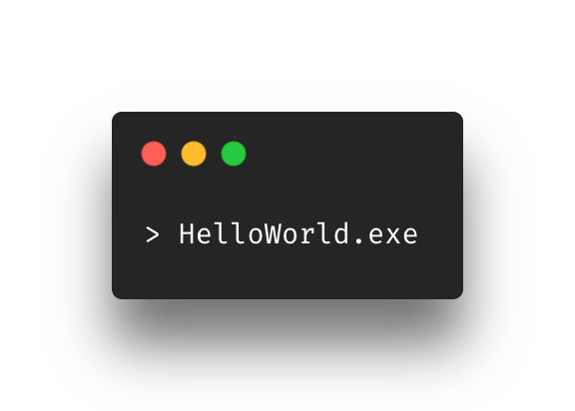
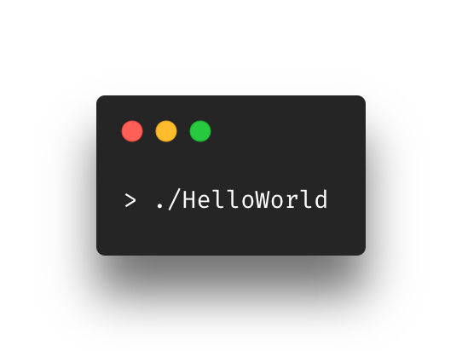
3. Execution
Run that thang

Slide 16
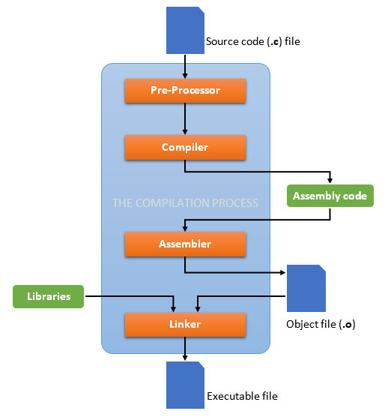
Process of a C file
Editing
Compilation
Preprocessing
Compiling
Linking
Executing

Slide 17
Overview
Structure of a C File
Process of a C File
Running a C File

Slide 18
References
https://www.geeksforgeeks.org/c-language-set-1-introduction/
https://www.tutorialspoint.com/cprogramming/c_header_files.htm
https://docs.microsoft.com/en-us/cpp/c-language/return-statement-c?view=msvc-160#:~:text=A%20return%20statement%20ends%20the,value%20to%20the%20calling%20function.
https://medium.datadriveninvestor.com/compilation-process-db17c3b58e62
https://medium.com/@laura.derohan/compiling-c-files-with-gcc-step-by-step-8e78318052
https://medium.com/swlh/linux-basics-static-libraries-vs-dynamic-libraries-a7bcf8157779

