Slide 1
Variables and Types
By: Lt Felipe Pineda

Slide 2
Overview
Exploring Variables
type
identifier
Value
Counting Ranges
<type>
<identifier>
<value>
printf statements
Format specifiers
* Exercises will be at the end

Slide 3

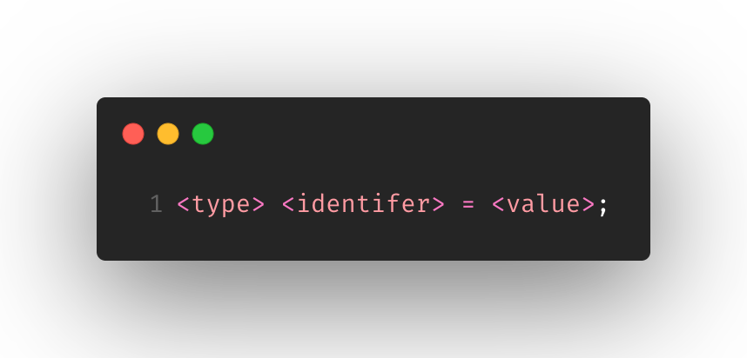
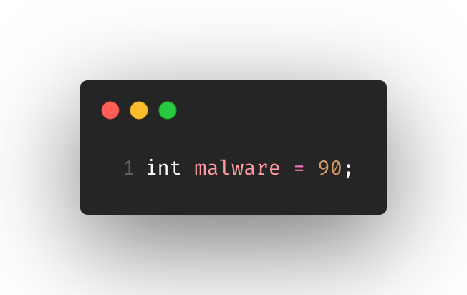
Exploring variables
What is a variable?
It is a container to hold data
It is referenced/called whenever you need that data
Each variable will be given its own type
Each variable will be given its own unique identifier
Each variable will be given a value (either initially or at some point)

Slide 4
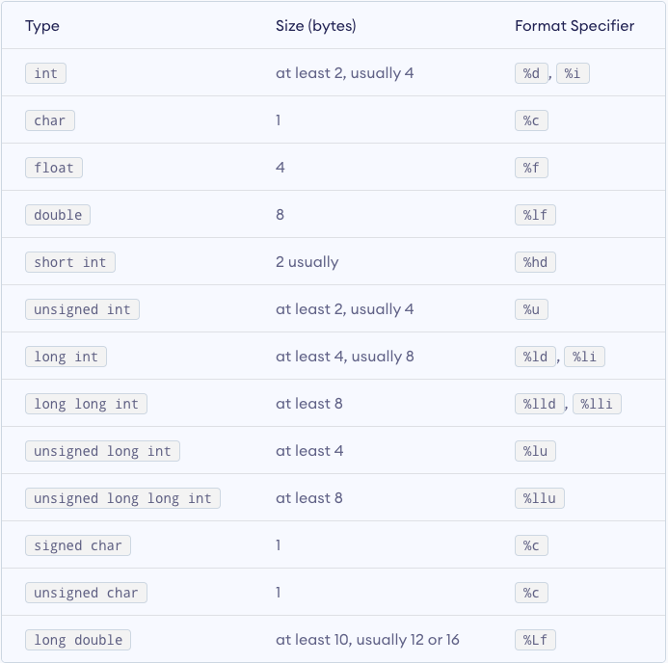
The <type>
<type> allows the program to do 2 things
To allocate the correct size for that variable
Specify what type of data will be stored in that variable
It’s a promise to the program
There are multiple types within the C language we will cover
Int
float and double
char
void
short and long
signed and unsigned
Depending on your env, the size may change
Notes:
When you set the type in a variable, you are making a promise to the compiler and program that you will stay within the bound of the type size.
If you put down “int” for the type, that means you will at most put 4 bytes of data down or it will complain.

Slide 5
Counting Ranges
What is 1 bit?
Ex: 0 or 1
What is 1 byte?
8 of those bits put together
Ex: 00100111
How many bits does 4 bytes have?
4 bytes = 8 x 4 = 32 bits
Scenario: How can we determine the value range of an int?
int x
Smallest value: -(2^{bits-1})
Largest value: (2^{bits-1})-1
Smallest value: -(2³¹) = -2,147,483,648
Largest value: (2³¹) - 1 = 2,147,483,647
The point here is not to have you calculate ranges for each type, but to understand that types will have a cap. It gets more convoluted and complex as you get into the different types. There’s scripts and libraries that do this for you if you want to see it.
Notes:
A single bit is length of 1 and can be only 0 or 1
A single byte is length of 8 bits that can have 0s or 1s
4 bytes = 8 x 4 = 32 bits
-- double check that everyone is good up until this point –
Let’s say we have variable x of type int. Someone comes along as says “Hey we need to put a value inside variable x but we don’t want to overflow it?” This means that we don’t want to put a value bigger than the space allocated for x, inside x. It will cause issues. So what do we do?
Find byte size for an int type
Plug into formula
What is range value for a 4-byte allocation?
Smallest value: -(2^31) = -2,147,483,648
Largest value: (2^31) - 1 = 2,147,483,647
Keep in mind that this is only for int only. As we explore signed/unsigned, short/long, it’ll modify the bytes and formula.
Also different env (OS) and machines (hardware/software) will allocate memory differently. Either run FindSizeOfTypes.c with in different machines or go to the References folder and see the MAC and Win10 results. They are super similar but they allocate the long double differently.

Slide 6
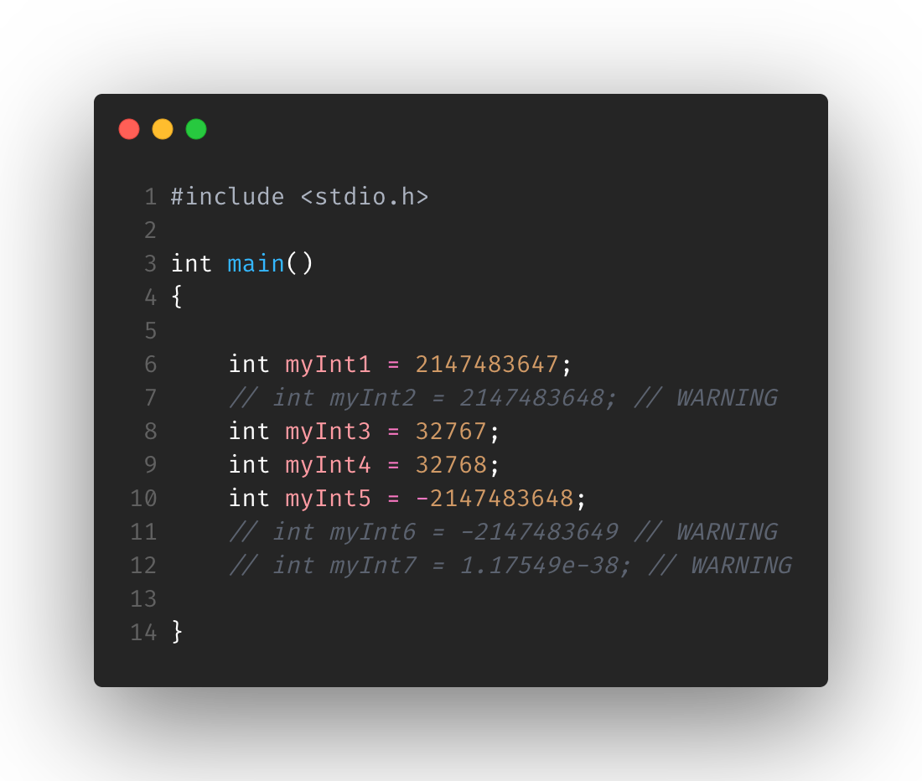
int
int type holds non-decimal values that can be zero, negative, or positive numbers
int are allocated either 2 bytes (16 bits) or 4 bytes (32 bits) per each
Meaning it can house value range
-2,147,483,648 to 2,147,483,647
Normally, it’s given 4 bytes (32 bits) == 2³² == 2147483647
Notes:
No decimals
-2147483648 to 2147483647
Since it normally is allocated 4 bytes or 32 bits (4x8=32), then you can take the bits and put it as an exponent
2^{bits} === total value
2³² === 2,147,483,647
Be wary of the compiler as you may go out of bound but it could alter the value so that it can run properly. This is good so it can avoid compile errors, but it will alter values inside your code possibly giving you run-time errors.
It says WARNING on some of these variables as it will scream at you to change them. They’re definitely outside the bounds.

Slide 7
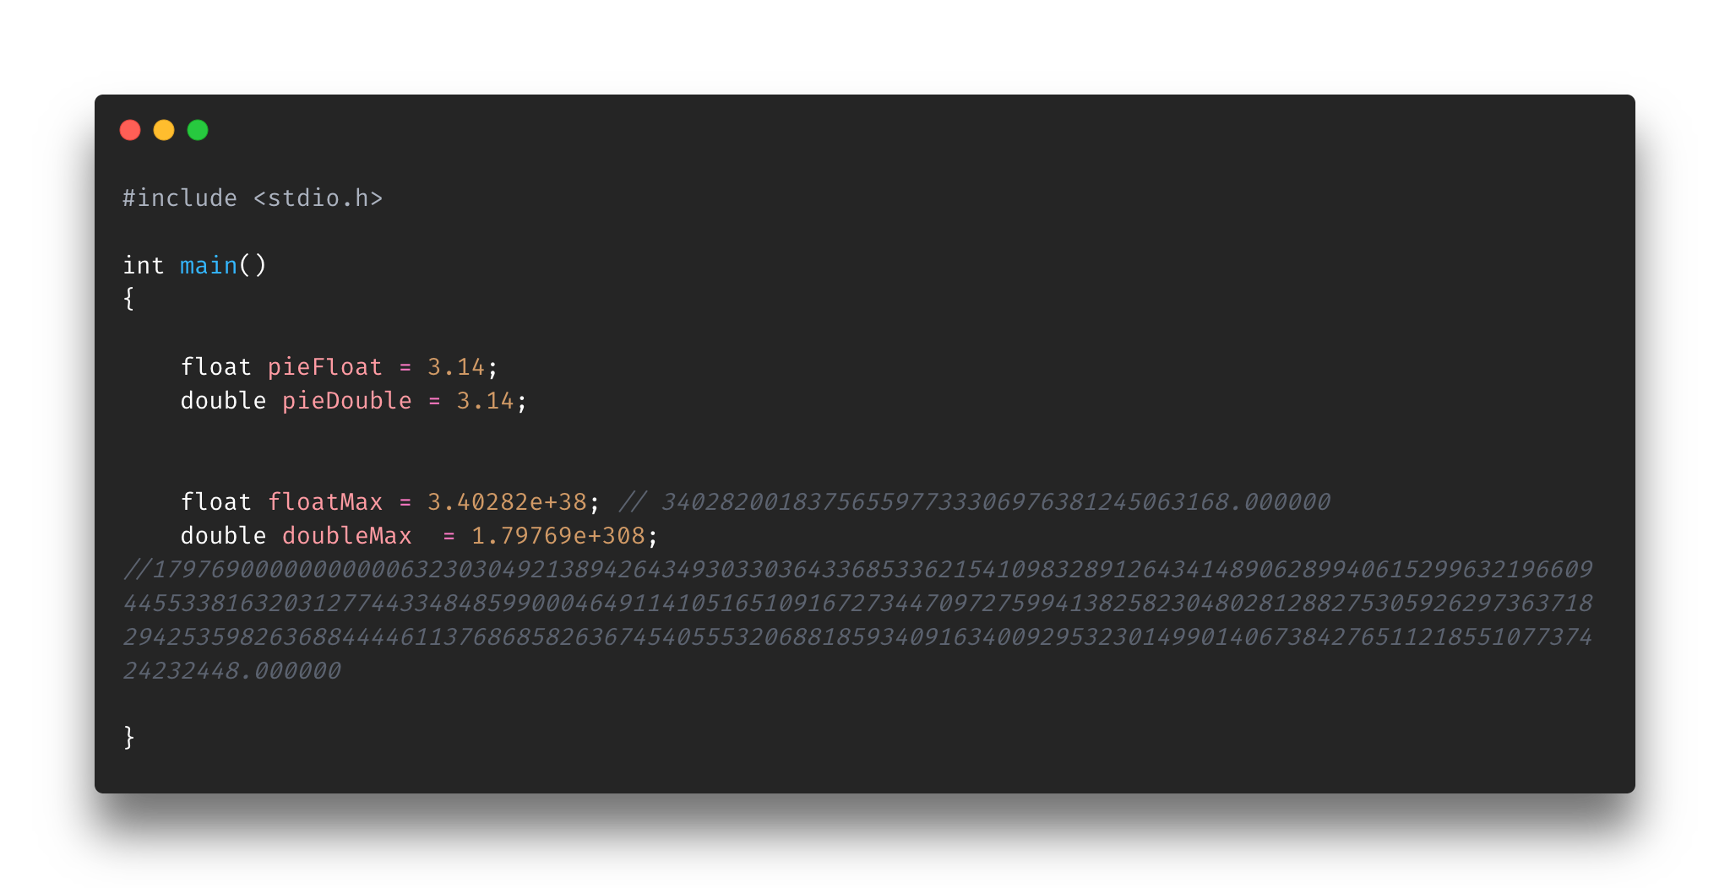
float and double
Float and double types hold positive or negative, large or small, whole numbers or decimal numbers (AKA real numbers)
Floats are allocated 4 bytes of allocated space
1.2E-38 to 3.4E+38
Doubles are allocated 8 bytes of allocated space
2.3E-308 to 1.7E+308
If you see an “e” constant know that it’s based off scientific E notation
3.2e45 == 3.2 x 10⁴⁵
Notes:
Whole numbers
Decimal numbers
Positive numbers
Negative numbers

Slide 8
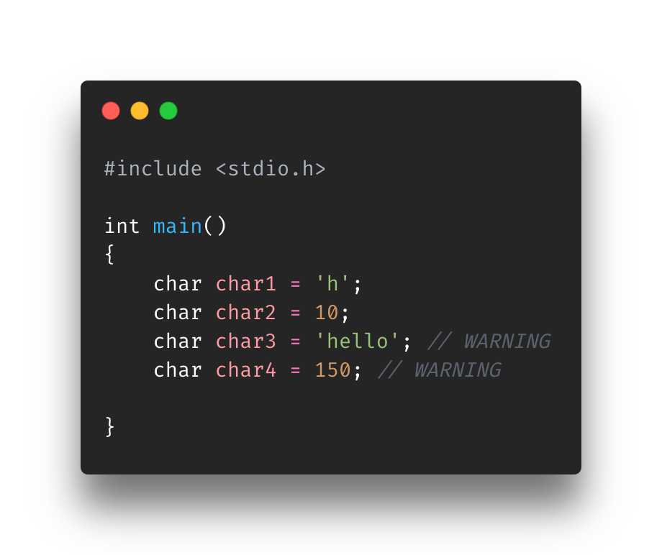
char
char type hold single ASCII letters or small int type values (-128 to 127)
chars are allocated 1 byte
Notes:
Char types are pretty simple as they can only store a single character or int value within the (-128 to 127) bounds
char3 didn’t work here because it isn’t a single character. It’s an entire string. We’ll see later how we can do that

Slide 9
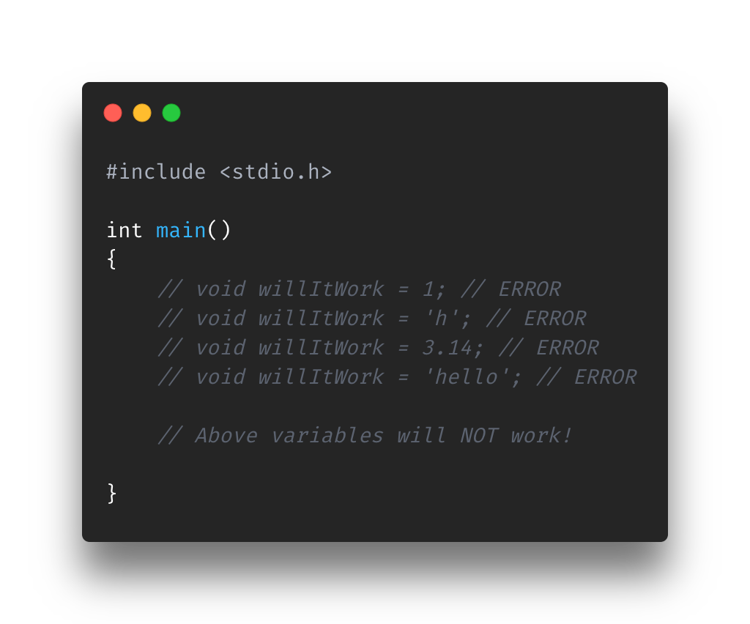
void
Void types basically says that no value is available
Normally used in three situations
void function return
void function arguments
void pointers
void may make more sense once we get to functions and pointers
For now know that if you see a function with ”void” as the function type, then it will not require a “return” statement
Take note that you cannot create variables of void type ;)
Notes:
void can be thought of “nothing”, “no type”, or just absent.
void function returns will never return anything. At the moment you may not know much about functions but know that most return something but if you give a void, then it will not return anything.
void function arguments are similar to void function returns, but instead of not returning (output) anything, it won’t take in (input) anything as arguments. Of course, the function must have the void keyword as the function argument
void pointers represent the address of a un-typed object.

Slide 10
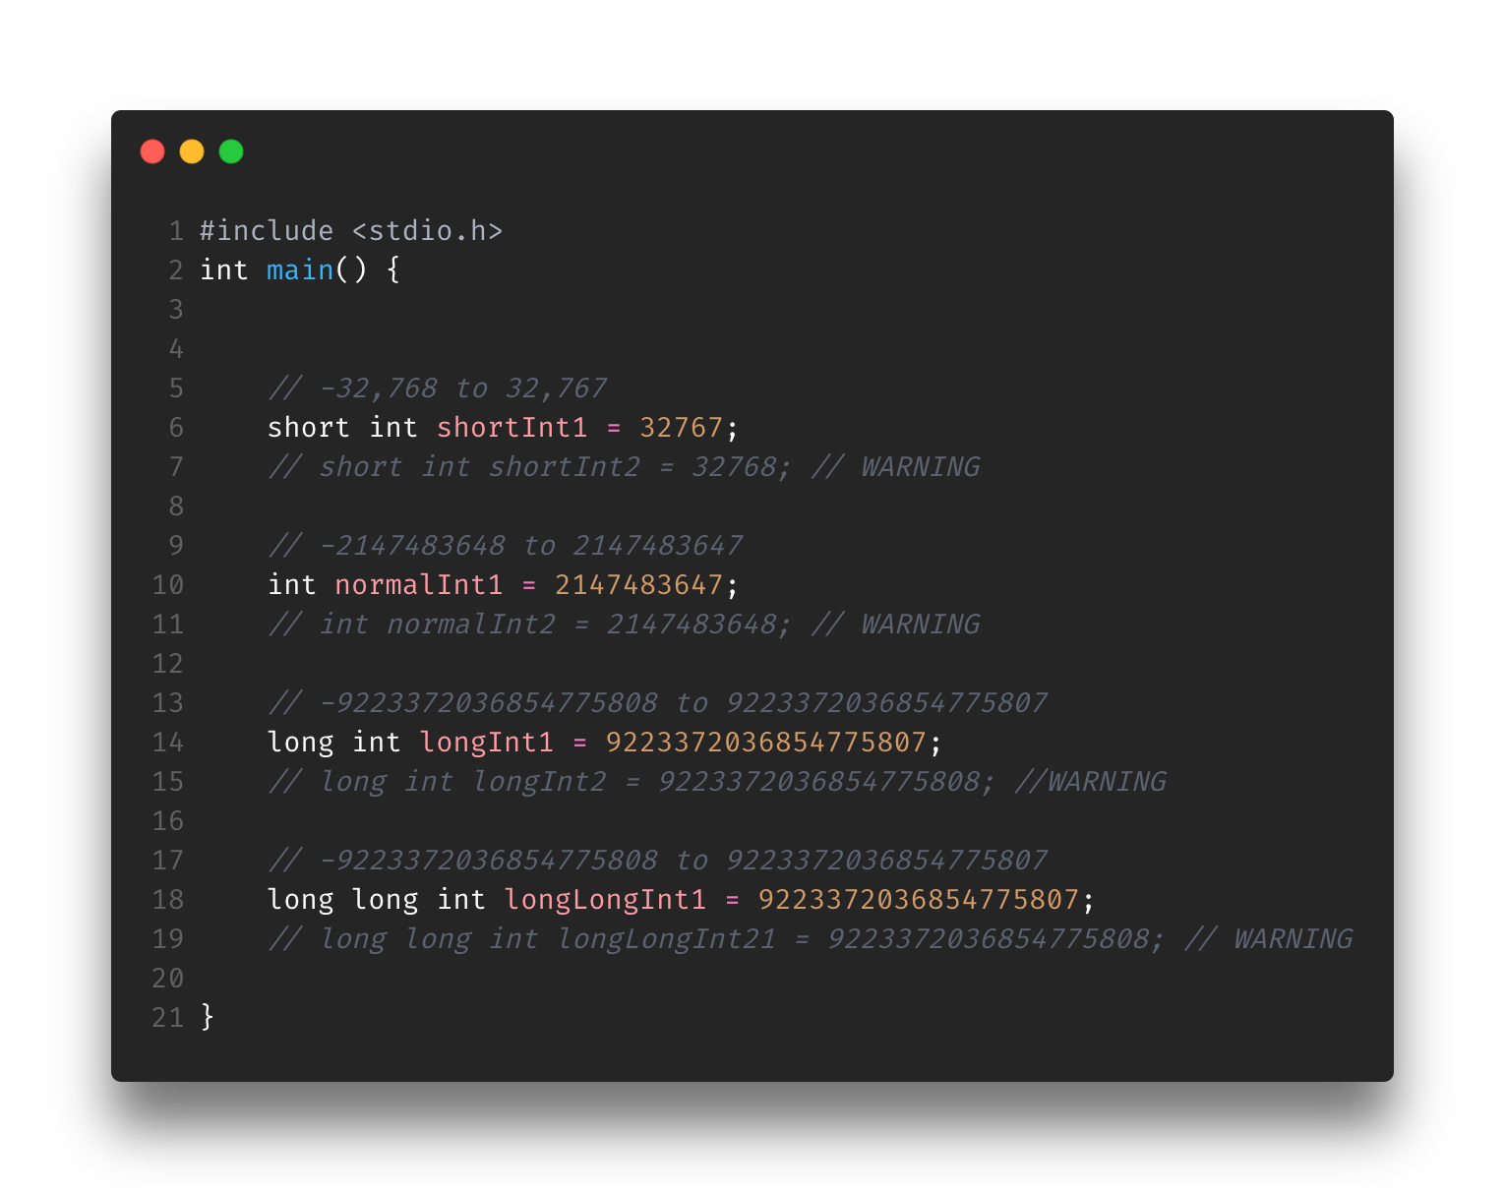
short and long
Know as type specifier
Meaning they specify an attribute on an already existing type
In this case, it shortens or enlarges the size of a type
short == decreases type size
long == increases type size
To you it may not be worth it to allocate memory correctly, but to a developer it can save hella space
There’s a size and speed difference between an efficiently allocated program and one that just used the biggest size available
Notes:
Let’s take the example of using short or long on a int type variable (I think it defaults to int if you only provide “short” or ”long” by itself as the type)
For short int
It’ll allocate 2 bytes which is value range [−32,767, +32,767]. As you can see line ? succeed and not in line ?
For long int
It’ll allocate 8 bytes which is [-9223372036854775808, 9223372036854775807]. As you can see in line ? succeed and not in line ?
For long long int
It’ll do the same long int

Slide 11
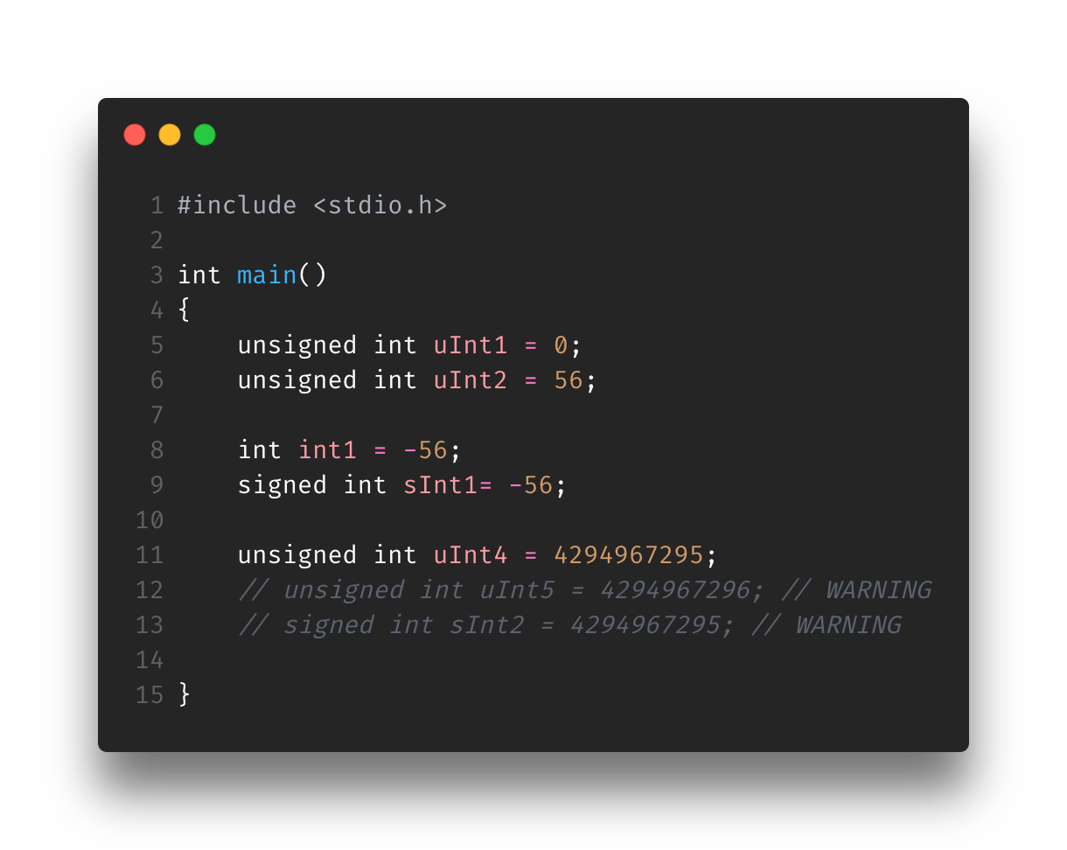
unsigned and signed
Known as type modifiers
Meaning they can alter the type of data being stored on an already existing data type
In this case, it alters sign (positive, negative) that the data type can store
unsigned == 0 and positive values
signed == negative, 0, and positive values
Notes:
Let’s take the example of using signed and unsigned on a int type variable
For an unsigned int type, it’ll remove its ability to have negative numbers but will add on the amount of positive numbers it can hold
0,1,2,..,4294967295 (more than a normal int or signed int)
For a signed int type (or just normal int, as an int is singed by default)
-2,147,483,647, -2,147,483,646, -2,147,483,645, …, -2, -1, 0

Slide 12
Keep in mind…
With the last two slides (short/long, signed/unsigned), there are so many permutations of adding these onto data types
I highly suggest playing with them and figuring it out
In other languages you don’t have as much control as C in terms of memory management
In the Section3-VariablesTypes folder, I added a small script called FindSizeOfTypes.c go and run it to see some of these sizes and min/max values for types.

Slide 13
The <identifier>
Two rules to naming variables
A variable will only have letters, digits, and underscores
First character of a variable should be a letter or an underscore

Slide 14


Let’s test your skillz

Slide 15
Questions
Variable name | Correct or Incorrect?
int malware = 90;
int ma!ware = 90;
int mAlware = 90;
int malware3 = 90;
int 1mAlwarw = 90;

Slide 16
Answers
Variable name | Correct or Incorrect?
int malware = 90; | ✅
int ma!ware = 90; | ❌
int mAlware = 90; | ✅
int malware3 = 90; | ✅
int 1mAlwarw = 90; | ❌

Slide 17
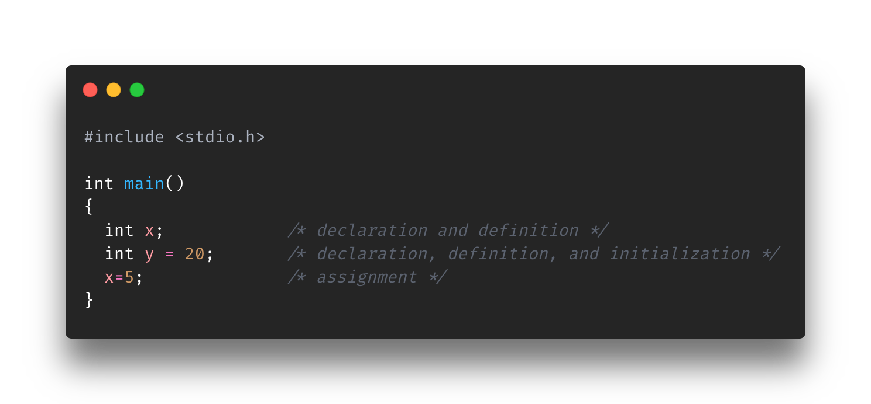
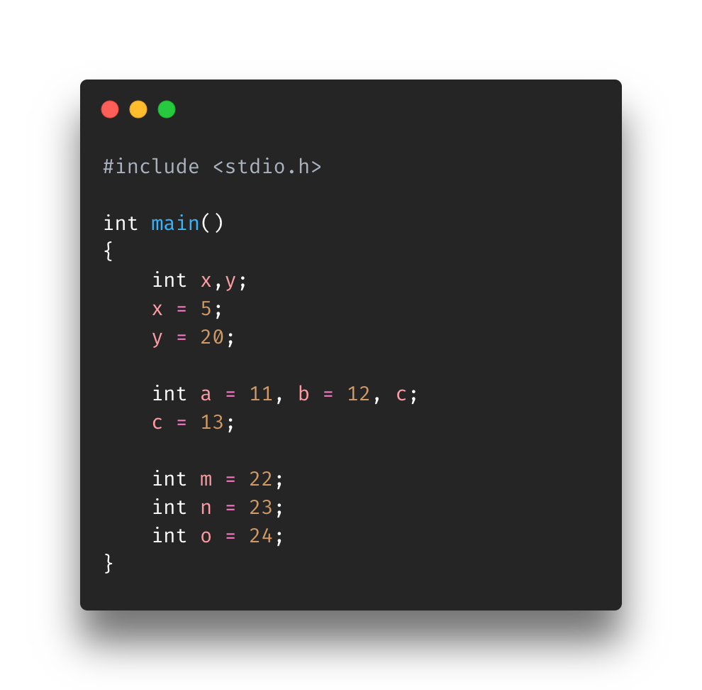
The <value>, well putting a value…
4 phases of variables
Declaration
Specifies type
Definition
Reserve storage space
Initialization
Gives initial value
Assignment
Get a new value
Notes:
All variables must be declared and defined; they can also be initialized and assigned a value.
declaration: specifies the type of the identifier
definition: reserves storage space for the object
initialization: gives an initial value to the object during definition
assignment: gets a new value

Slide 18
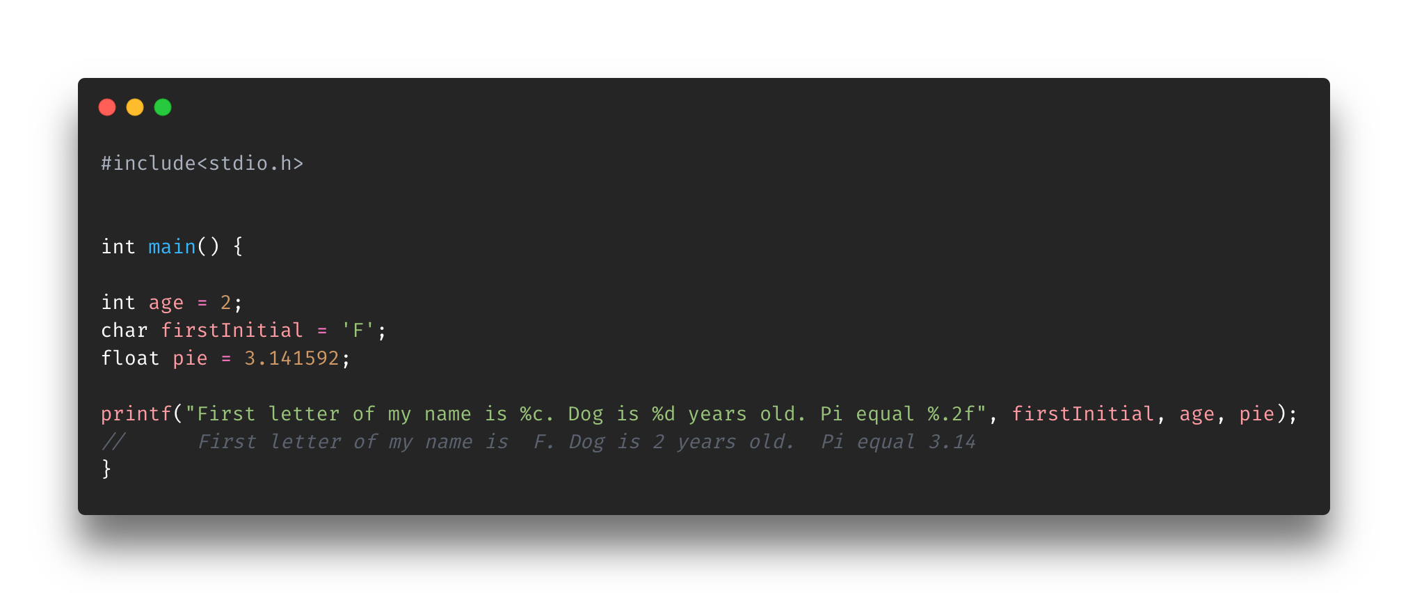
printf()
Print statements allow you to print an element to standard output (i.e. terminal)
Helps see what’s happening or what a variable/structure holds
In C, it’s called printf(…) and it takes 2+ parameters
String to be formatted with format specifiers in it
Values/Variables
Notes:
Printing is a part of the developer’s debugging toolset. Debugging can definitely can help figure out stuff easily but sometimes it’s easier to just write print statements and run the code. In the output you’ll see what was print.
For example, let’s say you want to see what’s being stored in a memory space, well, of course you can debug it but what if you don’t have a debugger? Then you write a print statement in that area so that you can see what it holds.
Printf: https://www.tutorialspoint.com/c_standard_library/c_function_printf.htm

Slide 19
Format Specifiers
Each type has it’s own
For doubles and floats you can modify how many decimal values are displayed
Notes:
Other references:
https://www.cplusplus.com/reference/cstdio/printf/ (hint for challenge3b.c)
https://www.programiz.com/c-programming/examples/ASCII-value-character (hint for challenge3b.c)
https://www.tutorialspoint.com/format-specifiers-in-c
Or you can google “c format specifiers” or “c format specifier <TYPE>” (ex: c format specifier float)

Slide 20
Overview
Exploring Variables
type
identifier
Value
Counting Ranges
<type>
<identifier>
<value>
printf statements
Format specifiers

Slide 21
References
https://www.programiz.com/c-programming/c-data-types
https://www.tutorialspoint.com/cprogramming/c_data_types.htm
https://www.mathsisfun.com/definitions/real-number.html
https://www.tutorialspoint.com/c_standard_library/c_function_printf.htm

