Slide 1
C Operators
By: Lt FElipe Pineda

Slide 2
Overview
Arithmetic Operators
Increment/Decrement Operators
Assignment Operators
Relational/Comparison Operators
Logical Operators

Slide 3

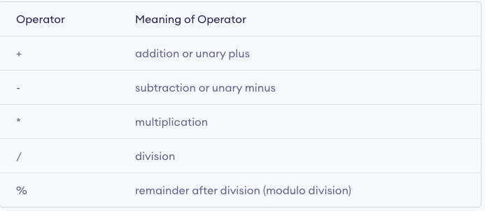
Arithmetic Operators
Very common sense, it’s just math
It takes two operands and performs a calculation
Notes:
Arithmetic operators are the simplest of the bunch. It completes a mathematical operation on two values and gives you the result. Think of it as like writing a math problem
On the next slide we’ll see more of the actual code

Slide 4
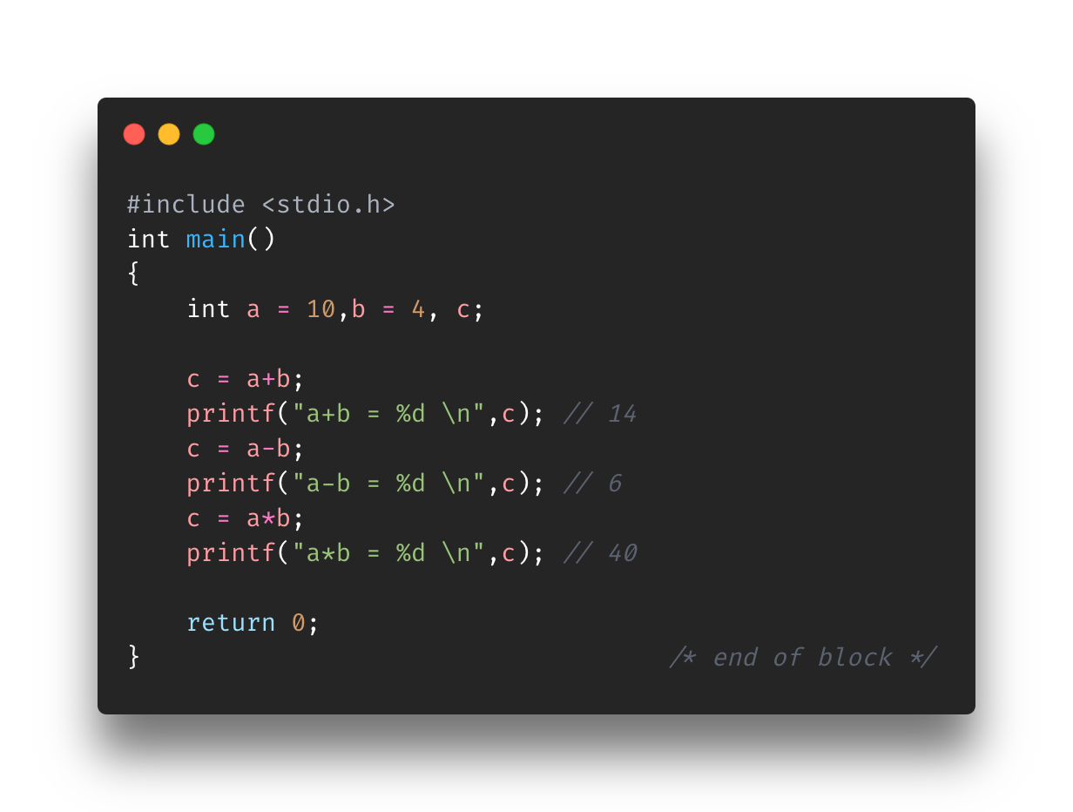
Running Arithmetic Operators
Addition, Subtraction, Multiplication run normally
Notes:
Addition, Subtraction, and Multiplication are either super simple or just mimic the way it’s done in the real world
Division and Remainder are a bit different, let’s see in the next slide

Slide 5
Exercise
Find Arithmetic-Exercise-a.c in the Exercise folder for Section4-Operators
Using Arithmetic Operators (Add, Sub, Mult) and the variables provided print out the following lines
Air Force birthday year: 1947
Army/Marines/Navy birthday year: 1775
Coast Guard birthday year: 1790
Instructions on are the script

Slide 6
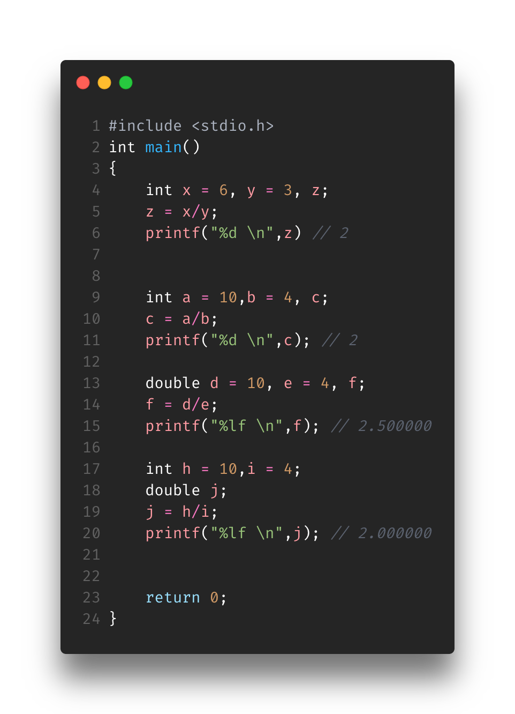
Running Arithmetic Operators
First Example (lines 4-6)
Division works normally on value that will not result in a decimal
It gets funky when the result is a decimal as it depends on the types of the variables
Second example (lines 9-11)
All three variables are int => int value
Third example (lines 13-15)
All three variables are doubles => double value (decimal)
Fourth example (lines 17-20)
Operands are ints and result is a double => int value converted into a double (after the ”.5” was stripped)
Notes:
First example is just normal integer division
Division will depend on the types of variables. Remember if you are expecting a decimal but put the type as int then it will restrict the result.
In the second example all three variables (a,b,c) are ints. Ints cannot hold decimals so mathematically it will compute 2.5 but because of it’s int type, it will resort to turning it into an int value, which 2.
In the third example, all three variables (d,e,f) are doubles. It’s expecting a decimal/double value
So why not just have the operands as ints and the result as double? That’s exactly what I was thinking, however it’s still wrong
In the fourth example, the operands (h,i) are int and the resulting value is a double. Well, in this case it would compute result with the 2 (because operands are ints) but since the resulting variable is a double it will cast into a double. Thus, adding the 6 zeros after the 2

Slide 7
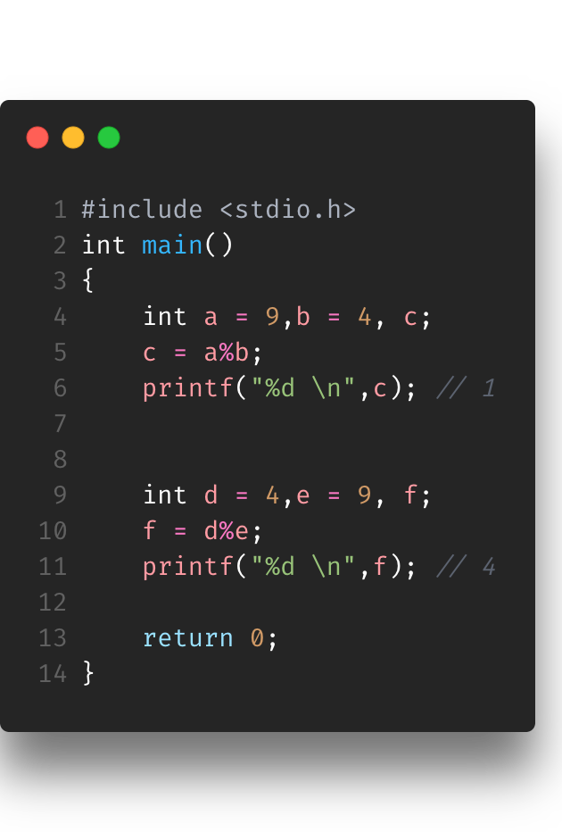
Running Arithmetic Operations
Modulo Operator
Can be a bit confusing but the way you think about it helps
First example (lines 4-6)
9%4
How many times will 4 go into 9 without it going over?
2, because 2*4=8
9 - 8 = 1
Second example (reversed) (lines 9-11)
4%9
How many times will 9 go into 4 without it going over?
0, because It cant lol so 0*9 = 0
4 – 0 = 4

Slide 8
Exercise
Find Arithmetic-Exercise-b.c in the Exercise folder for Section4-Operators
Using Arithmetic Operators (division and mod) and the variables provided print out the following lines
How many chainz does 2chainz have: 2
I need about 3.500000
How many rings does Tom Brady have: 7
Instructions on are the script

Slide 9

Increment and Decrement Operators
Unary Operators
Prefix Increment and Decrement Operators
“++” or “--” goes before the operand
Postfix Increment and Decrement Operators
“++” or “--” goes after the operand
“++” increments operand by 1
“--” decrements operand by 1
Notes:
Increment and Decrement Operators are unary operators meaning they only work on one operand or variable

Slide 10
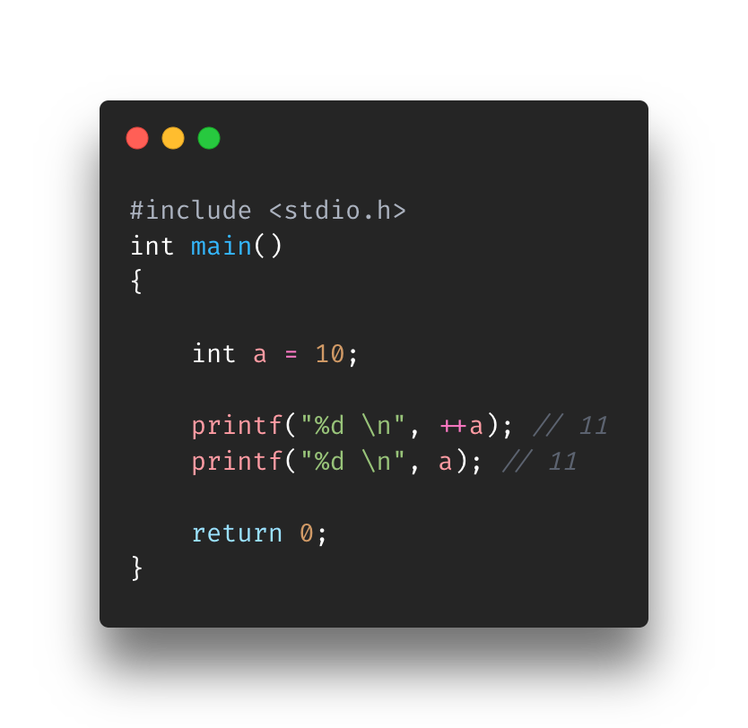
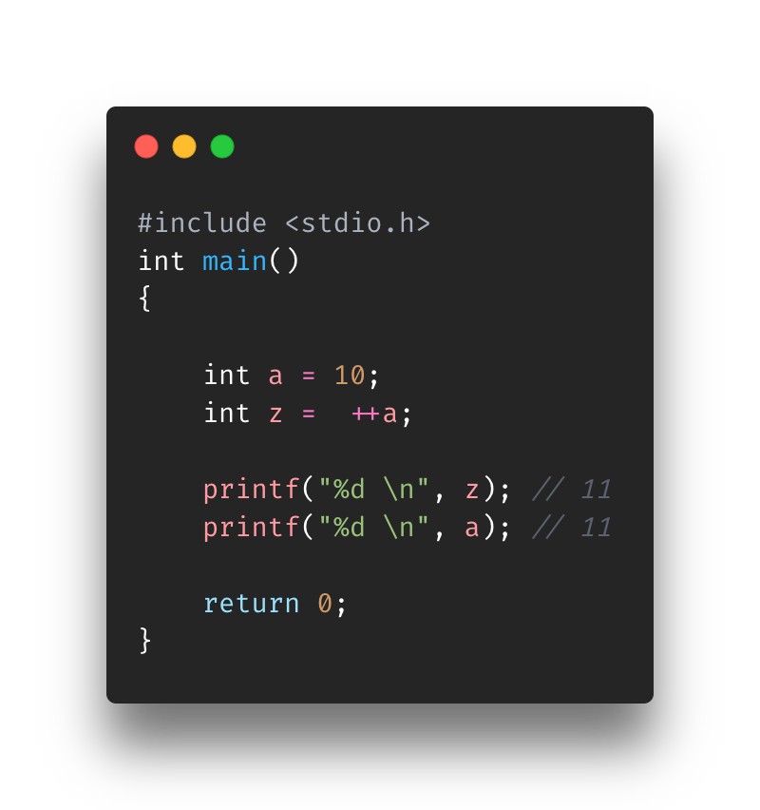
Prefix I/C Operators
Prefix I/C Operator goes before the operand
Ex: ++a or –a
What does this entail?
It increments the operand before using it
Let’s take two scenarios
Scenario 1 (top image)
++a
Scenario 2 (bottom image)
z = ++a
Same values, but’s see how it’s handled in postfix
Notes:
Basically, saying it’ll add 1 before doing ANYTHING else
Scenario 1
The first print statement will print the value inside “a” after it is incremented by 1.
The second print statement will print the same value as “a” was already incremented
Scenario 2
Since we are setting “++a” to “z”, we have to start there. The variable “a” will be incremented by 1 before setting it to z. That is why the first print statement prints 11
The second print statement will print the value inside “a”. Since “a” was incremented by 1 it will house 11

Slide 11
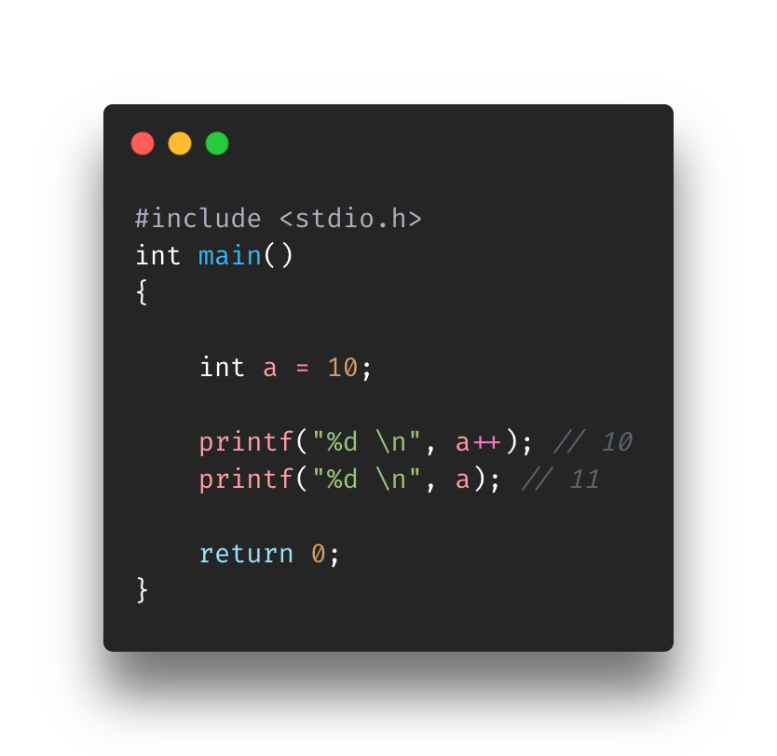

Postfix I/C Operators
Postfix I/C Operator goes after the operand
Ex: a++ or a++
What does this entail?
It increments the operand after using it
Let’s take two scenarios
Scenario 1 (top image)
a++
Scenario 2 (bottom image)
z = a++
Notes:
Basically, saying it’ll do something before adding the 1 to the operand
Scenario 1
The first print statement will print out a value which is 10 and then increments a by 1
At the point of the second print, a will have the value 11 so it will print 11
Scenario 2
Since we are setting “a++” to “z”, we have to start there. The variable “a” will be set to “z” first before incrementing by 1. That is why the first print statement prints 10
The second print statement will print the value inside “a”. Since “a” was still incremented by 1 (after being set to “z”) it will house the value 11
Set it a to z first (z=10) and then add 1(a=11)

Slide 12
Exercise
Find IncDec-Exercise.c in the Exercise folder for Section4-Operators
Using Pre/Post fix Inc/Dec operators and the variables provided print out the following lines
myNumber: 12
myNumber: 11
anotherNumber: 11
myNumber: 10
Instructions on are the script

Slide 13
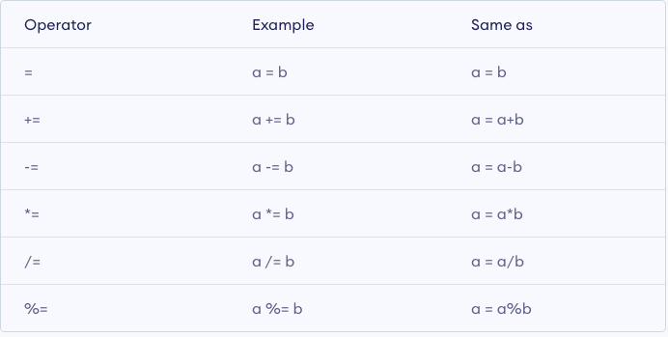
Assignment Operators
Assignment operators are used to assign values to variable
The “=“ you’ve already learned
What if you need to use the value already inside the variable?
The last five allow you to grab the value inside the resulting variable and use it as one of the operands in the operation
Notes:
You’ve already learned the first assignment operator. The “=“ is used to assign a value to variable. It’s the first instruction used to store something in an identifier
As we get into more logic, you’ll see that you will need to complete a operation on a variable but use the value already inside it as one of the operands. That’s where rest of them come in

Slide 14
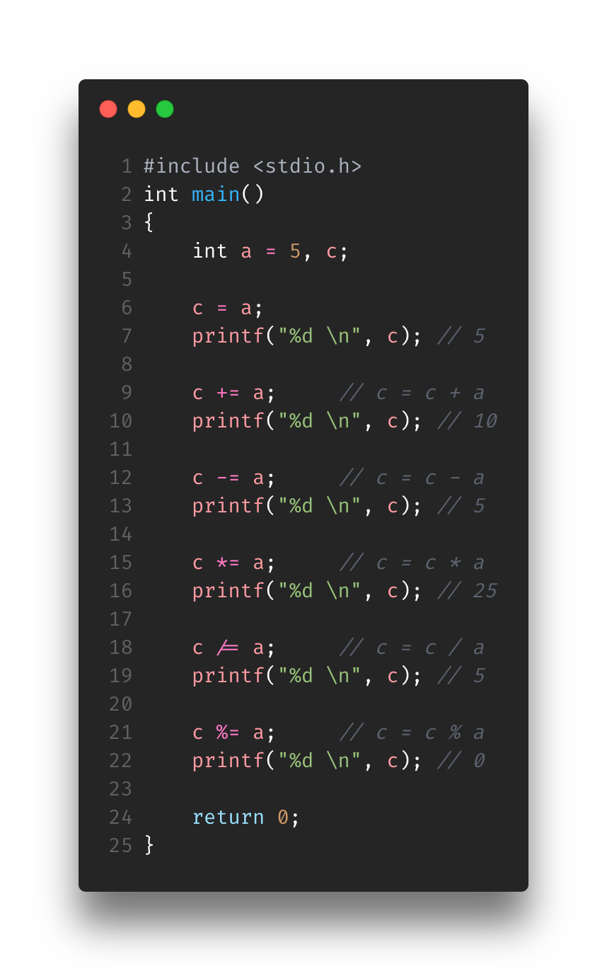
Running Assignment Operators
This might get a little confusing, so PLEASE stop me if you don’t understand it 🥺
Remember that every time an assignment operator is used, the c variable is modified

Slide 15
Exercise
Find Assignment-Exercise.c in the Exercise folder for Section4-Operators
Using Assignment operators and the variables provided print out the following lines
a: 25
a: 125
a: 25
a: 20
a: 0
Instructions on are the script

Slide 16
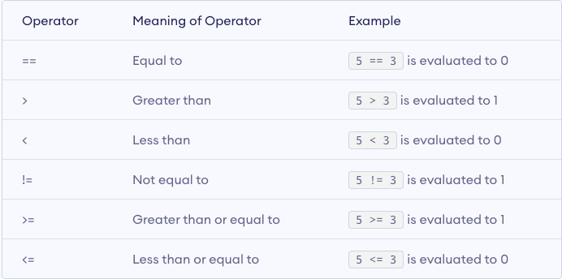
Relational/Comparison Operators
Compares two operands on the relational operator you chose and returns a 0 (false) or 1 (true)
Used in loops and decision making (if statements) but we will get into those later
For now, we will do single line expressions
Similar to math
Notes:
In C, relational operators return a 0 (false) or 1 (true). I think other languages do it differently but here C returns a 0 or 1.
Relational Operators are used to compares two operands and based on whatever operators you used (equal to, greater than, etc.) then it will return a 0 or 1
It is used in logic such as loops and and decision making like if statements. We will get into that later though so for now single line expressions will do

Slide 17
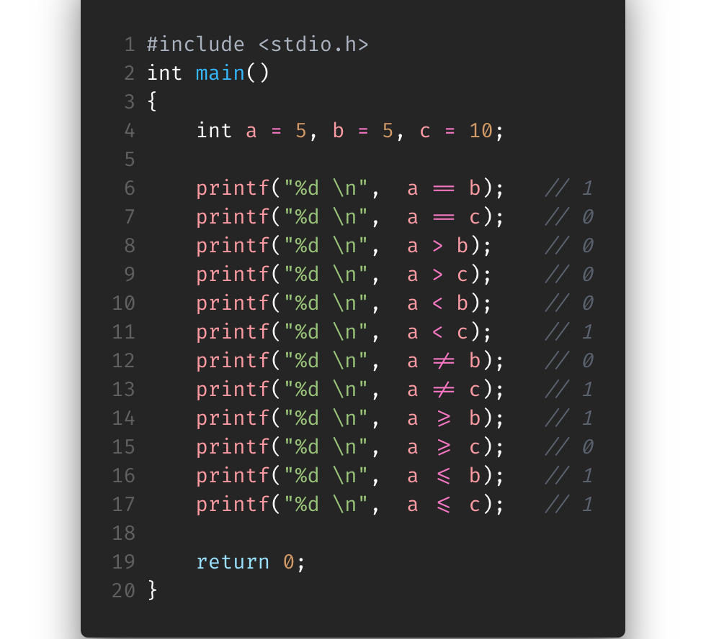
Running Relational Operators
Notes:
--Class Participation--
The weird “slash equals” character is the ”!=“. Some coding fonts just change it for visibility purposes
Same for the less than or equal to and greater than or equal to

Slide 18
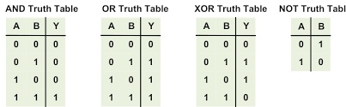
Truth Tables
People have different ways of memorizing it, but you choose your own
Logic
AND
Only True (1) if all inputs are True (1)
OR
Only True (1) if one of the inputs is True (1)
XOR
Only True (1) inputs do not match
NOT
Only True (1) if input was False (1)
Opposite of input
Many more…
xor eax,eax
Notes:
Before we get into Logical Operators, it’s important to know about AND, OR, XOR, NOT and their truth tables. It’ll help build a foundation in logic so that once we get into logical operators you’ll be able to know it.
xor eax, eax is a popular manner of clearing a register. As you can see from the slide, XOR will only output a 1 (True) if they do not match. If they do match then the output and EAX will be zero, thus clearing it.

Slide 19
And Truth Table
Only True (1) if all inputs are True (1)
A | B
0 | 0
0 | 1
1 | 0
1 | 1
A && B
0
0
0
1
Notes:
--Class Participation--

Slide 20
OR Truth Table
Only True (1) if one of the inputs is True (1)
A | B
0 | 0
0 | 1
1 | 0
1 | 1
A || B
0
1
1
1
Notes:
--Class Participation--

Slide 21
XOR Truth Table
Only True (1) inputs do not match
A | B
0 | 0
0 | 1
1 | 0
1 | 1
A^B
0
1
1
0
Notes:
--Class Participation--

Slide 22
NOT Truth Table
Opposite of input
A
0
1
!A
1
0
Notes:
--Class Participation--

Slide 23
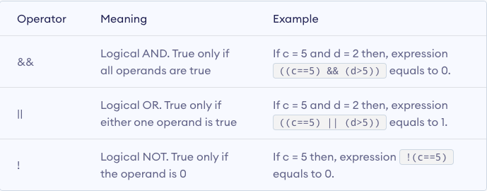
Logical Operators
Builds on Relational Operators and Logical AND, OR, and NOT
Multiple relational expressions (previous slide) tied together to result in one big expression with a 0 or 1
Notes:
Logical Operators builds on Relational Operators. It allows you to have multiple relational expressions within the same line and still return a 0 or 1

Slide 24
And
a = 10
b = 15
c = 20
(a == a) | (b > c) | (a == a) && (b > c)
1 | 0 | 0
(a < b) | (b < c) | (a < b) && (b < c)
1 | 1 | 1
Notes:
--Class Participation--

Slide 25
OR
a = 10
b = 15
c = 20
(a == c) | (c < a) | (a == c) || (c < a)
0 | 0 | 0
(c > a) | ( (b-a) > c ) | (a < b) || ( (b-a) > c )
1 | 0 | 1
Notes:
--Class Participation--

Slide 26
NOT
a = 10
b = 15
c = 20
(a == a) | (b > c) | (a == a) && (b > c) | ! ((a == a) && (b > c))
1 | 0 | 0 | 1
! (c > a) | ( (b-a) > c ) | (a < b) || ( (b-a) > c )
0 | 0 | 0
Notes:
--Class Participation--

Slide 27

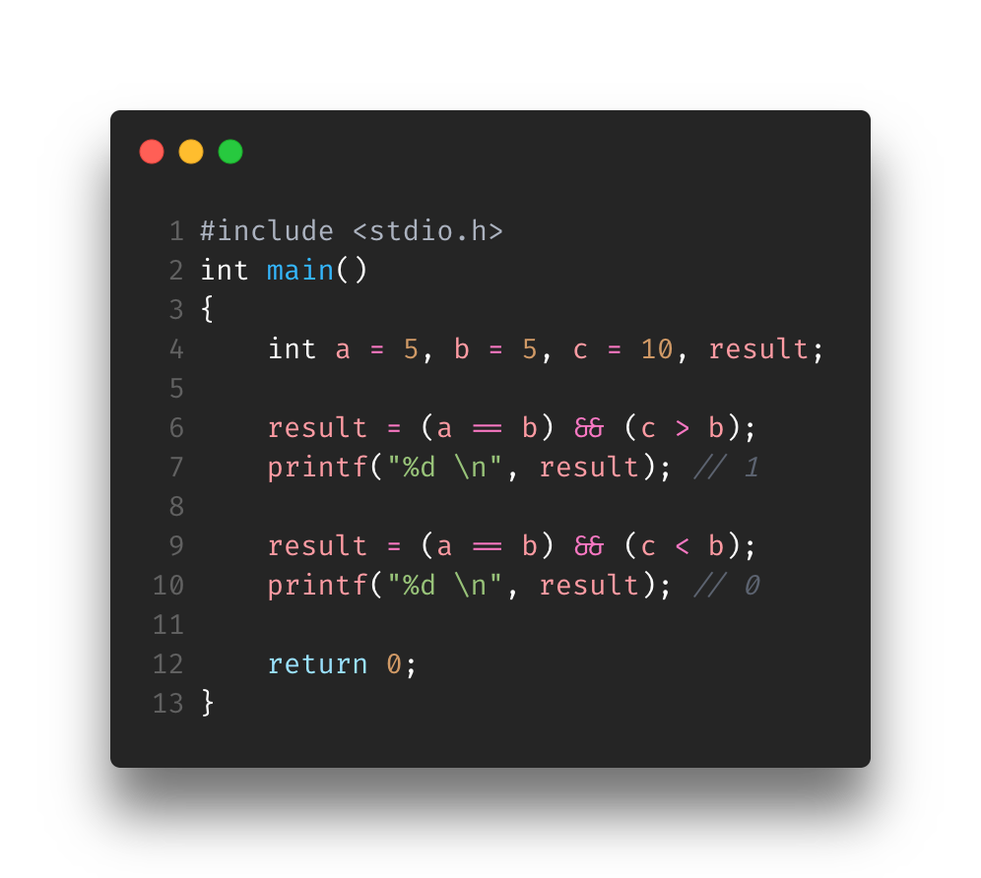
Running Logical Operators
AND

Slide 28
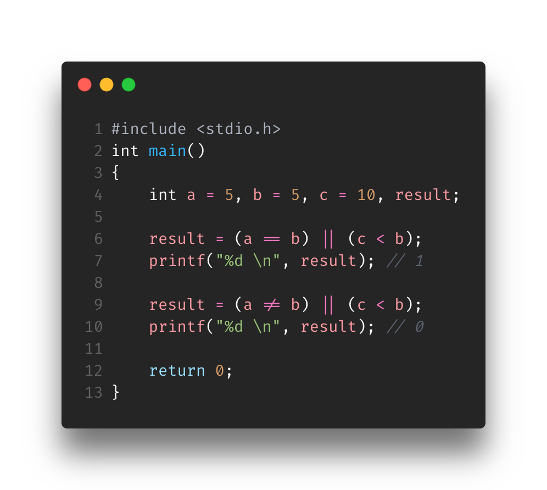
Running Logical Operators
OR

Slide 29
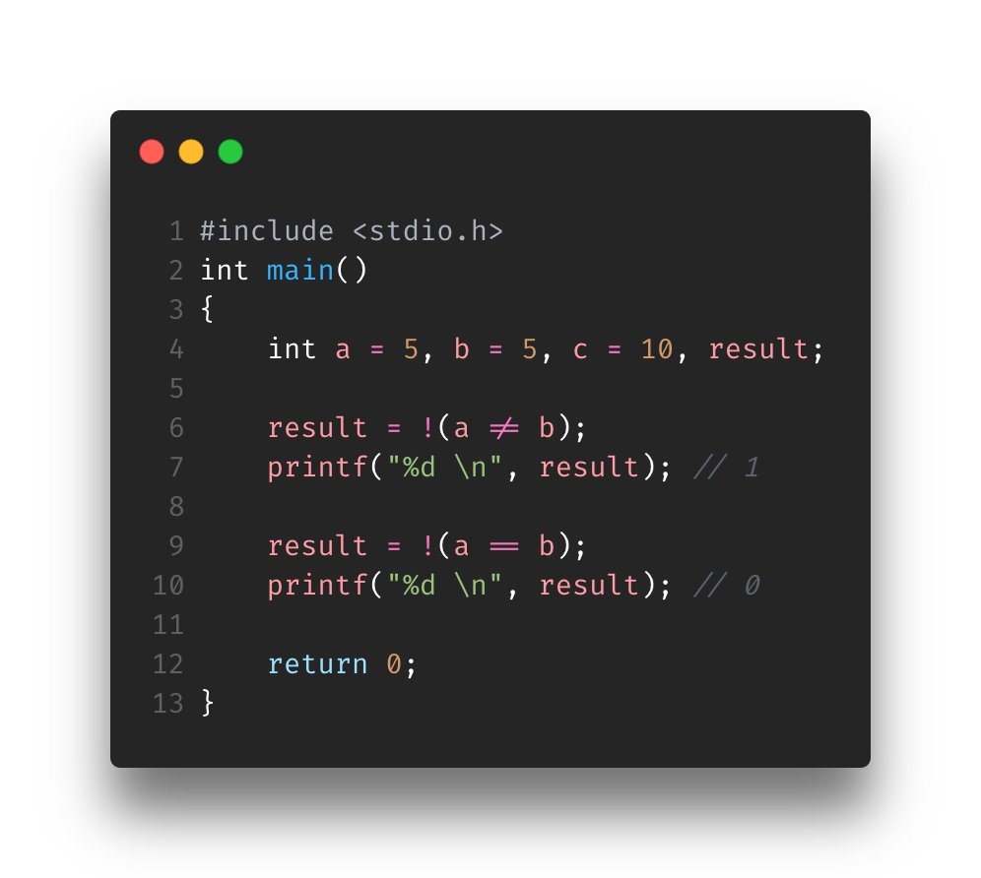
Running Logical Operators
NOT

Slide 30
Exercise
Find Logical-Exercise.c in the Exercise folder for Section4-Operators
Initialize the variables so that the output of the program matches the output requested. In order to set the correct variables/get the correct output you will need to know what is going on in the expressions.
expression1: 1
expression2: 0
expression3: 0
Instructions on are the script
This one is a bit tough, soooooo please ask questions! ☺

Slide 31
Overview
Arithmetic Operators
Increment/Decrement Operators
Assignment Operators
Relational/Comparison Operators
Logical Operators

Slide 32
References
https://www.programiz.com/c-programming/c-operators
https://www.freecodecamp.org/news/the-c-beginners-handbook/#operators

