Slide 1
C Flow Control
By: Lt FElipe Pineda

Slide 2
Overview
scanf(…)
If Else Statements
For Loop
While Loop
Do While Loop
Break and Continue
C Switch
Goto

Slide 3
Streams in C
What is a stream?
Interface that can represent a device or a file
Think “reading a book” when you start ingesting those words/characters in the book you are “inputting” that text in your brain.
In C, there are three steam types
stdin (standard input)
stdout (standard output)
stderr (standard error)
In C, instead of directly manipulating the three streams, it has functions that work with them
We already learned about printf(…), now let’s learn about scanf(…)
*Note: In documentation/courses, teachers often combine teaching I/O functions, but I decided to split them and pair them with another topic (ex: Flow Control). It helps understand them if you can apply them in actual logic right away
Notes:
A stream is a high-level interface that can represent a device or a file.
Actually, C has no way of differencing between reading from a file or reading from the command line (at least in terms of input
C has three kinds of I/O streams
stdin (standard input)
stdout (standard outpit)
Stderr (standard error)
I think there is a way to assign values to the stream but the C gods were awesome enough to create functions for us to use.
We have already learned one of the many functions used to output => printf(..)
In the next slide we will learn about scanf
If you were curious on how to print to stderr you can do “fprintf( stderr, "my %s has %d chars\n", "string format", 30);”

Slide 4

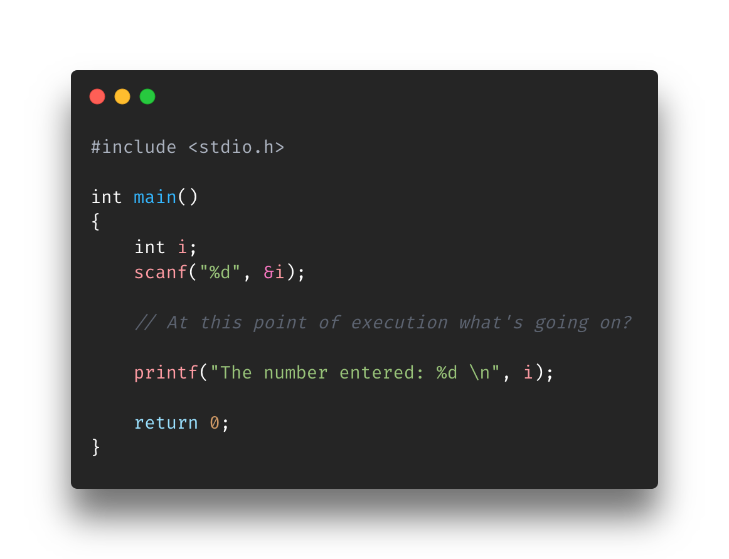
scanf
One of many functions to read from stdin (standard input)
In other words, one of the many functions to take input from the user (more specifically the keyboard)\
scanf takes >=1 arguments
Formatted string with specifier
value1, value2, …, valueN
Example of reading from stdin and printing to stdout
Notes:
Scanf is one of most commonly used functions to take in user input.
Others include getchar(), getch(), gets(), and fscanf()
It’s used in scripts to stop the program and wait for the user to the type in their input. The program will continue after until it completes.
Scanf takes in two arguments
Formatted specifier
Similar to printf, you have to tell the program what type of value to expect
The actual values
Why do they require a “&”?
In C, if you give a function (ex: scanf) arguments, and you want to change them then you need to provide the pointer so for example: void change(int *var) => change(&myVar)
Another explanation: all arguments (normal functions and arguments being passed into scanf) are passed by value. Once inside the code block if you want to change the variable/parameter you have to provide a pointer to the memory address of the variable (& = memory address)
Do not worry if you don’t fully understand this yet, we will go over it once we get to pointers. For now, just assume it

Slide 5
Exercise
Find Input-Exercise.c in the Exercise folder for Section5-FlowControl
Create the scanf calls for the the given variables. In this one you just create the scanf calls in the specified areas. Example output below (your values will be different)
Give me an int number: 334
Give me a float number: 3.14
Give me a double number: 3.1454454
Give me a single character: T
Actually, I don't want them anymore here you go: 334, 343.30 343.340000, T
Instructions on are the script

Slide 6
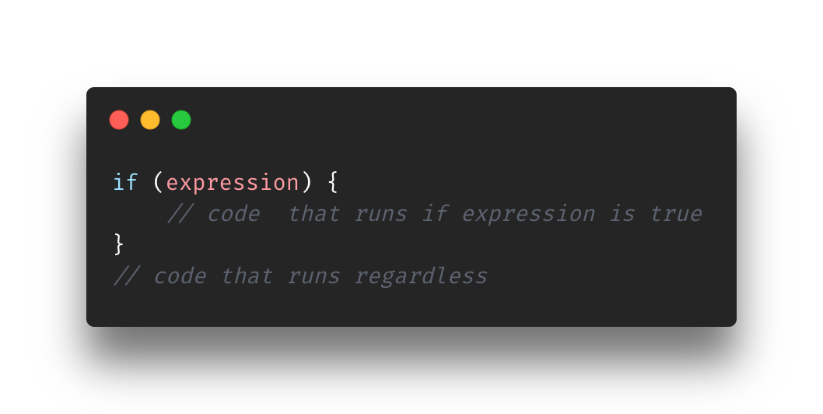
If Statement
Adds decision making to your program
Why is that necessary?
Run/not run code if a certain condition is met
Everything we have run has been going line by line
There was no avoiding or “jumping” to certain code
Let’s look at some examples
Notes:
The if statement is meant to add decision making to your program. Up until now all your code has been sequential and goes line by line.
What if you want to skip some lines of code? What if you want specific lines of code to run but only during certain conditions

Slide 7
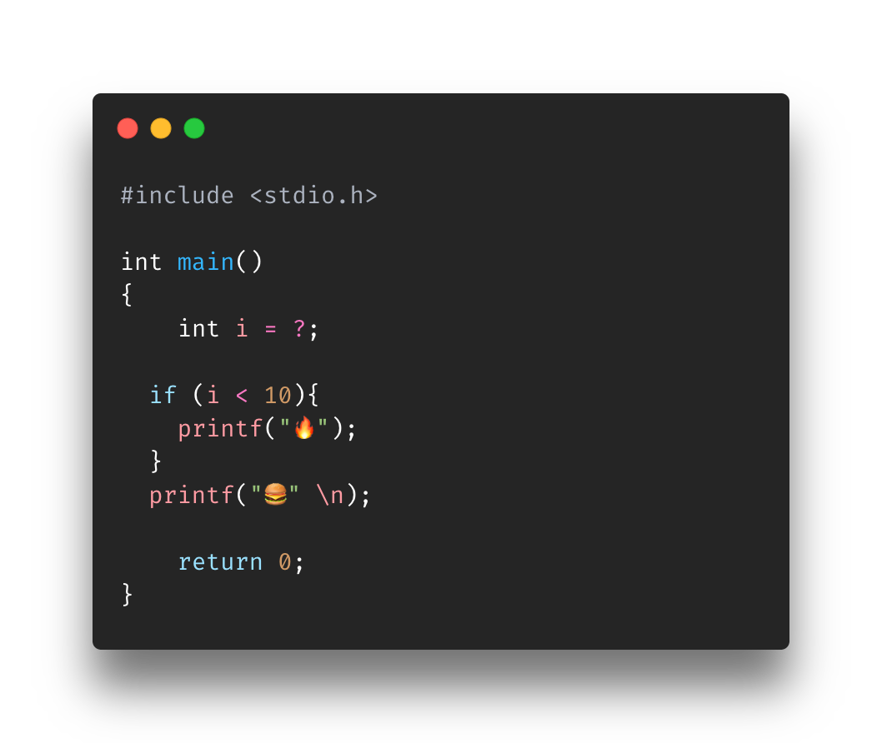
Fuego y hamburguesa
What does i need to be to output:
🔥 🍔
What does i need to be to output:
🍔

Slide 8
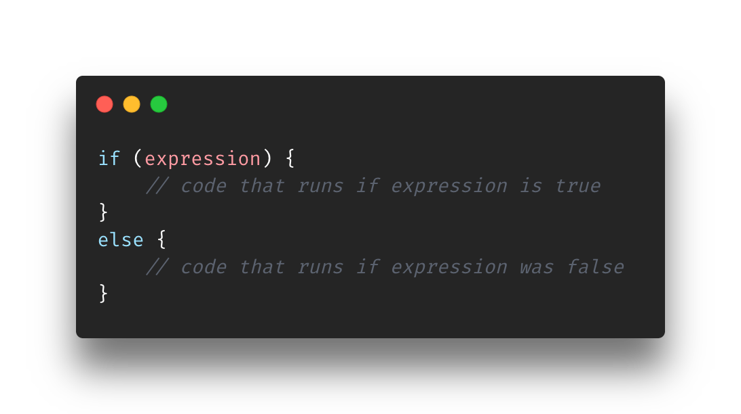
If … Else Statements
If Statement
Picture yourself a young program walking on the road
Some person comes up to you and says “you want this piece of fire? You can pass if you don’t want it”
You say yes/no and continue to go on your way
If Else Statement
Same program walking on the road
Some person comes up to you and says “stop, you have to choose between this piece of fire or burger? I cannot allow you to pass without taking one”
Take one and continue to go on your way
Notes:
Building on from the If statement, now we can restrict the program to choose ether option A or B when it gets to our IF Else statement

Slide 9
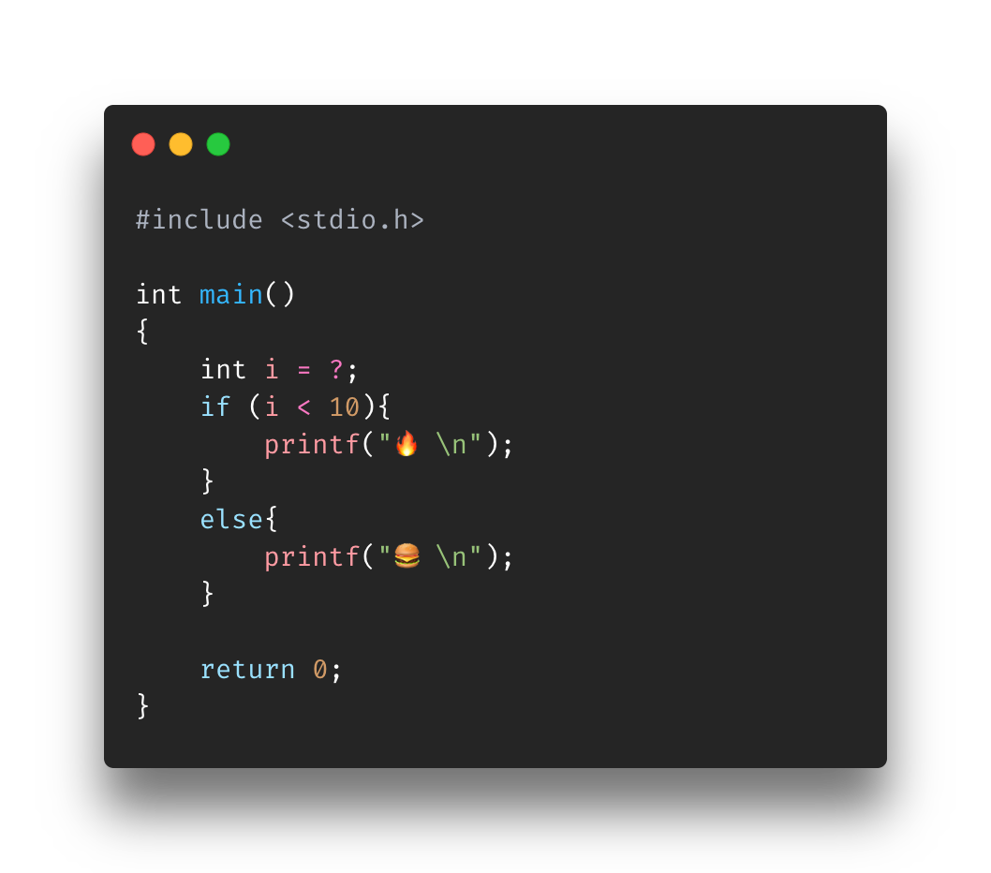
Fuego or hamburguesa
What does i need to be to output:
🔥
What does i need to be to output:
🍔

Slide 10
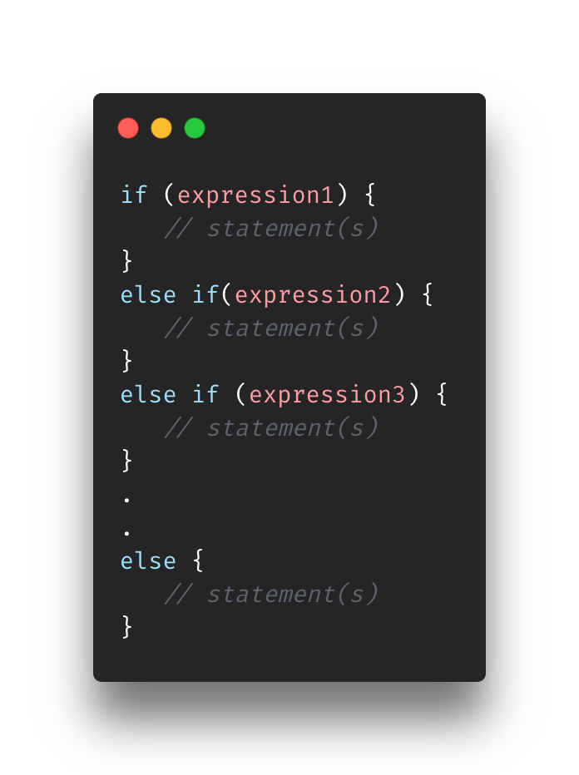
If … Else IF … Else IF … Else Ifn … else
^
Same program walking on the road
Some person comes up to you and says “stop, you have to choose one these items: fire, burger, green apple? At the very least you must take the tomato. I cannot allow you to pass without taking one”
You choose one and continue to go on your way

Slide 11
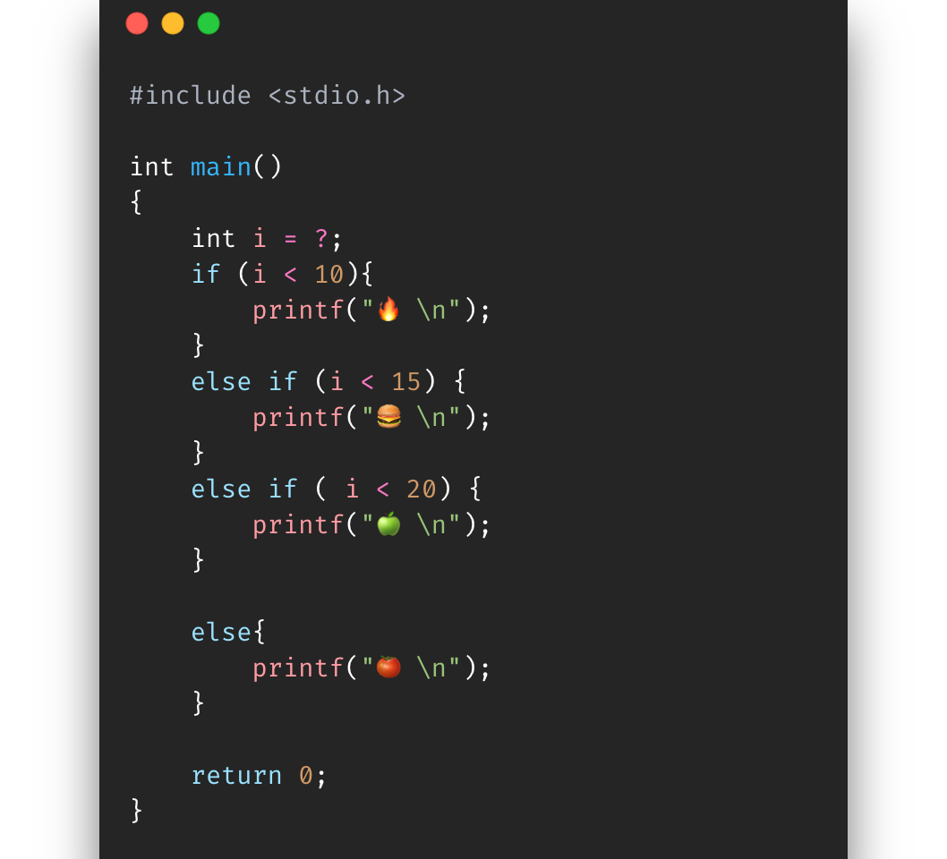
Fuego… hamburguesa… manzana verde… tomate
What does i need to be to output:
🔥
What does i need to be to output:
🍔
What does i need to be to output:
🍏
What does i need to be to output:
🍅

Slide 12
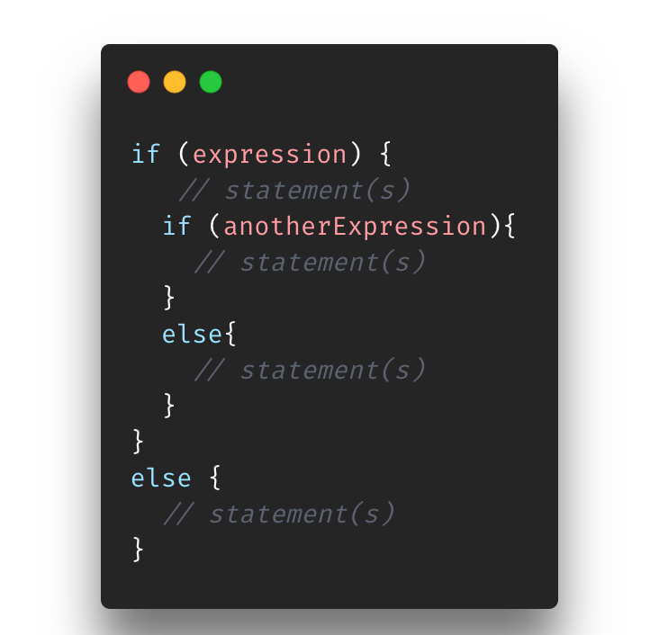
Nested If Statements
Same program walking on the road
Some person comes up to you and says “stop, you have to choose one these items: fire, burger, green apple? At the very least you must take the tomato. I cannot allow you to pass without taking one”
Before you go on your way, that same person asks you to make another decision. The person asks do are you team Android or Team iPhone?“
You choose one and you choose whatever team you belong to, then you continue to go on your way

Slide 13
Sike.. You thought… Time for an exercise
Find If-ElseIf-IfElse-Else-Exercise.c (what a lovely name) in the Exercise folder for Section5-FlowControl
Set the values to variables ”i” and “letter” so that the program outputs
hamburger
robot
Instructions on are the script

Slide 14
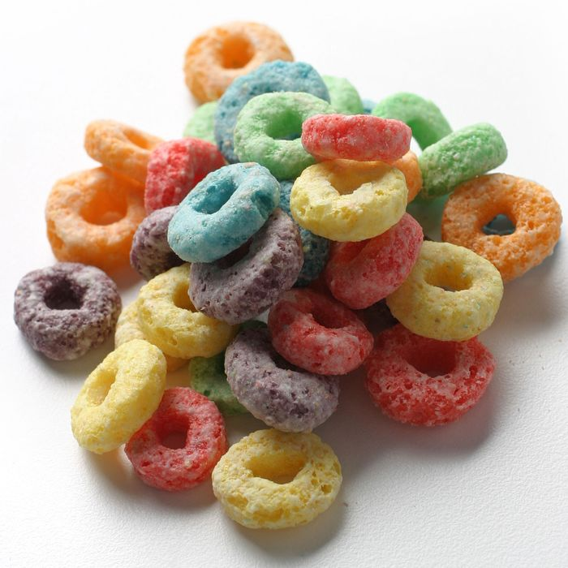
Loops
Cool, we learned decision making and whatnot
Now, how do we repeat stuff for an x number of times?
What if we have a code block that we need to run 10 times?
In more formal manner, until a specific condition is met (while loops, do…while loops)
For Loops, While Loops, do…while loops
Notes:
Cool, now we learned how to do simple decision-making stuff lol
How do we repeat stuff thought for x number of times? Say for example if we have three lines that we want to run 10 times, how do we do that?
LOOPS!!!

Slide 15
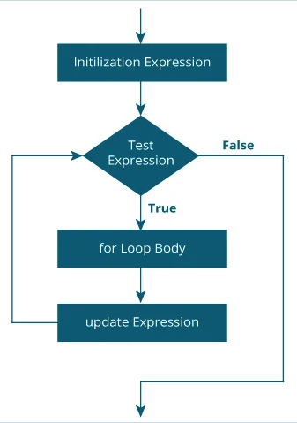
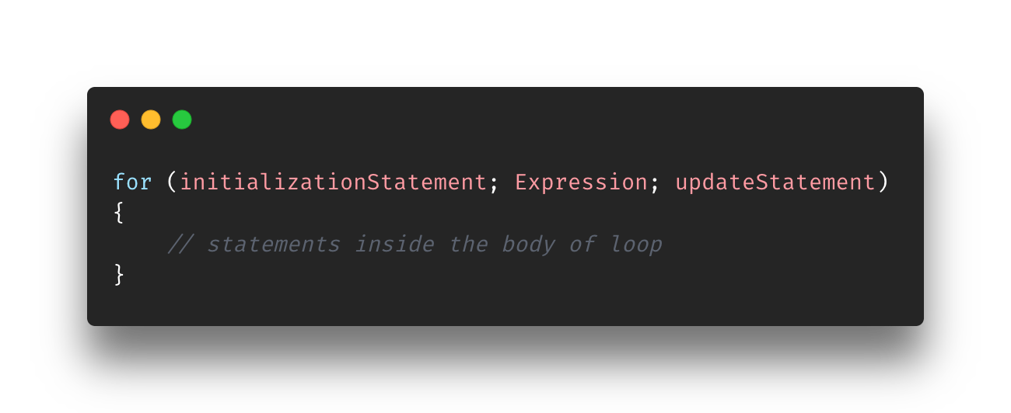
For LooP
For Loop flow
Initialization statement is executed once
Expression is evaluated
True: run For Loop body
False: Terminate
If it did not terminate (Expression was True), then the update expression/statement will be well.. Updated
Go to Step 2 and repeat

Slide 16
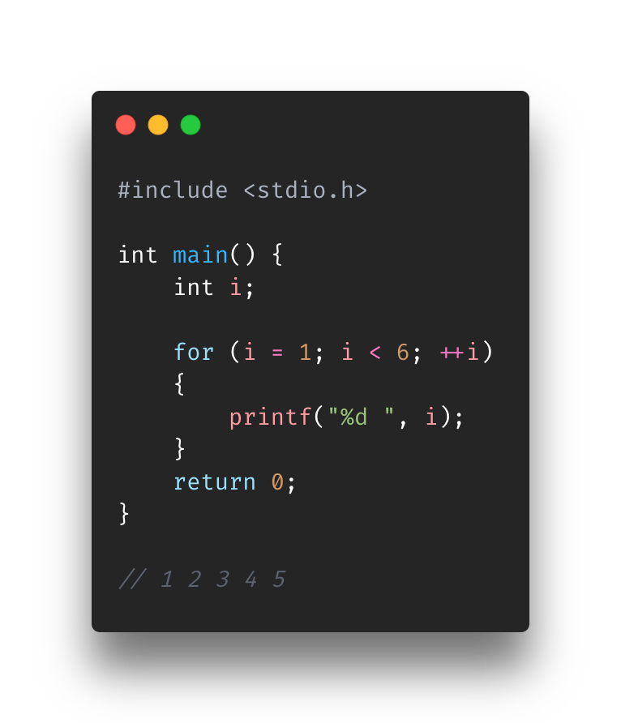
For Loop
What is the output of this program?
1 2 3 4 5
How many times does it go through the loop?
5
How many times does it evaluate the expression?
6

Slide 17
Exercise
Find ForLoop-Exercise.c in the Exercise folder for Section5-FlowControl
Create a for loop that uses the user input to print the the number between 1 and the number the user put in
Enter the loop count: 5
1
2
3
4
5
Instructions on are the script

Slide 18
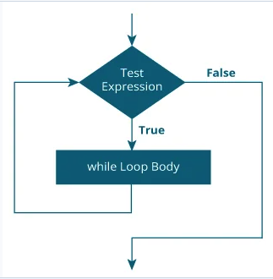
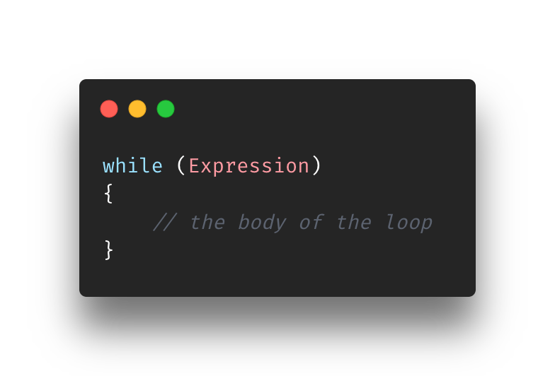
While loop
Simpler version of all the loops
While loop only cares about the expression and nothing else
It’s up to you set up the loop data beforehand (ex: setting the incrementing variable)
Also, you are tasked with keeping up with the loop data (ex: incrementing the variable to continue)
Notes:
While Loops are a simpler version of For Loops. It’s because they only requires/cares/tracks/acts on an expression and nothing else.
It’s up to you set up all the loop data beforehand keep up with after as well.

Slide 19
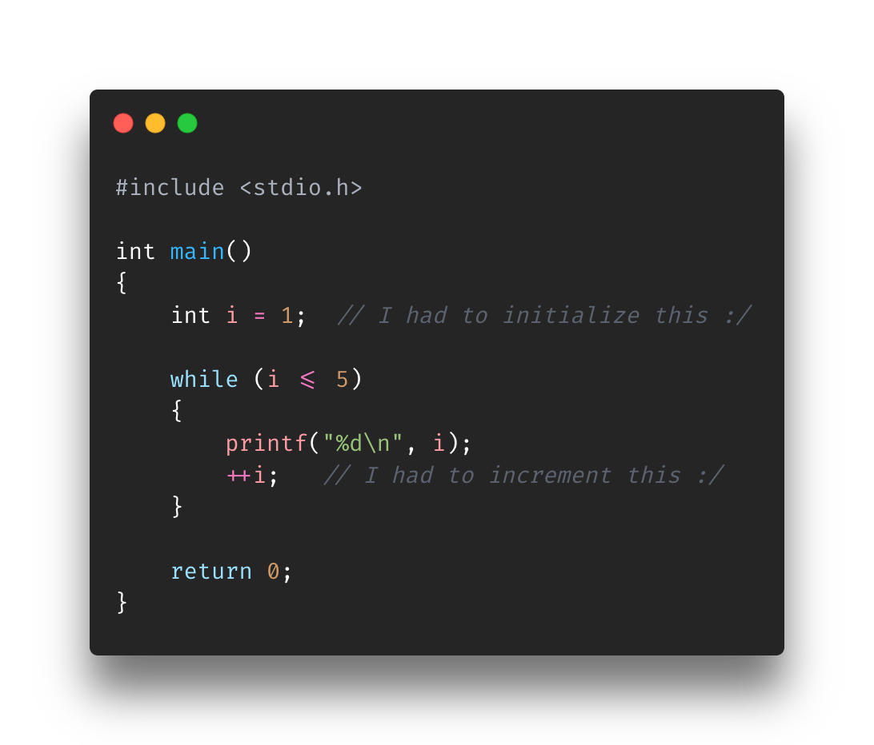
While Loop
What’s the output here?
1
2
3
4
5
We already saw this with the for loop ☺

Slide 20
Exercise
Find WhileLoop-Exercise.c in the Exercise folder for Section5-FlowControl
Create a While Loop that prints out all the even numbers between 1 (count variable) and 20
2
4
6
8
10
12
14
16
18
20
Instructions on are the script
Hint: count % 2 == 0

Slide 21
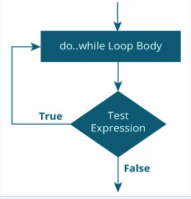
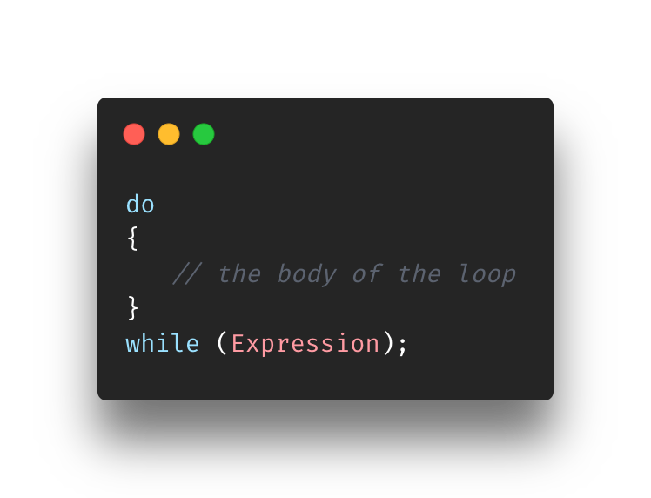
Do While Loop
Similar to While Loop
Only difference is that it runs the code block before testing the expression
Sooo.. Code will run at least once

Slide 22
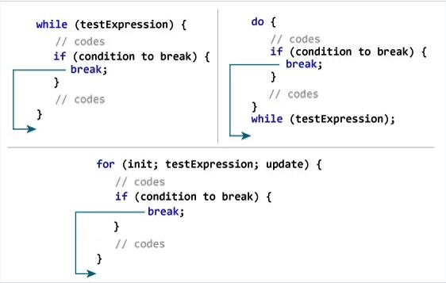
Break;
We’ve only learned about how to write loops that repeat
How do we stop the continuation of a loop if a condition is met?
Well, you could make it a part of the condition, right?
But what if you want to let it enter the loop first?
That’s where the break comes in
It ends the loops when it is hit
Execution continues on the next line after the loop
Let’s go through the image on the right
Notes:
Up until now we’ve learned about loops and how they repeat code until a certain condition no longer is true.
What if you want to stop the loop on condition but… you also want it to enter the loop for other reasons
You can use the break. The break ends the loop when it is hit and the code continues on the next line after the loop
It’s a end all solution for a loop.

Slide 23
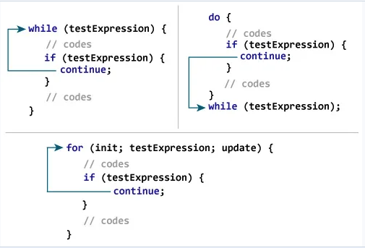
Continue;
Similar to Break in terms of acting on the loop
It doesn’t terminate the loop
It tells execution to go to the next cycle and ignore the rest of the code below it (within the code block)
Let’s go through the image on the right
Notes:
Continue, like the Break, will do something to the loop once it is hit.
It doesn’t terminate the loop, but actually tells it to go to the next cycle and ignore the code below it.

Slide 24
Exercise
Find BreakContinue-Exercise.c in the Exercise folder for Section5-FlowControl
Create two if statements within the For Loop to skip over 12 and terminate the loop on 18. The For Loop prints out even numbers between 1-20. Also execution must hit the printf statement after the loop :P
2
4
6
8
10
14
16
We don't get along with 18 :)
Instructions on are the script

Slide 25
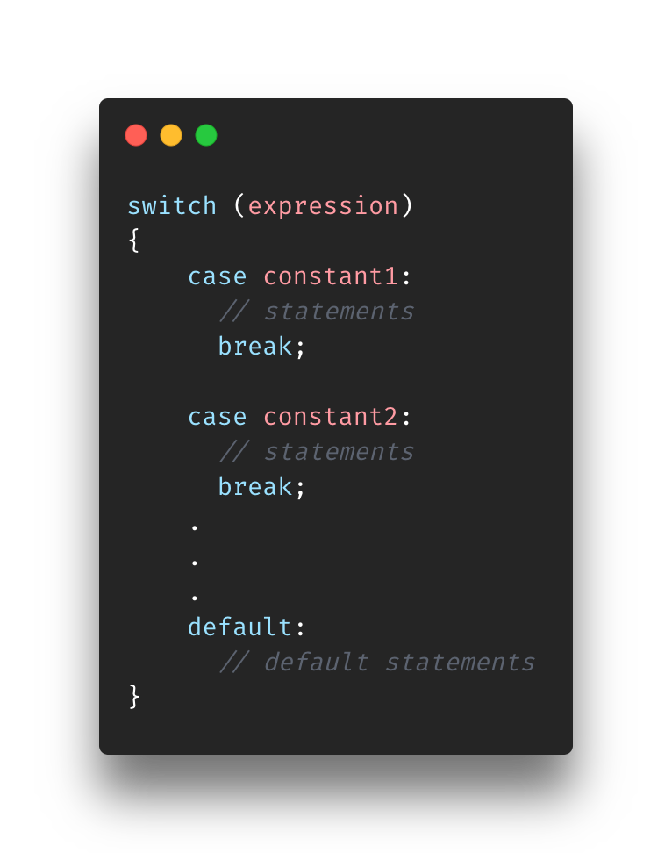
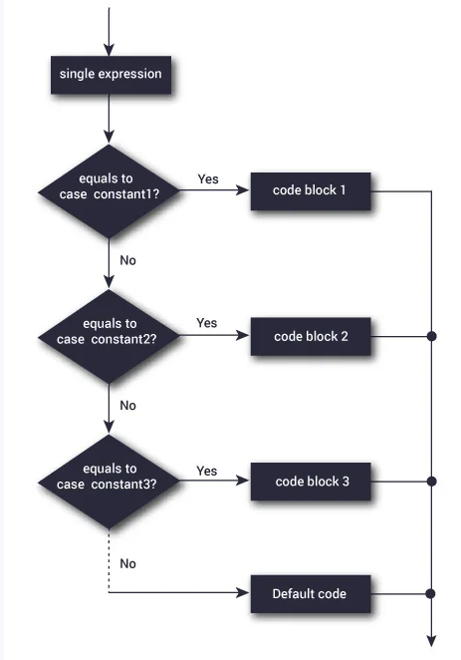
Switch Statement
Super similar to If – Else If- Else statements but cleaner
Switch statement evaluates an expression and will execute one more of the code blocks
Take note of the break
What would happen if we took out of the breaks?
It wouldn’t terminate the switch. It would go the next case executing until it hits the next break
Why do we have a default?
It’s equivalent the else in the If…Else statement. If it didn’t match any of the cases then it would hit the default

Slide 26
Exercise
Find Switch-Exercise.c in the Exercise folder for Section5-FlowControl
Create a program that is similar to a virtual pet. The program will ask you to enter a character and that character will be associated to specific action (ex: walking your dog). You will be building the logic within the switch statement.
See script for the output as it’s a lot
Instructions on are the script
This one is a bit tough so please ask questions If you have any!

Slide 27
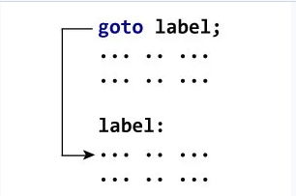
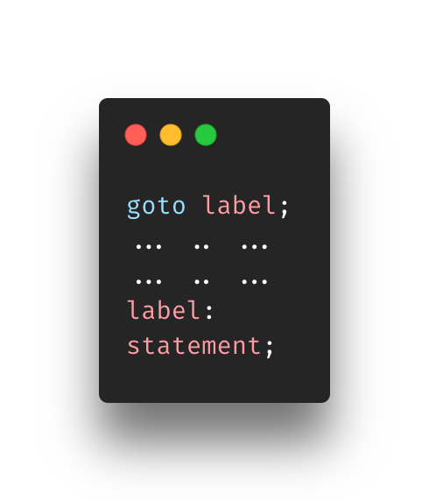
Goto Statement
If you played with assembly, you already know how this werks
The goto statement allow us to transfer control of the program to a specified label
Label is a unique identifier that names a specific piece/block of code
As execution hits the goto <label>, it will jump the label specified and continue execution on the code below it

Slide 28
Exercise
Find Goto-Exercise.c in the Exercise folder for Section5-FlowControl
Using the goto <label> statement you just learned to recreate the famous Earth, Wind, & Fire lyric.
Do you remember, 21st night of September?
Instructions on are the script

Slide 29
Overview
scanf
If Else Statements
For Loop
While Loop
Do While Loop
Break and Continue
C Switch
Goto

Slide 30
References
https://www.tutorialspoint.com/c_standard_library/c_function_scanf.htm
https://www.freecodecamp.org/news/the-c-beginners-handbook/
https://www.programiz.com/c-programming/c-input-output
https://stackoverflow.com/questions/10597606/why-does-scanf-require
https://stackoverflow.com/questions/29775323/scanf-function-seems-to-be-skipped-in-c
http://www.cplusplus.com/reference/cstdio/scanf/

