Slide 1
C Functions
By: Lt FElipe Pineda

Slide 2
Overview
User-defined functions
Functions types
Standard library functions

Slide 3
User-defined functions
Always building towards an easier way
Functions allow us to reuse code that performs a task
In C we can create new functions or block of code to reuse throughout the program
Why would we need this?
Saves space on the script
Modular code
More readable
Notes:
Just like everything in the course we are always building up to an easier way.
Functions allow us to reuse code that performs a specific task
The c programming language allows us to create new functions and implement them within our scripts
Why is this useful? Well, it’s useful to make the code more modular. This means you can easily move stuff around in your script if you need to. It also allows the reader to follow your code more easily. You can use well defined names that describe the functionality of the code. Lastly, it saves space on your machine/script. You don’t want to be scripter that uses 10,000 lines of code when you can do 5,000 (still a lot lol)

Slide 4
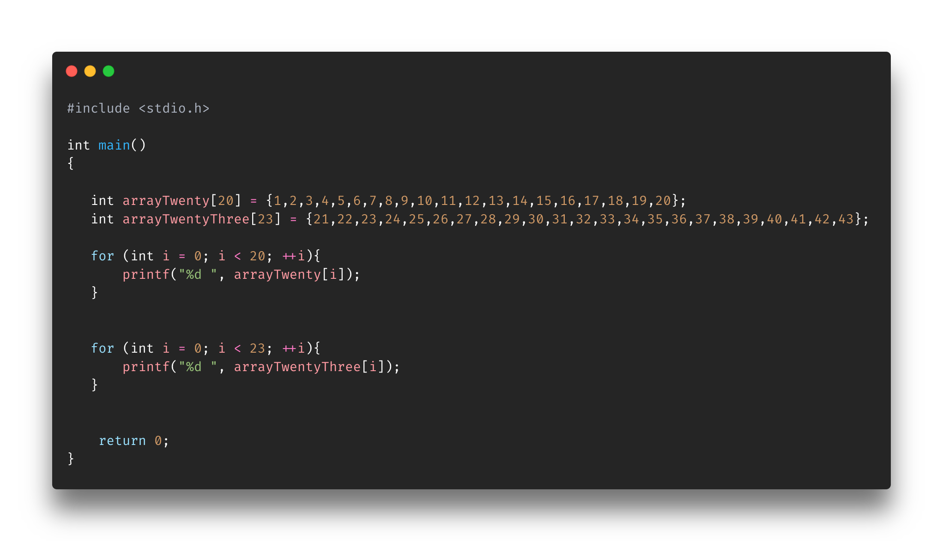
Notes:
In order to print the array, we need to implement two print for loops that each have 3 lines. In this script it doesn’t seem like a lot but imagine if you had 1000 arrays. That about 3000 lines just for the for loops.

Slide 5
Understanding functions
3 Ds and 3 Cs
Determine recurring code
Determine the input
Determine the output
Create the function prototype
Create the function definition
Create the function caller
Notes:
In order to create a user-defined function we need to
Determine recurring code
Code that just keeps repeating and most of it is (variables, actions, etc.) not changing
Determine the input
This means determine what arguments it will take in
Determine the output
This means determine what it will return or give back
This help identify if you’ll be setting it to a variable or just printing within the function
Create the Prototype
To create the prototype you will need
Return type (output)
Name of function
List of arguments (input)
Must be placed before the main function
Create the function definition
This is where the recuring code goes in
It can be placed anyone in the script
Create the caller
The caller is the line(s) of code that will call the function
Depending on your return type, it may return and save to variable or just print (void)

Slide 6
Determining the recurring code

Slide 7
Determining the input (arguments)
An array
Type: int
A size
Type: int
Notes:
What stays the same and what changes? Normally the things that change are the arguments to your function

Slide 8
Determining the output (return)
void type
Notes:
Normally the output/return is a type or just printing out
If it’s a type, then you’re more than likely returning it to save it somewhere
In this case we just wanted to print it out, so the function to be of void type. If for example, we wanted to return one of the numbers than the function would be of int type
To do this another scenario, you have to focus on what the outcome you want and how that will flow to the rest of the script.

Slide 9

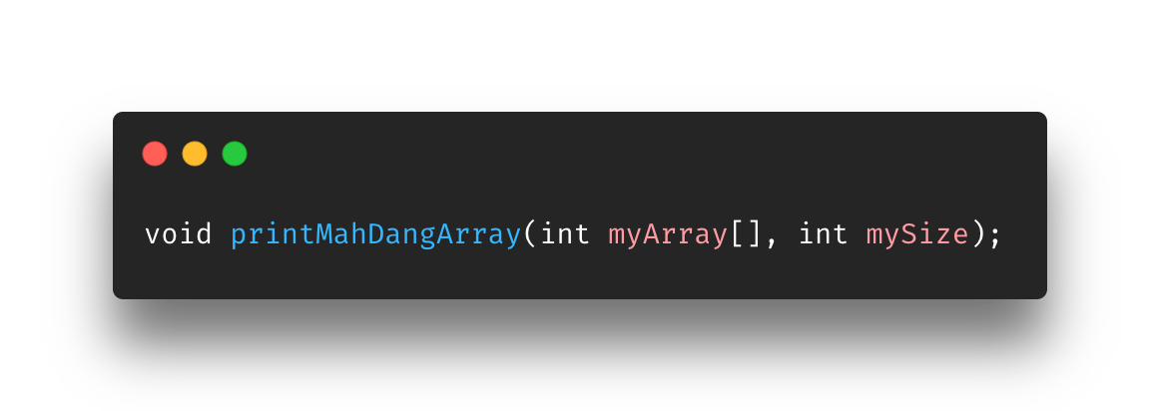
Create the function prototype
So, we want a function that takes in
An array
Type: int
A size
Type: int
And returns void
I have the perfect name…

Slide 10
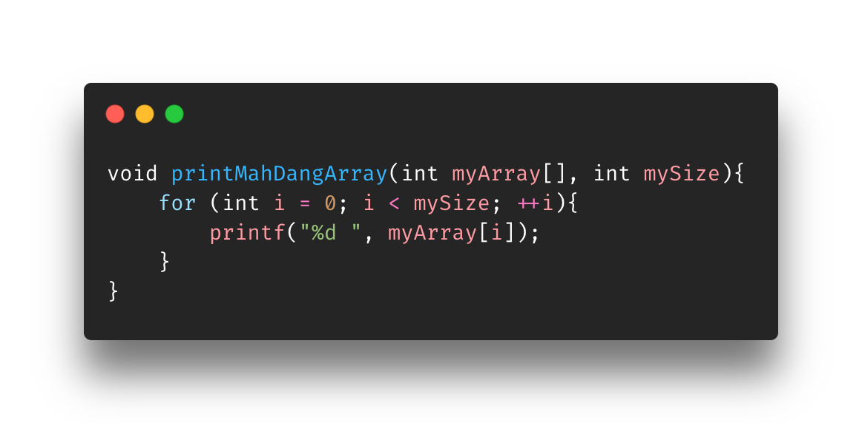
Create the function definition
Notes:
Function takes in the MyArray and mySize. In the for loop, it will loop through from 0 to mySize thus looping through all the numbers in the array.
Using the looping i (0…mySize), it will access each element in the array on every cycle and printing it out

Slide 11
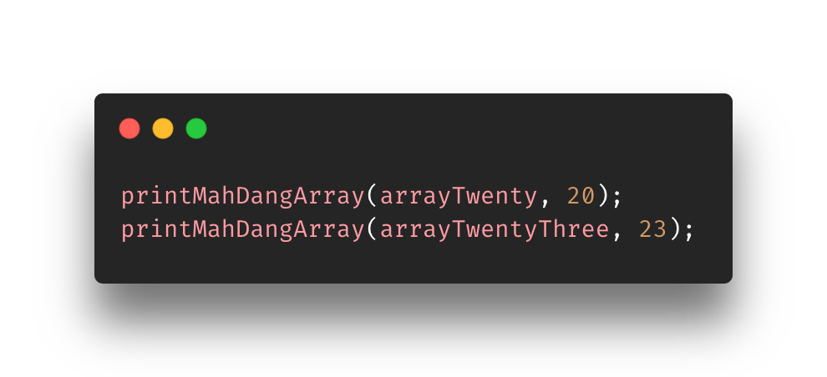
Create the function caller (more like call the function but it needed to start with create to be consistent with the 3cs)
Notes:
The calling function will go wherever you needed that action to be set off. In this case, we need it in the main function.
We’ll see the entire thing in the next slide

Slide 12
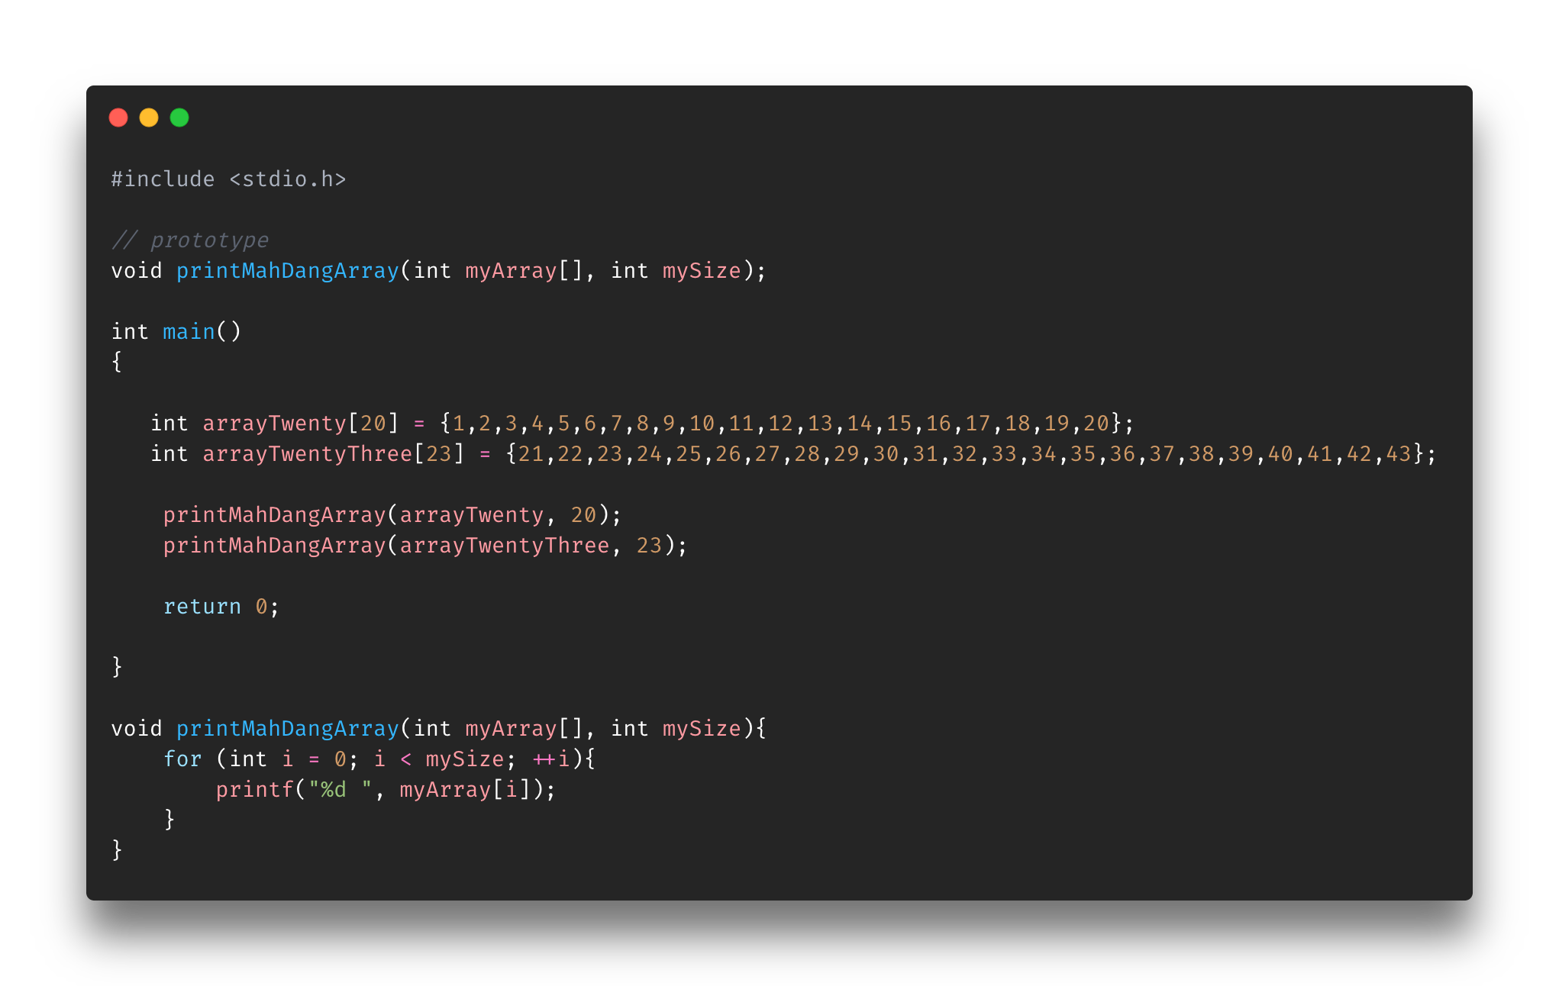
Notes:
Here we create a prototype (declaring the function before) and then define the function at the bottom. Now if we use this function correctly, we can print any array in just a single line. Going back to the previous slide where we said what if you had 1000 arrays, now it would take an additional 1000 lines of code instead of 3000.
Not the must efficient but hey, it’s better than 3000

Slide 13
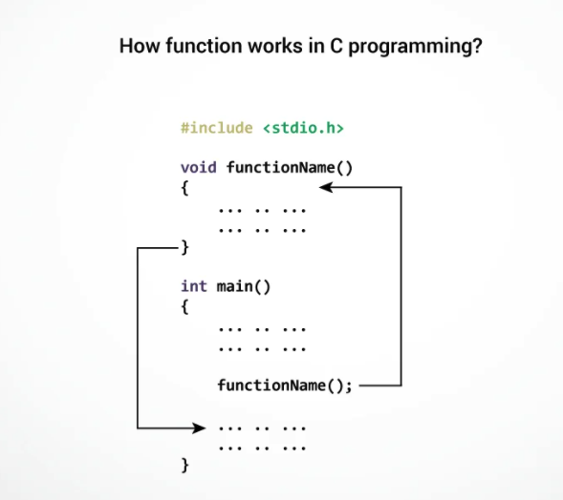
User-defined functions
El Flow
Execution of a C program will begin at the main() function
Encounters functionName();
Transfers execution to function definition passing in any arguments
After it’s done, it’ll return to the main() function and continue execution
Extra tip: function names should be unique!
Notes:
Like mentioned at the beginning of the class, the C program will begin execution at the main() function. Be advised, there are other ”beginning” functions a C file can have.
When the compiler encounters “functionName()”l in the main() function, it will transfer execution to the actual void function definition (top) passing in any arguments.

Slide 14
Function types
In slide example we had a void type meaning it didn’t return anything (we printed a value)
Now let’s talk about the types of functions and their returns

Slide 15
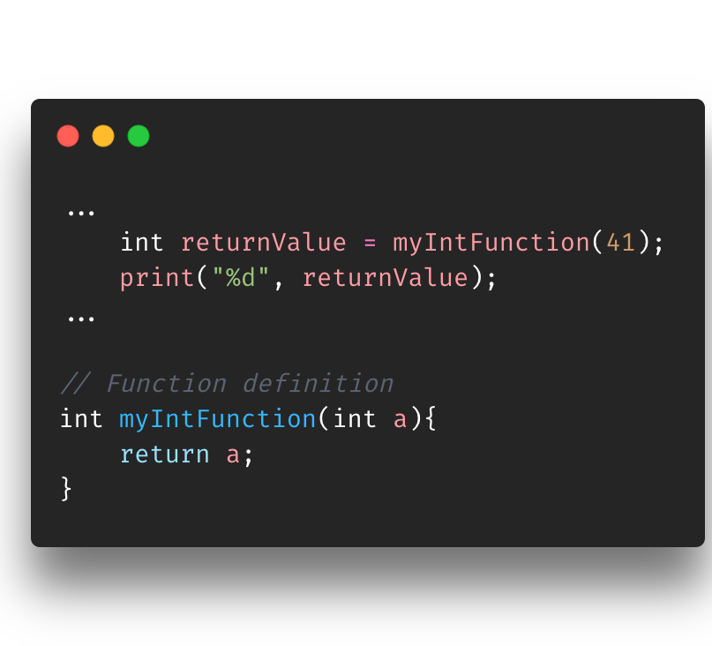
Int functions
Execution will call myIntFunction(41)
Execution will be transferred to the function definition (bottom part)
41 will be in place of the a variable (argument)
Function will return the a variable, which is 41
When a value is ”return’d” that means it will be given back to the calling line so the program can store it somewhere in this case the ”returnValue” variable
The “returnValue” variable, which stores 41, is then printed

Slide 16
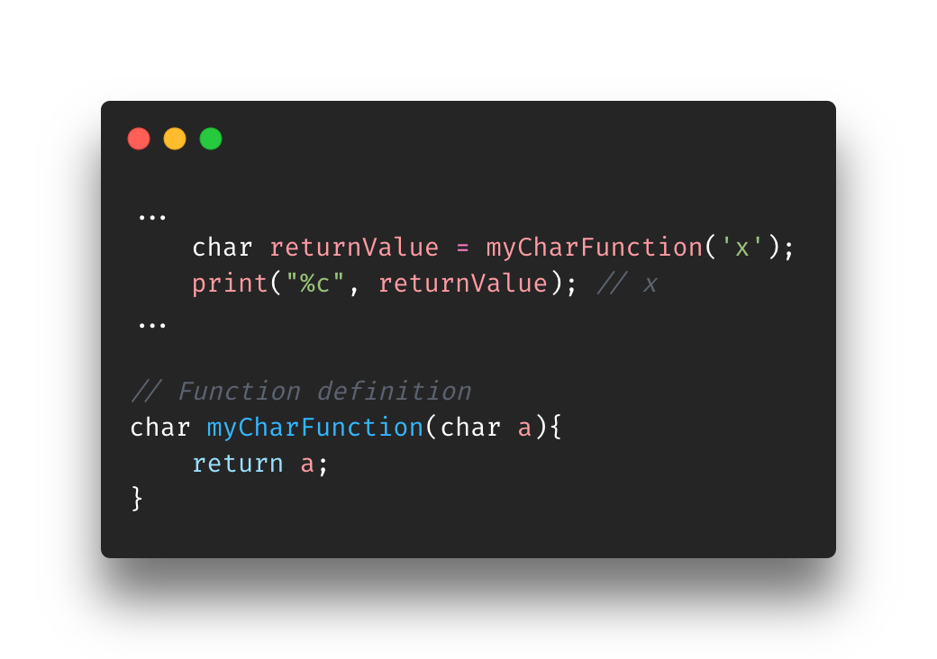
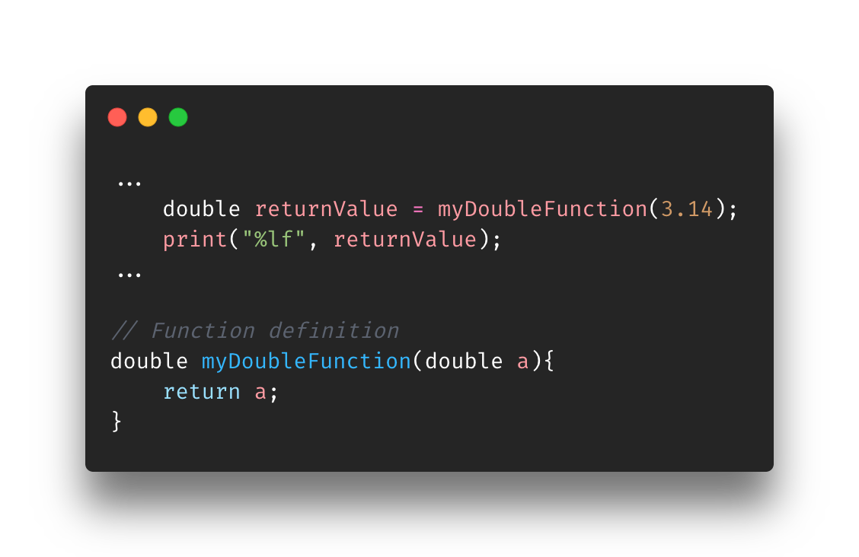
Same thing for all the other types
On the right you’ll see a char function (top) and double function (bottom)
Super simplified examples
Things to note
Function take in same return type arguments; this is not a requirement at all. It can take in whatever the function creator wants
Functions return the argument right away. Normally the function will have actual logic that involves the argument(s) and then returns a value
The whole point of this is to show what you can do with the return value
In this case, it is stored in the ”returnValue” variable to be used in later logic

Slide 17
Exercise
Find CreatingUserDefinedFunctions-Exercise.c in the Exercise folder for Section8-Arrays
Create a program that asks the user to enter two numbers (seperated by a space), adds them together, and then prints the result. The code below works, but let's use a function to create a more readable, modular, and efficient program...
Enters two numbers: 12 25
sum = 37
I left something out that will cause some issues. Let’s see if you were listening :P

Slide 18
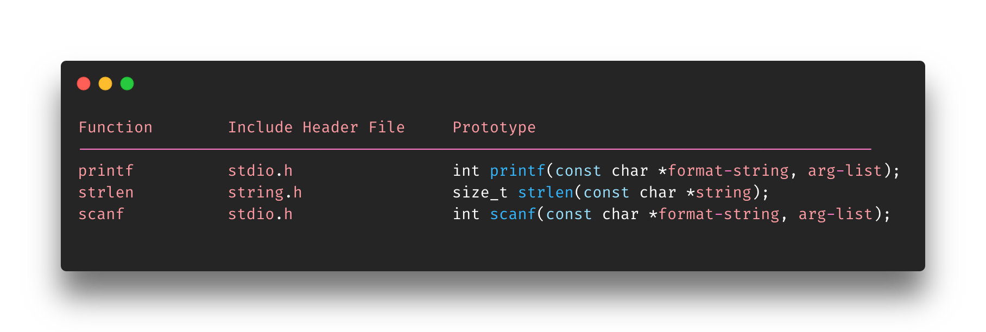
Standard Library functions
Built-in with the C programming language
Prototype and data definitions of in their respective header files
Useable at any time but may need to include (import)
Basically, functions that you do not write
Notes:
Standard Library Functions (SLF) are functions that come already packaged with C. This means you can use at any time although you might need to include the specific library.

Slide 19
Overview
User-defined functions
Functions types
Standard library functions

Slide 20
References
https://www.programiz.com/c-programming/c-arrays-functions
https://beginnersbook.com/2014/01/c-passing-pointers-to-functions/
https://www.ibm.com/docs/en/i/7.4?topic=extensions-standard-c-library-functions-table-by-name

