Slide 1
C Pointers
By: Lt FElipe Pineda

Slide 2
Overview
Pointers
Memory Addresses
Address Of Operator
Pointers Overview
Initializing/Accessing/Modifying Pointers
Dereferencing
Pointers and Arrays
Accessing
Modifying
Pointers and Functions
Memory Allocation

Slide 3

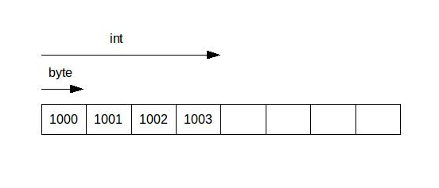
Memory and memory Addresses
Main memory is where all our variables and other information are stored during execution
It can be thought of an array of bytes
Each memory address (0x1000) is a(n)
Index
1 byte
Cell
When you declare a variable, it will go to unused memory and take up as many cells as it needs for that specific type (char == 1 byte === 1 cell)
Int x;
So, with that information, how many cells would an int variable take up?
4 cells
What addresses would it use?
0x1000 – 0x1003
What address would it return when want to use in our program?
0x1000
Because it is the pointer to beginning and the pointer variable can only store a single address, but we will talk about this later
* Memory addresses in image are examples
Notes:
Main memory is where all of our variables and other information are stored when a program is running.

Slide 4
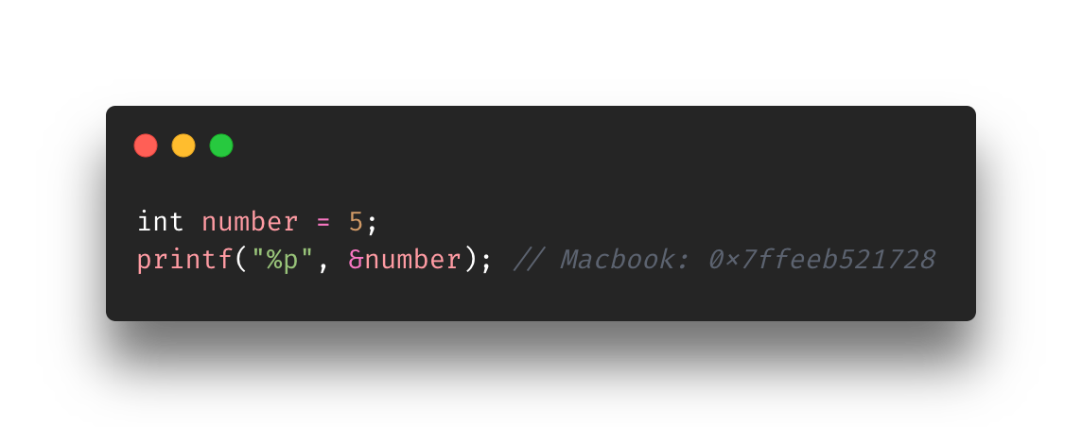
Address Of operator
You can see/print the memory address of any variable by using the “&”
Variable must be at least declared
Take note of the format specifier
We will see that pointers and Address of Operators go hand in hand but in this case, we just wanted to see the address.
We literally got back the memory address of something. Technically, we can set it to something……..
Addresses are only 12 hexadecimal characters long because it dropped the leading 4 zeros. Since my MacBook is 64 bit, it should have 16 hexadecimal characters (8 bytes) in total.
On a typical 32-bit architecture, there would only be 32 bits in a pointer, so only 8 hex digits (4 bytes).

Slide 5
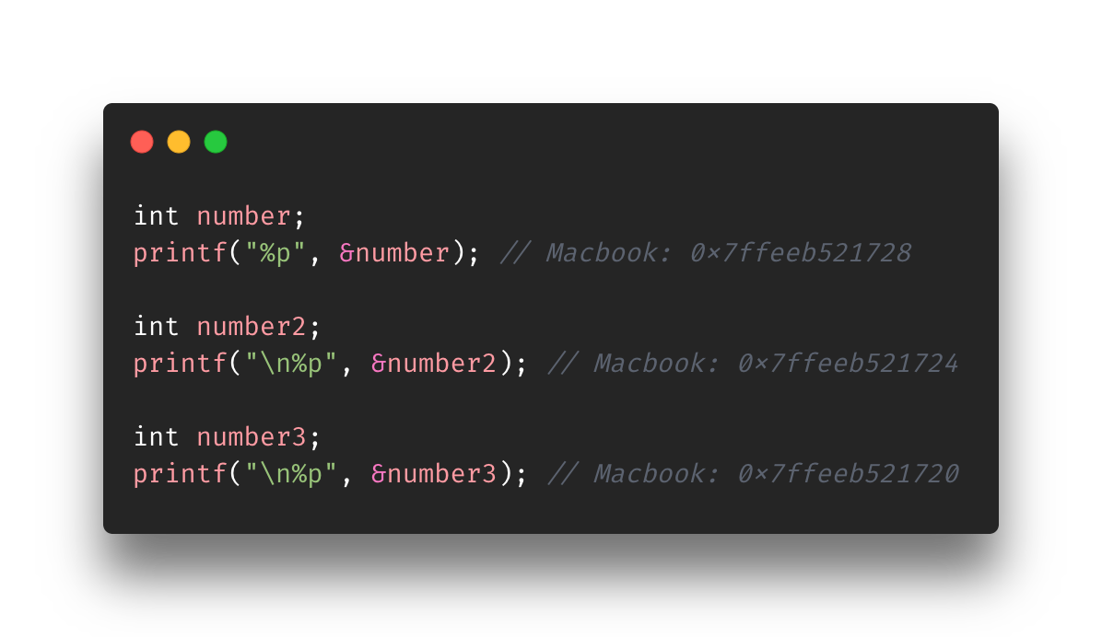
Further use of Address Of operator
Notes:
Take note of how the memory addresses are decreasing in 4s
That is because each for int number, there are 4 bytes being allocated.
This is true even if you haven’t set a value yet.
This is true for after you set your value. Even if you don’t use all the space, you are still using all 4 bytes.

Slide 6
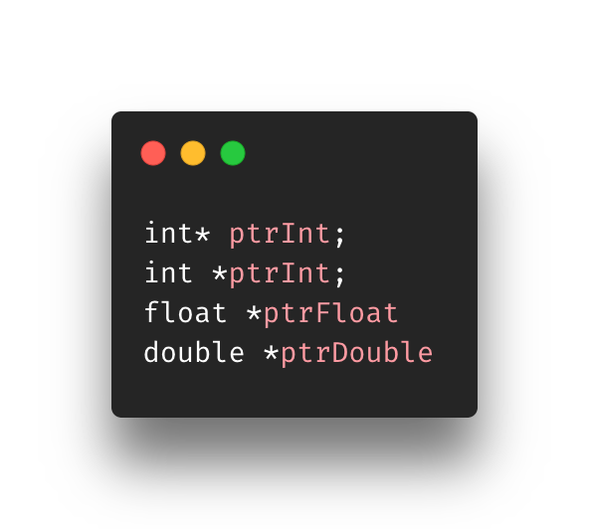
Pointers Overview
Concept of Indirection
Ex: chd
Pointers manipulate/access values through the value’s memory address
Pointers can only store memory addresses
Typically done by using the asterisk (*)
Called the indirection operator (in this context)
At point of declaration, you must specify what data type you will be pointing to
Extra Tip: The first two lines are equivalent. It does not matter if you put the asterisk on the type or variable. It’s a matter of style.
Notes:
Pointers use the concept getting to something through indirection. We have been using indirection all this time but through variables. When you modified a variable, you didn’t go to that memory address and change it. You went did on the variable and then it was changed.
What is the difference between int *p and int p* and int* p?: https://www.quora.com/What-is-the-difference-between-int-*p-and-int-p*-and-int*-p#:~:text=On%20the%20other%20hand%20int,feel%20free%20to%20do%20so.

Slide 7
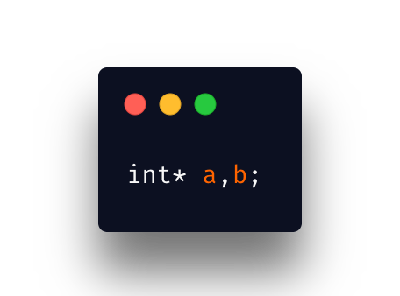
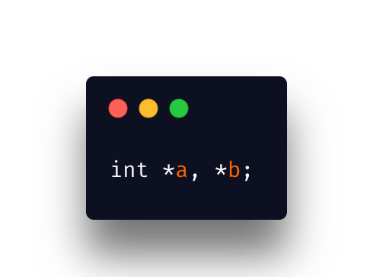
What’s the difference?
Top
“a” is an int pointer
“b” is not an int pointer
Bottom
”a” is an int pointer
“b” is an int pointer
I assume that’s why people prefer putting the asterisk on the variables instead of the type. It makes it easier to read.

Slide 8
What does it mean when you declare a pointer?
To simplify it, you are “creating” a container to store something
That something is a memory address in that container. You have clear intentions to put a hexadecimal memory address in your newly created pointer.
There is an actionable event (dereferencing) that’ll allow you to go to that memory address being stored and retrieve a value

Slide 9
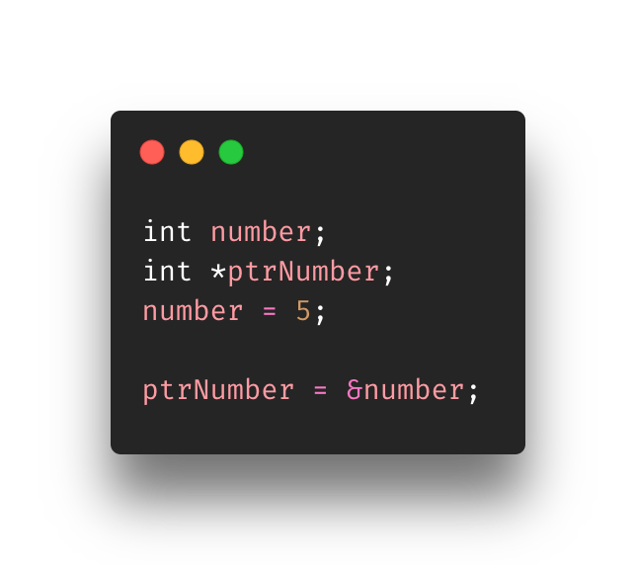
Initializing/Assigning Addresses to Pointers
Now we get to combine pointers (*) and memory addresses (&)
We declare an int variable called number
We declare an int pointer called ptrNumber using the indirection operator
We assign 5 to the variable number
We assign (we could have initialized) the memory address of number to ptrNumber
Now ptrNumber, which is a pointer, stores the memory address of the variable number

Slide 10
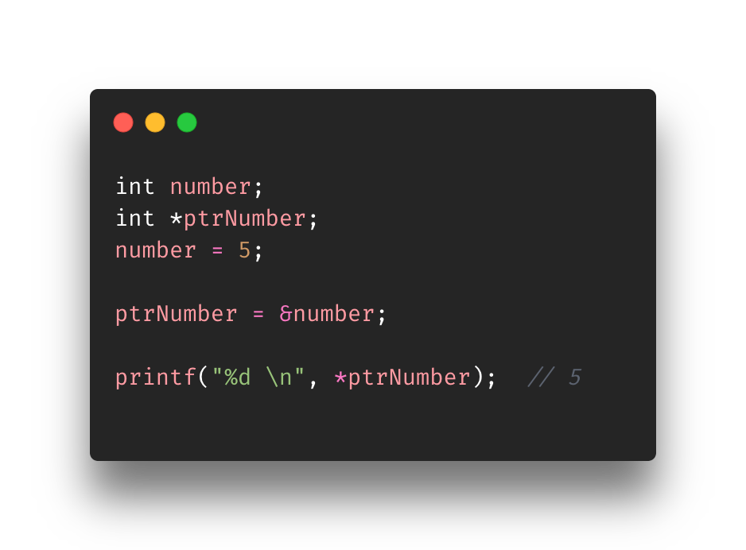
Accessing Pointer Values (dereferencing)
We saw that declaring a pointer used the asterisk notation or the indirection operator
well… so does dereferencing/accessing
Here ptrNumber contains the memory address of the the variable number
It’s basically saying
“Go to that memory address and retrieve the the value it holds”
ptrNumber
number
0x7ffee1efd728
5
0x7ffeef0ba720
0x7ffee1efd728

Slide 11
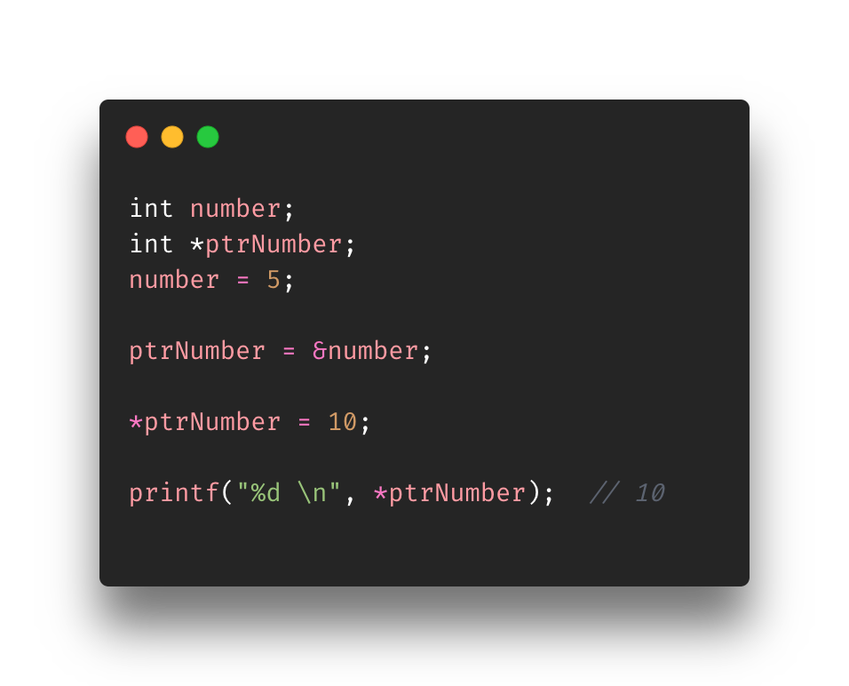
Modifying values pointed by pointers
We also use the dereferencing operator to assign new values to memory spaces or variables
Here we dereference what ptrNumber is pointing to and update that value
It’s basically saying
“Go that memory address and update it to 10”
In other words
*ptrNumber evaluates to &number evaluates to 0x7ffee1efd728
ptrNumber
number
0x7ffee1efd728
5 10
0x7ffeef0ba720
0x7ffee1efd728

Slide 12
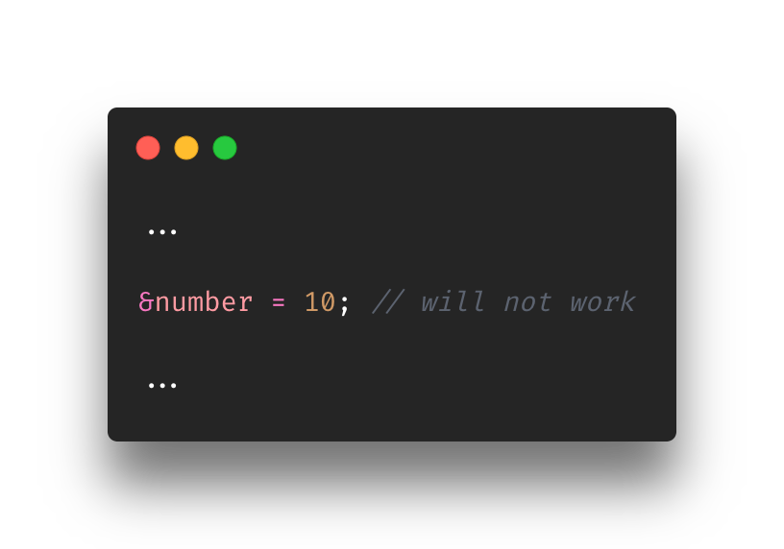
Dereferencing cont’d
Using the same example from the previous slide
The following would not work as the “&” cannot point to something
It is merely there to return a memory address
This brings to the light the importance of the dereferencing operator (*)
The variable attached to the “*” is called a pointer
The “*” is the dereferencing operator
Together they set off the action of ”pointing to the memory address located inside the variable”
It can get more complex than that but it’s a simple manner of explaining (ex: double pointers)

Slide 13

Be careful with the “*”
The indirection and dereferencing operator are identical to the multiplication operator (*)
As the program author you must know when to use either operator
Normally, the compiler will understand how to interpret it depending on the context though

Slide 14
DEMO

Slide 15
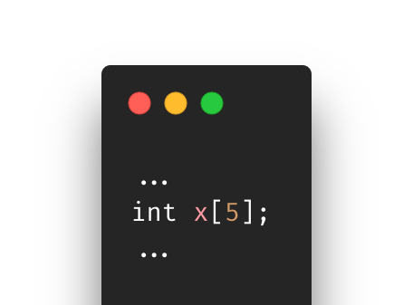
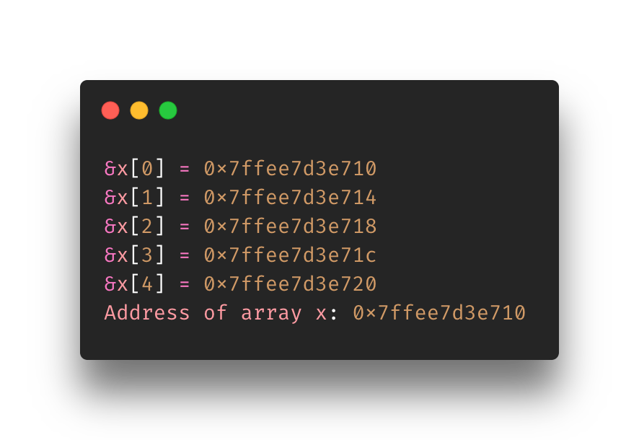
Pointers and arrays
If we create an int array of size 5 (0-4) then we can see the memory address output below
Of course, the addresses could be different on your machine
Things to note
Addresses are moving up sizes of 4, why is that?
Int type allocations
Address of our array is the first address. Why is that?
As mentioned in the “Memory and memory Addresses” slide, the x variable (array in this case) will point to the very first address
Notes:
https://www.programiz.com/c-programming/c-pointers-arrays

Slide 16
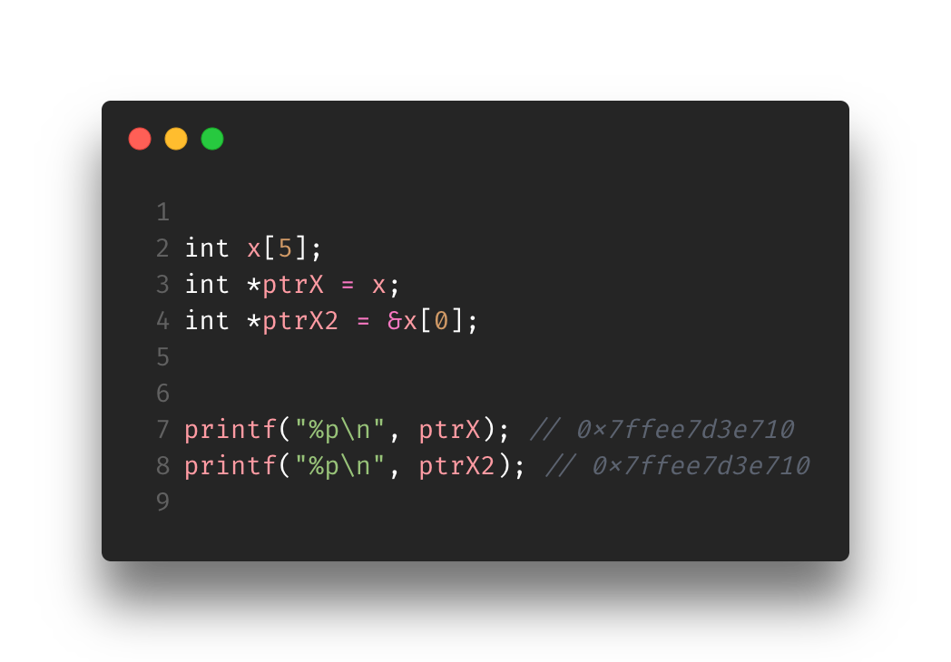
Pointers and array
Up until this point we have just set pointers to ints/doubles/etc
Now we will be setting pointer to element in the array (not pointer to array, that is considered wrong)
The pointer is meant to access the first, second, third, etc. elements in the array
We cannot point to the entire array, only to an element in the array (normally the first one)
Arrays are already pointers by definition so technically line 3 will work without using the Address Of Operator
You can still use the Address Of operator, see line 4
Both manners will give the same first value
Technically x == &x[0] since we are always being given the first slot

Slide 17
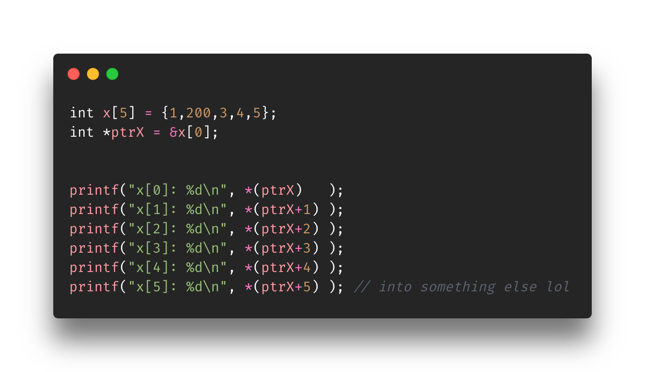
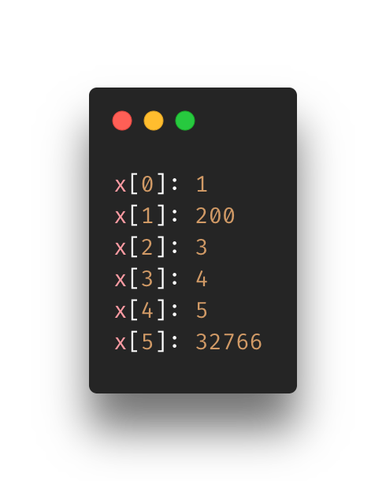
Pointers and arrays (accessing)
In the example we set an int array x with 5 values 1,200,3,4,5
We set pointer to the first element in the array
We can access the next elements by incrementing the pointer by 1
Can be done in a loop as well
”Adding 1”to the ptrX (without “*”) adds 4 bytes to the memory address for example
ptrX: 0x7ffee7d3e710
ptrX + 1: 0x7ffee7d3e714
…
Each element in the array is just another address

Slide 18
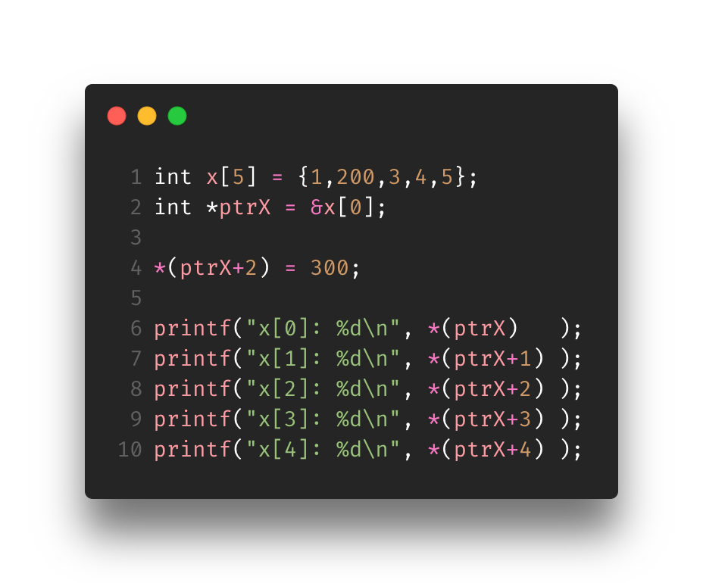
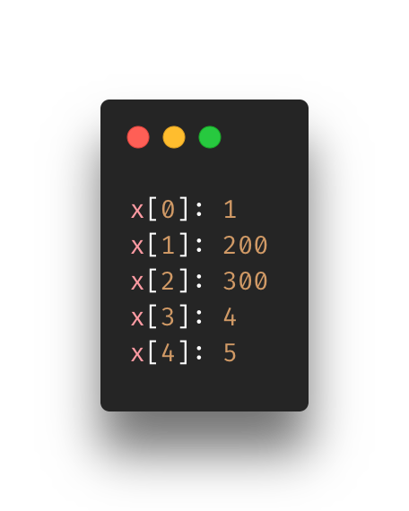
Pointers and arrays (modifying)
Modification occurs at line 4
It’s more or less the same, you must go to that specific block/address and assign it a new value
Can also modify entire array through loop

Slide 19
Pointers and functions
At times, functions need to use/access/modify values at memory locations/addresses.
Passing in variables may not perform the action you want it
In order to do this, the function definition must accept pointer parameters
Next slide presents an two examples. One with pointers being used in the function and the other without pointers in the function. The whole point of the examples are that if you feed it your salary and bonus, then it’ll give you the total.
We will see how the use of pointers will give us the correct total and how the absence of pointers will give us the incorrect salary total
Notes:
https://www.programiz.com/c-programming/c-pointer-functions

Slide 20
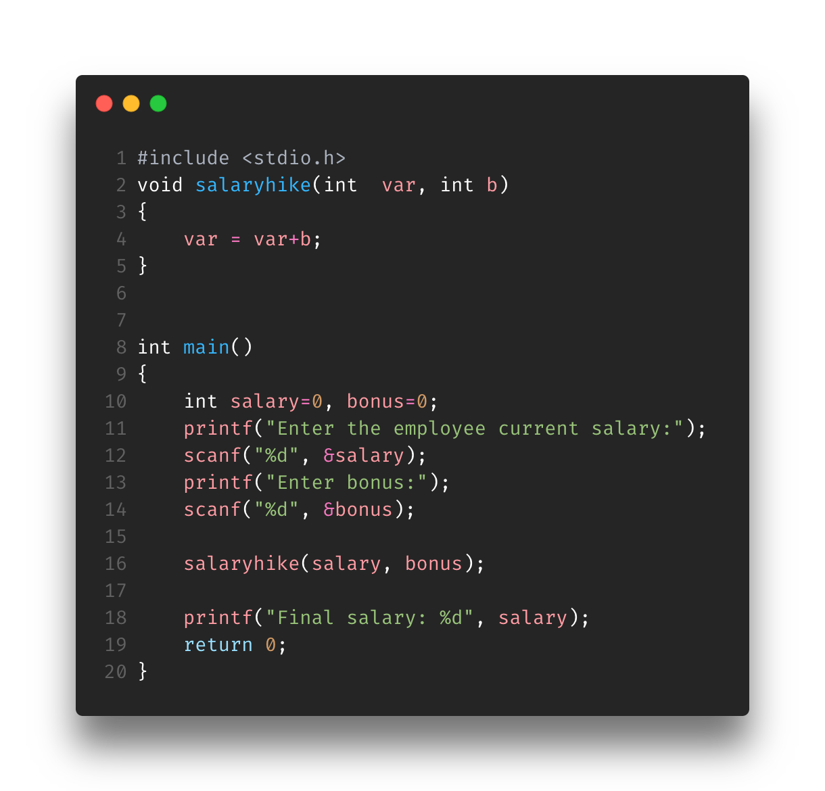
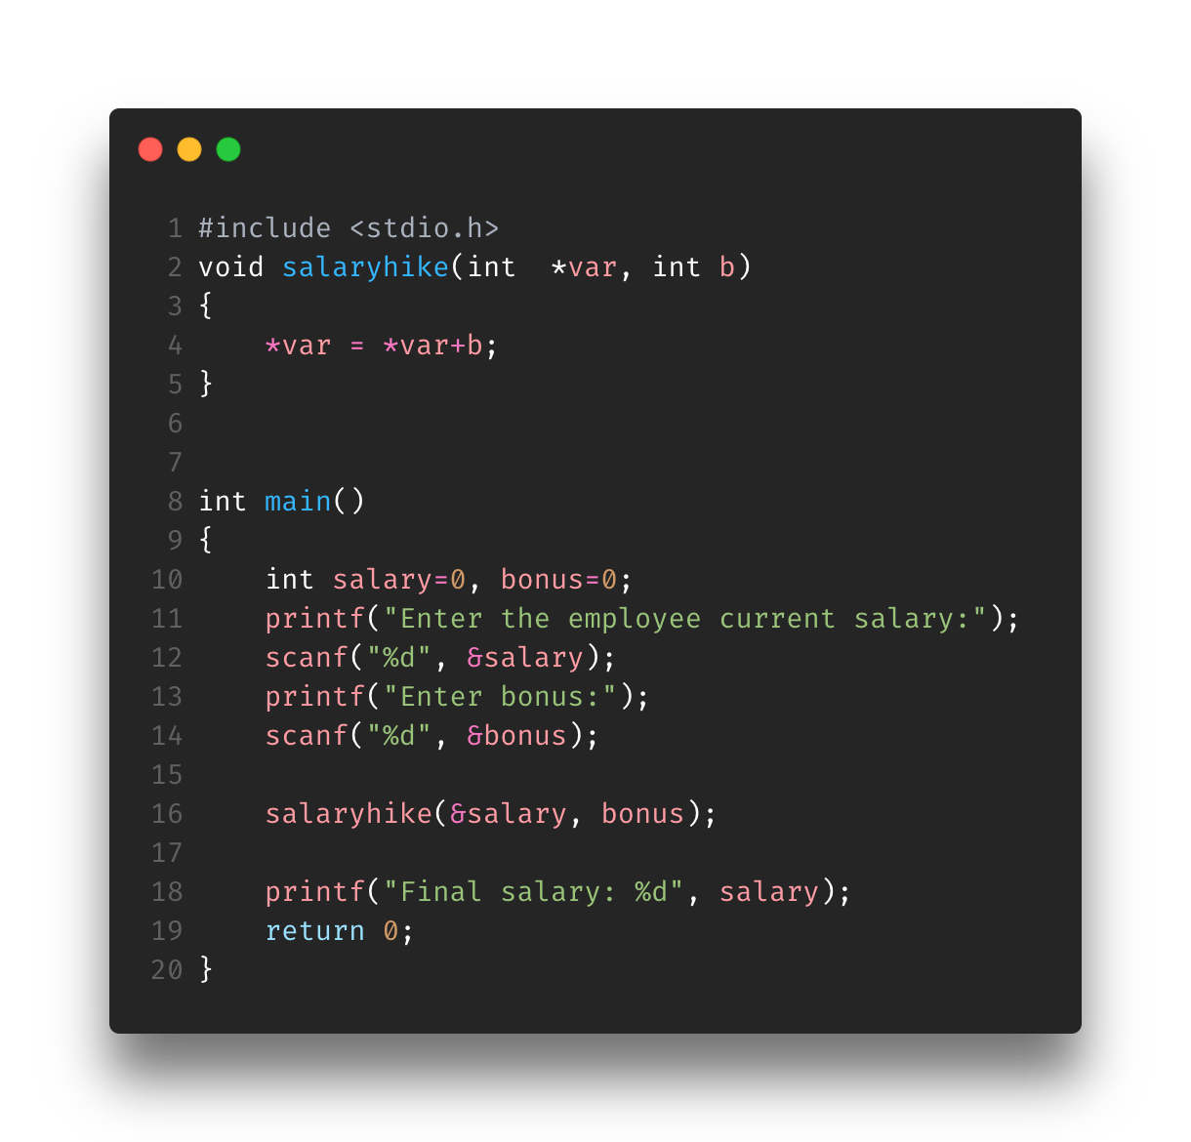
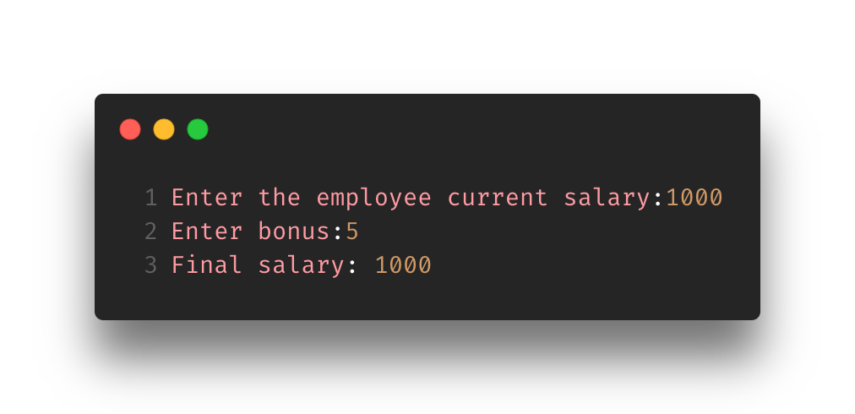


Slide 21
Memory Allocations
Memory allocation functions consist of: malloc(), calloc(), free(), and realloc()
malloc and calloc return a pointer of void that needs to be casted into its appropriate type
realloc() returns a pointer
free() function frees allocated memory
Let’s check them out!

Slide 22
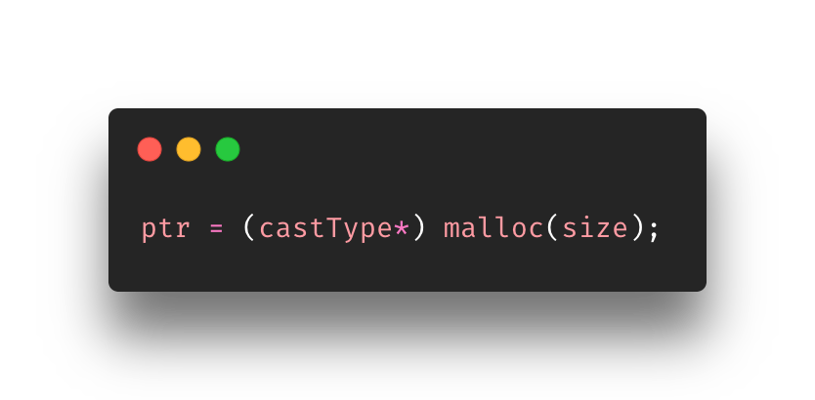
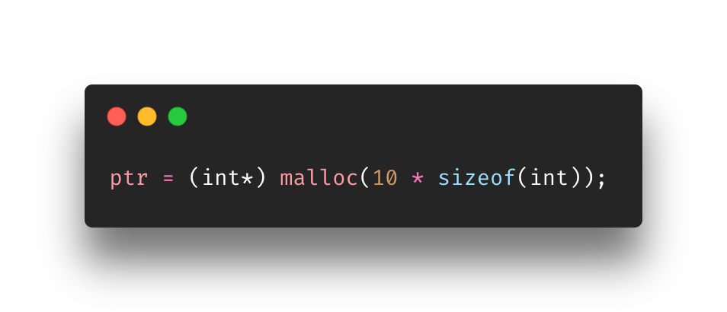
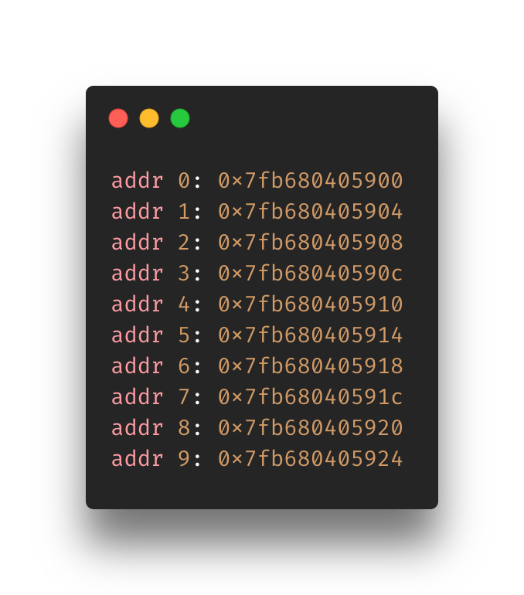
Malloc(…)
malloc stands for Memory Allocation
It reserves a block of memory of specified number of bytes
has memory uninitialized (nothing inside)
Returns pointer that needs to be casted

Slide 23
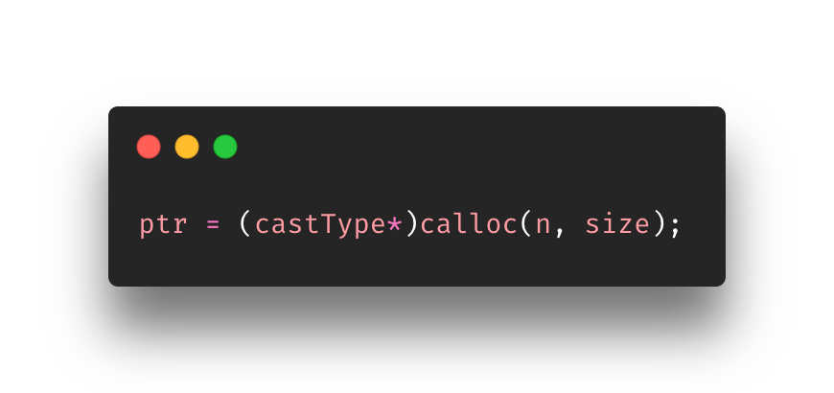
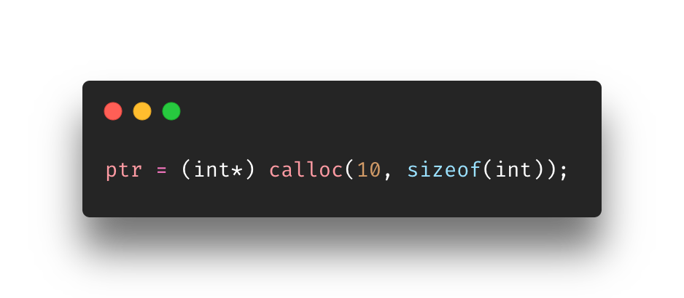
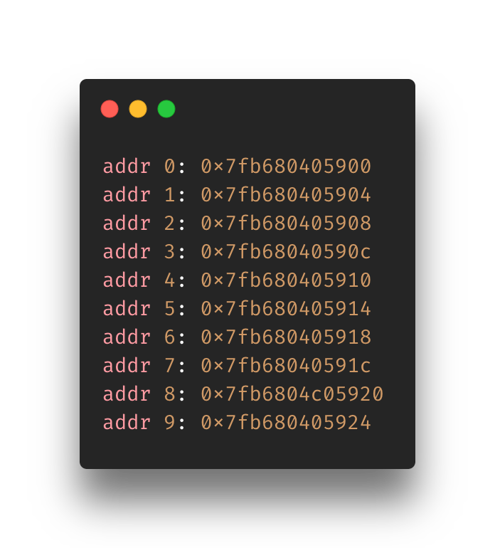
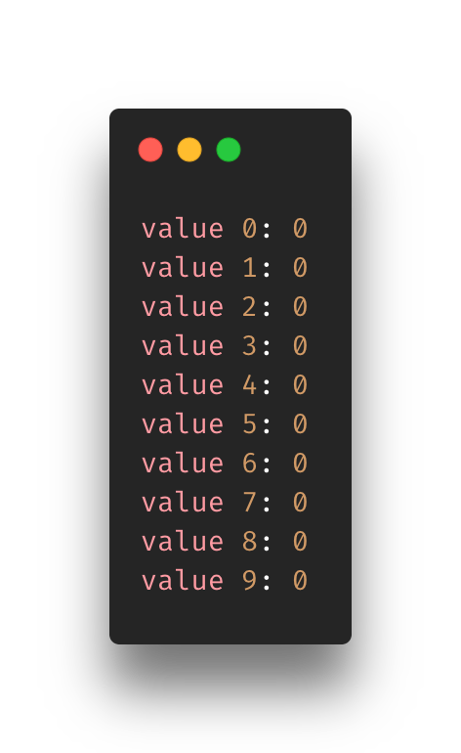
Calloc(…)
calloc means Contiguous Allocation
Does the same as malloc, but instead of leaving the spaces uninitialized, it sets them to zero
Returns pointer to be casted

Slide 24
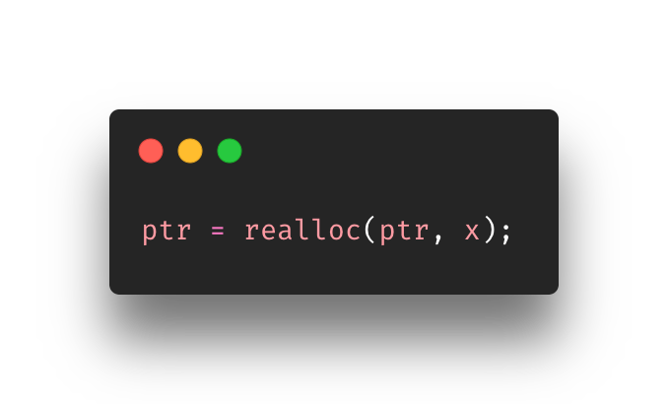
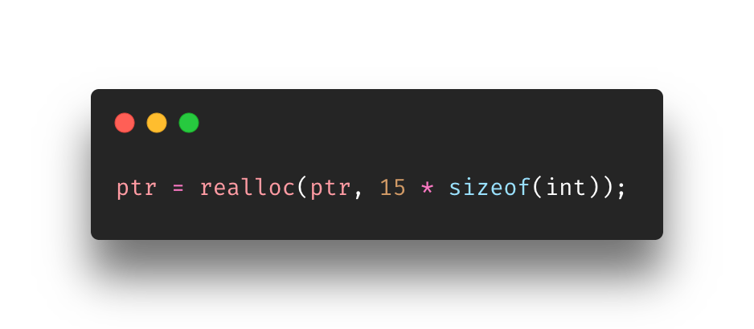
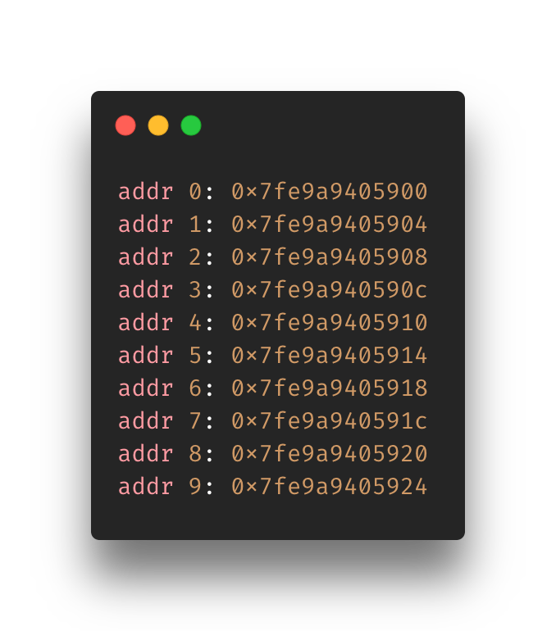
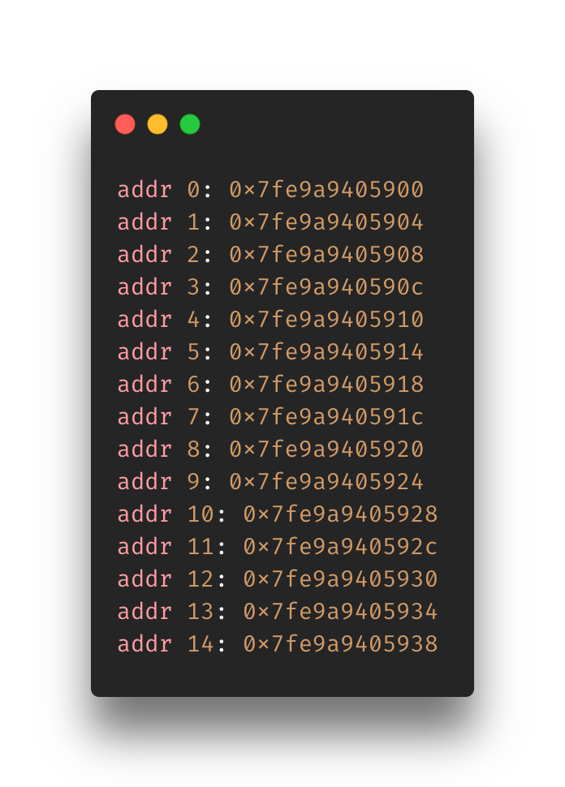
Realloc(...)
Realloc means re-allocate memory
It’s meant change the size of a already allocated memory/pointer
Returns a pointer

Slide 25
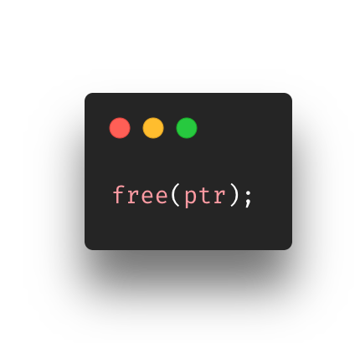
Free(…)
Memory allocated with the functions mentioned does not get freed automatically
It must be freed by the free(…) function
It’s simple, just give it the pointer to the memory

Slide 26
Overview
Pointers
Memory Addresses
Address Of Operator
Pointers Overview
Initializing/Accessing/Modifying Pointers
Dereferencing
Pointers and Arrays
Accessing
Modifying
Pointers and Functions
Memory Allocation

Slide 27
References
https://www.programiz.com/c-programming/c-pointers
https://www.programiz.com/c-programming/c-pointers-arrays
https://www.freecodecamp.org/news/the-c-beginners-handbook/#pointers
https://denniskubes.com/2012/08/17/basics-of-memory-addresses-in-c/
https://computer.howstuffworks.com/c23.htm
http://www.cs.ecu.edu/karl/3300/spr14/Notes/C/Memory/memory.html#:~:text=A%20memory%20address%20is%20called,type%20of%20the%20executable%20program).
https://www.udemy.com/course/c-programming-for-beginners-/learn/lecture/8795422#overview
https://www.programiz.com/c-programming/c-pointer-functions
https://www.programiz.com/c-programming/c-dynamic-memory-allocation
Notes:
https://www.programiz.com/c-programming/c-pointer-functions

