Slide 1
C Pointers
By: Lt FElipe Pineda

Slide 2
Overview
Pointers
Memory Addresses
Pointers Overview
Diagram
Using basic pointers
Pointers and Arrays
Pointers and Functions
Memory Allocation

Slide 3

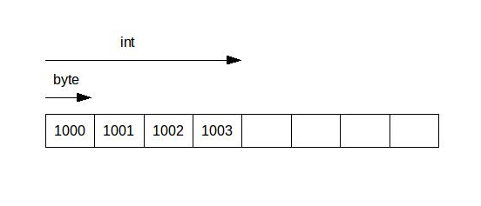
Memory and memory Addresses
Main memory is where all our variables and other information are stored during execution
It can be thought of an array of bytes
Each memory address (0x1000) is a(n)
Index
1 byte
Cell
When you declare a variable, it will go to unused memory and take up as many cells as it needs for that specific type (char == 1 byte === 1 cell)
Int x;
So, with that information, how many cells would an int variable take up?
4 cells
What addresses would it use?
0x1000 – 0x1003
What address would it return when want to use in our program?
0x1000
Because it is the pointer to beginning and the pointer variable can only store a single address, but we will talk about this later
* Memory addresses in image are examples
Notes:
Main memory is where all of our variables and other information are stored when a program is running.

Slide 4
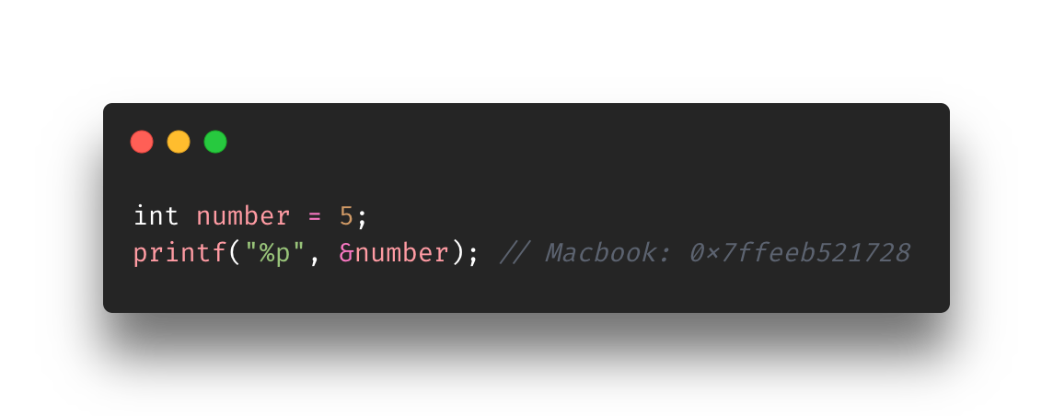
Address Of operator
You can see/print the memory address of any variable by using the “&”
Variable must be at least declared
Take note of the format specifier
We will see that pointers and Address of Operators go hand in hand but in this case, we just wanted to see the address.
We literally got back the memory address of something. Technically, we can set it to something……..
Addresses are only 12 hexadecimal characters long because it dropped the leading 4 zeros. Since my MacBook is 64 bit, it should have 16 hexadecimal characters (8 bytes) in total.
On a typical 32-bit architecture, there would only be 32 bits in a pointer, so only 8 hex digits (4 bytes).

Slide 5
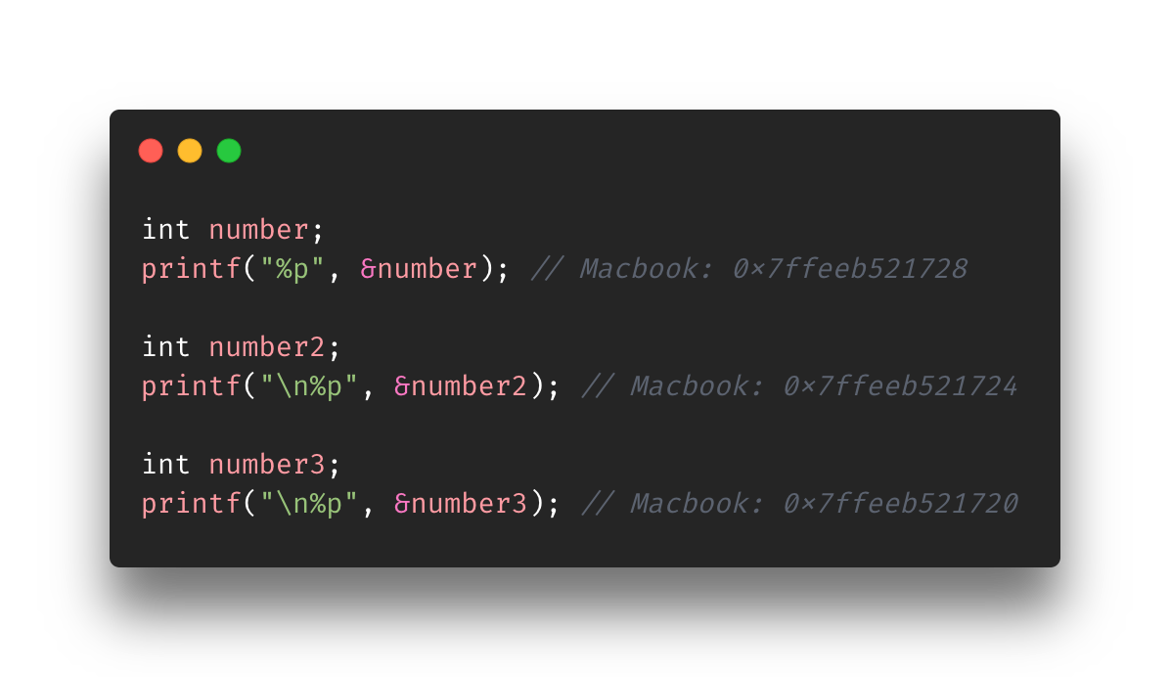
Further use of Address Of operator
Notes:
Take note of how the memory addresses are decreasing in 4s
That is because each for int number, there are 4 bytes being allocated.
This is true even if you haven’t set a value yet.
This is true for after you set your value. Even if you don’t use all the space, you are still using all 4 bytes.

Slide 6
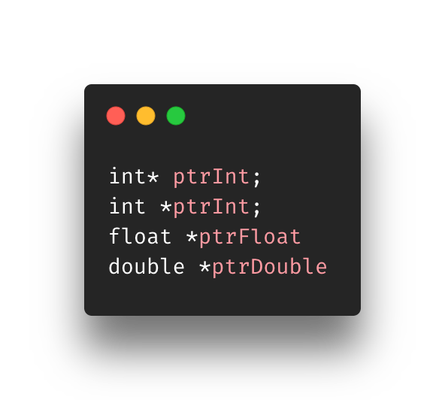
Pointers Overview
Concept of Indirection
Ex: chd
Pointers manipulate/access values through the value’s memory address
Pointers can only store memory addresses
Typically done by using the asterisk (*)
Called the indirection operator (in this context)
At point of declaration, you must specify what data type you will be pointing to
Extra Tip: The first two lines are equivalent. It does not matter if you put the asterisk on the type or variable. It’s a matter of style.
Notes:
Pointers use the concept getting to something through indirection. We have been using indirection all this time but through variables. When you modified a variable, you didn’t go to that memory address and change it. You went did on the variable and then it was changed.
What is the difference between int *p and int p* and int* p?: https://www.quora.com/What-is-the-difference-between-int-*p-and-int-p*-and-int*-p#:~:text=On%20the%20other%20hand%20int,feel%20free%20to%20do%20so.

Slide 7
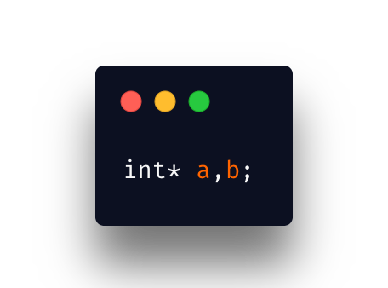
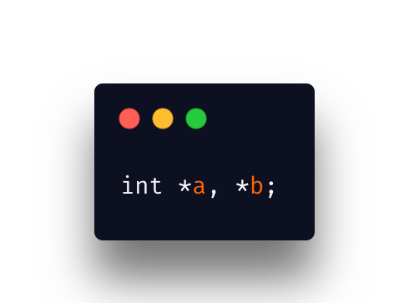
What’s the difference?
Top
“a” is an int pointer
“b” is not an int pointer
Bottom
”a” is an int pointer
“b” is an int pointer
I assume that’s why people prefer putting the asterisk on the variables instead of the type. It makes it easier to read.

Slide 8
What does it mean when you declare a pointer?
To simplify it, you are “creating” a container to store something
That something is a memory address in that container. You have clear intentions to put a hexadecimal memory address in your newly created pointer.
There is an actionable event (dereferencing) that’ll allow you to go to that memory address being stored and retrieve a value

Slide 9
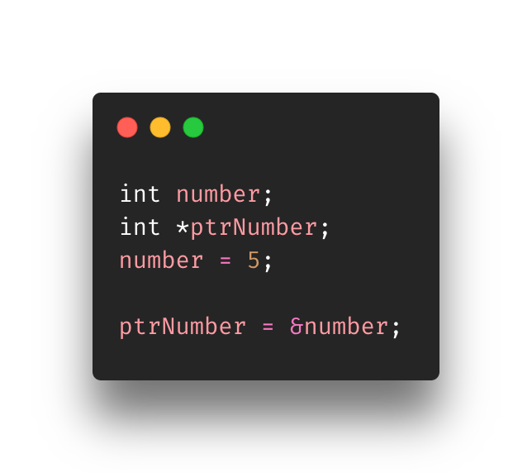
Initializing/Assigning Addresses to Pointers
Now we get to combine pointers (*) and memory addresses (&)
We declare an int variable called number
We declare an int pointer called ptrNumber using the indirection operator
We assign 5 to the variable number
We assign (we could have initialized) the memory address of number to ptrNumber
Now ptrNumber, which is a pointer, stores the memory address of the variable number

Slide 10
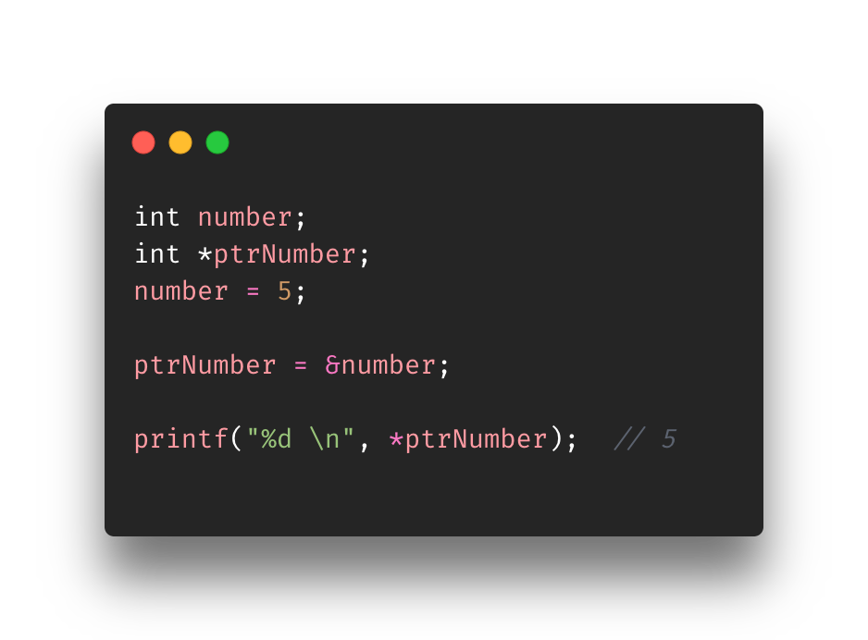
Accessing Pointer Values (dereferencing)
We saw that declaring a pointer used the asterisk notation or the indirection operator
well… so does dereferencing/accessing
Here ptrNumber contains the memory address of the the variable number
It’s basically saying
“Go to that memory address and retrieve the the value it holds”
ptrNumber
number
0x7ffee1efd728
5
0x7ffeef0ba720
0x7ffee1efd728

Slide 11
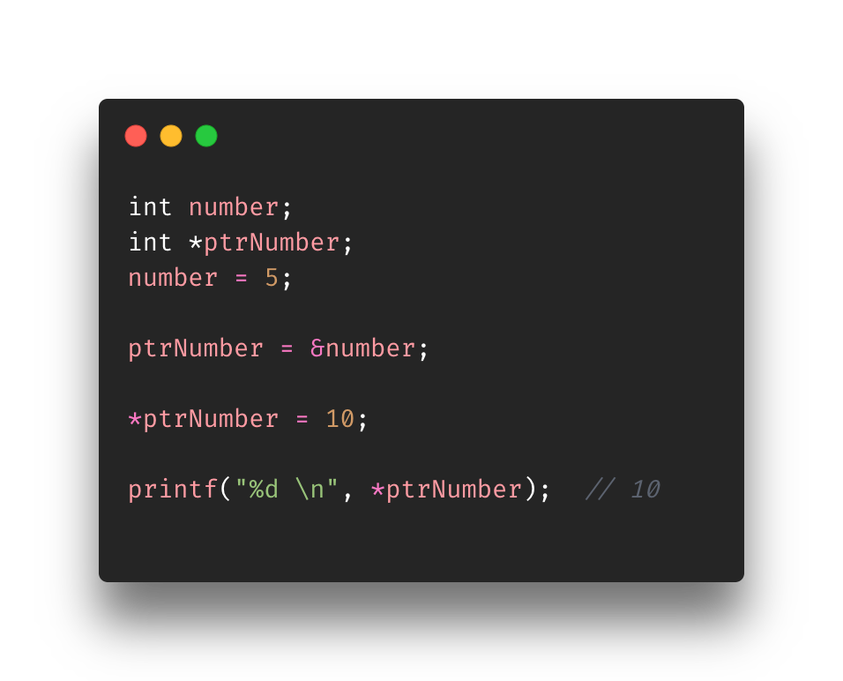
Modifying values pointed by pointers
We also use the dereferencing operator to assign new values to memory spaces or variables
Here we dereference what ptrNumber is pointing to and update that value
It’s basically saying
“Go that memory address and update it to 10”
In other words
*ptrNumber evaluates to &number evaluates to 0x7ffee1efd728
ptrNumber
number
0x7ffee1efd728
5 10
0x7ffeef0ba720
0x7ffee1efd728

Slide 12
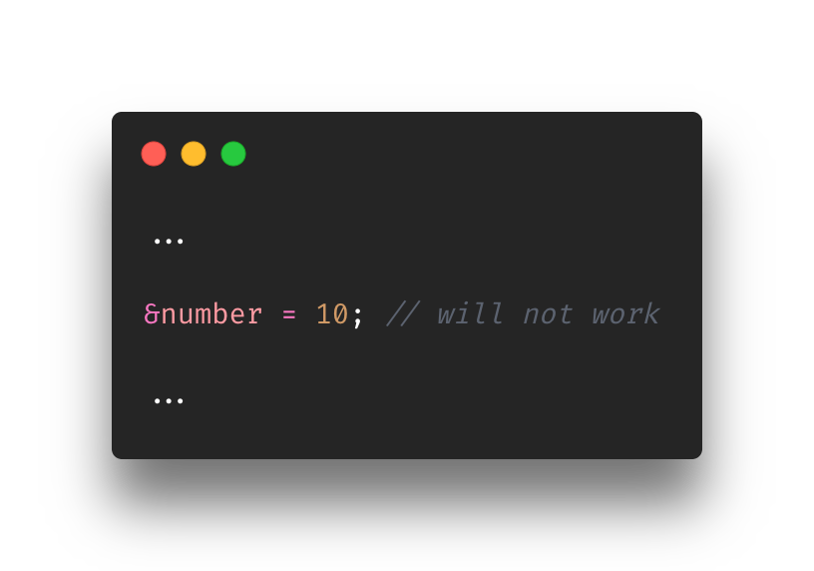
Dereferencing cont’d
Using the same example from the previous slide
The following would not work as the “&” cannot point to something
It is merely there to return a memory address
This brings to the light the importance of the dereferencing operator (*)
The variable attached to the “*” is called a pointer
The “*” is the dereferencing operator
Together they set off the action of ”pointing to the memory address located inside the variable”
It can get more complex than that but it’s a simple manner of explaining (ex: double pointers)

Slide 13

Be careful with the “*”
The indirection and dereferencing operator are identical to the multiplication operator (*)
As the program author you must know when to use either operator
Normally, the compiler will understand how to interpret it depending on the context though

Slide 14
Using (basic) pointer??

Slide 15
Exercise?

Slide 16
References
https://www.programiz.com/c-programming/c-pointers
https://www.freecodecamp.org/news/the-c-beginners-handbook/#pointers
https://denniskubes.com/2012/08/17/basics-of-memory-addresses-in-c/
https://computer.howstuffworks.com/c23.htm
http://www.cs.ecu.edu/karl/3300/spr14/Notes/C/Memory/memory.html#:~:text=A%20memory%20address%20is%20called,type%20of%20the%20executable%20program).

