Slide 1
C Scope
By: Lt FElipe Pineda

Slide 2
Overview
What is scope?
File Scope
Global variables
Block Scope
Local variables
Static variables
Notes:
https://stackoverflow.com/questions/36615960/is-there-an-advantage-in-using-global-variables-instead-of-pointers/36622061#36622061
https://stackoverflow.com/questions/36638375/where-can-i-declare-global-variable-in-c-program-whether-in-header-or-source-f
https://www.faceprep.in/c/difference-static-and-global-variables/#:~:text=Global%20variables%20are%20variables%20which%20are%20defined%20outside%20the%20function.&text=%EF%BB%BFStatic%20local%20variables%3A%20Variables,visibility%20as%20automatic%20local%20variables.

Slide 3



What is scope?
Scope is the region where that item (functions, variables, etc. ) can be used
In other words, If you create an identifier in a certain scope, then it can only be referenced in that scope
There’s two types of scope that we will talk about
File Scope
Global variables
Block Scope
Local variables
As you can see, the scopes are associated to types of variables

Slide 4

File Scope
Variables declared in this scope are normally are declared outside of all functions and blocks
Normally associated to global variables as these type of variables can be accessed from any portion of the program
File scope encompasses the entire file from start to finish

Slide 5
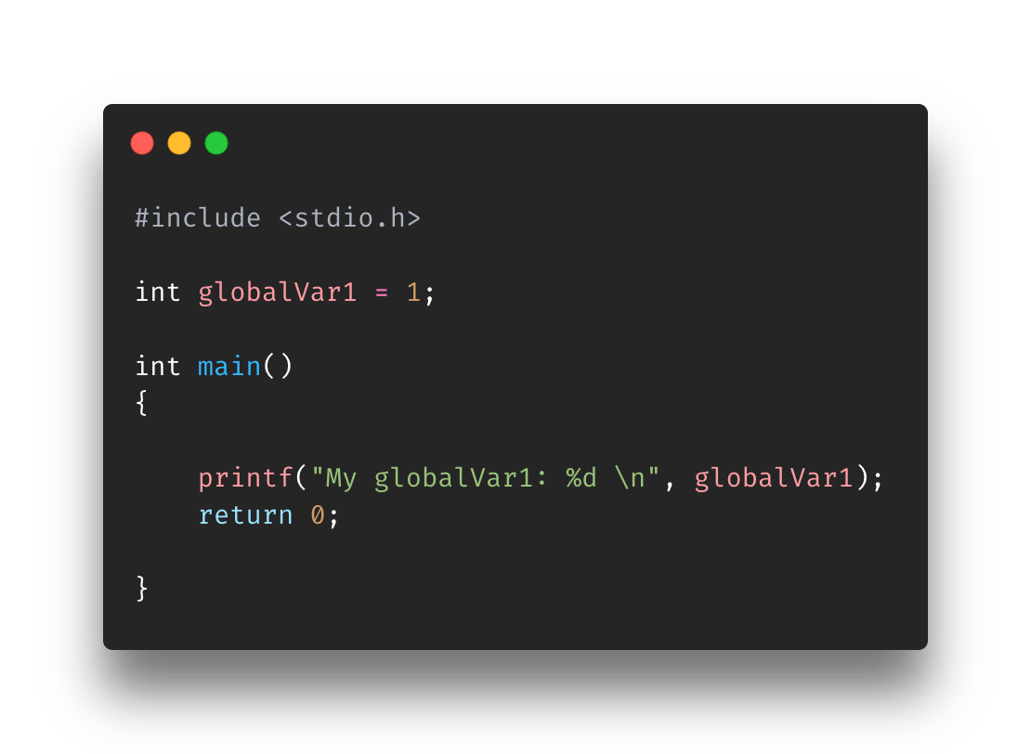
Global variables
Again, identifiers that are declared outside functions and blocks
Global variables exist (i.e useable) through the entire lifetime of the program
Accessible by any functions or block
Dangerous huh?
Global variables are considered unsafe for develop because anyone/anything can modify them. Also, it can create bugs if multiple functions or code depend on them
Workarounds include using using const variables, static variables, or passing in data as parameters
Const variables are variables that when declared never change
Static variables will be covered later

Slide 6
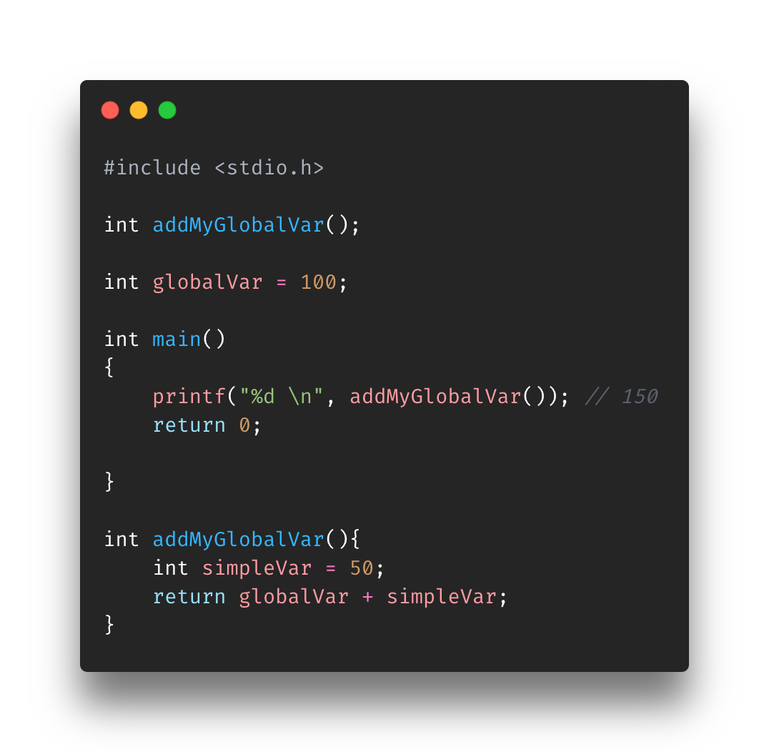
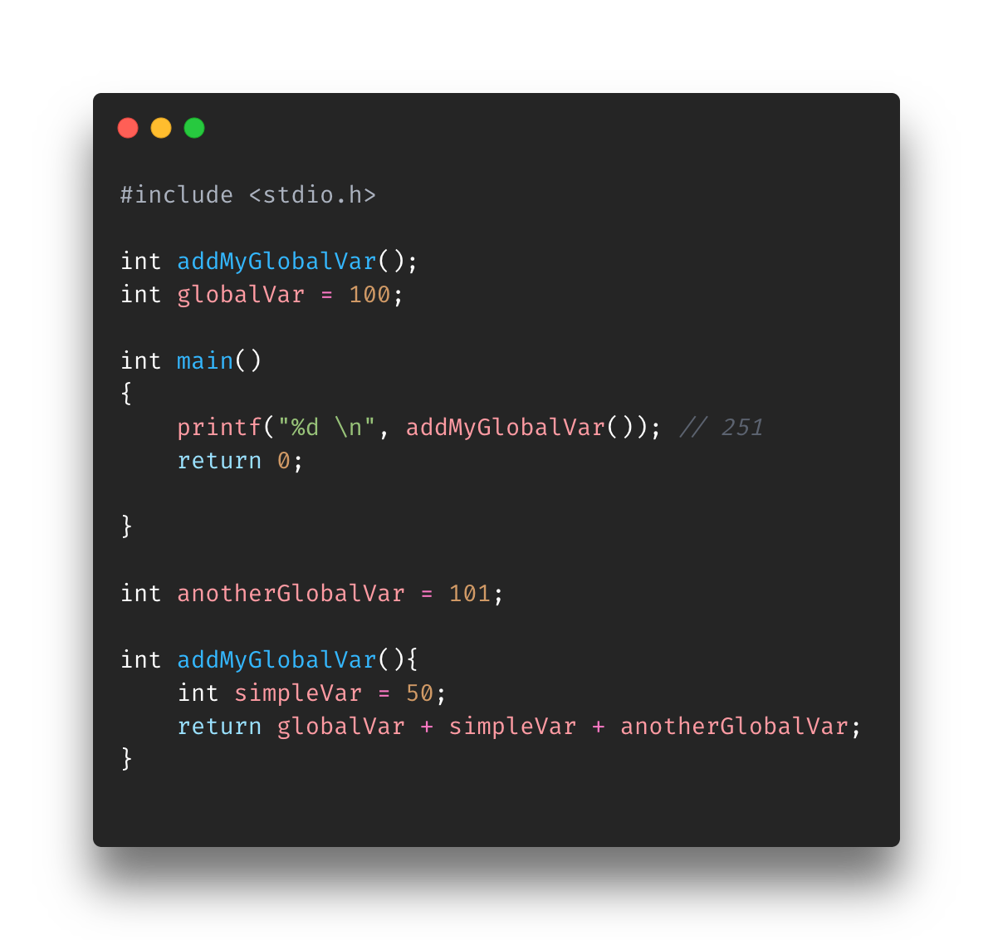
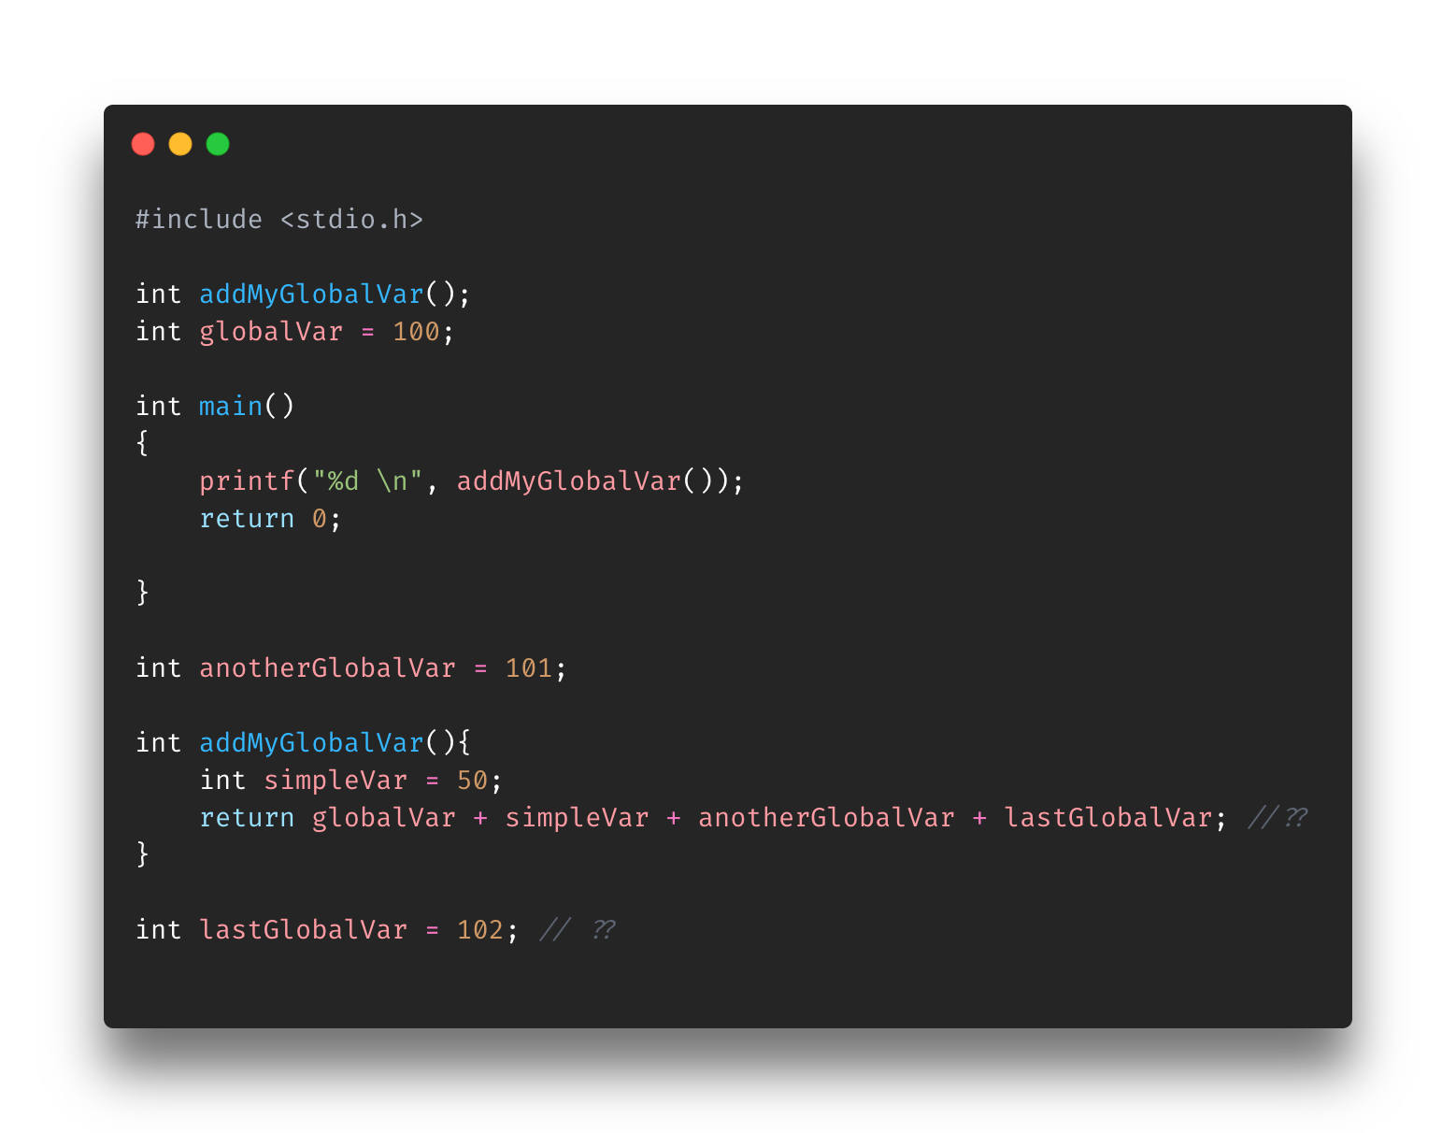
More global variable examples
IIIIIIIF you are setting global variables, then make sure they are set in the beginning for ease

Slide 8
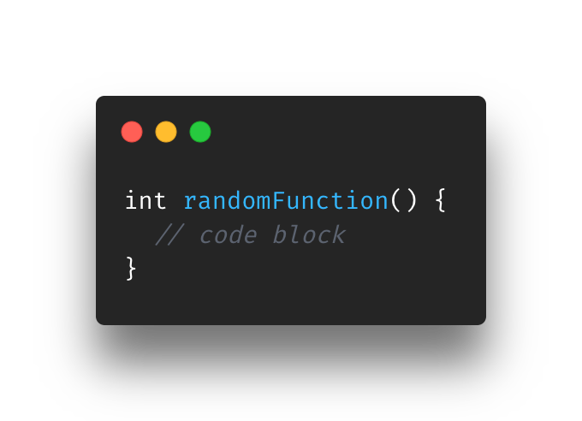
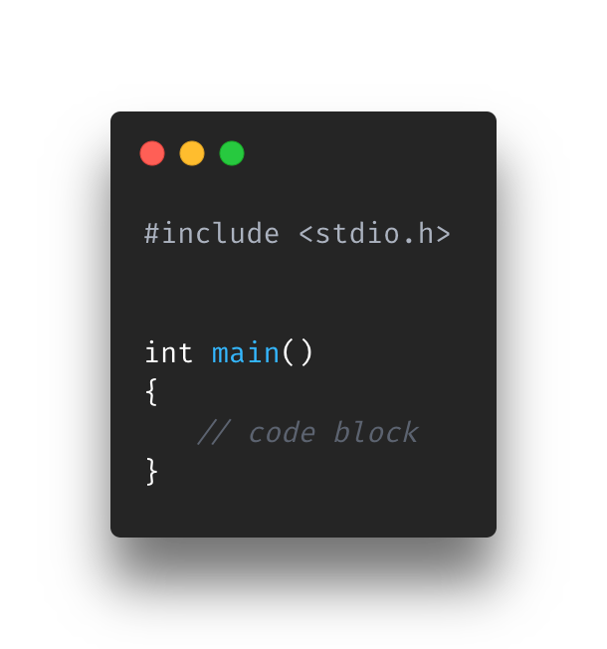
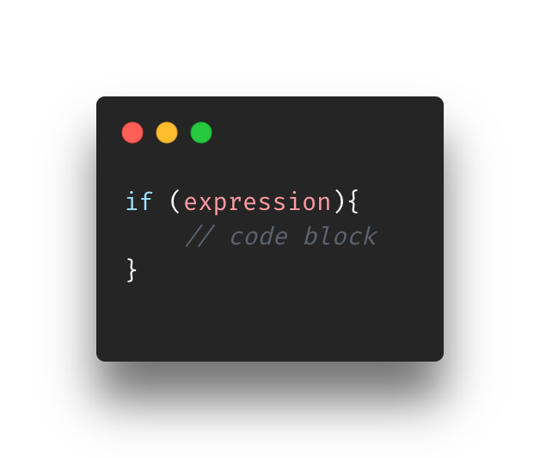
What’s a block?
A block is anything within curly brackets
Everything we have seen up until now has curly brackets
This includes
Functions
Flow Control
Etc
We are going to see that certain variables and scopes rely on “blocks”

Slide 9
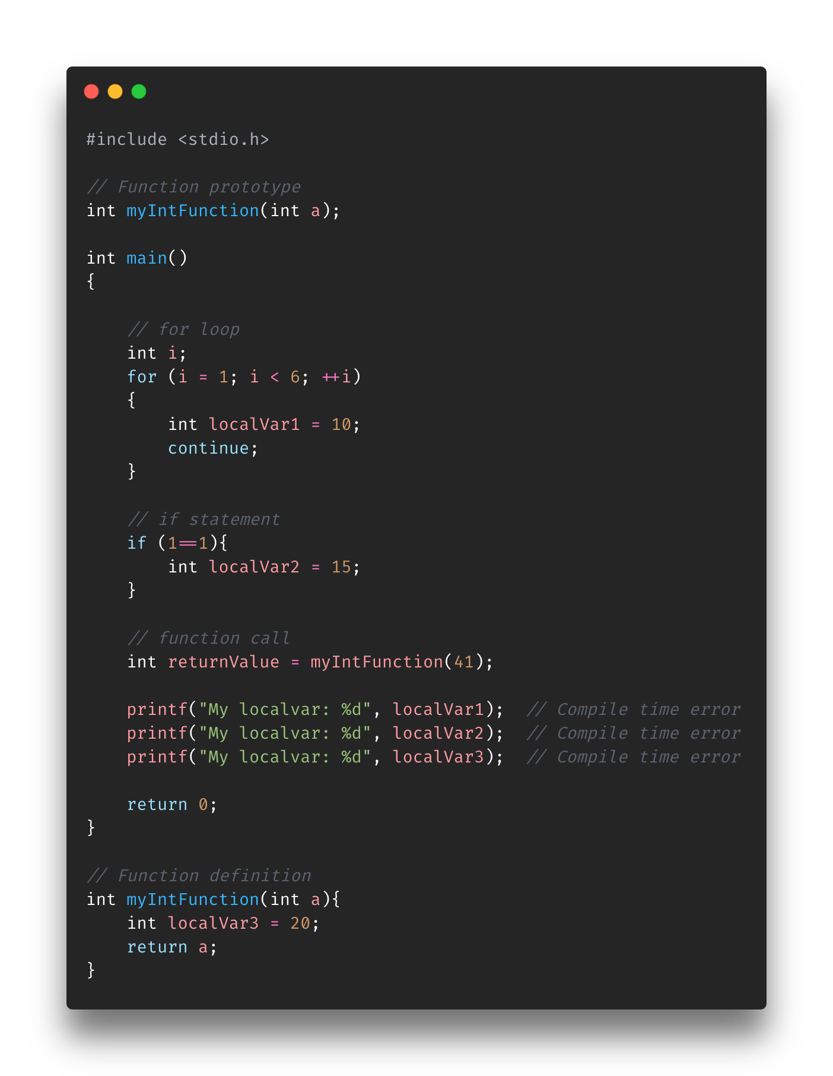
Block scope
As mentioned in the previous slide, blocks are the space within the curly brackets
Anything declared in a block will only be accessible to that block and its inner blocks
Normally associated to local variables

Slide 10
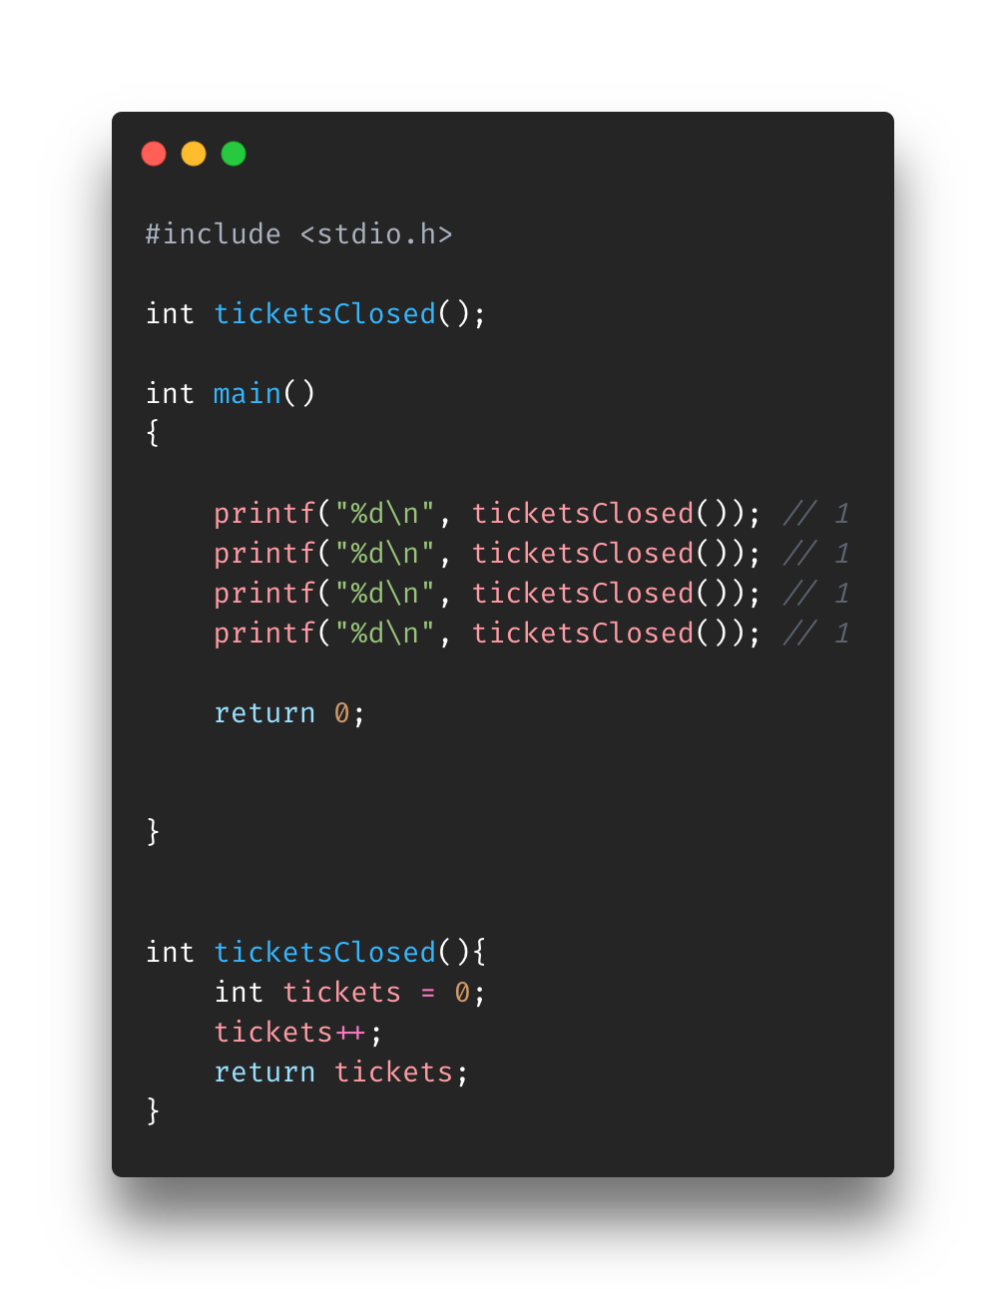
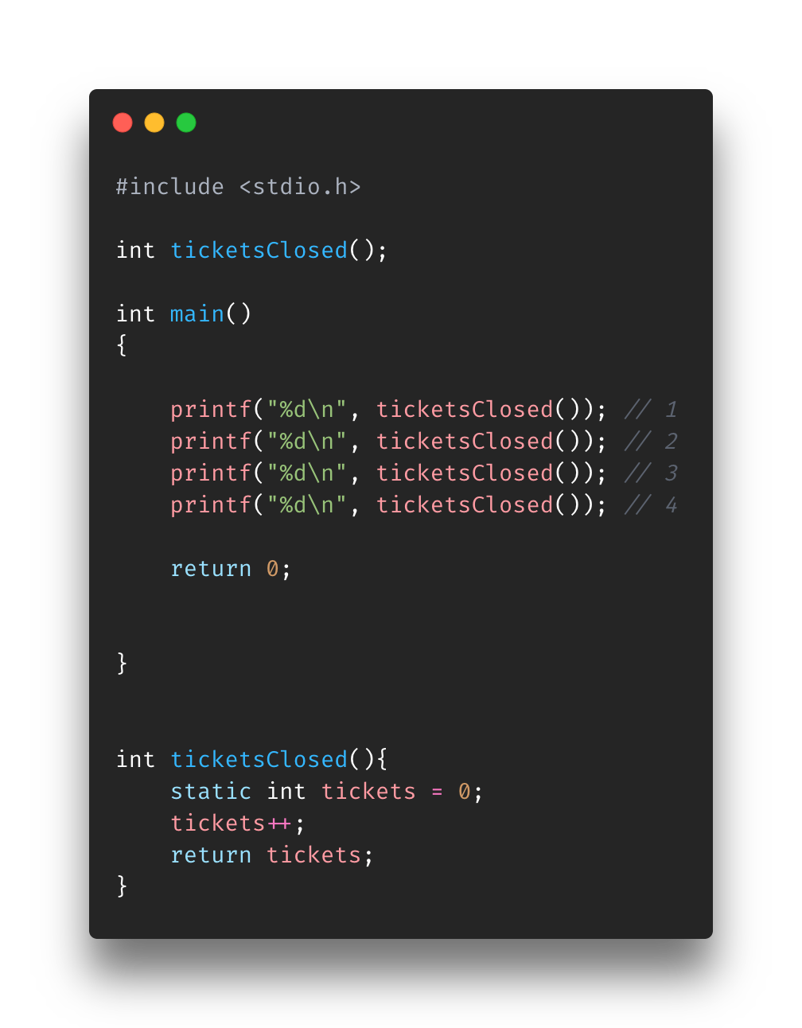
Static variables
Preserve values even after leaving scope
Basically, static variables will remain in memory while the program is running
Basically, retains its value across function calls

Slide 11
Overview
What is scope?
File Scope
Global variables
Block Scope
Local variables
Static variables
Notes:
https://stackoverflow.com/questions/36615960/is-there-an-advantage-in-using-global-variables-instead-of-pointers/36622061#36622061
https://stackoverflow.com/questions/36638375/where-can-i-declare-global-variable-in-c-program-whether-in-header-or-source-f
https://www.faceprep.in/c/difference-static-and-global-variables/#:~:text=Global%20variables%20are%20variables%20which%20are%20defined%20outside%20the%20function.&text=%EF%BB%BFStatic%20local%20variables%3A%20Variables,visibility%20as%20automatic%20local%20variables.

Slide 12
References
https://www.tutorialspoint.com/cprogramming/c_scope_rules.htm#:~:text=Global%20variables%20are%20defined%20outside,be%20accessed%20by%20any%20function.
https://www.geeksforgeeks.org/scope-rules-in-c/
https://www.programiz.com/c-programming/c-variables-constants
https://www.freecodecamp.org/news/the-c-beginners-handbook/#static-variables
https://www.udemy.com/course/c-programming-for-beginners-/learn/lecture/8795314#overview
https://press.rebus.community/programmingfundamentals/chapter/scope/
https://stackoverflow.com/questions/36615960/is-there-an-advantage-in-using-global-variables-instead-of-pointers/36622061#36622061
https://stackoverflow.com/questions/36638375/where-can-i-declare-global-variable-in-c-program-whether-in-header-or-source-f
https://www.dummies.com/programming/c/basics-of-global-variables-in-c-programming/
https://www.geeksforgeeks.org/static-variables-in-c/
https://www.geeksforgeeks.org/understanding-extern-keyword-in-c/

