Slide 1
MY COURSE AND WHAT TO EXPECT
BY: LT FELIPE PINEDA

Slide 2
OVERVIEW
Expectations
Lectures
Exercises
Folder Layout
Things we will go over
Mi Pregunta...

Slide 3
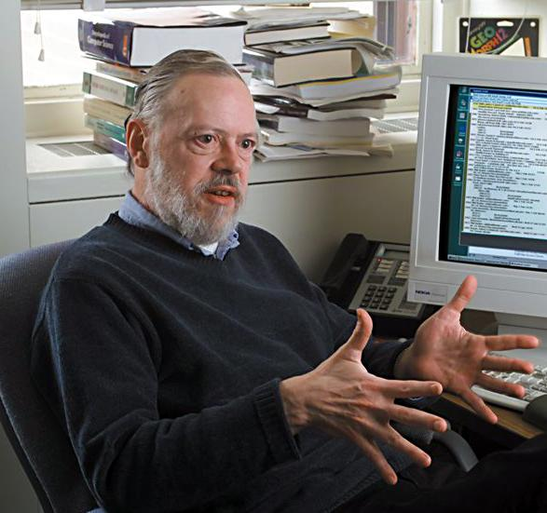
EXPECTATIONS
C is hard, no way around it
Two things that stood out to me: complicated and boring
How do I tackle that?
complicated -> simple
boring -> somewhat fun
Notes:
C is very complicated language. Just the fact that it does memory management already defeats other languages in terms of difficulty.
Two things stood out to me when I was tasked with creating an intro to c course. It’s both complicated (hard) and boring. As a dev doing this for close to 3-4 years (all actual working experience combined) now, I can say that.
I tackle that by taking the complicated parts and working it down to a very simplified version. Hey, it’s a very short intro class so I focused on the concepts. I simplified all documentation to the point that anyone can understand it. I added images and graphics to help the students understand. The exercises themselves are not difficult but still allow the students practice what they learned. Every exercise should take 10-15 minutes total to complete. Like I said, it’s a short class.
To tackle the boring part, I made the exercises have some sort of theme or funny result when you complete the exercise. I figured it would be less boring if at the end of the struggle there was something to made the student chuckle.

Slide 4
LECTURES
Lectures consists of slides, slide notes, and exercises
slides
slide notes
exercises
Exercises are c script skeletons
They’re made to be completed quickly and implement the concepts you learned
Notes:
Lectures will consist of slides, slide notes (notes within the slides), and exercises.
The slides are pretty simple, just read over them and look at any code images seen in there.
The slide notes are there to provide extra knowledge and give me my talking points if I need them. They give the same knowledge but with more language.
The exercises c script skeletons that you can open with an editor and edit them. In the next slide will talk about the dos and don’ts of them.
Entire process can be summarized by: I will teach a topic within a section/slide and then there will be an exercise for that topic. This allows the student to learn something and then quickly apply it. It’ll help retention build sort of muscle memory.

Slide 5
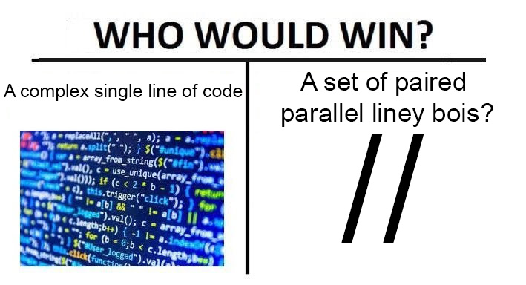
EXERCISES
C script skeletons
No wasted time rewriting things over and over again
Script should have the necessary items to run unless the concepts being being implement is one of them
Instructions will be placed in comments (also in the slides)
Comments
Instructions
//CODE GOES HERE
// Do not touch
Output
In the REM Linux, you should be able to open it with any text editor or IDE of your choice
Lastly, we will be using REM Linux for most of the class. Only a few sections will use Visual Studio
Notes:
Like I said in the previous slide, the scripts are skeletons so that the student does not have to unnecessarily rewrite things over and over again. The skeleton is created to be opened in an editor or IDE and write your code in. The student will then run then compile and run the script. You’ll see once we get there
The comments will detail
Instructions
Instructions will give the student the steps necessary to complete the exercise. It will give an overview and then give detailed steps on what to do. Of course, some of the information may be left out so that the student can problem solve and complete the exercise without full assistance (i.e. learn the concepts)
//CODE GOES HERE
Since some script will have a lot code, it may be difficult for the student know where his/her code will go. For that, I added the “//CODE GOES HERE” line. This is used so that the student will know where to write their code. It helps direct the student and makes sure that the script sequence is not messed up
// Do not touch
These are lines that will not be touched. The student is not being tested on these line during this exercise.
The lines are means to make sure the script runs normally
Output
Once the student has written their code, he/she will compile and run the script. The output from the script should match the output from the comment in the script

Slide 6

FOLDER LAYOUT
“References” folder has a few resources that could come in handy
“Slide-Scripts” folder has all the code used in the slides and the exercises
Organized by sections
“Slides” folder has all the slides (except for this one)

Slide 7

THINGS WE WILL GO OVER
What is the C Language?
Running a C file
Variables and C Data Types *
Operators
Flow Control
Arrays
Strings
Functions
Scope
Pointers *
More in-depth Input/Output
Structures *
Project Requirements *
El Project *

Slide 8
Mi Pregunta...
Is an egg a fruit or a vegetable?

Slide 9
OVERVIEW
Expectations
Lectures
Exercises
Folder Layout
Things we will go over
Mi Pregunta...

