Slide 1
C Flow Control
By: Lt FElipe Pineda

Slide 2
Overview
What in tarnation is an array?
Why do we need it?
Declaring an array
Initializing an array
Accessing elements in an array
What is out of bounds?
Updating elements in an array
Inserting elements in an array
Deleting elements in an array

Slide 3

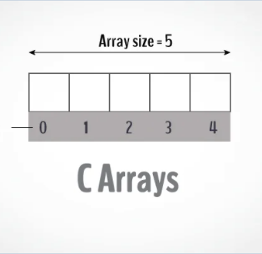
What is an array?
Single values inside a variable. Nah fam. Let’s kick it up a notch
Arrays are store more than one value of the same type
Can anyone name some of the types we’ve gone over?
You want 1000 ints all in one package. You got it.
You 10000 doubles all in one package. You got it.
Etc.
Arrays have a size limit
Array size cannot be changes once it is declared
Think of it as a package of the same type elements
Notes:
Up until now all we have done is store single values in variables. Now let’s learn about a variable (array) that can store multiple values.
An array is a variable that can store multiple values of a same type. For example, if you wanted 1000 ints all in one packaged group, then you’d create an int array with 1000 ints.
Arrays have a size limit. At the point of declaration, you have to give it a size amount so that it will allocate memory for it.
Once you declare an array with the amount you want, that amount cannot be change. The elements inside it can but not the size.

Slide 4
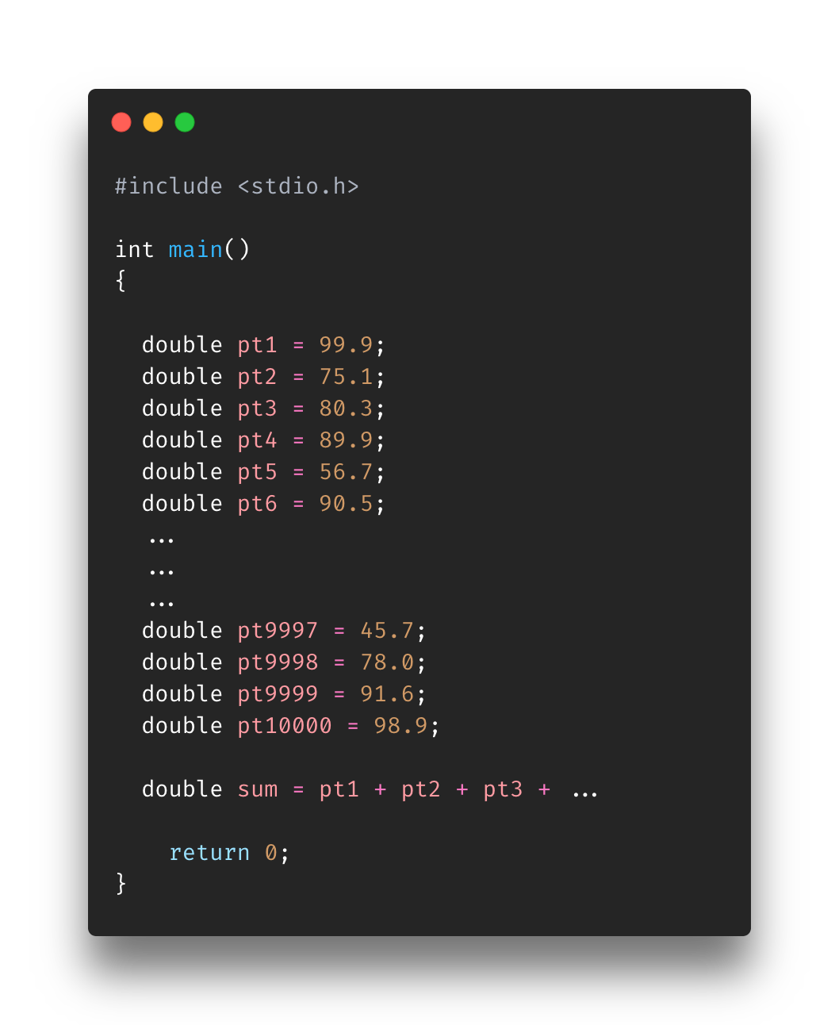
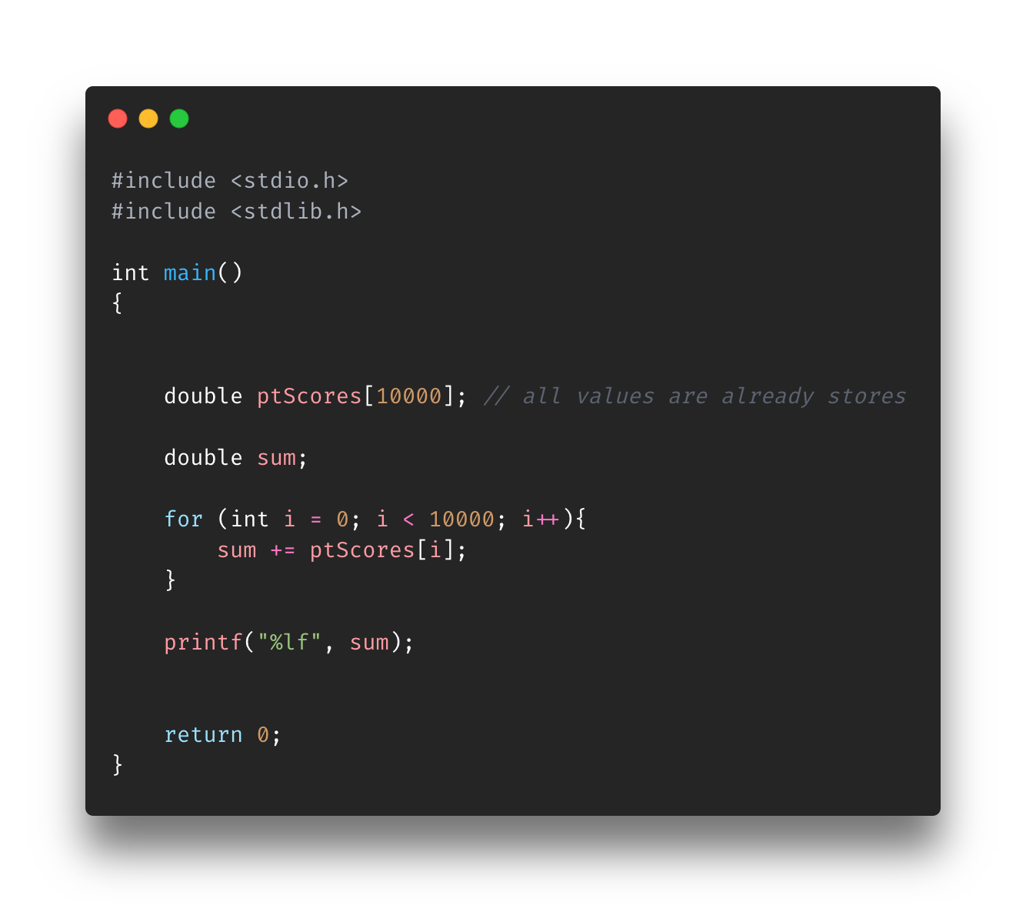
Why do we need it?
Scenario
10,000 PT Scores
How would you store that?
10,000 variables or 10,000 lines of code vs a few lines of code
Can be bypassed or worked around
Where it gets harder is what if you need to do calculations on all (or some) values?
Add them all together
Sort them?
Get the median value?
Notes:
Up until now all have stored are single elements. That’s cool and all but what our task requires more than that?
What if you’re tasked with storing 10,000 binary hash values within your program? With the things you’ve learn all you could do to complete this task is set 10,000 variables? Bruh what..
That would be quite inefficient. Arrays make that an easier task. By using an array, you can store those 10,000 hashes with a few lines of code
At the end of the day, the above could be bypassed but let’s someone tasks you with finding the mean or sum all all the values? It will get ugly real quick
Left image is pseudo code of how we would sum all the values it if arrays did not exist
Bottom image how you could do it in an array

Slide 5
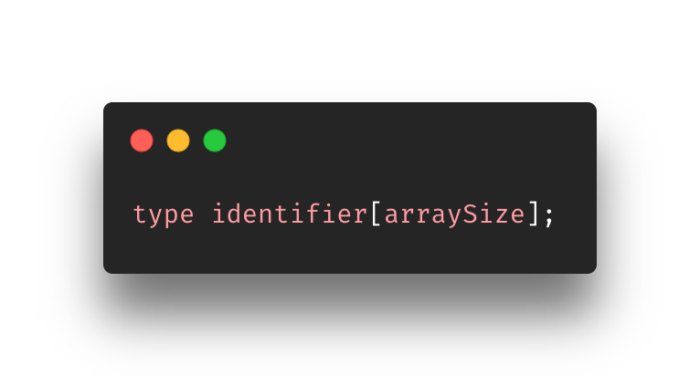
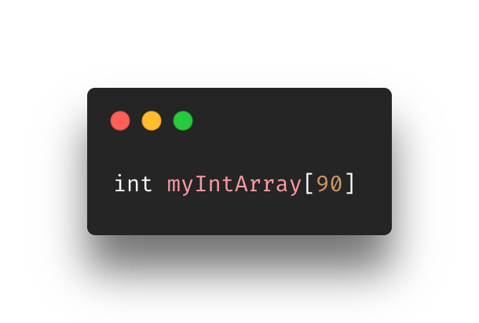
Declaring an array
Like how we declare variables
type will the type for all the elements inside
identifier must match the rules that were given is earlier slideset
Take not that the size is encased in square brackets
Again, once you declare an array the size and type of an array cannot change
Do we get what that means?
Notes:
Declaring an array is similar to how we declare a variable. We give it the type of the elements it will hold. The identifier or name of this array variable and the size.
Take note that the size is encased in square brackets.

Slide 6
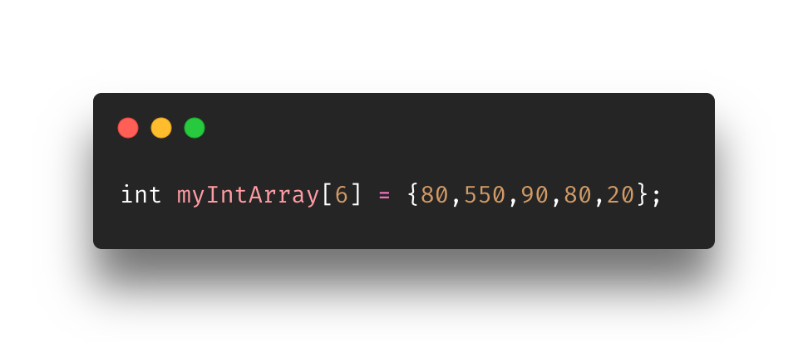
Initializing an array
Simple as just putting the values you want in curly brackets
Does anyone see anything wrong or inefficient in the code?
Yes, allocated memory for 6 but only put 5. What’s going to happen to that last element?
A 0 will be put there. What is put there depends on what the type is

Slide 7
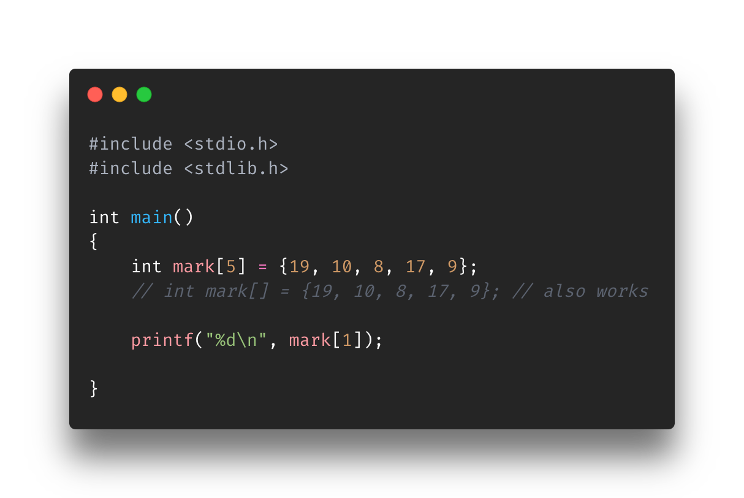
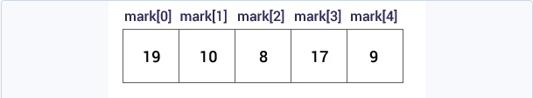
Accessing elements in an array
First, indexes start at 0
The range is from [0, n-1] where n equal the size of the array
In the array mark it has a size of 5.
The range [0,5-1] or [0,4]
To access an element, you must know it’s associating index
Call the index within square brackets as shown in code
Notes:
First thing you need to know is how indexing works. Indexes in arrays start at 0.
They continue until n-1 where n is equal to the total length.

Slide 8
Exercise
Find AccessingArrays-Exercise-a.c in the Exercise folder for Section6-Arrays
Create an array with the given details and print the specified values
6843
45
5
2
354
67
Instructions on are the script

Slide 9
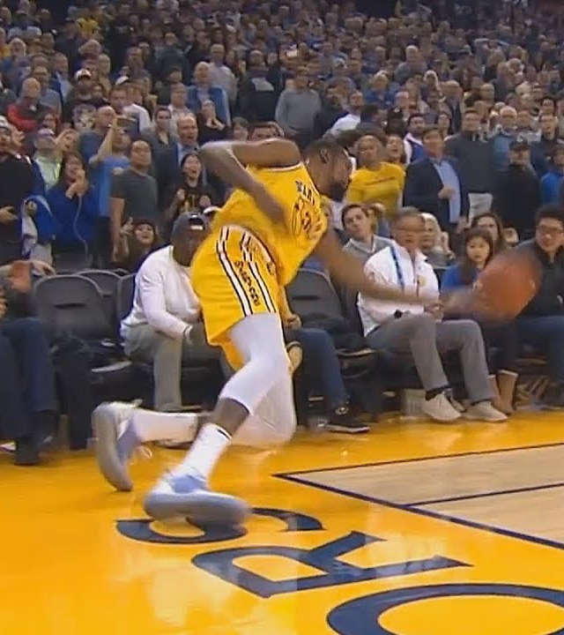
Out of bounds
Indexes are associated to an element in the array
Ex
{45,67,87,79,24}
{0, 1, 2, 3, 4}
What happens when you provide an index outside of what it has available?
Ex: 50
Runtime error!
Program will compile
Does anyone know why?
Extremely important for you use indexes within array size
How tho?
4 ways we can do it (next slide)
Notes:
So we know about indexing and how it works. Indexes are used to grab a specific element from the array. You can do this by finding the associated index to the element you want. For Example in an array with elements {45,67,87,79 24} the indexes will be 0,1,2,3,4
What would happen if you give you give an index out of bounds? Let’s say a 50?
Well, the program will compile (as it cannot check for it) but it will crash at runtime

Slide 10
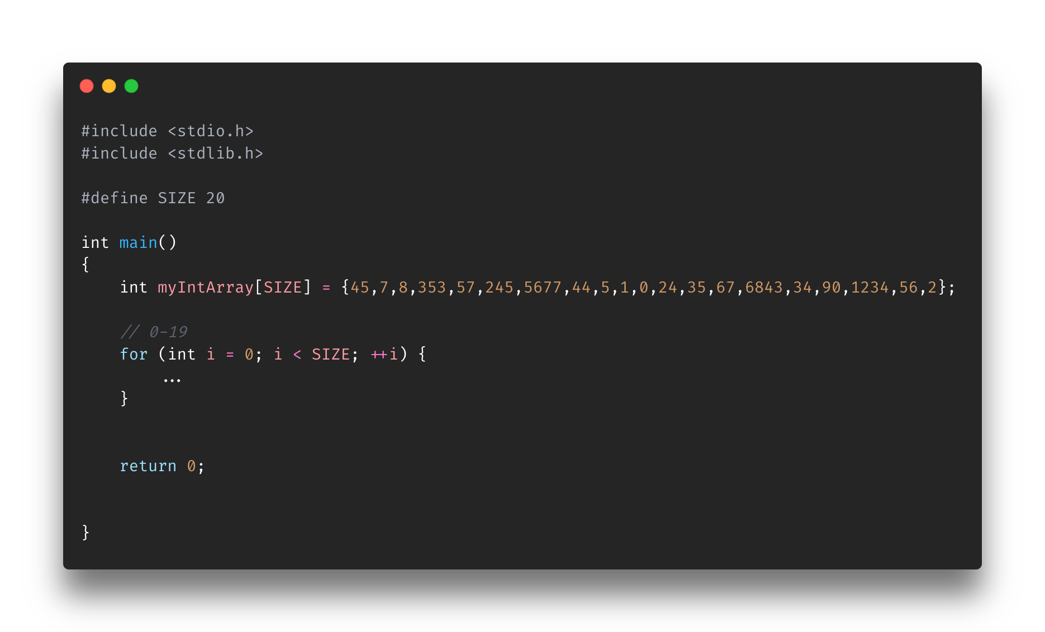
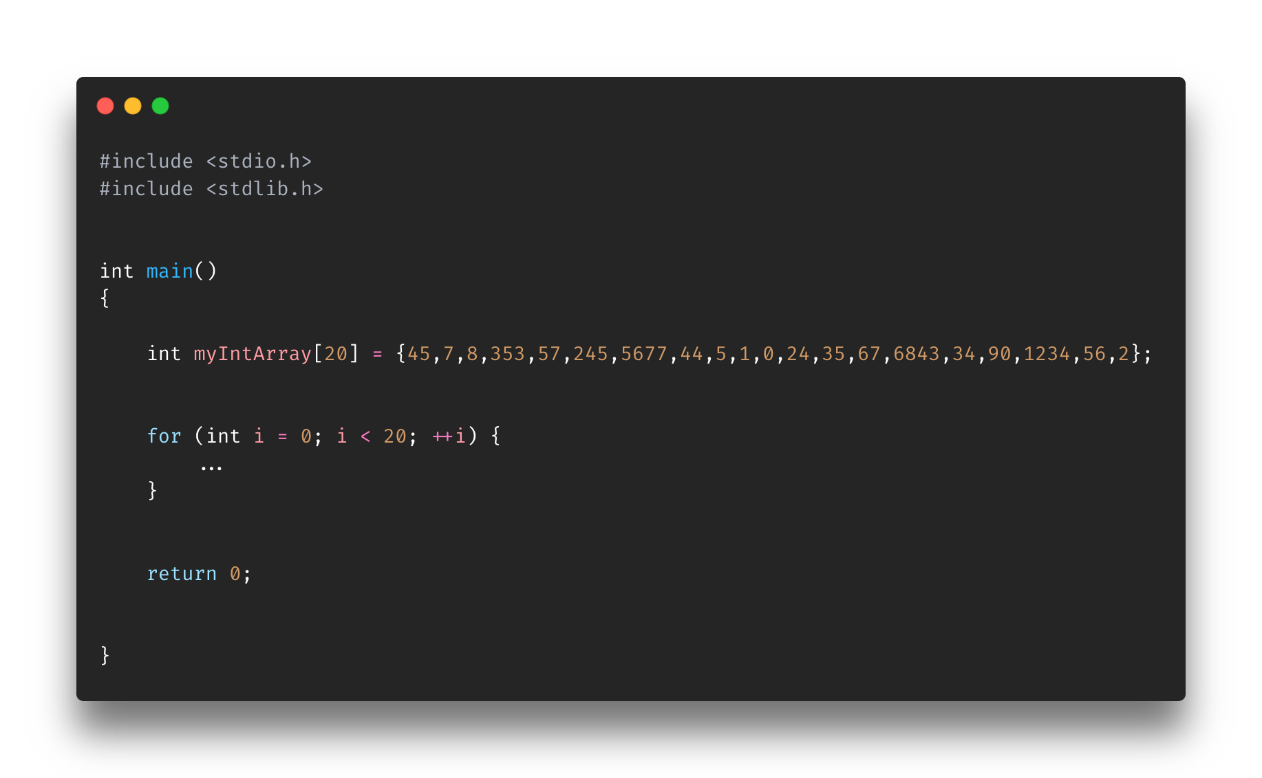
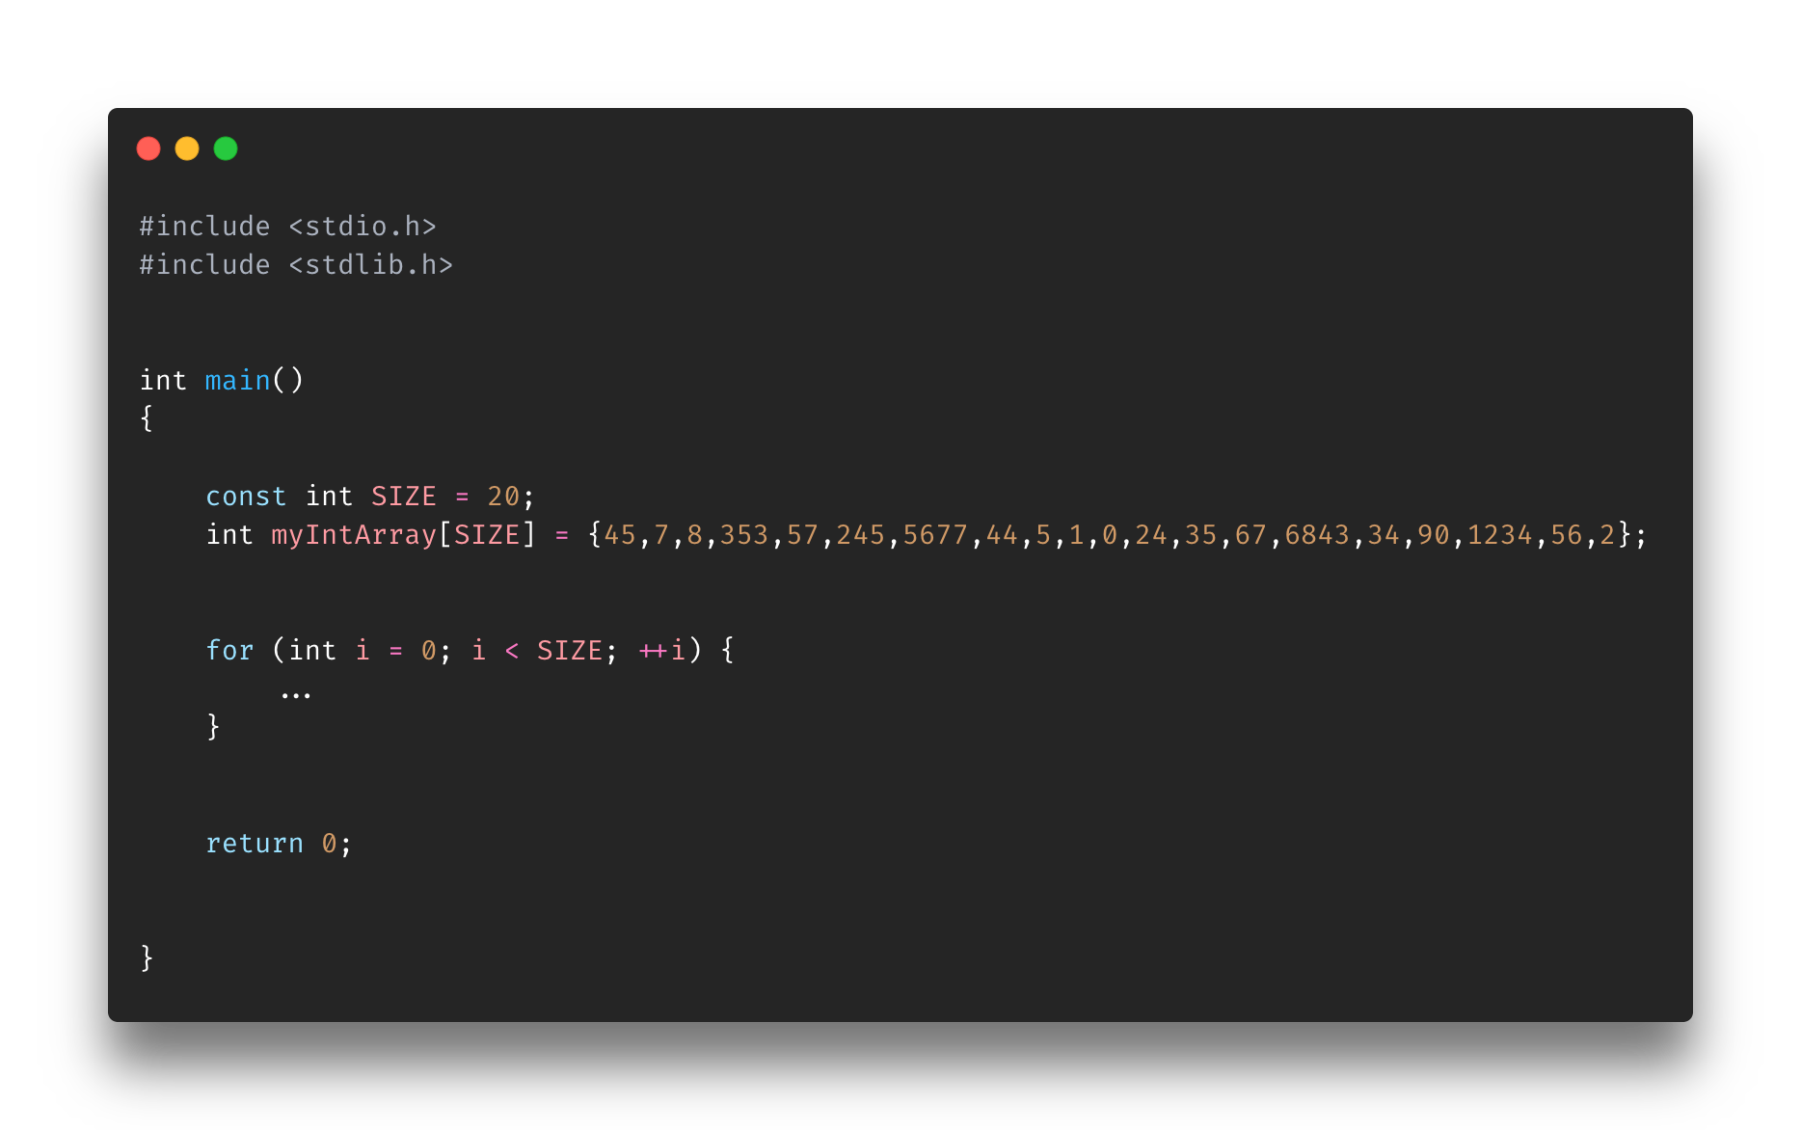
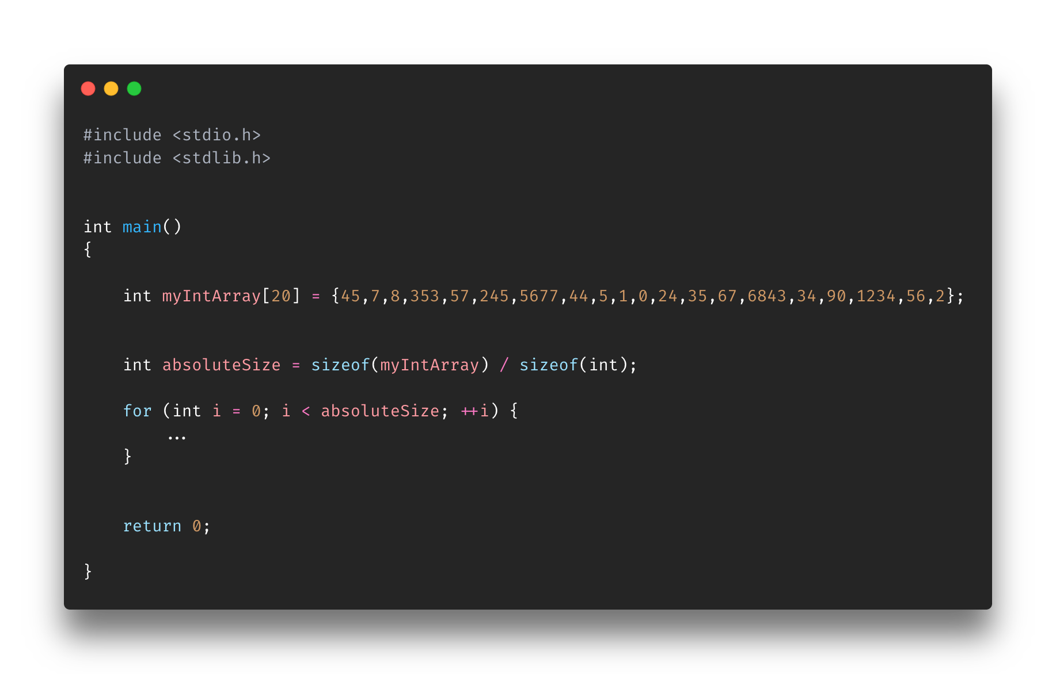
Notes:
Top Left: Uses the define directive to create a macro called SIZE with the value 20 inside it. A macro is a name which will stand for a fragment of code. Yes, fragment of code. It can house functions. Here, it is using it to set a constant-like value of 20 to the variable SIZE. That macro will exist throughout the entire program. We can use it in the loop as a bound (middle expression of the for loop)
Bottom left: Similarly, we can use the const word to create a constant variable. The variable SIZE will always have a value of 20. If we did not put the const keyword in the declaration an error would be thrown saying that the array may not be initialized. It needs to have a “constant” value. We can use it in the loop as a bound (middle expression of the for loop).
Top right: Just using the literal values lol If you know the number porque no. We can use it in the loop as a bound (middle expression of the for loop)
Bottom right: using the sizeof(…) function to take the size of the array. Why do we have to take the size of array and divide it by the type???????
We can use it in the loop as a bound (middle expression of the for loop)

Slide 11
Exercise
Find AccessingArrays-Exercise-b.c in the Exercise folder for Section6-Arrays
Using the skills you've learned up until now and loop through the array printing the odd numbers
45
7
353
57
245
5677
5
1
35
67
6843
Instructions on are the script

Slide 12
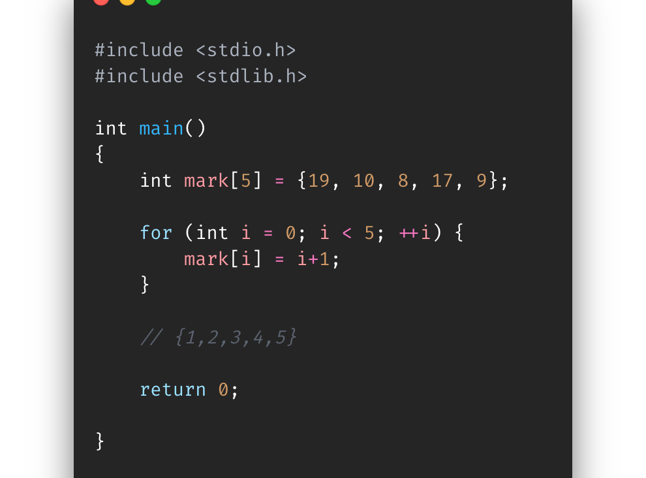
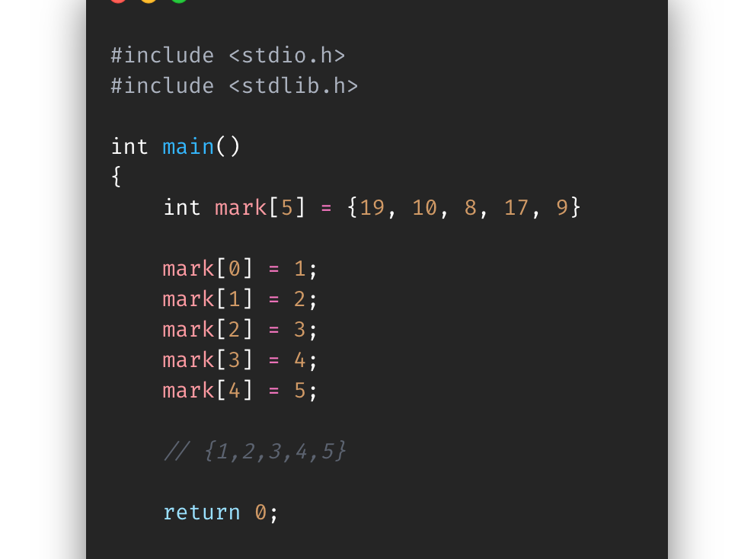
Updating elements in an array
To update an element, you must know the index
Access that element and then set it to the new value
That’s all
Super simple
It get’s a little different if you want to update multiple values

Slide 13
Exercise
Find AccessingArrays-Exercise-c.c in the Exercise folder for Section6-Arrays
Without touching the array initialization, turn off all the lights in the house (in other words turn the 1s to 0s)
0
Instructions on are the script

Slide 14
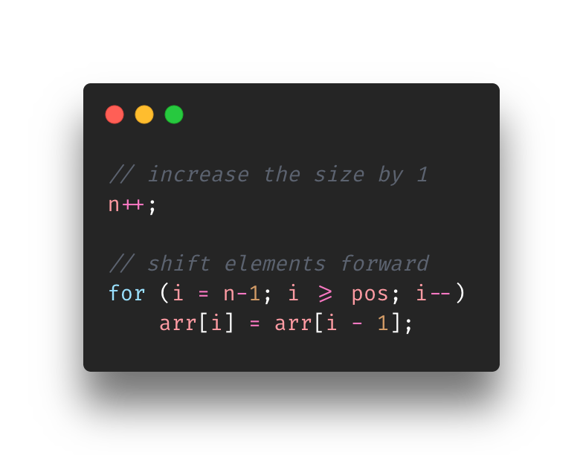
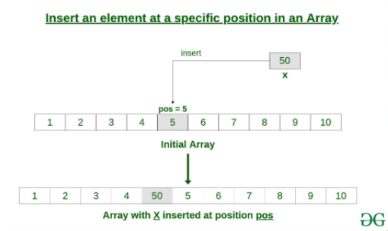
Inserting elements in an Array
Not as easy as updating elements
Inserting requires
All elements to the right of the insertion position will be shifted to the right by one
You may need another array in the process
Process consists of starting at the end and moving every element to the right by 1 all while moving inwards. Eventually the position requested will be open to just set it.
Notes:
Unfortunately inserting elements in an array isn’t as easy as updating an element.
Inserting an element in the array (let’s say the middle) you will need to shift all the right elements to the right by 1
https://www.geeksforgeeks.org/c-program-to-insert-an-element-in-an-array/

Slide 15
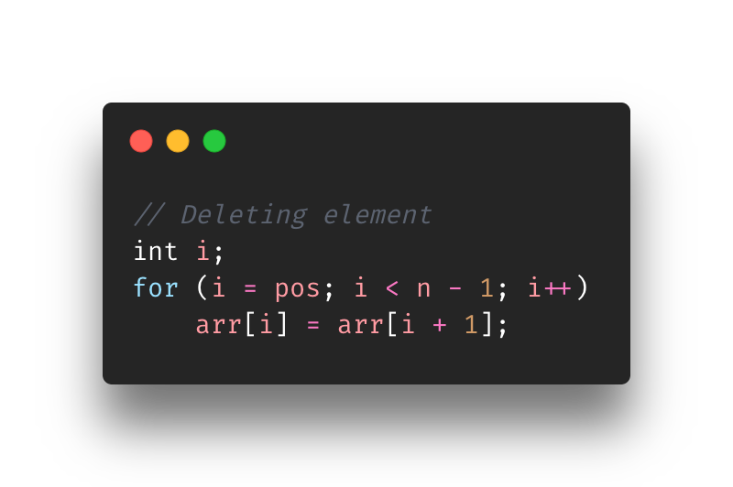
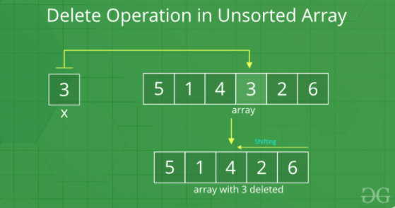
Deleting an elements in an array
Also, not as easy as updating
Deleting requires
All elements to the right of the deletion position will be shifted to the left by one
Probably doesn’t require another array as you won’t be going “out of bounds”
Process consists of going to that deleting position and just overwriting it with the elements to the right of it (shifting left)
Notes:
https://www.geeksforgeeks.org/c-program-to-insert-an-element-in-an-array/

Slide 16
Overview
What in tarnation is an array?
Why do we need it?
Declaring an array
Initializing an array
Accessing elements in an array
What is out of bounds?
Updating elements in an array
Inserting elements in an array
Deleting elements in an array

Slide 17
References
https://www.quora.com/Why-should-you-use-Arrays
https://www.programiz.com/c-programming/c-arrays
https://www.freecodecamp.org/news/the-c-beginners-handbook/#strings
https://www.quora.com/How-can-I-update-an-element-in-an-array-using-C
https://gcc.gnu.org/onlinedocs/gcc-2.95.3/cpp_1.html#SEC10
https://www.geeksforgeeks.org/c-program-to-insert-an-element-in-an-array/
https://www.geeksforgeeks.org/search-insert-and-delete-in-an-unsorted-array/

