Slide 1
C Command Line PArameters
By: Lt FElipe Pineda

Slide 2
Overview
What do I mean by command line?
What are parameters?
Using them in C Scripts
Why is this useful?

Slide 3

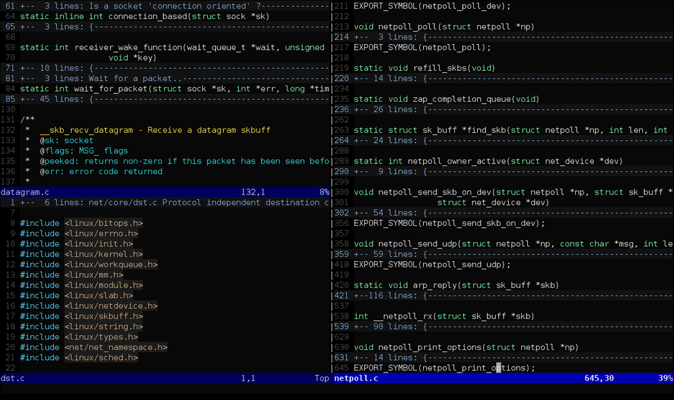
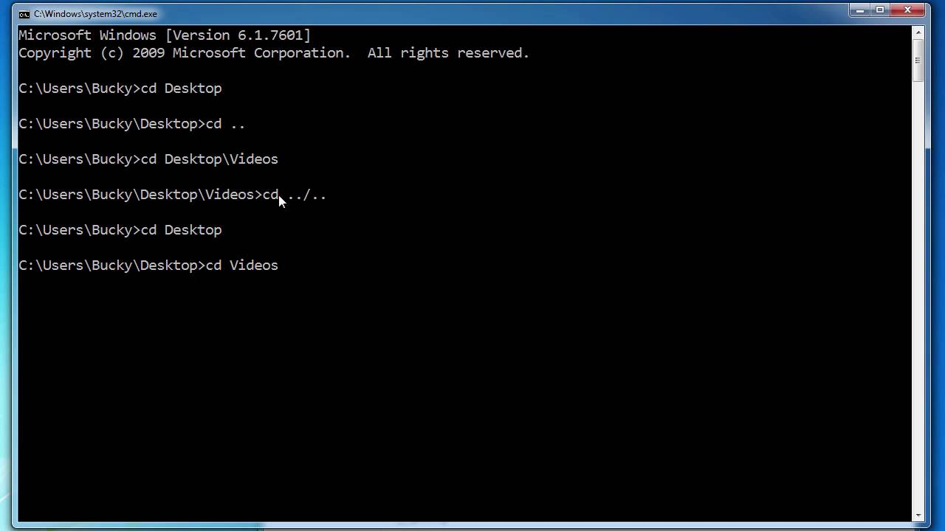
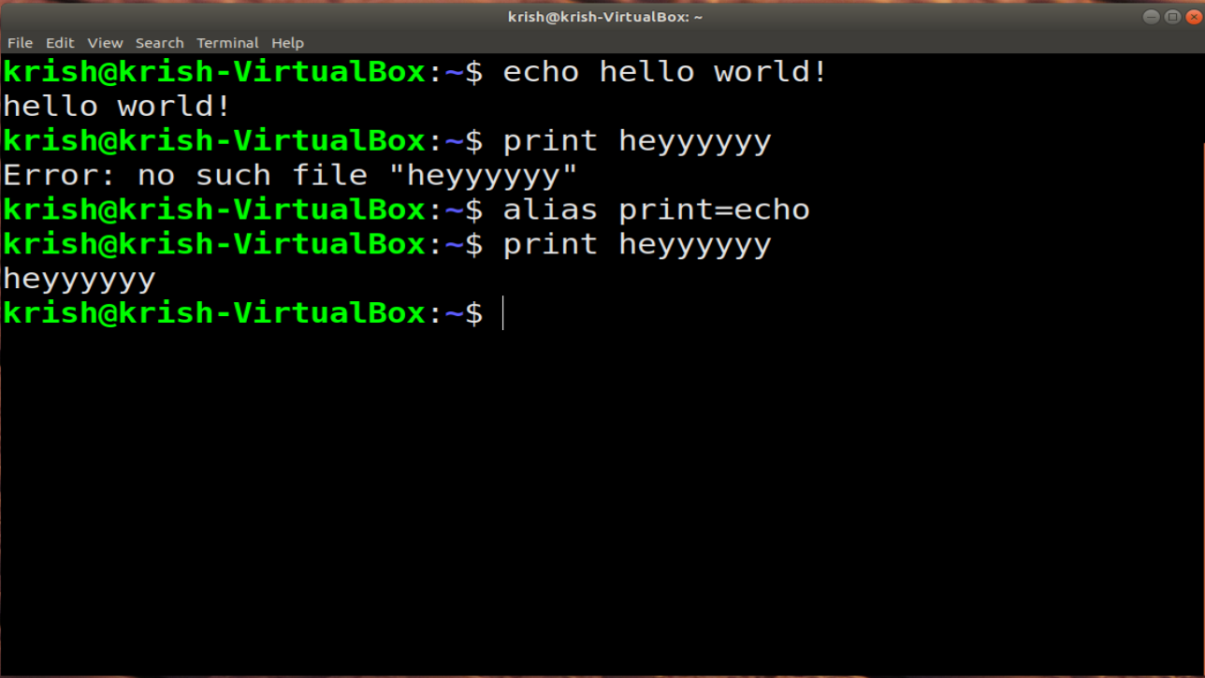
What do I mean by command line?
Command line is the small black box you see all the hackers use
Of course, we are using it to access/edit our scripts, compile them, and then run them
Command line is a tool used by computer professionals to type commands and interface with the computer directly
There is no GUI or visuals, it is all text
Technically, you don’t even need the mouse as much (speaking to all the advanced VIM users)
It requires the user to type a command and the computer will execute the command.
Depending on what was typed, the computer will either display the output or greet you with a new line to type your next command
It is also used to navigate the directories of your machine

Slide 4
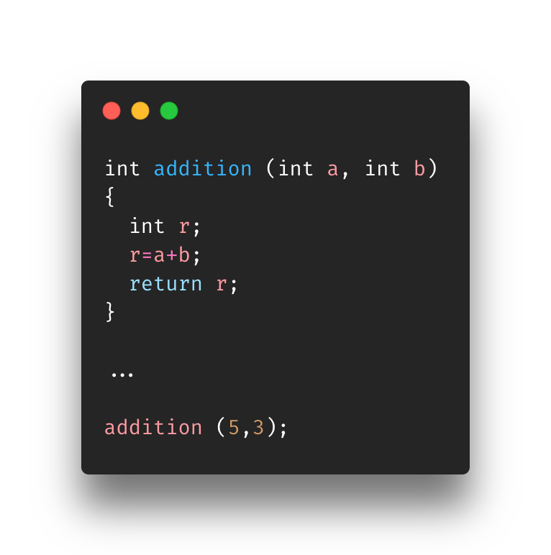
What are parameters?
We covered parameters back in the function’s section
Parameters are values passed into functions, in this case, to the script (main function)
In the case of Command Line Parameters, they allow us to pass in certain elements into the program before it runs
Good practice: using parameters and arguments the right way
Parameters are the type and identifiers in the function declaration. I like to think of it as parameters will be used in the blueprint of the function. It describes values.
Ex: int a, int b
Arguments are the values passed to the function.
Ex: 3, 5

Slide 5
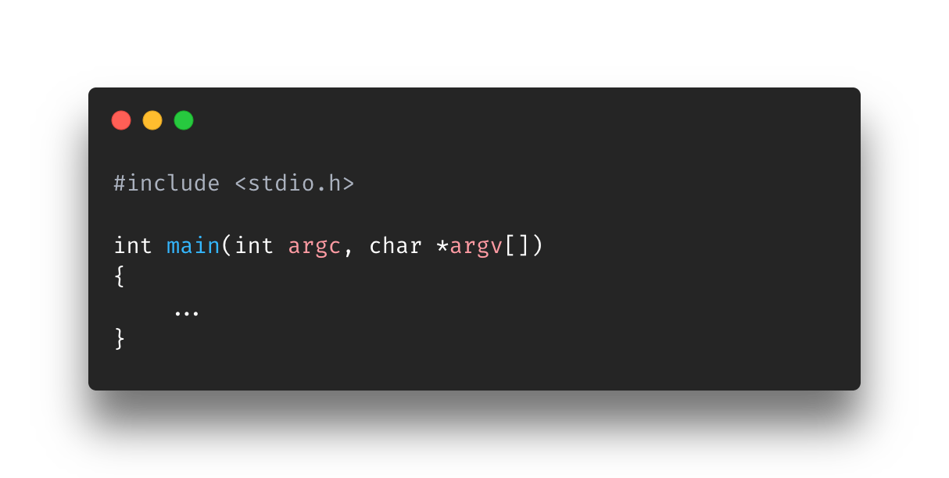
Using them in C scripts
Before we jump into the script you must know these two parameters
argc
Is the number of arguments you passed in
argv
Is a char array of the arguments (actual values) given
Both parameters are written in the main functions for it use command line parameters

Slide 6
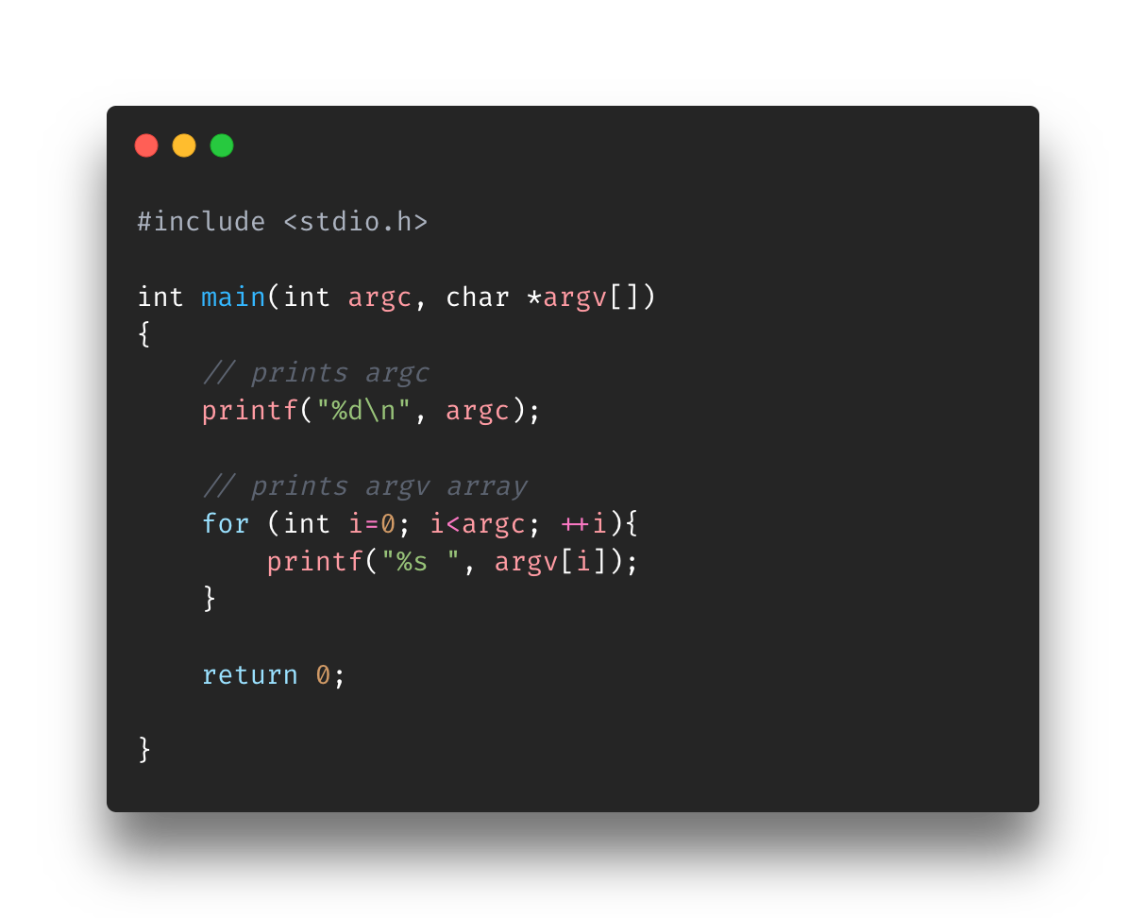
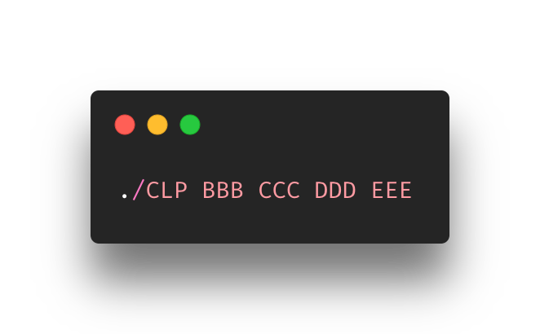
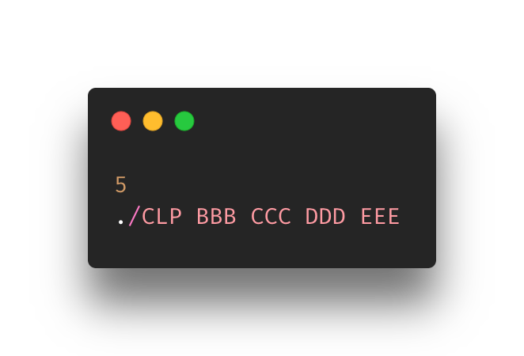
Using them in C Scripts
Normally, they are used when you need to accept values from the command line
In other words, you use them when you need to feed in values at the time that you run the file from the command line
Let’s see it in action, we are running a script called CLP.c (top image)
The script accepts both parameters and just prints them out (top image)
We run the file (middle image)
Output (bottom image)
Note that the script execution call is a part of the argument count and argument values. It will always be the first element (0th index).
So if we have a script with an argument count of 10, how many arguments (with actual values) were passed in?
9

Slide 7
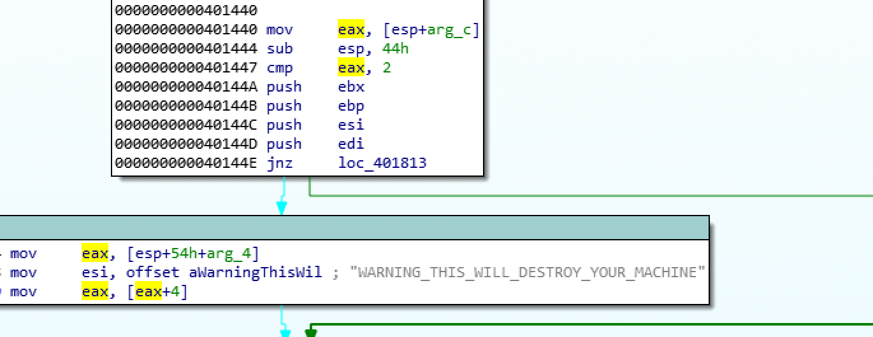
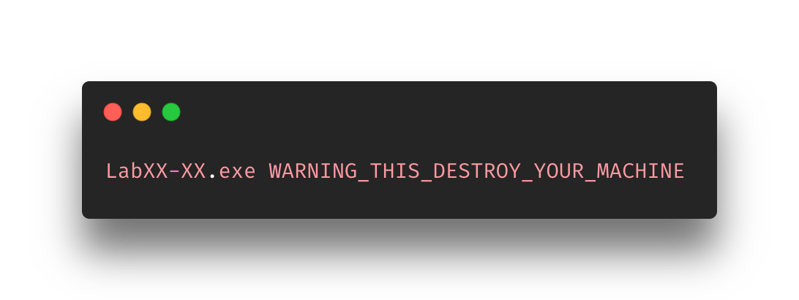
Why is this useful?
Programs (malware ;) ) will use these parameters as commands for specific actions
At the time of calling the program to execute, you feed it a specific argument and based on that argument (and logic inside it) it will do a specific action
The images to the right demonstrate how a command can be used for malware. The top image is the disassembly of a PMA lab malware. The image focuses on the code that checks for the argument seen in the bottom image
The big point here is that malware will use commands. It’s useful to know how they work so you can find them easily.

Slide 8
Exercise
Find CLP-Exercise in the Exercise folder for Section11-CommandLineParameters
DO NOT LOOK AT THE CODE INSIDE CLP-Exercise.c
The goal here is the run the executable provided (./CLP-Exercise) with arguments
The arguments (3) are:
bunny
yankee
Towers
Find the correct order of the arguments
The program will output messages
“The amount of arguments given is off...” means you didn’t give enough arguments
“nah fam, try again...” means you gave the correct amount of arguments but either they aren’t the right ones (see above) or they are the right ones and they are in the wrong order
“Got it!” means you completed the exercise

Slide 9
References
https://www.freecodecamp.org/news/the-c-beginners-handbook/#command-line-parameters
https://www.computerhope.com/jargon/c/commandi.htm
https://www.thoughtco.com/definition-of-parameters-958124

