Slide 1

Machine Learning Approach to Bank Customer Retention
SEP 785: Machine Learning - 2025 Fall
Students: Foram Brahmbhatt & Savan Sachpara
Instructor: Sayyed Faridoddin Afzali
TA: Mahdi Astaraki

Slide 2
Abstract: Predicting Bank Customer Churn
Financial institutions face significant challenges with customer retention, impacting profitability and customer lifetime value. This project introduces a machine learning method to forecast bank customer churn and discover behavioral segments.
Methodology
Key Findings
Combines EDA, PCA for dimensionality reduction, K-Means for segmentation, and supervised models (Random Forest, XGBoost).
XGBoost outperforms Random Forest. Age, credit score, products, activity, and balance are key churn drivers.

Slide 3
Introduction: The Churn Challenge
In a competitive banking industry, customer retention is paramount. Predicting churn allows for proactive engagement and retention efforts. Traditional models often miss complex relationships, making ML techniques essential.
Background
Problem Statement
Churn is driven by dissatisfaction, low engagement, or financial stress. Forecasting churn enables targeted interventions like personalized offers.
Precisely identify high-probability churn customers using demographic, financial, and behavioral data, addressing class imbalance and non-linear relationships.

Slide 4
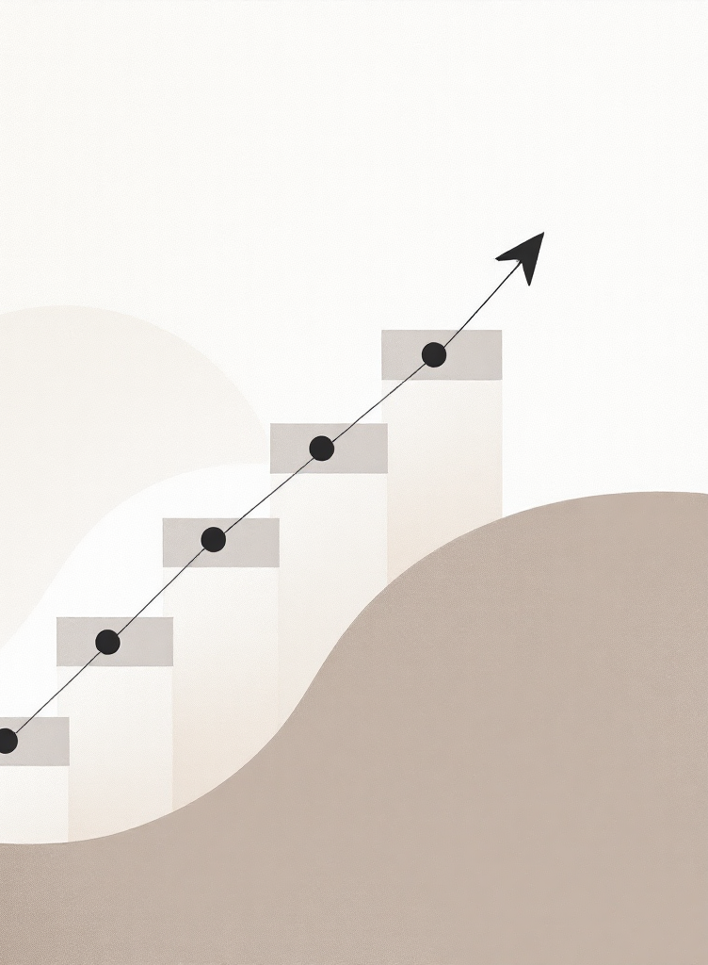
Project Objectives
1
Exploratory Analysis
Uncover relationships between features and churn characteristics.
2
Customer Segmentation
Apply PCA + K-Means to interpret segments by churn likelihood.
3
Classification Models
Develop Random Forest and XGBoost models for churn prediction.
4
Robust Evaluation
Utilize cross-validation, hyperparameter tuning, and robust metrics.
5
Actionable Insights
Extract insights for effective customer retention strategies.

Slide 5
Data & Preprocessing
The project utilizes a publicly accessible bank customer churn dataset with 10,000 records.
Key Features
Preprocessing Steps
CreditScore, Geography, Gender, Age, Tenure, Balance
No missing values or duplicates.
NumOfProducts, HasCrCard, IsActiveMember, EstimatedSalary
Categorical Encoding: One-Hot Encoding for Gender and Geography.
Churn (Target Variable: 1 = Exited, 0 = Stayed)
Feature Scaling: StandardScaler for numerical features.
Class Imbalance: 20% churn rate addressed by threshold tuning.

Slide 6



Methodology: Unsupervised & Supervised Learning
Our approach combines K-Means for customer segmentation and two ensemble models for churn prediction.
Customer Segmentation (K-Means)
Preprocessing Pipeline
Model Selection
Unsupervised learning to group customers with similar financial and behavioral profiles. Optimal k=4 based elbow method.
StandardScaler for numerical features, OneHotEncoder for categorical. Unified pipeline for consistent data transformation.
Random Forest (baseline) and XGBoost (advanced) chosen for handling mixed feature types and non-linear relationships.

Slide 7
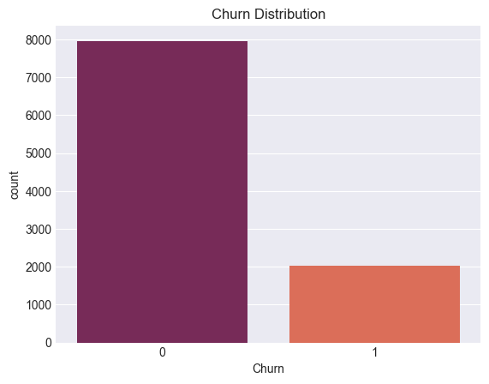
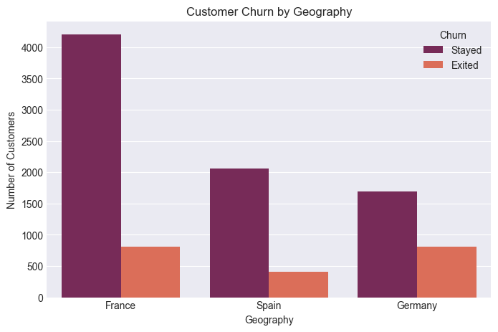
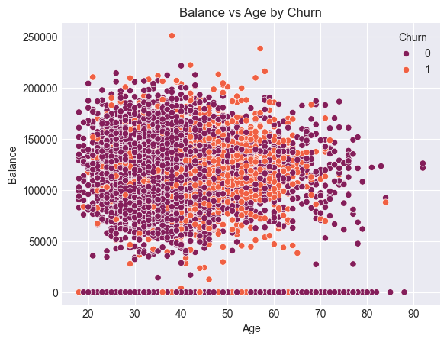
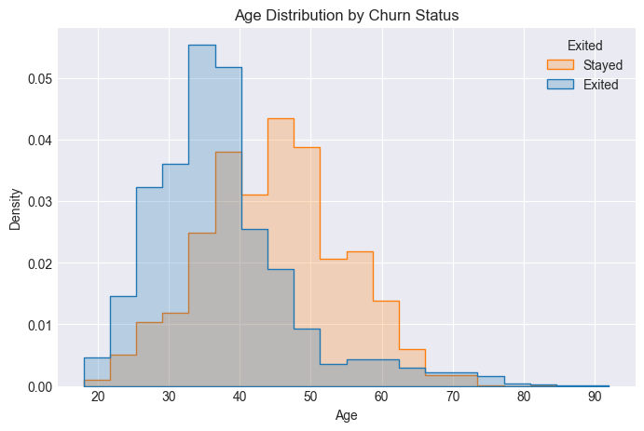
Experiments & Findings: EDA
Exploratory Data Analysis revealed key insights into customer churn.
Data Quality & Cleaning
10,000 customer entries, no missing values. Irrelevant columns (RowNumber, CustomerId, Surname) dropped. 'Exited' renamed to 'Churn'.
Target Variable Distribution
Significant class imbalance: 20.37% churn rate (2,037 exited) vs. 79.63% stayed (7,963 customers).
Impact of Features
Age 40-65 have lower churn; 25-40 have higher. Strongest positive correlation with Age, negative with IsActiveMember and NumOfProducts.

Slide 8
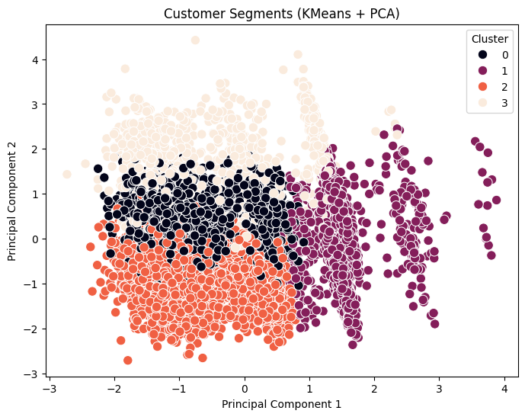
Customer Segmentation (K-Means) Insights
PCA reduced 7 features to 6 components, explaining 90% variance. K-Means identified four distinct customer segments.
Cluster 0
High Balance & Very Active
13%
Cluster 1
Many Products, Low Balance
12%
Cluster 2
High Balance but Inactive
29%
Cluster 3
Older Customers with Medium Balances
36%
The Elbow Method confirmed K=4 as the optimal number of clusters.

Slide 9
Model Performance Comparison
Random Forest and XGBoost models showed distinct trade-offs in churn prediction.
Matrix | Random Forest | XGBoost | Difference | Winner
Accuracy | 0.8225 | 0.8570 | 0.0345 | XGBoost
Precision | 0.5528 | 0.7553 | 0.2025 | XGBoost
Recall | 0.6683 | 0.4398 | -0.2285 | Random Forest
F1-Score | 0.6051 | 0.559 | -0.0492 | Random Forest
ROC-AUC | 0.8473 | 0.8540 | 0.0067 | XGBoost
F2-Score | 0.6415 | 0.4799 | -0.1616 | Random Forest
Random Forest delivers a $83,050 greater net benefit, confirming a recall-prioritized strategy.

Slide 10
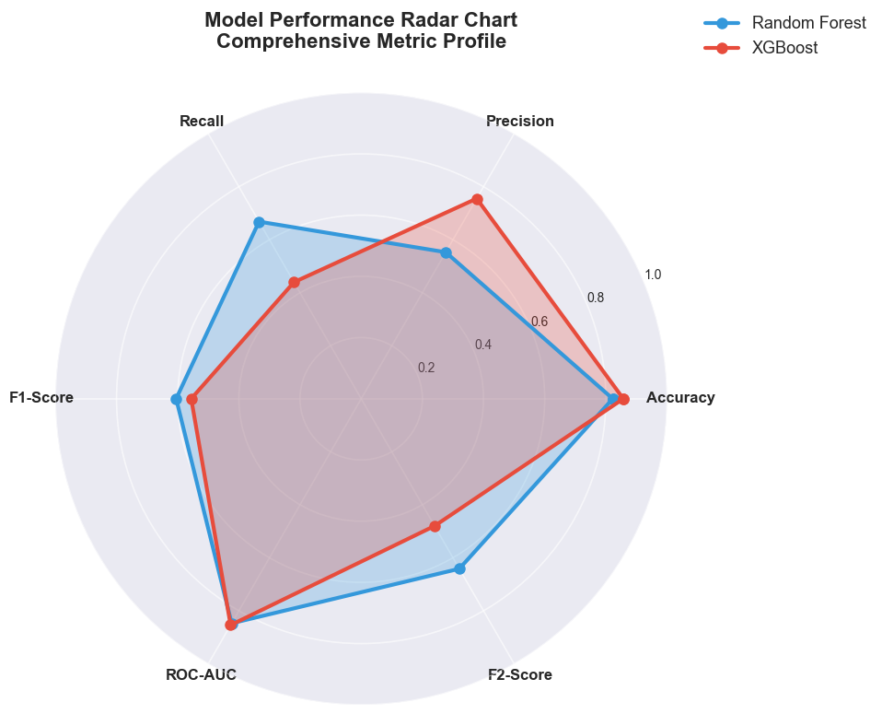
Conclusion & Recommendations
The project provides a comprehensive, data-informed structure for minimizing customer churn.
1
3
Model Choice
Practical Application
Random Forest is recommended for production due to its superior F2-Score (0.6415) and 48% higher ROI.
Implement a three-level risk scoring system for targeted retention offers and personalized outreach.
2
4
Key Drivers
Future Directions
Age (40-60), number of products (3+), account balance (100K+ dollars) are significant churn factors.
Focus on threshold optimization, incorporating temporal behavioral patterns, and longitudinal validation for sustained performance.

Slide 11
Thank You!

