Slide 2
Time-predictable End-system Design for Real-Time Communication
Eleftherios Kyriakakis

Slide 3
Outline
Introduction
Cyber-physical systems
Motivation
Background
Time-predictable hardware
Task execution
Real-time communication
Time synchronization
Contributions
Hardware-assisted clock synchronization with PTP
Fault-tolerant PTP synchronization using multi-domain aggregation
Time-predictable open-source TTEthernet end-system
Synchronizing real-time tasks in time-triggered networks
Evaluation the runtime system by distributing a flight controller
Conclusion
Composing a time-triggered system
Future Outlook

Slide 4
Introduction Cyber-physical systems
Computing systems have evolved
From Information processing devices,
Industrial, Automotive & Aerospace
BMW and Audi motors triplicated the number of electronic control units in their vehicles since 1995.
Airbus and Boeing has recently introduced Ethernet-based communication protocols in modern aircraft.
Nowadays
Distributed embedded systems interface with multiple sensors to control various actuation systems.
Cyber-physical systems networks.
To embedded microcontrollers in several control systems.
Hard real-time systems
Embedded systems in safety-critical domains.
Functional requirement of timeliness and in-order data reception without losses.

Slide 5
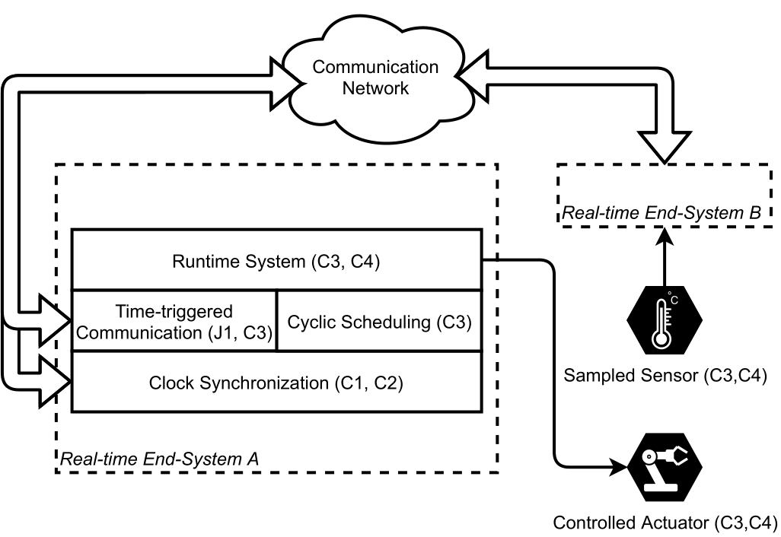
Introduction Example cyber-physical system network
Components:
Network protocol provides the communication channel.
Time synchronization coordinates the data flow.
Runtime system interfaces with sensors and actuators.
Cyclic scheduling coordinates the task execution.
Goal:
Compose a time-predictable end-system for real-time communication.
Develop hardware/software components for time-predictable communication & computation.
Research contributions mapped to the individual components of the real-time end-systems.

Slide 6
Introduction Motivation
Hard real-time systems require:
End-to-end timing analysis
Task scheduling
Precise time-synchronization
Quality-of-control
Current research:
Significant optimization on the components individually.
Use of proprietary network interface cards.
Focus on simulation and analysis.
Reliability for PTP needs more research.
This research work goals:
Investigate the composition of a time-predictable end-system.
Provide open-source solutions for time-triggered communication.
Investigate end-to-end isochronous computation and communication.
Provide fault-tolerant PTP synchronization.

Slide 7
Background Hard real-time systems
The functional correctness depends both on their functional aspects on their temporal behavior.
Different temporal requirements classify real-time systems into three classes:
Soft real-time, i.e., a streaming media application.
Firm real-time, i.e., motor controllers and some actuation devices.
Hard real-time, i.e., a vehicle airbag system, aircraft landing gears etc.
Variations in the system input can lead to different computation/communication times.
Time-predictable architecture has to guarantee bounded:
worst-case execution time (WCET): for computation.
worst-case end-to-end latency (WCEL): for communication.

Slide 8
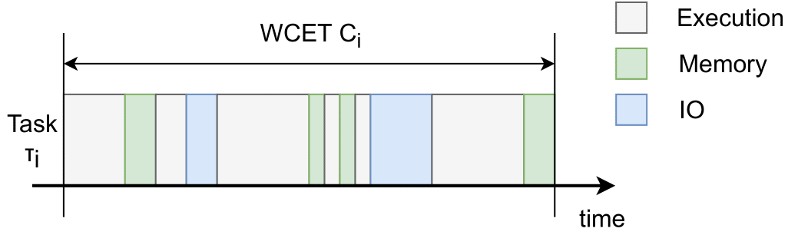
Background Task execution

Slide 9
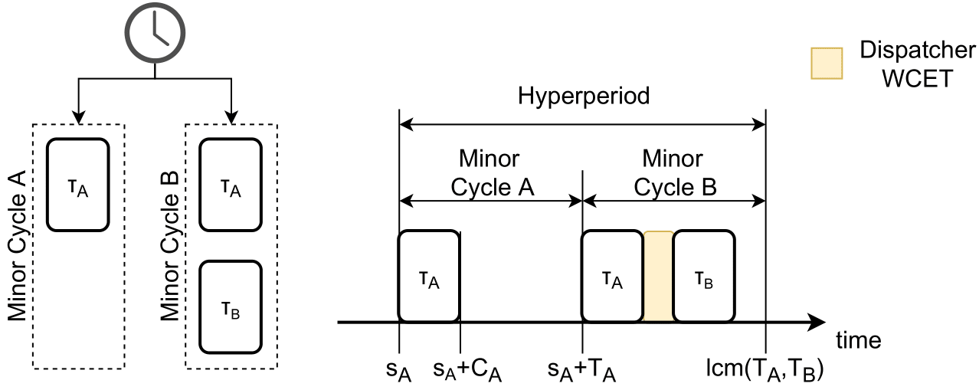
Background Task execution

Slide 10
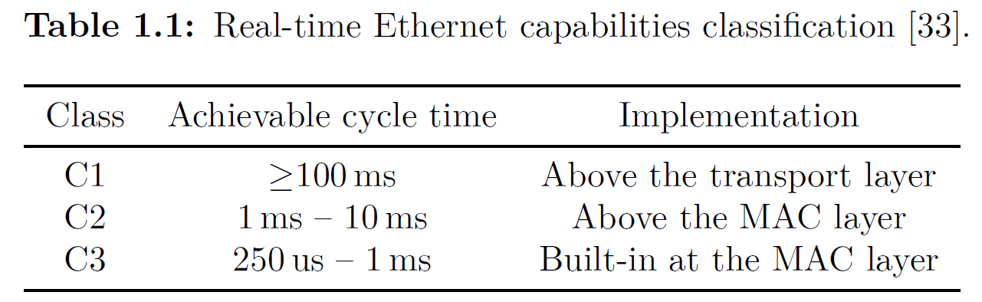
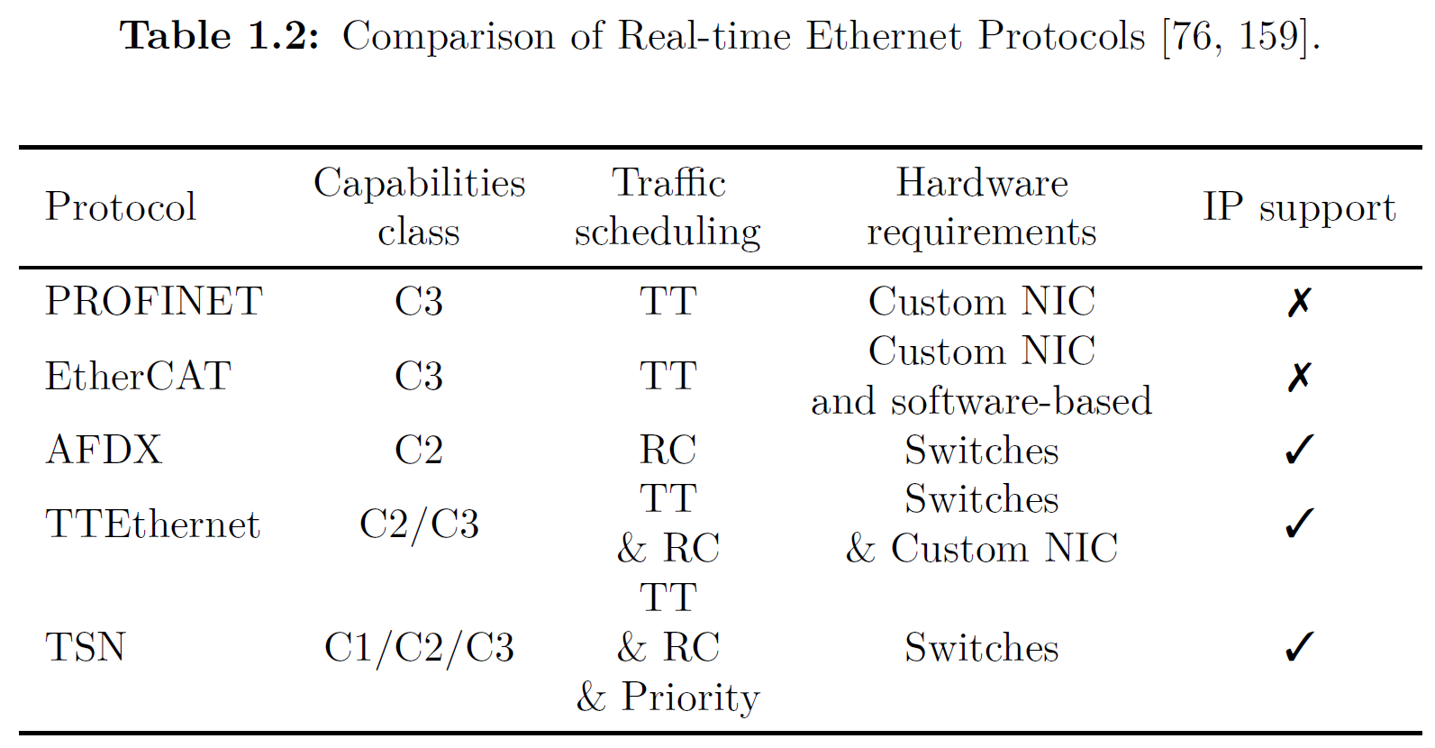
Background Real-time Communication

Slide 11
Background Real-time Communication - ET

Slide 12
Background Real-time Communication - RC

Slide 13
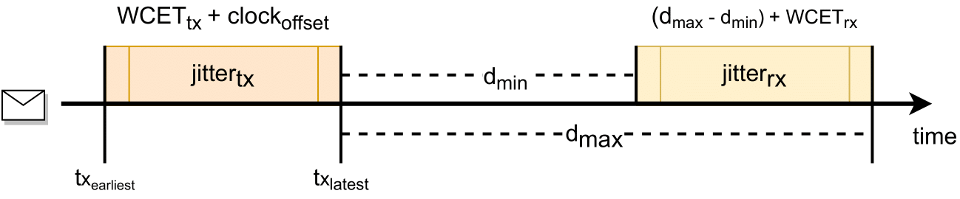
Background Real-time Communication - TT

Slide 14
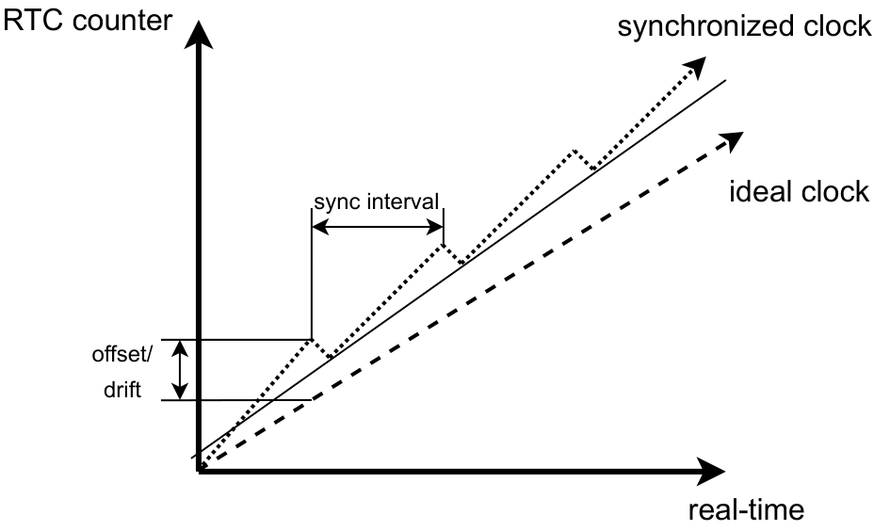
Background Time synchronization

Slide 15
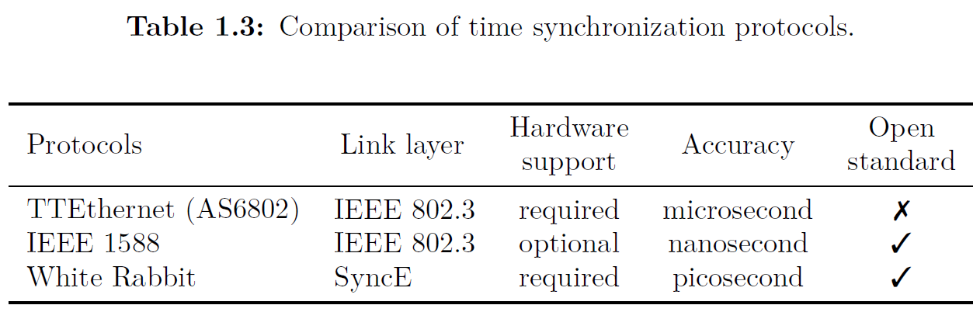
Background Time synchronization

