Slide 1

Crumble
Group No- 10
Name: FORAM R. GAJJAR(Roll No.09),
MIHIR J.GOSAI (Roll No.20)
College: VP & RPTP Science College

Slide 2
PROJECT DEFINITION
CRUMBLE is a social news aggregation and discussion website.
Posts are organized into different communities which include variety of topics like science, politics, movies, games, sports, music, fitness and many more.
Registered members can submit their content through text posts, images and these are liked or disliked by other members.

Slide 3
PURPOSE
Crumble is website comprising user-generated content and discussion.
The content on site is divided into categories called communities.
User can like /dislike or comment any post and continue further conversation.
Discussions are organized on user-created areas of interest.

Slide 4
SCOPE
Registering account is free and apart from registration user can create its own community.
Discussions are organized based on user-created interests and communities.
Discussion on current topic and related content.

Slide 5
Product Function
Registration is validated through email verification.
Authenticated users can make posts on website.
CONSTRAINTS
To make a post the user must be logged in.

Slide 6
Tools & Technologies Used
For Front-End :- Angular, Html, CSS, JavaScript.
For Back-End :- Spring Boot, Spring Security, Spring Data JPA, MySQL

Slide 7
Logical_Database Requirements
This website contains database necessary for it to function according to requirements.
It includes database such as User_Info, Posts.
User_Info includes all the information collected from the user at the time of signup.
Posts refers to the collection of all the posts created by the user.

Slide 8
Front-End
Back-End
User can view posts created by other memebers on the website.
User can login in to his account through usernmae and password.
User can browse different communities .
It consists of 2 major tables
1.User_Info
2.Posts

Slide 9
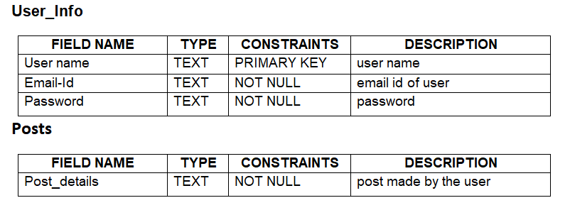
Database

Slide 10
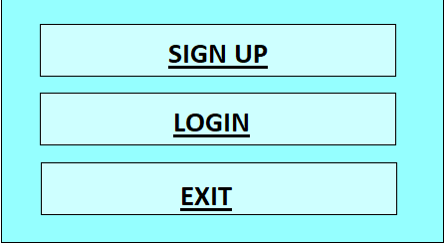
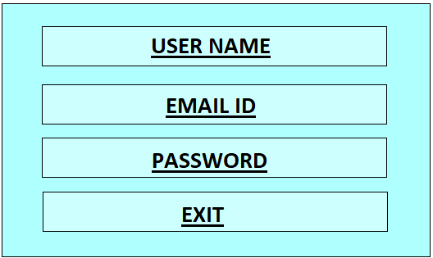
FORM
MAIN MENU FORM SIGN UP FORM

Slide 11
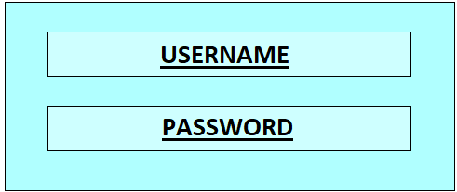
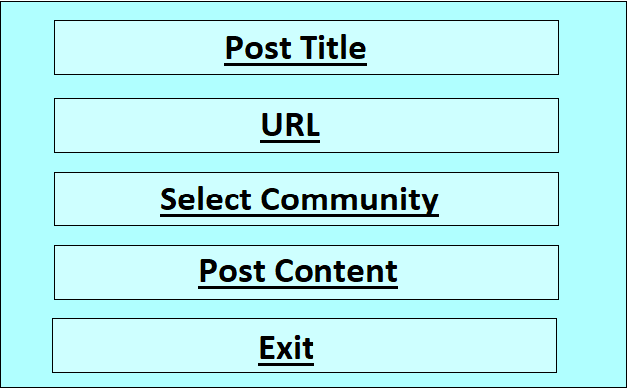
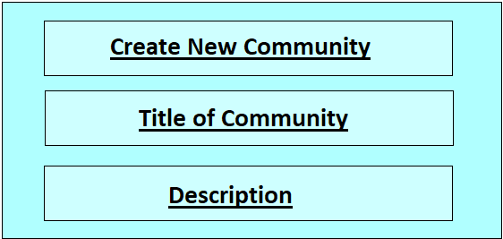
LOGIN FORM CREATE POST FORM
CREATE COMMUNITY FORM

