Slide 1
Crumble
Group No- 10
Name : FORAM R. GAJJAR (Roll No. 09) , MIHIR J. GOSAI (Roll No. 20)
College: VP & RPTP Science College

Slide 2
Project Definition
CRUMBLE is a social news aggregation and discussion website.
Posts are organized into different communities which include variety of topics like science, politics, movies, games, sports, music, fitness and many more.
Registered members can submit their content through text posts, images and these are liked or disliked by other members.

Slide 3
Purpose
Crumble is website comprising user-generated content and discussion.
The content on site is divided into categories called communities.
User can like /dislike or comment any post and continue further conversation.
Discussions are organized on user-created areas of interest.

Slide 4
Scope
Registering account is free and apart from registration user can create its own community.
Discussions are organized based on user-created interests and communities.
Discussion on current topic and related content.

Slide 5
Product Function &
Registration is validated through email verification.
Authenticated users can make posts on website.
To make a post the user must be logged in.
Constraints​

Slide 6
Tools & Technologies Used
For Front-End :- Angular, Html, CSS, JavaScript.
For Back-End :- Spring Boot, Spring Security, Spring Data JPA, MySQL

Slide 7
Front-End
User can view posts created by other memebers on the website.
User can login in to his account through usernmae and password.
User can browse different communities .

Slide 8
Back-End
It consists of 2 major tables
1.User_Info
2.Posts

Slide 9
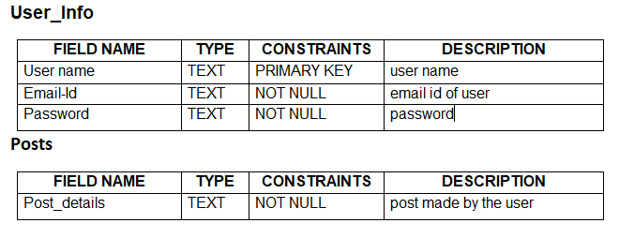
Database

Slide 10
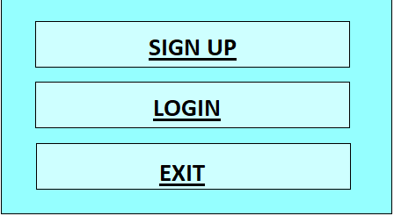
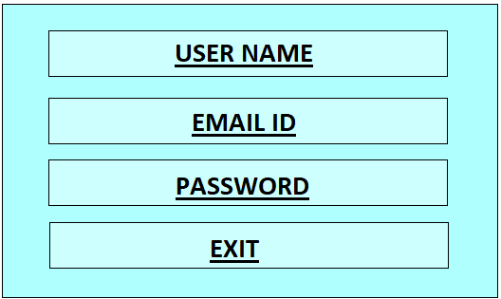
Sample Form
Main Menu Form
Sign Up Form

Slide 11
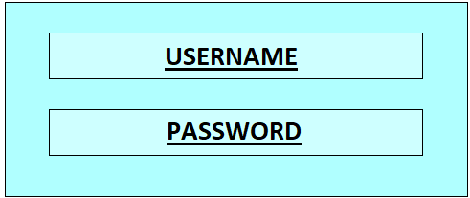
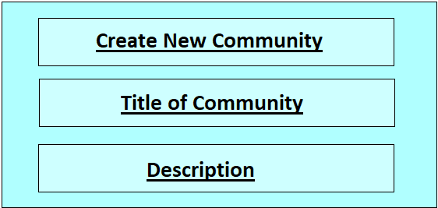
Sample Form
Login Form
Create Community Form

Slide 12
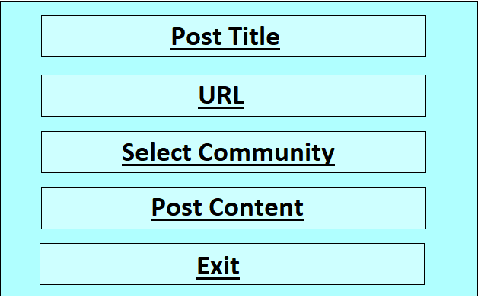
Sample Form
Create Post Form

