Slide 1

Team Members
Crime Data Analytics
Foram Gandhi U23CS032
Chicago Crime Dataset
Bhumika Patil U23CS046
Nirmeet Parmar U23CS047
DATA SCIENCE
Harsh Parmar U23CS056
Krishna Chhipa U23CS075
SVNIT Surat · B.Tech 3rd Year, 6th Semester · 2025–2026
Notes:
1

Slide 2
Problem Statement & Motivation
02
Crime ≠ Random
Data Overload
Behind every incident is a pattern — a neighbourhood, a time, a type that clusters predictably.
Chicago has 7.8M+ raw crime records. Manual analysis is impossible at this scale.
Resource Allocation
Smarter Scheduling
Hotspot maps help deploy limited patrol resources where they matter most.
Temporal rhythms — by hour, day, season — can reshape patrol shift planning.
Key Questions: Which crime types dominate? · Are there temporal rhythms? · Where are the hotspots? · Can we predict arrests?
Notes:
2

Slide 3
Dataset Description
03
7.8M+
2001–26
19
Crime Records
Time Span
Attributes
Source: City of Chicago Open Data Portal
Column | Description | Role
Date | Timestamp of incident | Temporal feature extraction
Primary Type | Crime category (THEFT, BATTERY…) | Target / Feature
Location Description | Physical location type | Feature
Arrest | Boolean — was arrest made? | ★ Target Variable
District / Comm. Area | Police district & community zone | Geographic feature
Latitude / Longitude | WGS84 coordinates | Spatial features
Notes:
3

Slide 4
Data Preprocessing
04
1
Deduplication
4
Date Parsing
Per-partition ID-based dedup in Dask — no costly cross-partition shuffle
String → datetime; extracted Hour, Month, DayOfWeek, Year
2
Null Removal
5
Rare Encoding
Rows with any null dropped — 0 missing values remain after this step
Top-25 Location & Description values kept; rest → OTHER
3
Coord Filtering
6
Column Pruning
Lat/Lon = 0 excluded (unresolved location data)
Dropped Case No., IUCR, FBI Code, Beat, Ward, Updated On
⚙ Infrastructure: Dask for parallel EDA (lazy eval across CPU cores) · PySpark for ML pipeline (cluster-aware scaling, BKM, Random Forest)
Notes:
4

Slide 5
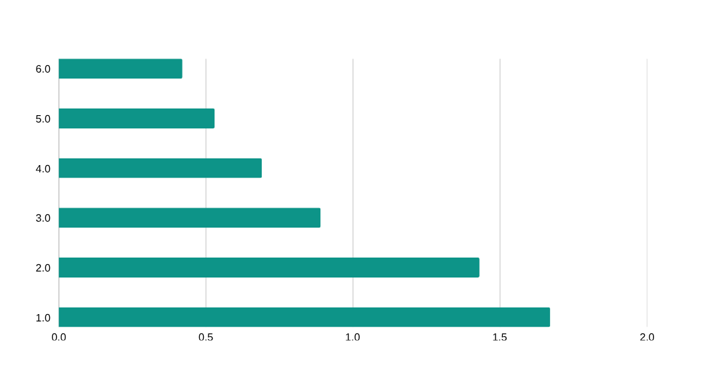
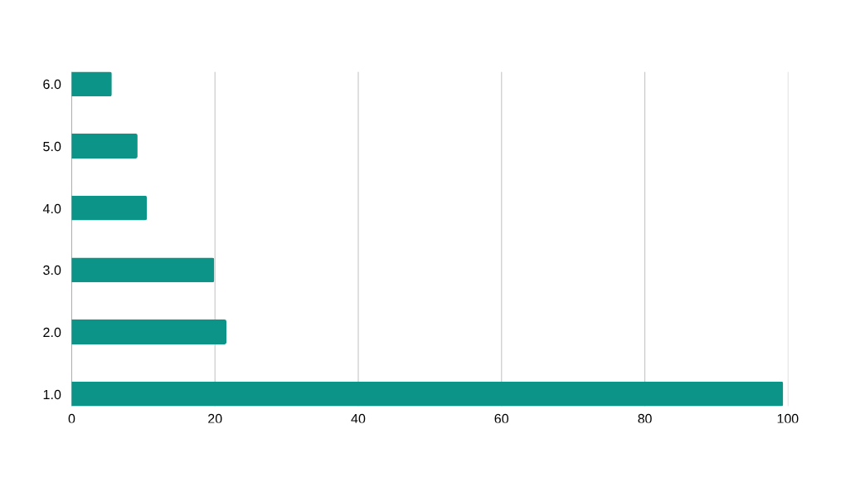
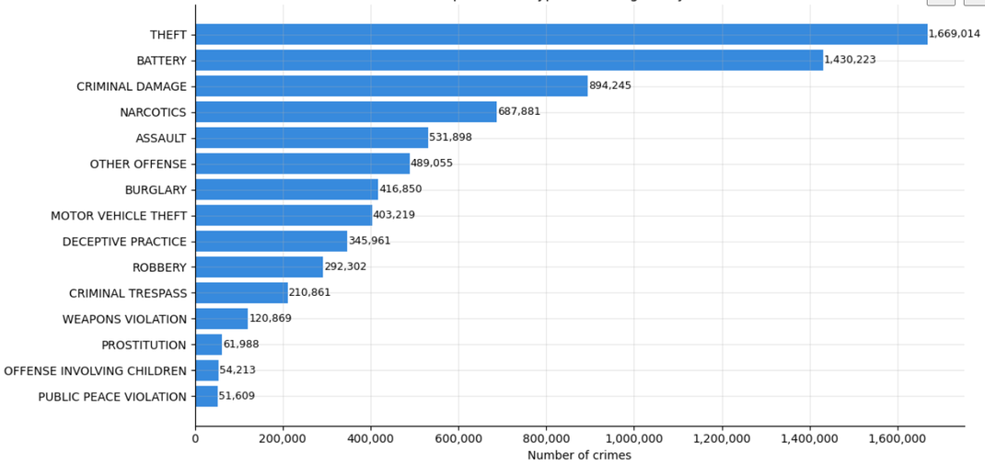
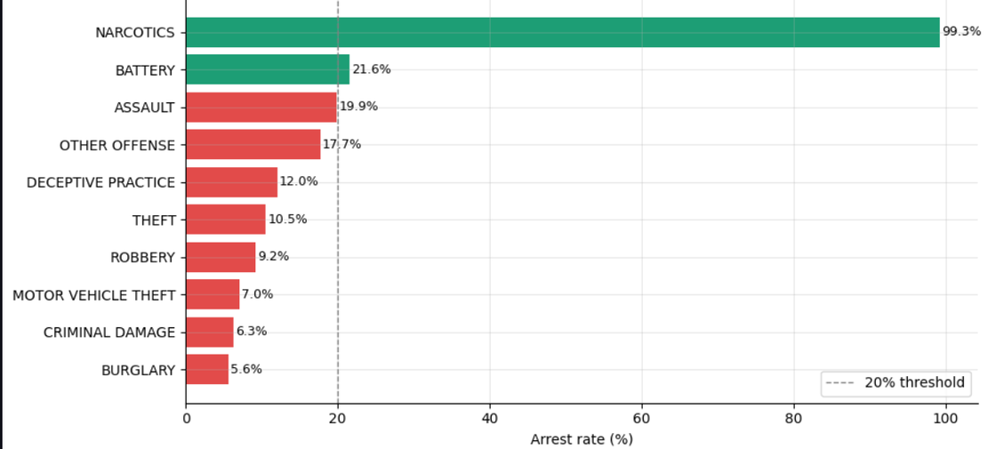

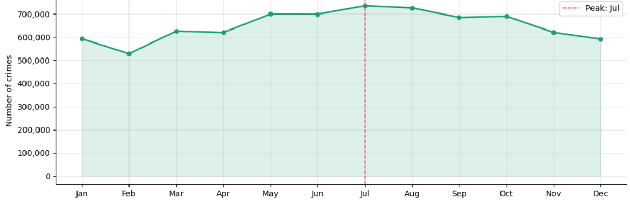
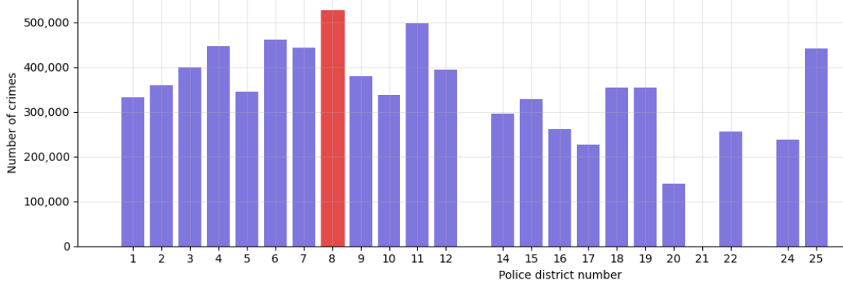
Exploratory Data Analysis
05
Top Crime Types
Arrest Rate by Crime Type
Monthly Crime Pattern (Seasonal)
Crime Count per Chicago Police District
Notes:
5

Slide 6
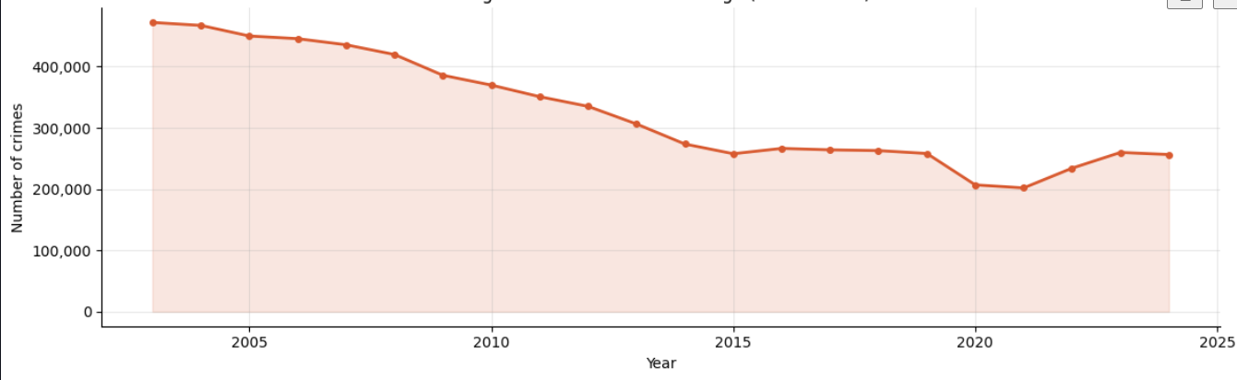
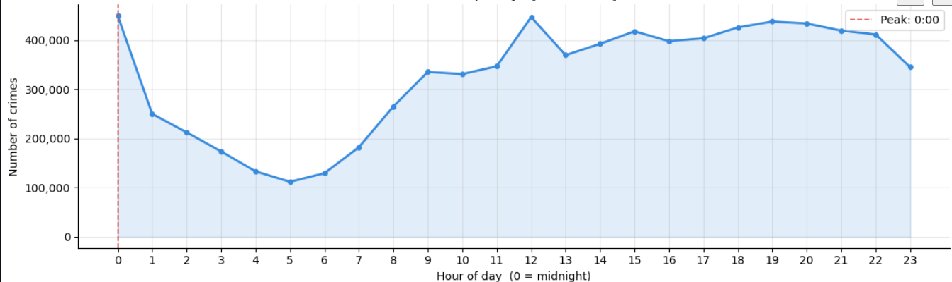
Exploratory Data Analysis
05
Long-term Trend (2003–2024)
Crime Frequency by hour of day
Notes:
5

Slide 7
Methodology
06
Raw CSV
7.8M rows
Dask
Cleaning
Dask
EDA
PySpark
BKM Clust.
PySpark
RF Classif.
Chicago Open
Data Portal
Dedup · Nulls
Coord filter
Type · Time
Geo analysis
K=30 zones
Lat·Lon·Hour
Arrest
Prediction
Bisecting K-Means (BKM)
Random Forest Classifier
Why chosen: Scales to 7.8M records — recursively splits highest-variance cluster, far faster than standard K-Means
Why chosen: Handles class imbalance, non-linear interactions, and high-cardinality categoricals naturally
⚙ K = 30 · Seed = 42 · 200 Spark partitions
⚙ 100 trees · Max depth 10 · 40 bins/feature · 80/20 split
Features: Latitude, Longitude, Hour (standardised with StandardScaler)
Features: typeIndex, Hotspot_ID, Hour, DayOfWeek, Lat, Lon
Notes:
6

Slide 8
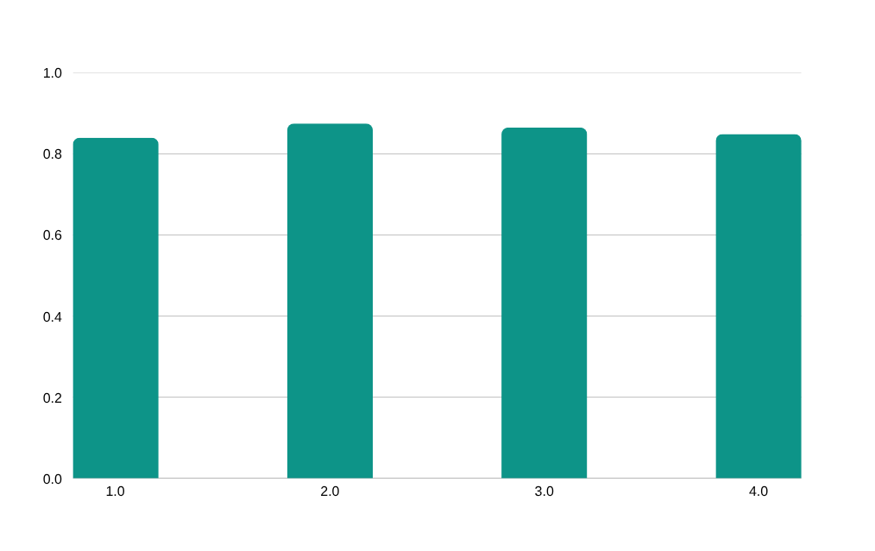
Results & Evaluation
07
0.8402
87.5%
86.5%
0.8494
AUC-ROC
Precision
Recall
F1 Score
Strong separability
Correct arrest pred.
Actual arrests found
Balanced metric
Confusion Matrix (1.58M test records)
Model Performance Summary
 | Predicted: No Arrest | Predicted: Arrest
Actual: No Arrest | TN = 1,172,130 | FP = 13,755
Actual: Arrest | FN = 199,289 | TP = 195,522
★ Class imbalance: only 24.8% of incidents resulted in arrest. Model is intentionally conservative — threshold adjustable.
Notes:
7

Slide 9
Comparison with Existing Approaches
08
Dimension | Ref. Paper 1 Bogomolov et al. (ICMI'14) | This Project | Ref. Paper 2 — Kadar & Pletikosa (EPJ DS '18)
Task | Hotspot forecasting — will area be a crime hotspot tomorrow? | Arrest outcome prediction + hotspot zone detection | Long-term crime count prediction (yearly)
Dataset | Mobile phone + demographic data, London | Chicago Open Data Portal — 7.8M records (2001–2026) | Foursquare, NYC subway & taxi, census — New York City
Scale | Small city-level sample | Full 7.8M records — no sampling | 2,154 NYC census tracts, 2 years
ML Method | SVM + demographic features | Bisecting K-Means + Random Forest (classification) | Random Forest / Gradient Boosting (regression)
Features | Demographics + mobile call records | typeIndex + Hotspot_ID + spatial + temporal | Census + POI + Foursquare checkins + taxi + subway
Best Metric | ~70% hotspot accuracy | AUC 0.8402 · F1 0.8494 | R² up to 89% (temporal), 65% (geo out-of-sample)
Key Differentiator:
Both reference papers treat clustering and classification as separate pipelines — Bogomolov et al. use mobile data as raw features, while Kadar & Pletikosa predict crime counts without linking spatial zones to a classifier. This project's novelty: BKM cluster assignments (Hotspot_ID) directly feed the Random Forest, fusing geographic and temporal context into one compact signal.
Notes:
8

Slide 10
Challenges, Limitations & Future Work
09
⚠ Challenges & Limitations
✦ Future Improvements
▸ Scale: 7.8M rows — standard Pandas operations impractically slow
▸ DBSCAN / HDBSCAN for density-based hotspot detection
▸ Class imbalance: only 24.8% arrests; model skews conservative
▸ XGBoost / LightGBM for arrest classification uplift
▸ Midnight spike partly a recording artifact, not pure signal
▸ Real-time streaming pipeline with Kafka + Spark Structured Streaming
▸ K=30 clusters chosen without exhaustive elbow analysis
▸ Address class imbalance via SMOTE or cost-sensitive learning
▸ No causal inference — correlations, not policy explanations
▸ Interactive web dashboard for patrol resource allocation
▸ Data limited to reported crimes; dark figure not captured
▸ Expand to socioeconomic overlay (poverty index, school proximity)
Notes:
9

Slide 11
Conclusion & Key Findings
10
1
Theft dominates (1.67M incidents) but has only a 10.5% arrest rate — prevention-first strategy needed
2
~50% crime reduction since 2003 — genuine long-run improvement, not data artifact
3
Peak hour: midnight · Peak day: Friday · Peak month: July — clear scheduling signals
4
30 spatiotemporal clusters identify distinct hotspot zones, each with a unique crime signature
5
Random Forest achieves AUC 0.84, F1 0.85 on 1.58M test records — operational-grade arrest predictor
Thank You
Notes:
10

