Slide 1

Content Based Recommendation Engine
Sitaram Tadepalli
Tata Consultancy Services Ltd

Slide 2




Agenda
Content Based
vs
Collaborative Filtering
Image Processing
Transfer Learning
Hands On Demo

Slide 3
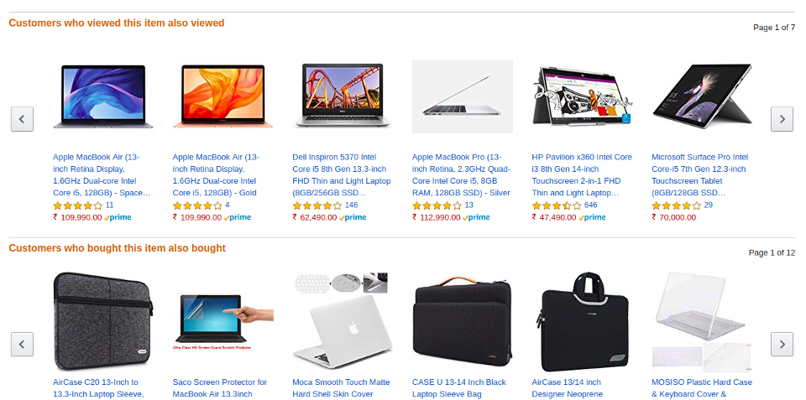
Recommender Systems

Slide 4
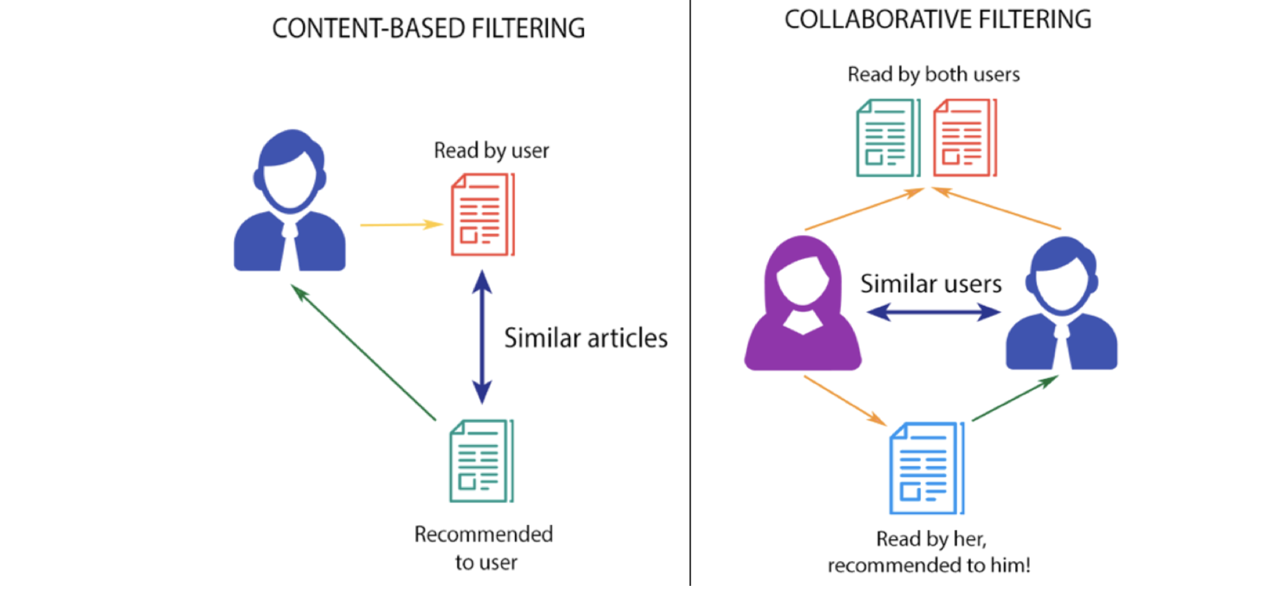
Content Based vs Collaborative
Image Credits: http://datameetsmedia.com/an-overview-of-recommendation-systems/

Slide 5
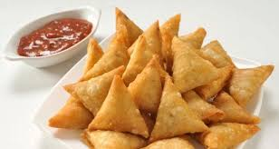

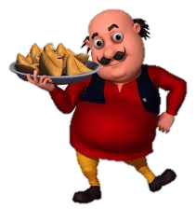
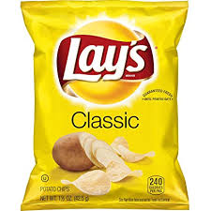
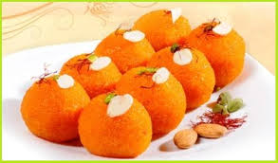
Collaborative Filtering
likes
likes
Similar tastes
likes
likes
likes
Recommend

Slide 6
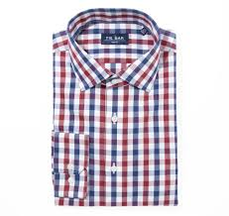

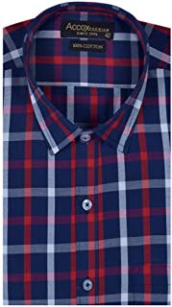
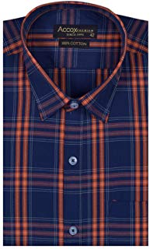
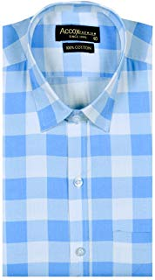
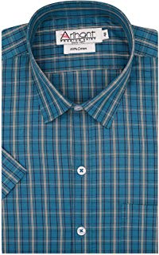
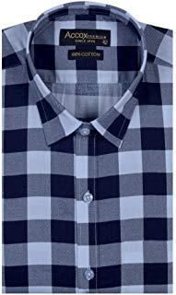
Content Based Recommender System
Model Recommendation

Slide 7
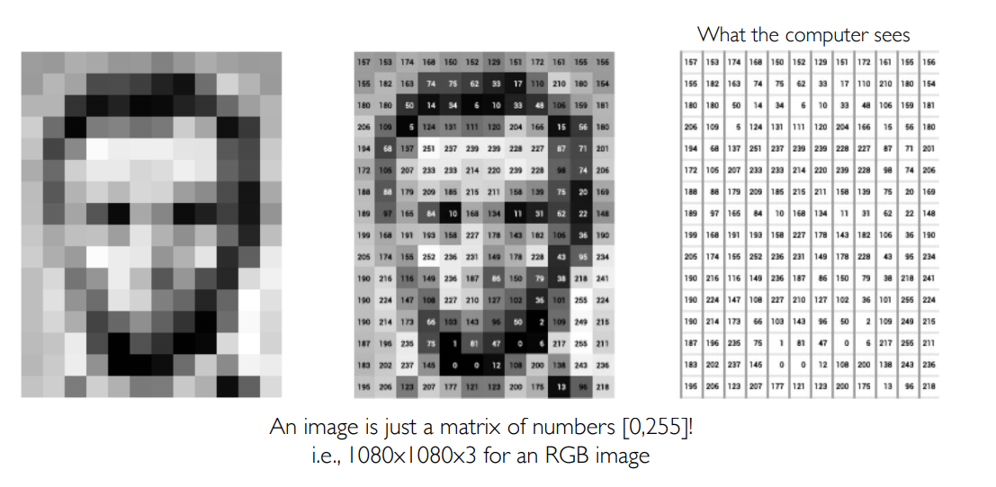
Image representation as Numbers

Slide 8
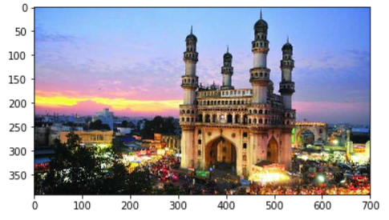
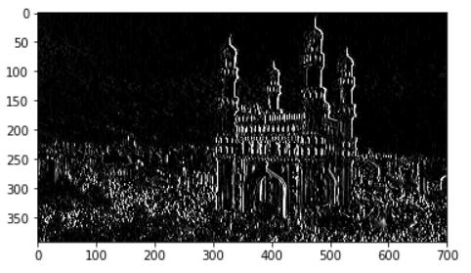
Feature Extraction from Images
Original Image
Edge Detection using Sobel Filter

Slide 9
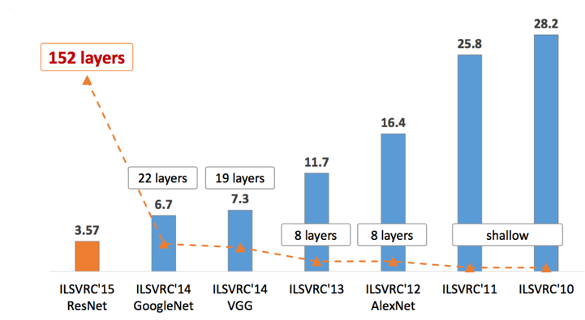
ImageNet Models
Error Rate
Image Credits: https://towardsdatascience.com/various-types-of-convolutional-neural-network-8b00c9a08a1b

Slide 10
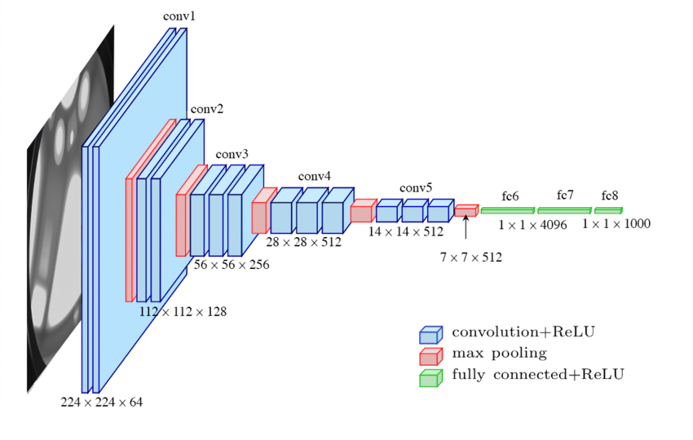
Transfer Learning using VGG

Slide 11
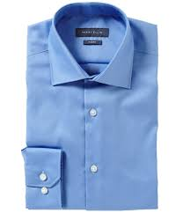
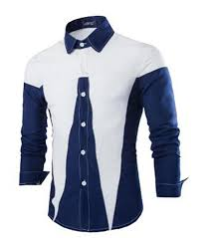
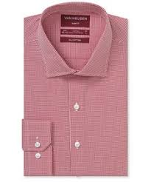
Shirts as Vectors
1.452 | 0.872 | 0.987 | 1.243 | 3.234 | 2.32 | 0.076 | 0.876 | 0.998 | 1.234
-------- | --------- | ------ | -------- | -------- | -------- | --------- | --------- | -------- | --------
2.323 | 4.232 | 3.232 | 3.987 | 1.234 | 1.765 | 2.987 | 0.654 | 0.876 | 1.876
4.523 | 2.345 | 6.231 | 3.422 | 2.323 | 0.344 | 0.348 | 0.987 | 1.223 | 3.453
-------- | --------- | ------ | -------- | -------- | -------- | --------- | --------- | -------- | --------
-------- | --------- | ------ | -------- | -------- | -------- | --------- | --------- | -------- | --------
0.098 | 1.602 | 2.002 | 1.997 | 1.234 | 1.765 | 2.987 | 0.654 | 0.876 | 1.876
-------- | --------- | ------ | -------- | -------- | -------- | --------- | --------- | -------- | --------
-------- | --------- | ------ | -------- | -------- | -------- | --------- | --------- | -------- | --------
1.523 | 2.345 | 6.231 | 3.422 | 2.323 | 0.344 | 0.348 | 1.277 | 1.423 | 3.453
-------- | --------- | ------ | -------- | -------- | -------- | --------- | --------- | -------- | --------
-------- | --------- | ------ | -------- | -------- | -------- | --------- | --------- | -------- | --------
-------- | --------- | ------ | -------- | -------- | -------- | --------- | --------- | -------- | --------
2.673 | 2.345 | 6.231 | 4.422 | 0.323 | 0.344 | 0.348 | 6.987 | 3.223 | 3.453

Slide 12
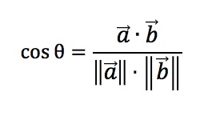
Shirts in Vector Space
Cosine Similarity
θ
θ

Slide 13
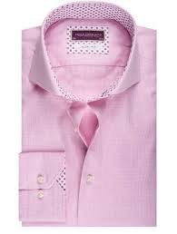
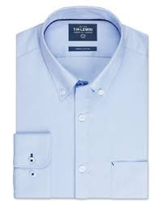
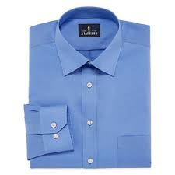
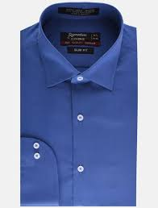
Recommending similar Shirts
Recommend
Recommend

Slide 14
Hands on Demo

Slide 15

Thank you!
Sitaram Tadepalli
https://www.linkedin.com/in/sitaramtadepalli/

