Slide 1
Customer_churn_case_study
File created on: 9/21/2022 10:08:40 AM
created by : Foram Solanki

Slide 2
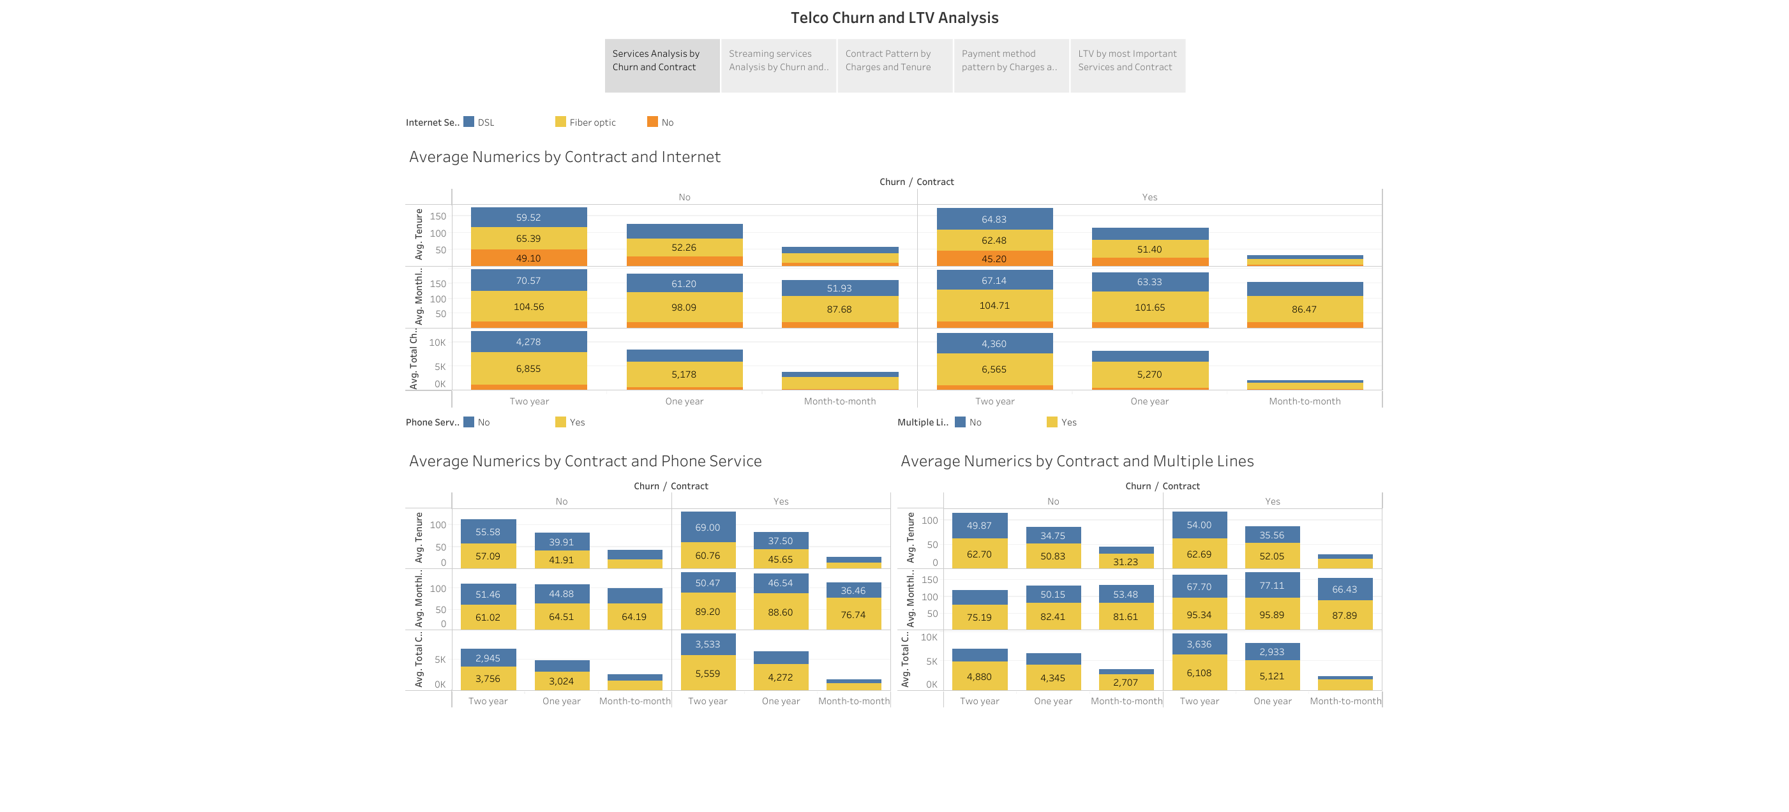

Slide 3
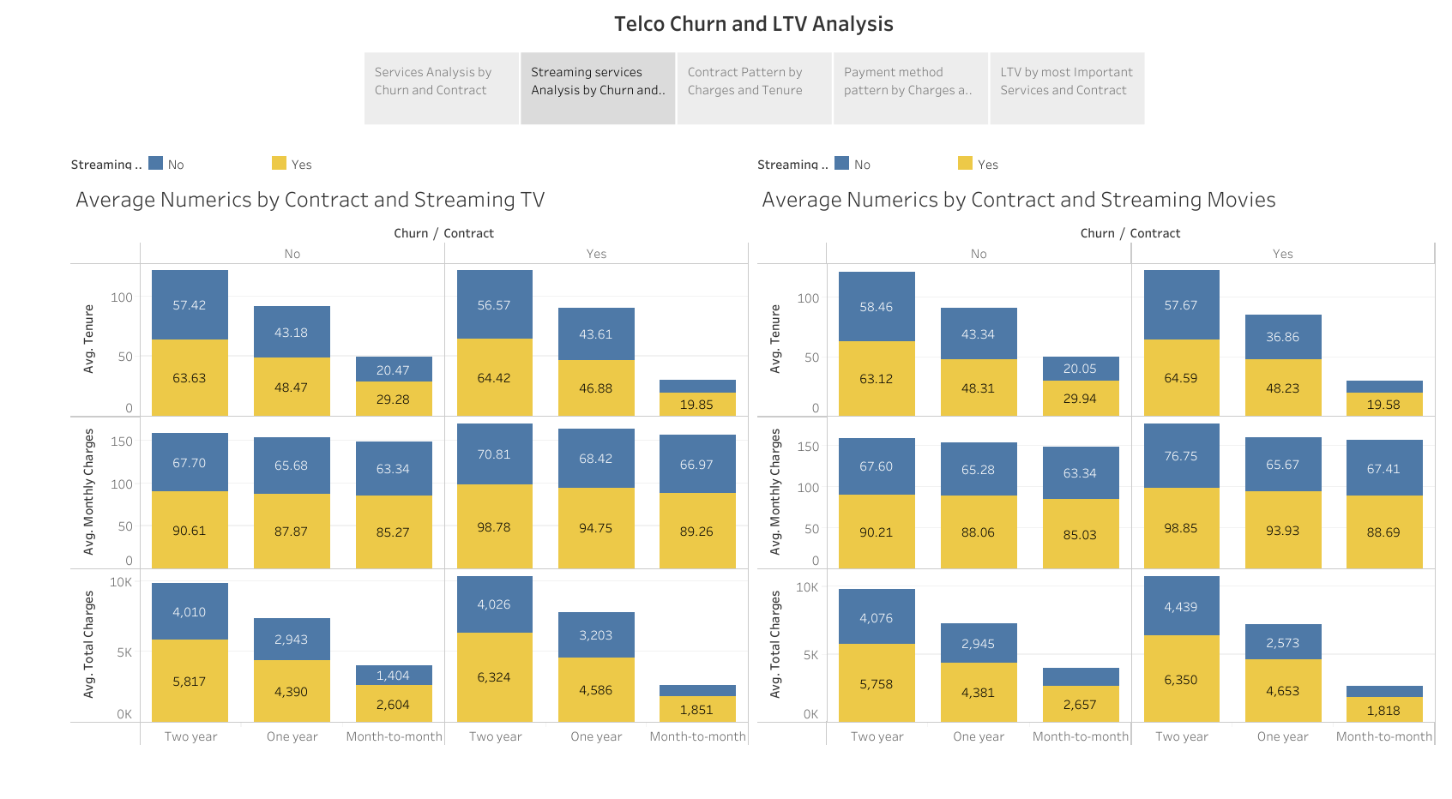

Slide 4
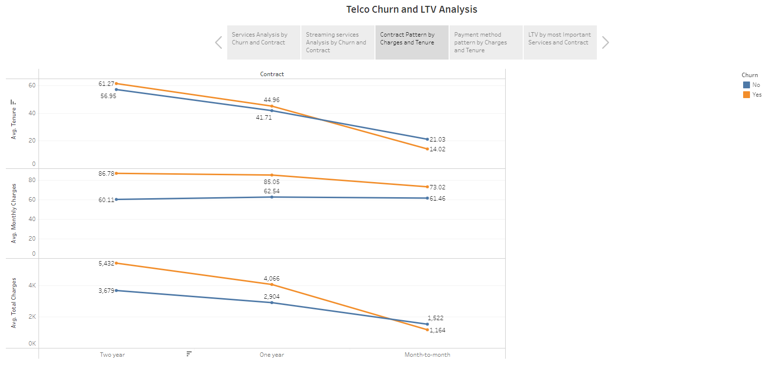

Slide 5
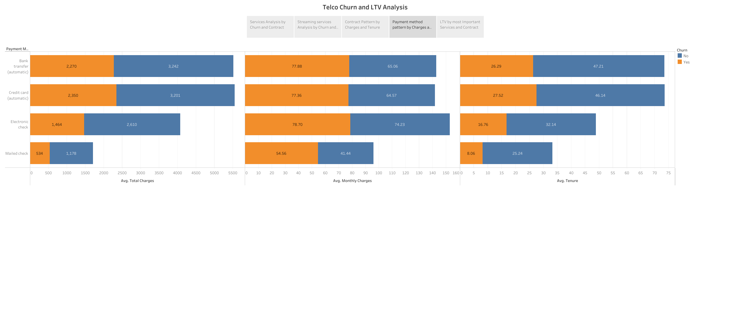

Slide 6
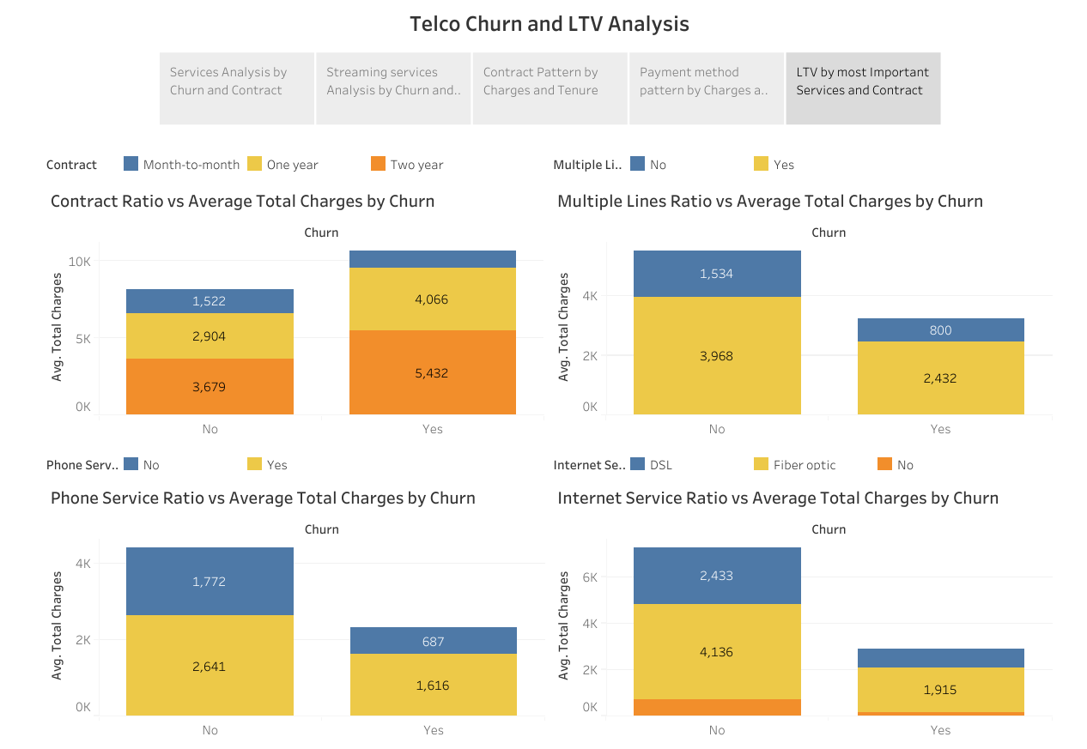

Slide 7
short analysis of each dashboard
Average numerics by contract and internet
People leaving the company have paid more money in general when they have a 2-year contract.
People who have a month-to-month contract are most likely to churn.
People who have used phone services and multiple lines tend to pay more in general, but we saw that these customers tend to leave the company if they have to pay higher monthly charges.
Streaming services analysis by churn and contract
Customers subscribed to streaming movies and streaming TV were contributing more to revenue (high LTVs).
Many customers subscribed to these services left the company as they had to pay higher monthly charges. So, customers are more likely to leave the company if we try to increase the LTV by increasing the monthly charges. Hence, the company can decide to check the effect that increasing LTV has on churn and then take a decision.
Contract pattern by charges and tenure
Having a 2-year contract is the best for having a high LTV and for retaining the customers for as long as possible.
Customers with a month-to-month contract do not contribute much to LTV and are also more likely to churn.
Payment method pattern by charges and tenure
We should encourage customers to make more automatic payments because such people generally have higher LTVs and stay with us longer.
LTV by the most important services and by contract
We want to encourage customers to use 2-year contracts, internet services, phone services and multiple lines.

Slide 8
key takeaways from this case study:
Using SQL with Python is a great idea if you have to build complicated business logics and if you want to have a single interface to run queries and perform analysis.
It is important to understand the business objectives and context prior to starting any type of analysis.
Concerning churn, saw that the most important variables related to it include contract, monthly charges, and some services (internet, phone, and multiple lines).
People who stay with a company longer normally lead to higher LTVs and enforcing 2- or 1-year contracts can help with this.
We can and must categorize people as having high and low LTVs.

Slide 9
https://public.tableau.com/views/Customer_churn_case_study/Story1?:language=en-US&:display_count=n&:origin=viz_share_link

