Slide 1

Design Pattern Reloaded
Rémi Forax / ParisJUG / June 2015
https://github.com/forax/design-pattern-reloaded

Slide 2
Me, Myself and I
Assistant Prof at Paris East University
Expert for JSR 292, 335 and 376
Open source dev: OpenJDK, ASM, JsJs, etc
Father of 3

Slide 3
Apprenticeship !
Warning, this is an ad !
Ecole Supérieur d'Ingénieurs Paris Est
(Fillière Informatique)
http://esipe.u-pem.fr/
Université Paris Est Marne La Vallée
(Licence 3 / Master Informatique)
http://www.u-pem.fr/

Slide 4
Foreword - Functional Interface
A function type is represented by a functional interface
  @FunctionalInterface
  interface BinOp {
  int apply(int val1, int val2);
  }
  a functional interface has only one abstract method

Slide 5
Foreword - Lambda
  @FunctionalInterface
  interface BinOp {
  int apply(int val1, int val2);
  }
  a functional interface has only one abstract method
  Conceptually equivalent to
  typedef BinOp = (int, int) → int
  BinOp add = (x, y) -> x + y;
  BinOp mul = (a, b) -> a * b;

Slide 6
Foreword - Predefined interfaces
Defined in package java.util.function
signature | interface | method
() → void | Runnable | run
() → T | Supplier | get
T → void | Consumer | accept
int → void | IntConsumer | accept
T → boolean | Predicate | test
int → boolean | IntPredicate | test
T → R | Function<T,R> | apply
int → R | IntFunction<R> | apply
T → int | ToIntFunction | applyAsInt

Slide 7
Foreword - Method Reference
The operator :: allows to reference an existing method (static or not)
:: on a type
BinOp add = Integer::sum;
:: on a reference
ThreadLocalRandom r = ThreadLocalRandom.current();
BinOp randomValue = r::nextInt;

Slide 8
Live Coding in jshell (1/3)
-> interface BinOp {
>> int apply(int v1, int v2);
>> }
| Added interface BinOp
-> BinOp add = (a, b) -> a + b;
| Added variable add of type BinOp with initial value $Lambda$1/13648335@6bdf28bb
-> add.apply(2, 3);
| Expression value is: 5
| assigned to temporary variable $1 of type int
-> add = (x, y) -> x – y;
| Variable add has been assigned the value $Lambda$2/968514068@511baa65
-> add.apply(2, 3);
| Expression value is: -1
| assigned to temporary variable $2 of type int

Slide 9
Live Coding in jshell (2/3)
-> List<String> list = Arrays.asList("hello", "paris");
| Added variable list of type List<String> with initial value [hello, paris]
-> list.forEach(item -> System.out.println(item));
hello
paris
-> Consumer<Object> printer = item -> System.out.println(item);
| Added variable printer of type Consumer<Object> with initial value $Lambda$4/2114889273@3d24753a
-> list.forEach(printer);
hello
paris
-> Files.list(Paths.get(".")).forEach(printer);
./jimage-extracted
./.project
...

Slide 10
Live Coding in jshell (3/3)
-> IntStream.range(0, 10).reduce(0, (a, b) -> a + b);
| Expression value is: 45
| assigned to temporary variable $3 of type int
-> IntStream.range(0, 10).reduce(0, Integer::sum);
| Expression value is: 45
| assigned to temporary variable $4 of type int
-> Consumer<Object> printer = System.out::println;
| Modified variable printer of type Consumer<Object> with initial value $Lambda$8/1419810764@36f6e879
-> list.forEach(printer);
hello
paris
-> Files.list(Paths.get(".")).forEach(printer);
./jimage-extracted
./.project
...

Slide 11

All I'm offering is the truth. Nothing more

Slide 12
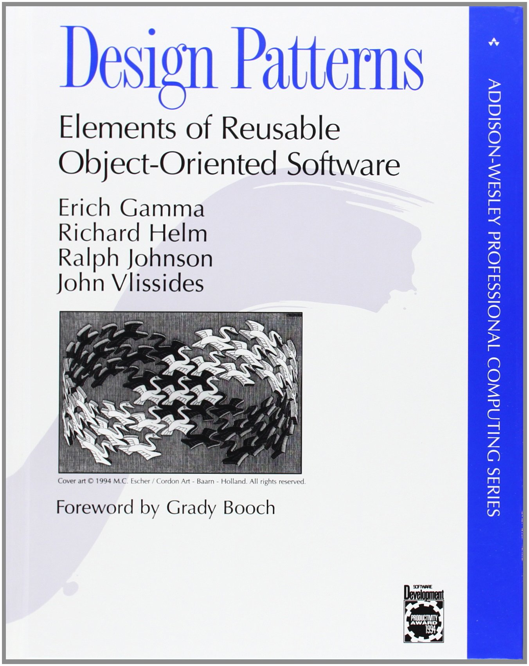
Design Pattern - 1994
Classes are not only for data !
Two big principles:
  Program to an interface, not an implementation
  Favor object composition over class inheritance
Side note:
  Some GoF patterns do not respect these principles

Slide 13

A simple Logger
public interface Logger {
void log(String message);
public static void main(String[] args) {
Logger logger = msg -> System.out.println(msg);
}
}
No parenthesis if one argument

Slide 14
Filtering logs
public interface Logger {
void log(String message);
}
public interface Filter {
boolean accept(String message);
}
I want a Logger that only log messages that are accepted by a filter

Slide 15
GoF Template Method !
public interface Logger {
void log(String message);
}
public interface Filter {
boolean accept(String message);
}
public abstract class FilterLogger implements Logger, Filter {
private final Logger logger;
public FilterLogger(Logger logger) {
this.logger = Objects.requireNonNull(logger);
}
public void log(String message) {
if (accept(message)) {
logger.log(message);
}
}
public abstract boolean accept(String message);
}

Slide 16

GoF Template Method :(
public interface Logger {
void log(String message);
}
public interface Filter {
boolean accept(String message);
}
public abstract class FilterLogger implements Logger, Filter {
private final Logger logger;
public FilterLogger(Logger logger) {
this.logger = Objects.requireNonNull(logger);
}
public void log(String message) {
if (accept(message)) {
logger.log(message);
}
}
public abstract boolean accept(String message);
}

Slide 17
GoF Template Method :(
public abstract classes
are harmful !

Slide 18
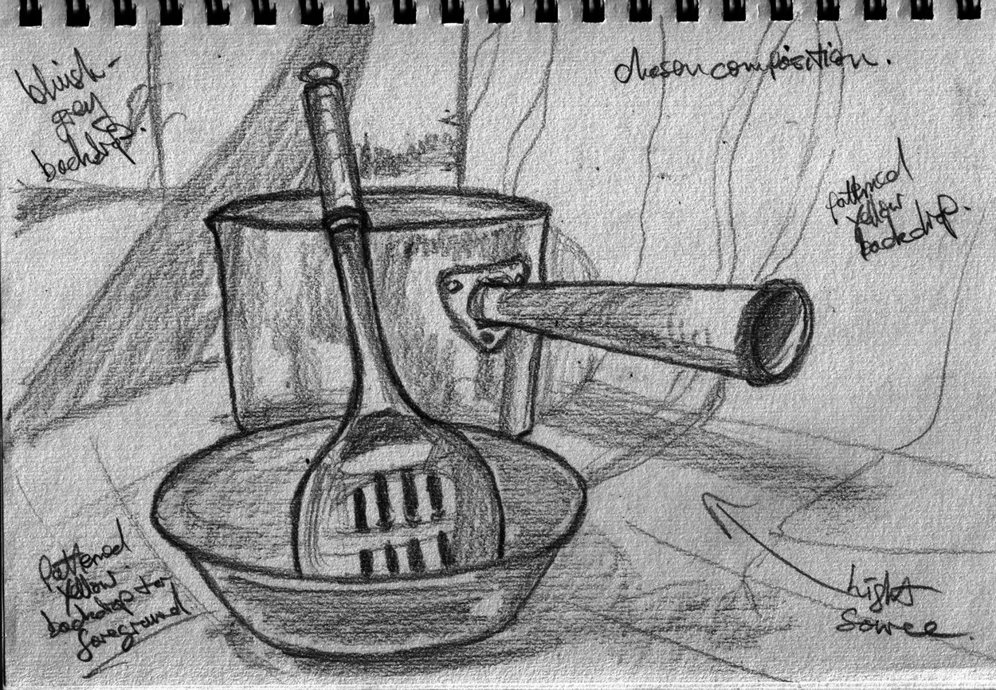
Favor object composition !
public class FilterLogger implements Logger {
private final Logger logger;
private final Filter filter;
public FilterLogger(Logger logger, Filter filter) {
this.logger = Objects.requireNonNull(logger);
this.filter = Objects.requireNonNull(filter);
}
public void log(String message) {
if (filter.accept(message)) {
logger.log(message);
}
}
}

Slide 19
With an anonymous class
FilterLogger has the same interface as Logger,
so it can be “unamed” !
public class Loggers {
public static Logger filterLogger(Logger logger, Filter filter) {
Objects.requireNonNull(logger);
Objects.requireNonNull(filter);
return new Logger() {
public void log(String message) {
if (filter.accept(message)) {
logger.log(message);
}
}
};
}
}
Local variable values
are captured !

Slide 20
Higher order function
Garbage class
public class Loggers {
public static Logger filterLogger(Logger logger, Filter filter) {
Objects.requireNonNull(logger);
Objects.requireNonNull(filter);
return message -> {
if (filter.accept(message)) {
logger.log(message);
}
};
}
}
Logger logger = msg - > System.out.println(msg);
Logger filterLogger =
Loggers.filterLogger(logger, msg -> msg.startsWith("foo"));

Slide 21
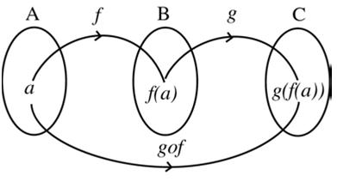
Function composition using instance (default) method
public interface Logger {
void log(String message);
default Logger filter(Filter filter) {
Objects.requireNonNull(filter);
return message -> {
if (filter.accept(message)) {
log(message);
}
};
}
}
Logger logger = msg - > System.out.println(msg);
Logger filterLogger =
logger.filter(msg -> msg.startsWith("foo"));
g.filter(f)

Slide 22
With Java 8 predefined interfaces
public interface Logger {
void log(String message);
default Logger filter(Predicate<String> filter) {
Objects.requireNonNull(filter);
return message -> {
if (filter.test(message)) {
log(message);
}
};
}
}
package java.util.function;
@FunctionalInterface
public interface Predicate<T> {
public boolean test(T t);
}

Slide 23

Summary
Public abstract classes are harmful because behaviors are encoded in inheritance tree thus can not be composed easily
Use function composition instead !

Slide 24
FP vs OOP from 10 000 miles
FP
  no class, no inheritance, only functions
FP can be seen through GoF Principles:
  Program to an interface, not an implementation
    function can be seen as interface with one abstract method
    function doesn't expose their implementation detail
  Favor object composition over class inheritance
    function composition <=> object composition

Slide 25



GoF kind of patterns
Structural
Behavioral
Creational

Slide 26
Structural Patterns
Adapter,
Bridge,
Decorator,
Composite,
Proxy,
Flyweight, etc
most of them derive from
  “Favor object composition over class inheritance”

Slide 27
Yet Another Logger
public enum Level { WARNING, ERROR }
public interface Logger2 {
void log(Level level, String message);
}
Logger2 logger2 = (level, msg) ->
System.out.println(level + " " + msg);
logger2.log(ERROR, "abort abort !");
// how to adapt the two loggers ?
Logger logger = logger2 ??

Slide 28
Partial Application
Set the value of some parameters of a function
(also called curryfication)
interface BinOp { int apply(int x, int y); }
interface UnOp { int apply(int x); }
BinOp add = (x, y) -> x + y;
UnOp add1 = x -> add.apply(x, 1);
BinOp mul = (a, b) - > a * b;
UnOp mulBy2 = a - > mul.apply(2, a);

Slide 29
Partial Application
Logger.log == Logger2.log + a specific level
public interface Logger {
void log(String message);
}
public interface Logger2 {
void log(Level level, String message);
default Logger level(Level level) {
...
}
}

Slide 30
Adapter
public interface Logger2 {
void log(Level level, String message);
default Logger level(Level level) {
return msg -> log(level, msg);
}
}
Logger2 logger2 = ...
Logger logger = logger2.level(ERROR);
logger.log("abort abort !");

Slide 31
Partial Application & Method Ref.
The operator :: also allows to do partial application on the receiver
  BiConsumer<PrintStream, Object> consumer =
  PrintStream::println;
  PrintStream out = System.out;
  Consumer<Object> consumer2 = out::println;
type
instance
package java.util.function;
public interface Consumer<T> {
public void accept(T t);
}
public interface BiConsumer<T, U> {
public void accept(T t, U u);
}

Slide 32

Summary
partial application allows to set some values and let the others to be set later
a partially applied function can be shared !

Slide 33
Behavioral Patterns
Command
Iterator Iteration
Observer
State
Visitor

Slide 34
Command
A command is just a function
interface Command {
void perform();
}
Command command =
() - > System.out.println("hello command");

Slide 35
Iteration
2 kinds
  Internal iteration (push == Observer)
  External iteration (pull == Iterator)
List<String> list = …
Internal:
list.forEach(item -> System.out.println(item));
External:
for(String item: list) {
System.out.println(item);
}

Slide 36
External iteration is harder to write
forEach is easier to write than an Iterator
  public class ArrayList<E> implements Iterable<E> {
  private E[] elementData;
  private int size;
  public void forEach(Consumer<E> consumer) {
  for(int i = 0; i < size; i++) {
  consumer.accept(elementData[i]);
  }
  }
  public Iterator<E> iterator() {
  return new Iterator<E>() {
  private int i;
  public boolean hasNext() { return i < size; }
  public E next() { return elementData[i++]; }
  };
  }
  }
internal
external

Slide 37
Internal Iteration is less powerful in Java
No side effect on local variables allowed !
List<Double> list = …
Internal:
double sum = 0;
list.forEach(value -> sum += value);
External:
for(double value: list) {
sum += value;
}
sum is not effectively final

Slide 38

Sum values of a CSV ?
public class SumCSV {
public static double parseAndSum(Path path) throws … {
try (Stream<String> lines = Files.lines(path)) {
return lines
.flatMap(line -> Arrays.stream(line.split(","))
.mapToDouble(token -> Double.parseDouble(token))
.sum();
}
}
}

Slide 39
Sum values of a CSV ?
(using method reference)
public class SumCSV {
public static double parseAndSum(Path path) throws … {
try (Stream<String> lines = Files.lines(path)) {
return lines
.flatMap(Pattern.compile(",")::splitAsStream)
.mapToDouble(Double::parseDouble)
.sum();
}
}
}
Partial application

Slide 40

Observer
Decouple work in order to close the CVSParser
(as in Open/Close Principle)
public interface Observer {
void data(double value);
}
public class CSVParser {
public static void parse(Path path, Observer observer) throws … {
...
}
}
public class SumCSV {
public double parseAndSum(Path path) throws … {
CSVParser.parse(path, ...);
...
}
}

Slide 41
Observer side
public interface Observer {
void data(double value);
}
public class CSVParser {
public static void parse(Path path, Observer observer) throws … {
...
}
}
public class SumCSV {
private double sum;
public double parseAndSum(Path path) throws … {
CSVParser.parse(path, value -> sum += value);
return sum;
}
}
side effect

Slide 42
Observable side
The closed module
public interface Observer {
void data(double value);
}
public class CSVParser {
public static void parse(Path path, Observer observer) throws … {
try (Stream<String> lines = Files.lines(path)) {
lines.flatMap(Pattern.compile(",")::splitAsStream)
.mapToDouble(Double::parseDouble)
.forEach(value -> observer.data(value));
}
}
}

Slide 43
Functional Interfaces conversion
DoubleStream.forEach() takes a DoubleConsumer as parameter
public interface Observer {
void data(double value);
}
public class CSVParser {
public static void parse(Path path, Observer observer) throws … {
try (Stream<String> lines = Files.lines(path)) {
lines.flatMap(Pattern.compile(",")::splitAsStream)
.mapToDouble(Double::parseDouble)
.forEach(value -> observer.data(value));
}
}
}
DoubleConsumer

Slide 44
Functional Interfaces conversion
:: can be used to do interface to interface conversion
public interface Observer {
void data(double value);
}
public class CSVParser {
public static void parse(Path path, Observer observer) throws … {
try (Stream<String> lines = Files.lines(path)) {
lines.flatMap(Pattern.compile(",")::splitAsStream)
.mapToDouble(Double::parseDouble)
.forEach(observer::data);
}
}
}
DoubleConsumer

Slide 45

Summary
function interface to functional interface conversion is just a partial application using instance method reference

Slide 46
State
Yet another another logger !
chatty()
quiet()
quiet()
Chatty
Quiet
chatty()
error(msg)
warning(msg)
error(msg)
warning(msg)
Consumer<String>

Slide 47
State interface
Logger
public interface Logger {
enum Level { ERROR, WARNING }
void error(String message);
void warning(String message);
Logger quiet();
Logger chatty();
static Logger logger(Consumer<String> printer) {
return new ChattyLogger(printer);
}
}
Logger logger = Loggers.logger(System.out::println);
logger.error("ERROR");
logger.warning("WARNING");
Logger quiet = logger.quiet();
quiet.error("ERROR");
quiet.warning("WARNING");
ChattyLogger
QuietLogger

Slide 48
State implementation
class ChattyLogger implements Logger { class QuietLogger implements Logger {
private final Consumer<String> printer; private final Consumer<String> printer;
ChattyLogger(Consumer<String> printer) { QuietLogger(Consumer<String> printer) {
this.printer = printer; this.printer = printer;
} }
public void error(String message) { public void error(String message) {
printer.accept(message); printer.accept(message);
} }
public void warning(String message) { public void warning(String message) {
printer.accept(message); // empty
} }
public Logger quiet() { public Logger quiet() {
return new QuietLogger(printer); return this;
} }
public Logger chatty() { public Logger chatty() {
return this; return new ChattyLogger(printer);
} }
} }
Use inheritance not composition :(

Slide 49
Destructuring State
Use delegation instead
public class Logger {
public enum Level { ERROR, WARNING }
private final Consumer<String> error;
private final Consumer<String> warning;
private Logger(Consumer<String> error, Consumer<String> warning,
?? quiet, ?? chatty) {
this.error = error;
this.warning = warning;
...
}
public void error(String message) { error.accept(message); }
public void warning(String message) { warning.accept(message); }
public Logger quiet() { return ??; }
public Logger chatty() { return ??; }
public static Logger logger(Consumer<String> consumer) {
Objects.requireNonNull(consumer);
return new Logger(consumer, consumer, ??, ??);
}
}

Slide 50
Circular initialization ?
How to create an instance of A that depends on B that depends on A ?
class A { class B {
B b; A a;
A(B b) { B(A a) {
this.b = b; this.a = a;
} }
} }
A a = new A(new B(...));

Slide 51
Circular initialization
In the constructor, send “this” to a factory function taken as parameter !
class A { class B {
B b; A a;
A(Function<A, B> fun) { B(A a) {
this.b = fun.apply(this); this.a = a;
} }
} }
A a = new A(a -> new B(a));

Slide 52
Circular initialization
In the constructor, send “this” to a factory function taken as parameter !
class A { class B {
B b; A a;
A(Function<A, B> fun) { B(A a) {
this.b = fun.apply(this); this.a = a;
} }
} }
A a = new A(B::new);
Method reference on new + constructor

Slide 53
Destructuring State impl
public class Logger {
private final Logger quiet;
private final Logger normal;
private Logger(Consumer<String> error, Consumer<String> warning,
Function<Logger, Logger> quietFactory,
Function<Logger, Logger> chattyFactory) {
this.error = error;
this.warning = warning;
this.quiet = quietFactory.apply(this);
this.chatty = chattyFactory.apply(this);
}
public Logger quiet() { return quiet; }
public Logger chatty() { return chatty; }
public static Logger logger(Consumer<String> consumer) {
Objects.requireNonNull(consumer);
return new Logger(consumer, consumer,
chatty -> new Logger(consumer, msg -> { /*empty*/ }, identity(), it -> chatty),
identity());
}
}
import static java.util.function.Function.identity

Slide 54

Summary
lambdas allow to delay computation
if used in constructor, can solve
circular initialization issues

Slide 55

Visitor ?
Given a hierarchy
public interface Vehicle { … }
public class Car implements Vehicle { … }
public class Moto implements Vehicle { … }
want to close it but
allow to add new operations and new subtypes
(let solve the expression problem :) )

Slide 56
Visitor – Double dispatch
public interface Vehicle {
<R> R accept(Visitor<R> v);
}
public class Car implements Vehicle {
<R> R accept(Visitor<R> v) { return v.visitCar(this); }
}
public class Moto implements Vehicle {
<R> R accept(Visitor<R> v) { return v.visitMoto(this); }
}
public class MyVisitor implements Visitor<String> {
public String visitCar(Car car) { return "car"; }
public String visitMoto(Moto moto) { return "moto"; }
}
Visitor<String> visitor = new MyVisitor();
Vehicle vehicle = ...
vehicle.accept(visitor);

Slide 57
Destructured Visitor API
API first !
Visitor<String> visitor = new Visitor<>();
visitor.when(Car.class, car -> "car")
.when(Moto.class, moto -> "moto");
Vehicle vehicle = ...
String text = visitor.call(vehicle);
package java.util.function;
public interface Function<T, R> {
public R apply(T t);
public default <V> Function<V,R> compose(Function<V,T> f) {}
public default <V> Function<T,V> andThen(Function<R,V> f) {}
}

Slide 58
Destructured Visitor
public class Visitor<R> {
public <T> Visitor<R> when(
Class<T> type, Function<T, R> fun) { … }
public R call(Object receiver) { … }
}
Visitor<String> visitor = new Visitor<>();
visitor.when(Car.class, car -> "car")
.when(Moto.class, moto -> "moto");
Vehicle vehicle = ...
String text = visitor.call(vehicle);

Slide 59
Destructured Visitor :(
Java has no existential type :(
public class Visitor<R> {
private final HashMap<Class<?>, Function<Object, R>> map =
new HashMap<>();
public <T> Visitor<R> when(Class<T> type, Function<T, R> f) {
map.put(type, f);
return this;
}
public R call(Object receiver) {
return map.getOrDefault(receiver.getClass(),
r -> { throw new ISE(...); })
.apply(receiver);
}
}
Doesn't compile !

Slide 60
Destructured Visitor :(
Java has no existential type / maybe with a wildcard ?
public class Visitor<R> {
private final HashMap<Class<?>, Function<?, R>> map =
new HashMap<>();
public <T> Visitor<R> when(Class<T> type, Function<T, R> f) {
map.put(type, f);
return this;
}
public R call(Object receiver) {
return map.getOrDefault(receiver.getClass(), r -> { throw … })
.apply(receiver);
}
}
Doesn't compile !

Slide 61
Destructured Visitor :)
All problems can be solved by another level of indirection :)
public class Visitor<R> {
private final HashMap<Class<?>, Function<Object, R>> map =
new HashMap<>();
public <T> Visitor<R> when(Class<T> type, Function<T, R> f) {
map.put(type, object -> f.apply(type.cast(object)));
return this;
}
public R call(Object receiver) {
return map.getOrDefault(receiver.getClass(), r -> { throw … })
.apply(receiver);
}
}

Slide 62
Destructured Visitor + function composition
And using function composition
public class Visitor<R> {
private final HashMap<Class<?>, Function<Object, R>> map =
new HashMap<>();
public <T> Visitor<R> when(Class<T> type, Function<T, R> f) {
map.put(type, f.compose(type::cast));
return this;
}
public R call(Object receiver) {
return map.getOrDefault(receiver.getClass(), r -> { throw … })
.apply(receiver);
}
}

Slide 63
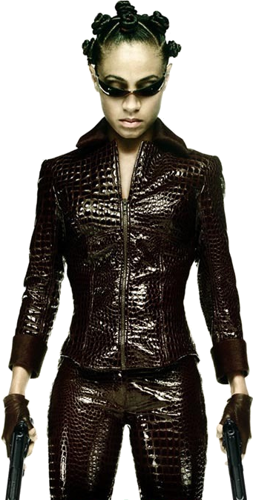
Summary
function composition allows to decompose behavior into simpler one

Slide 64
Creational Patterns
Static Factory
Factory method
Singleton
Abstract Factory
Builder
Monad ?
Same problem as template method
Who want a global ?

Slide 65
Instance Creation
public interface Vehicle { … }
public class Car implements Vehicle {
public Car(Color color) { … }
}
public class Moto implements Vehicle {
public Moto(Color color) { … }
}
I want to create only either 5 red cars or 5 blue motos ?

Slide 66
Instance Factory ?
public interface VehicleFactory {
public Vehicle create();
}
public List<Vehicle> create5(VehicleFactory factory) {
return IntStream.range(0,5)
.mapToObj(i -> factory.create())
.collect(Collectors.toList());
}
VehicleFactory redCarFactory = ...
VehicleFactory blueMotoFactory = ...
List<Vehicle> redCars = create5(redCarFactory);
List<Vehicle> blueMotos = create5(blueMotoFactory);

Slide 67
Instance Factory
public interface VehicleFactory {
public Vehicle create();
}
public List<Vehicle> create5(VehicleFactory factory) {
return IntStream.range(0,5)
.mapToObj(i -> factory.create())
.collect(Collectors.toList());
}
VehicleFactory redCarFactory = () -> new Car(RED);
VehicleFactory blueMotoFactory = () -> new Moto(BLUE);
List<Vehicle> redCars = create5(redCarFactory);
List<Vehicle> blueMotos = create5(blueMotoFactory);

Slide 68
With Java 8 predefined interfaces
public List<Vehicle> create5(Supplier<Vehicle> factory) {
return IntStream.range(0,5)
.mapToObj(i -> factory.get())
.collect(Collectors.toList());
}
Supplier<Vehicle> redCarFactory = () -> new Car(RED);
Supplier<Vehicle> blueMotoFactory = () -> new Moto(BLUE);
List<Vehicle> redCars =
create5(redCarFactory);
List<Vehicle> blueMotos =
create5(blueMotoFactory);
package java.util.function;
@FunctionalInterface
public interface Supplier<T> {
public T get();
}

Slide 69
Instance Factory ==
Partial application on constructors
public List<Vehicle> create5(Supplier<Vehicle> factory) {
return IntStream.range(0,5)
.mapToObj(i -> factory.get())
.collect(Collectors.toList());
}
public static <T, R> Supplier<R> partial(
Function<T, R> function, T value) {
return () -> function.apply(value);
}
List<Vehicle> redCars =
create5(partial(Car::new, RED)));
List<Vehicle> blueMotos =
create5(partial(Moto::new, BLUE)));
Method reference on new + constructor

Slide 70
Static Factory
public interface Vehicle {
public static Vehicle create(String name) {
switch(name) {
case "car":
return new Car();
case "moto":
return new Moto();
default:
throw ...
}
}
}
Quite ugly isn't it ?

Slide 71
Abstract Factory
public class VehicleFactory {
public void register(String name,
Supplier<Vehicle> supplier) {
...
}
public Vehicle create(String name) {
...
}
}
VehicleFactory factory = new VehicleFactory();
factory.register("car", Car::new);
factory.register("moto", Moto::new);

Slide 72
Abstract Factory impl
public class VehicleFactory {
private final HashMap<String, Supplier<Vehicle>> map =
new HashMap<>();
public void register(String name, Supplier<Vehicle> supplier) {
map.put(name, fun);
}
public Vehicle create(String name) {
Supplier<Vehicle> supplier = map.get(name);
if (supplier == null) {
throw new …;
}
return supplier.get();
}
}
The pattern is encoded into several lines :(

Slide 73
Abstract Factory impl
public class VehicleFactory {
private final HashMap<String, Supplier<Vehicle>> map =
new HashMap<>();
public void register(String name, Supplier<Vehicle> supplier) {
map.put(name, fun);
}
public Vehicle create(String name) {
return map.getOrDefault(name, () - > { throw new ...; })
.get();
}
}
VehicleFactory factory = new VehicleFactory();
factory.register("car", Car::new);
factory.register("moto", Moto::new);

Slide 74

With a singleton-like ?
public class VehicleFactory {
public void register(String name, Supplier<Vehicle> supplier) {
...
}
public Vehicle create(String name) {
...
}
}
What if I want only one instance of Moto ?

Slide 75
With a singleton-like
public class VehicleFactory {
public void register(String name, Supplier<Vehicle> supplier) {
...
}
public Vehicle create(String name) {
...
}
}
VehicleFactory factory = new VehicleFactory();
factory.register("car", Car::new);
Moto singleton = new Moto();
factory.register("moto", () -> singleton);

Slide 76
From Factory to Builder
public class VehicleFactory {
public void register(String name, Supplier<Vehicle> supplier) {
...
}
public Vehicle create(String name) {
...
}
}
How to separate the registering step from the creation step ?

Slide 77

Classical Builder
public class Builder {
public void register(String name, Supplier<Vehicle> supplier) { … }
public VehicleFactory create() { … }
}
public interface VehicleFactory {
Vehicle create(String name);
}
Builder builder = new Builder();
builder.register("car", Car::new);
builder.register("moto", Moto::new);
VehicleFactory factory = builder.create();
Vehicle vehicle = factory.create("car");

Slide 78
Lambda Builder !
public interface Builder {
void register(String name, Supplier<Vehicle> supplier);
}
public interface VehicleFactory {
Vehicle create(String name);
static VehicleFactory create(Consumer<Builder> consumer) {
…
}
}
VehicleFactory factory = VehicleFactory.create(builder - > {
builder.register("car", Car::new);
builder.register("moto", Moto::new);
});
Vehicle vehicle = factory.create("car");

Slide 79
Lambda Builder impl
public interface Builder {
void register(String name, Supplier<Vehicle> supplier);
}
public interface VehicleFactory {
Vehicle create(String name);
static VehicleFactory create(Consumer<Builder> consumer) {
HashMap<String, Supplier<Vehicle>> map = new HashMap<>();
consumer.accept(map::put);
return name -> map.getOrDefault(name, () -> { throw new ...; })
.get();
}
}

Slide 80

Summary
factories are just a way to do partial application in order to create class instance

Slide 81
Validation ?
public class User {
private final String name;
private final int age;
...
}
How to validate a user ?
User user = new User("bob", 12);
if (user.getName() == null) {
throw new IllegalStateException("name is null");
}
if (user.getName().isEmpty()) {
throw new IllegalStateException("name is empty");
}
if (!(user.getAge() > 0 && user.getAge() < 50)) {
throw new IllegalStateException("age isn't between 0 and 50");
}

Slide 82
Monad
Represent 2 (or more) states has a unified value in order to compose transformations
public static User validateName(User user) {
if (user.getName() == null) {
throw new IllegalStateException("...");
}
return user;
}
User
User
validate
Exception

Slide 83

Monad
Represent 2 (or more) states
has a unified value in order to
compose transformations
User
of
User | Exception
User | Exception
User | Exception
User | Exception
validate1
validate2
User | Exception
get
User
Exception

Slide 84
Monad
public class Validator<T> {
public static <T> Validator<T> of(T t) {
...
}
public Validator<T> validate(Predicate<T> validation, String message) {
...
}
public T get() throws IllegalStateException {
...
}
}
User validatedUser = Validator.of(user)
.validate(u -> u.getName() != null, "name is null")
.validate(u -> !u.getName().isEmpty(), "name is empty")
.validate(u -> u.getAge() > 0 && u.getAge() < 50, "age isn't between ...")
.get();

Slide 85
Monad impl
public class Validator<T> {
private final T t;
private final IllegalStateException error;
private Validator(T t, IllegalStateException error) {
this.t = t;
this.error = error;
}
public static <T> Validator<T> of(T t) {
return new Validator<>(Objects.requireNonNull(t), null);
}
public Validator<T> validate(Predicate<T> validation, String message) {
if (error == null && !validation.test(t)) {
return new Validator<>(t, new IllegalStateException(message));
}
return this;
}
public T get() throws IllegalStateException {
if (error == null) { return t; }
throw error;
}
}

Slide 86
Separate attribute from validation
public class Validator<T> {
public Validator<T> validate(Predicate<T> validation,
String message) { … }
public <U> Validator<T> validate(Function<T, U> projection,
Predicate<U> validation, String message) {
...
}
}
User validatedUser = Validator.of(user)
.validate(User::getName, Objects::nonNull, "name is null")
.validate(User::getName, name -> !name.isEmpty(), "name is ...")
.validate(User::getAge, age -> age > 0 && age < 50, "age is ...")
.get();

Slide 87
Higher order function
public static Predicate<Integer> inBetween(int start, int end) {
return value -> value > start && value < end;
}
User validatedUser = Validator.of(user)
.validate(User::getName, Objects::nonNull, "name is null")
.validate(User::getName, name -> !name.isEmpty(), "...")
.validate(User::getAge, inBetween(0, 50), "...")
.get();

Slide 88
Monad impl
public class Validator<T> {
public Validator<T> validate(Predicate<T> validation,
String message) {
...
}
public <U> Validator<T> validate(Function<T, U> projection,
Predicate<U> validation, String message) {
return validate(t -> validation.test(projection.apply(t)), message);
}
}
package java.util.function;
public interface Function<T, R> {
public R apply(T t);
public default <V> Function<V,R> compose(Function<V,T> f) {}
public default <V> Function<T,V> andThen(Function<R,V> f) {}
}

Slide 89
Monad impl
public class Validator<T> {
public Validator<T> validate(Predicate<T> validation,
String message) {
...
}
public <U> Validator<T> validate(Function<T, U> projection,
Predicate<U> validation, String message) {
return validate(
projection.andThen(validation::test)::apply, message);
}
}
Function<U,Boolean>
Predicate<T>

Slide 90
Gather validation errors
public class Validator<T> {
private final T t;
private final ArrayList<Throwable> throwables = new ArrayList<>();
public Validator<T> validate(Predicate<T> validation, String message) {
if (!validation.test(t)) {
throwables.add(new IllegalStateException(message));
}
return this;
}
public T get() throws IllegalStateException {
if (throwables.isEmpty()) { return t; }
IllegalStateException e = new IllegalStateException();
throwables.forEach(e::addSuppressed);
throw e;
}
}

Slide 91

Summary
A monad represents several states
as a unified value
Monads allow to do function
composition on function that have
several return values

Slide 92
TLDR;
Functional interface
  bridge between OOP and FP
Enable several FP techniques
  Higher order function, function composition,
  partial application
UML class diagram is dead !
  public abstract classes are dead too !

Slide 93


